Slide 1
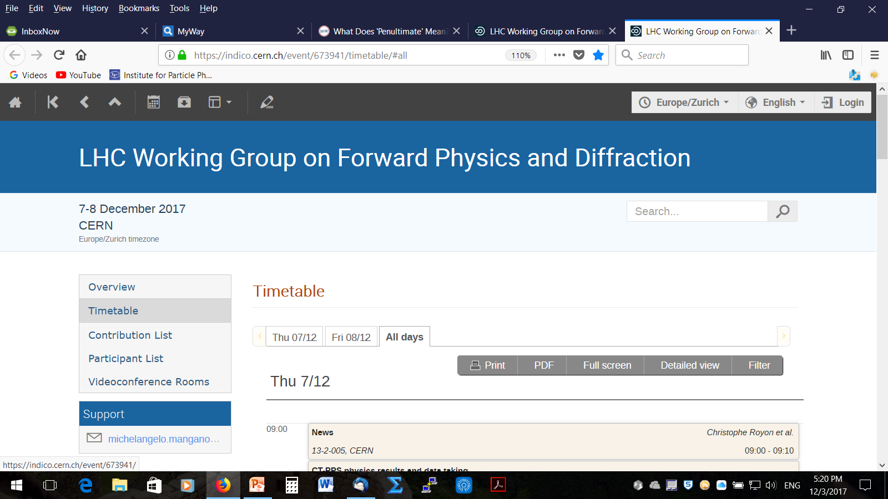
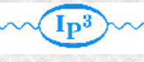

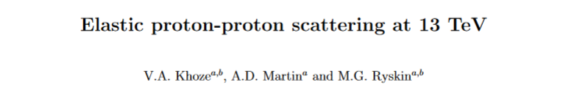
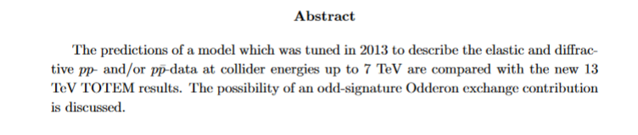
Elastic proton-proton scattering at 13 TeV in the theoretical perspective
Valery Khoze (IPPP, Durham & PNPI, St.Pb.)
(in collaboration with Alan Martin and Misha Ryskin)
 | arXiv:1712.00325
Work still in progress

Slide 2

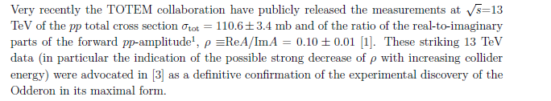
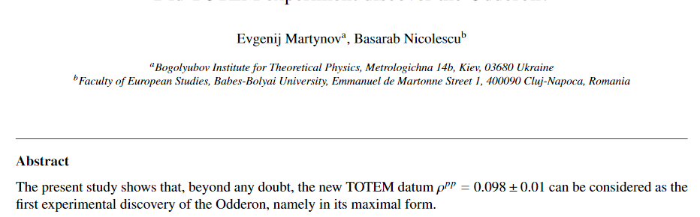
Jan’s talk at
MO
arXiv:1711.03288

Slide 3
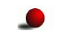

Long-awaited Odderon would be very welcome news for the theoretical community
our main aim is to try to evaluate whether the new TOTEM data could be accommodated within the existing ‘conventional’ multi-Pomeron framework
exemplified by the untuned KMR 2013-model

Slide 4
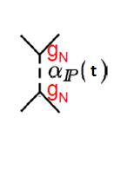
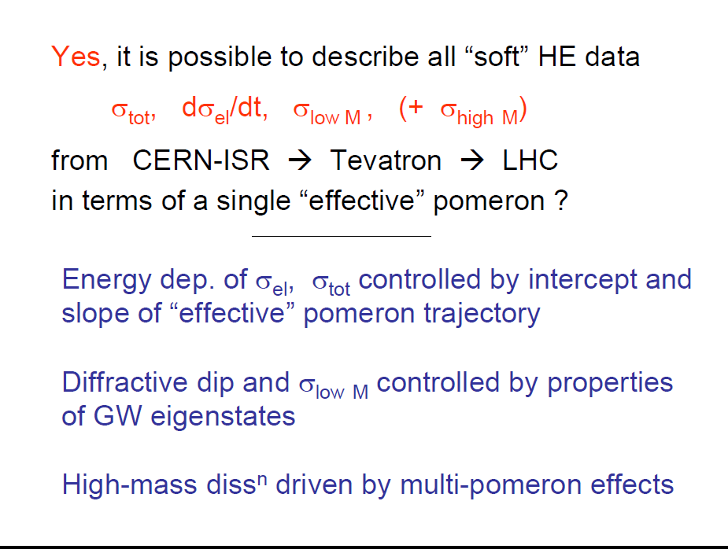

QCD
(KMR, 2011-2014)
(Gribov-1961)
(BFKL-1975-78)
BFKL Pomeron naturally allows to continue from the ‘hard’ domain to the ‘soft’ region: after resummation of the main HO effects- the intercept weakly depends on the scale,

Slide 5
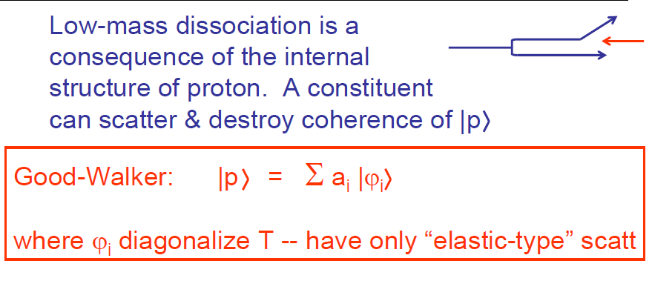
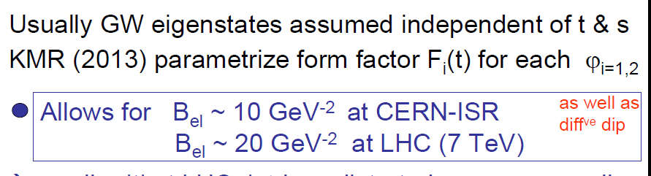
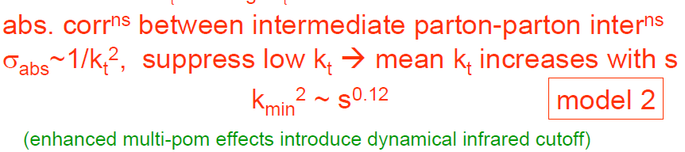

(1960)
0.28
✶ Conventional RFT assumed all limited and small.

Slide 6

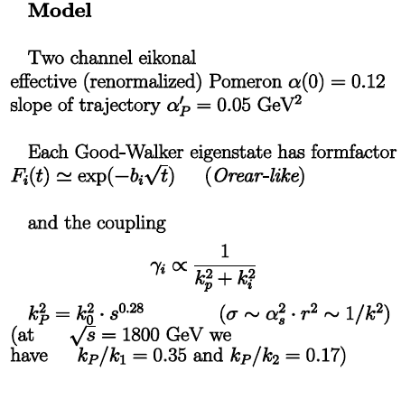
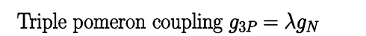





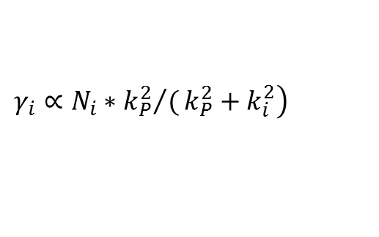
KMR MODEL
-
-
The size of the effective
Pomeron deceases with energy
(screening effects)
$$\left.γ_{i}∝N_{i}∗{k_{P}^{2}}/(k_{P}^{2}+k_{i}^{2}\right)$$
,
.
Introduction of the theoretically motivated energy dependence of within
the 2-channel eikonal model allows to describe the existing HE data on the
elastic and SD cross sections, including .

Slide 7
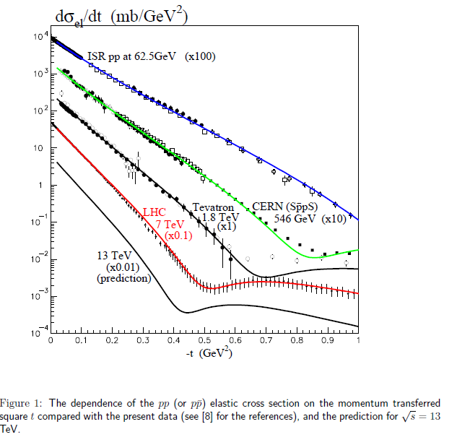
Untuned 2013 predictions
Looking forward to seeing TOTEM 13 TeV results

Slide 8
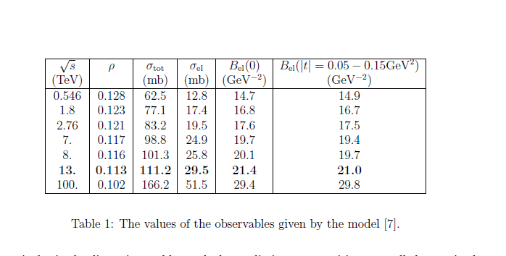

Slide 9
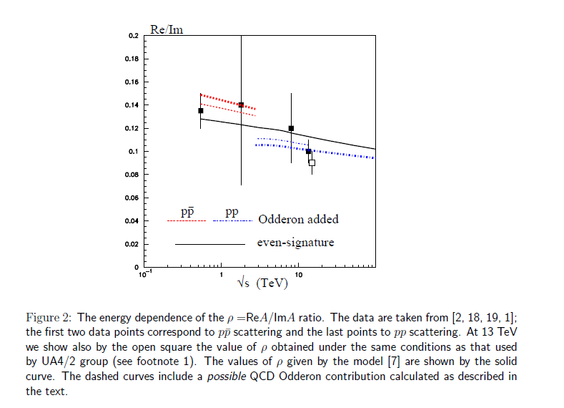
Model for Odderon:

Slide 10
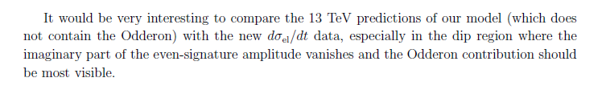
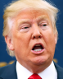
Preliminary conclusions

Within 1Ϭ level an overall agreement with UA4 (2) and TOTEM data in all cases
Δρ=0.005-0.02


Upon releasing the new TOTEM data 13 TeV on elastic cross section we plan to check whether the Odderon is providing better description

The data at 541 GeV strongly restrict the Odderon contribution.

More work needed ( many sides, many sides )

Slide 11

ODDERON-1973 –asymptotic theorems
1975
MO
z=
QCD
Very intensive theoretical discussions :
reviews
most models asympt.~
but not a Must
Recall:The Froissart-Martin bound:

Slide 12

Some comments on MO
■
M. Braun, hep-ph/9805394
■
In CGC models the odderon contribution is decreasing with energy due to saturation effects
■
Problems with the multiparticle s-channel unitarity – KMR work in progress

Slide 13


