Slide 1
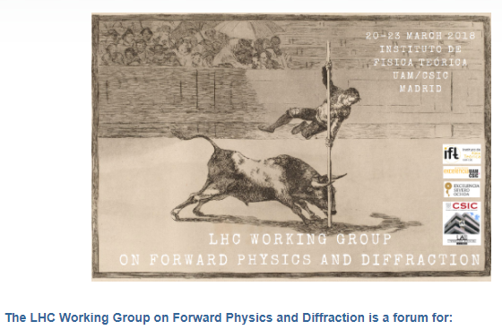
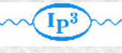

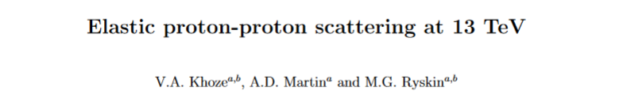
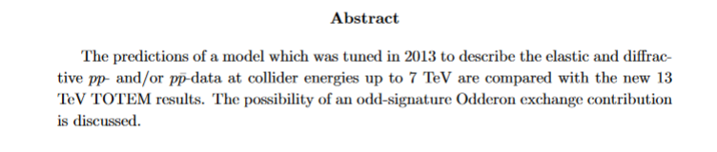

Elastic proton-proton scattering at 13 TeV in the theoretical perspective
Valery Khoze (IPPP, Durham & PNPI, St.Petersburg.)
(in collaboration with Alan Martin and Misha Ryskin)
 | arXiv:1712.00325- revisited
Disclaimer:

Slide 2
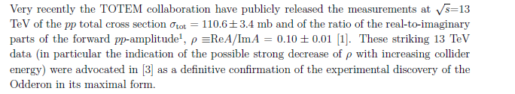
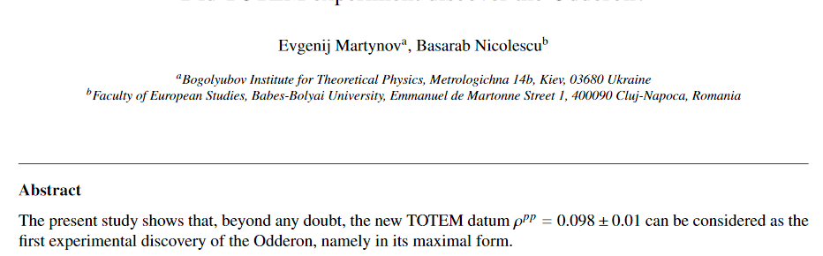
(Valentina’s talk)
(MO)
(Evgenij’s talk)
arXiv:1711.03288

Slide 3
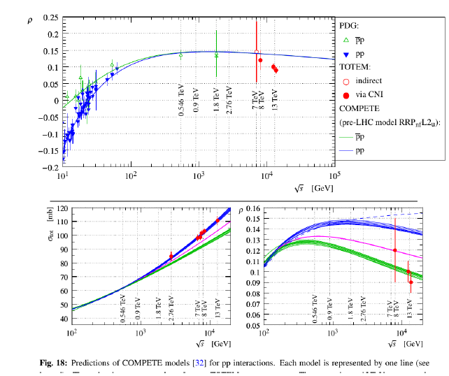


Slide 4
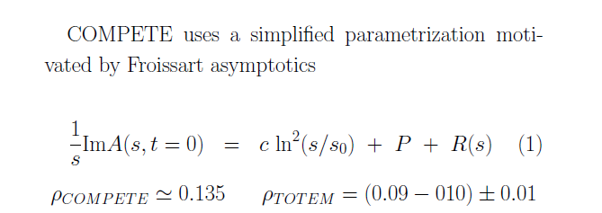
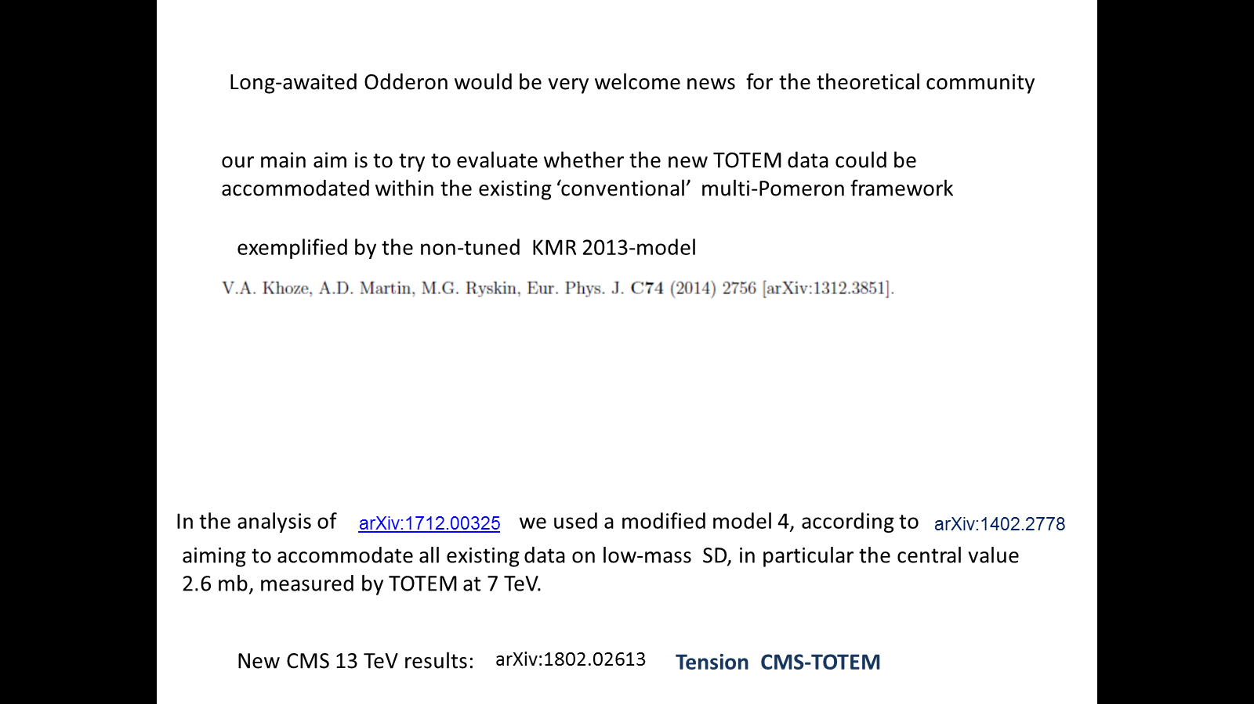


=110.6 mb
arXiv:1306.2149
(study within the framework of dynamical (QCD-based) models for both P&O)
Tension in CMS-TOTEM data

Slide 5






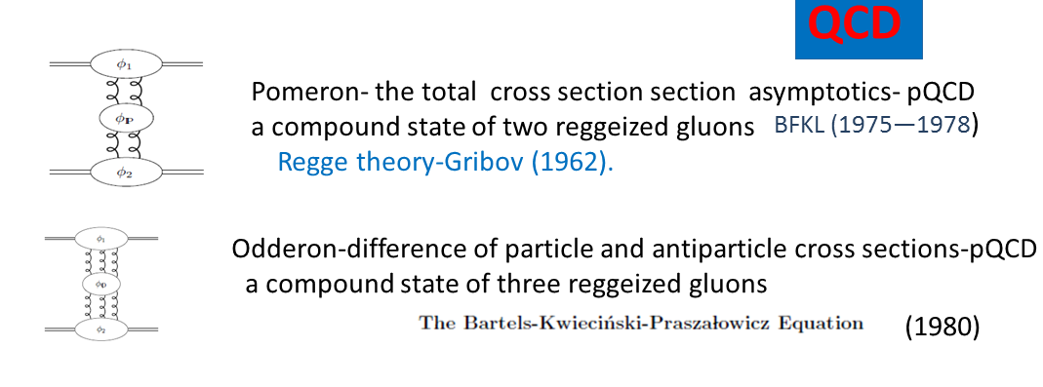
Not a MUST !
(Per’s talk)
I
Odderon in asymptotic theories , L .Lukaszuk , B.Nicolescu-1973
BKP
Until very recently no firm experimental observation

Slide 6
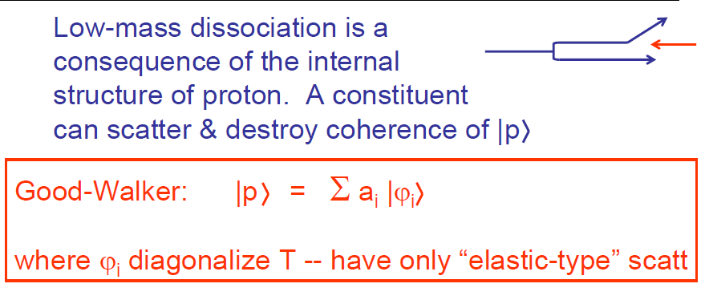
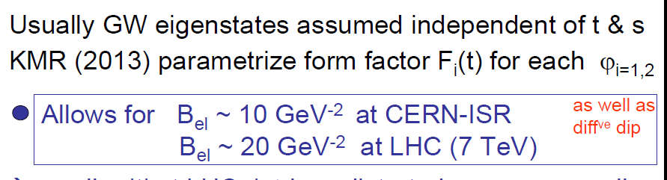
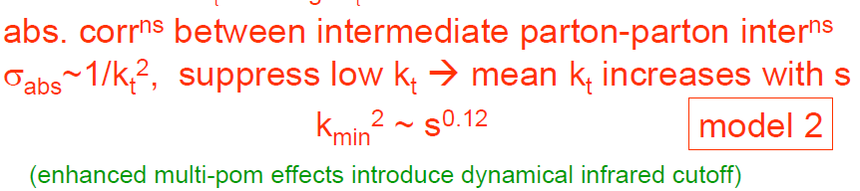

KMR-2013
Models (1-4)
(1960)
0.28
✶ Conventional RFT assumed all limited and small.

Slide 7
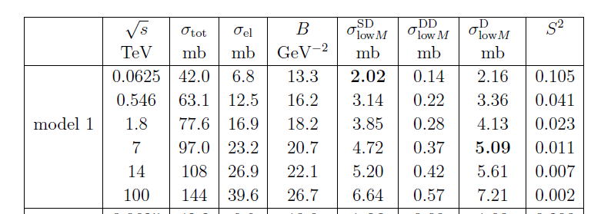
 | arXiv:1306.2149
V.A. Khoze, A.D. Martin, M.G. Ryskin

Slide 8
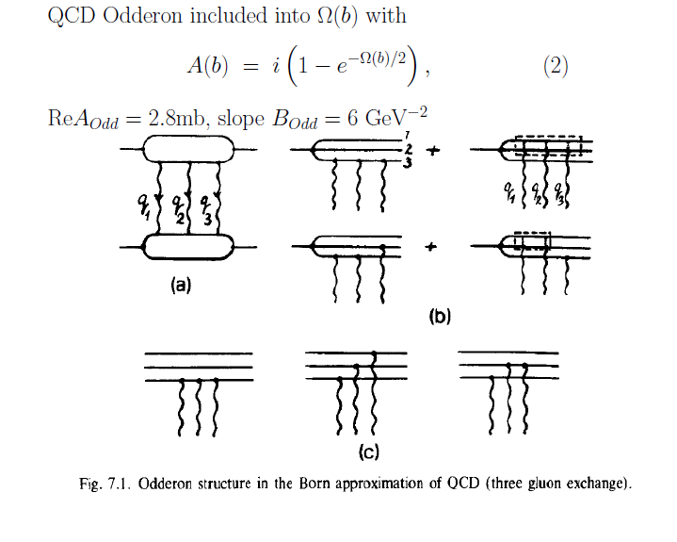
Simplified Model for Odderon:
E.M. Levin, M.G. Ryskin, Phys. Rept. 189 (1990) 267 (sect.7).
M.Fukugita,J.Kwieciński, 1979
general solution of unitarity equation
Absorptive effects

Slide 9





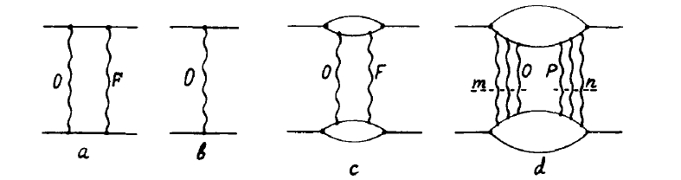



~


Decreases the Odderon contribution
Asymptotically Pomeron → black absolutely absorptive disc

Slide 10
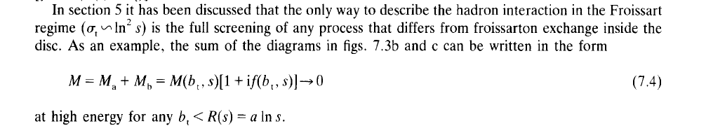
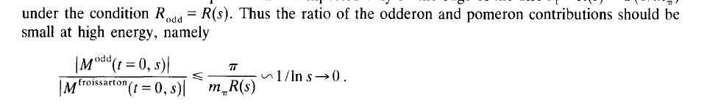

Slide 11
KMR-Non-tuned 2013 predictions, model 1
TOTEM-2017 data

Slide 12
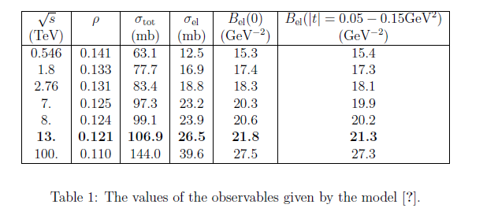

1.
 | KMR, arXiv:1306.2149
TOTEM
results
=
Model 1- 4.72 mb at 7 TeV

Slide 13
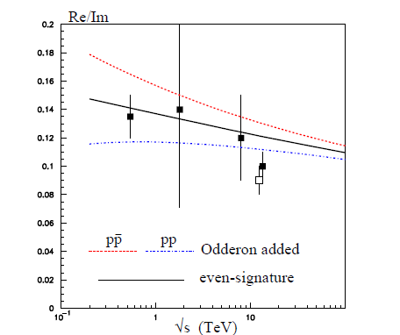
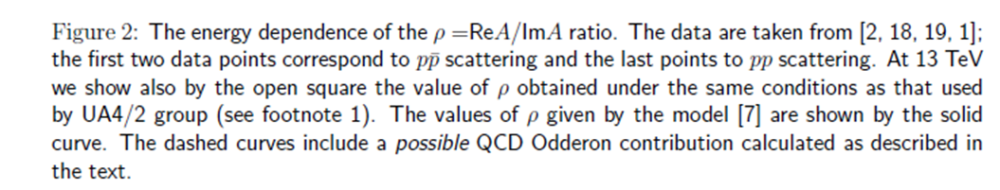

Slide 14
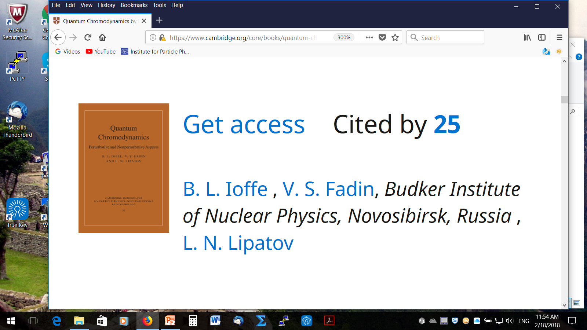
ODDERON-1973 –asymptotic theorems
1975
MO
z=
QCD
Intensive theoretical discussions :
reviews

Slide 15
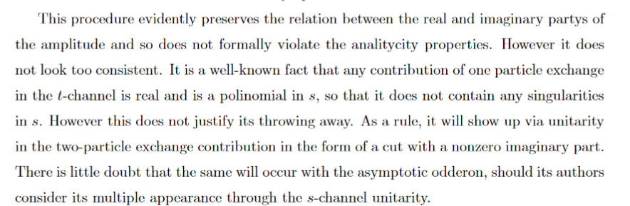
Some comments on MO
■
M. Braun, hep-ph/9805394
■
In CGC models the odderon contribution is decreasing with energy due to saturation effects
For example
■
Problems with the multi-particle unitarity: KMR-17

Slide 16

Forward scattering at collider energies and eikonal unitarization of the odderon
Abstract
The continuing increase of hadron total cross sections up to the highest energies currently available can most naturally be understood through an eikonal mechanism, leading to the saturation of the Froissart bound. This picture can be motivated in a nonperturbative treatment of QCD, e.g., in the large-N limit. It is then natural to ask whether this same mechanism would lead to the maximal allowed behavior for the difference of the particle-particle and antiparticle-particle cross section, i.e., the “maximal odderon”. We shall show in this paper that, using eikonals which are dynamically meaningful for high-energy hadron-hadron scattering at collider energies, this behavior is not possible.
J.Finkelstein, H.M.Fried, K.Kang and C.I.Tan
Phys.Lett. B232 (1989) 257-262

Slide 17
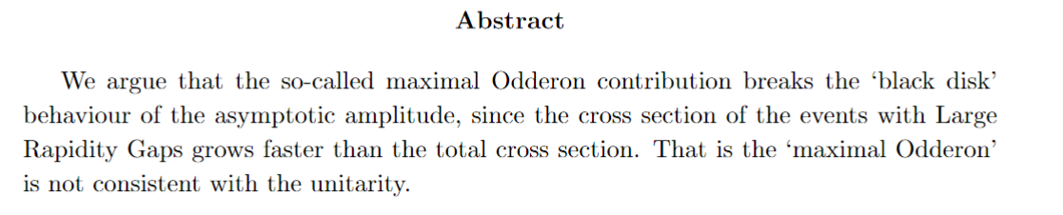

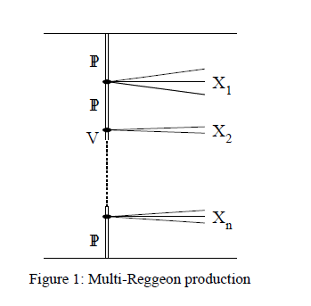


KMR arXiv:1801.07065
Black disk, maximal Odderon and unitarity
■
Finkilstein-Kajantie disease

Slide 18
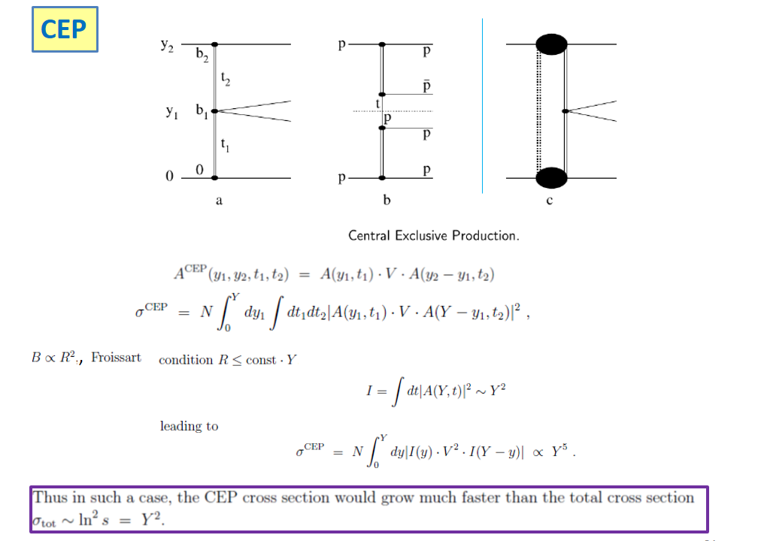

Slide 19
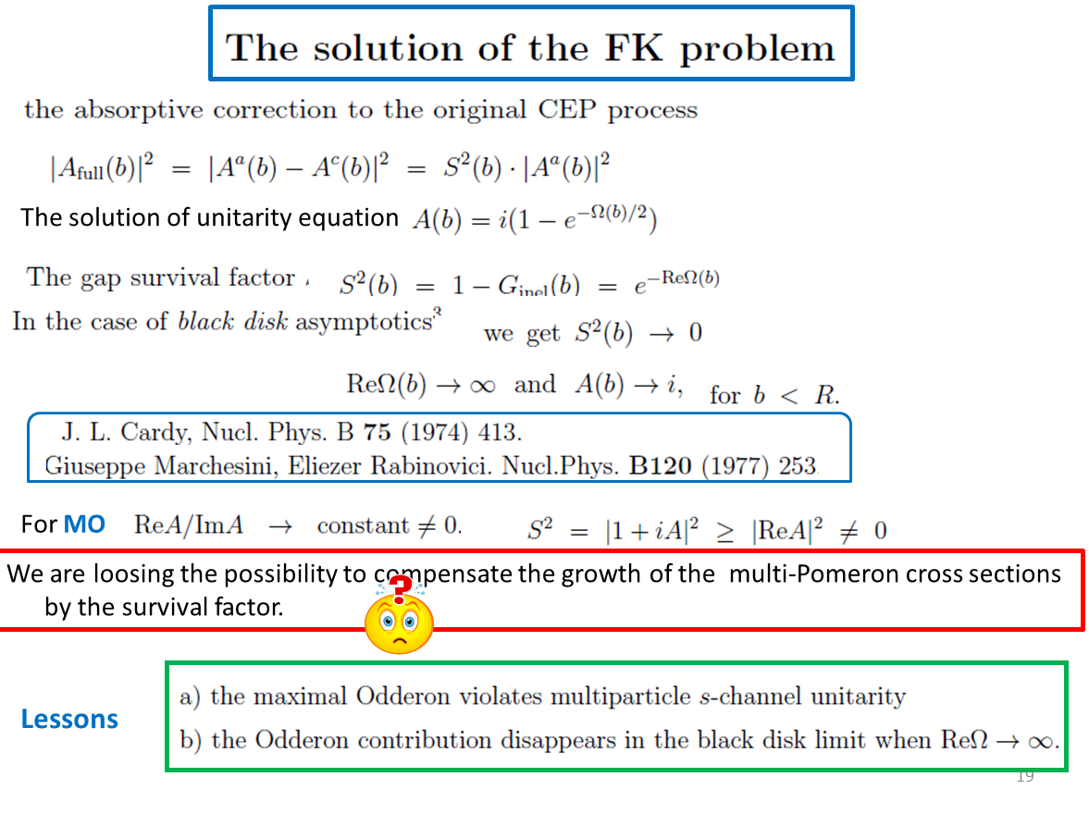


Slide 20


Preliminary conclusions
Either the total cross section above 13 TeV starts slowing down or
there is a sizeable Odderon contribution at 13 TeV .
New precise data on Re/Im at 7-8 TeV and
especially at 0.9 TeV would be very useful.
The possible Odderon contribution at 0.9 TeV could be quite significant.
High statistics TOTEM data on elastic cross-section
in the dip-bump region are very welcome.
In order to resolve a tension between the Totem and CMS results
on low mass SD more experimental studies are needed.
Per-nice pedagogical overview
The data at 540 GeV strongly restrict the Odderon contribution.

Slide 21


J.Finkelstein, H.M.Fried, K.Kang and C.I.Tan
Phys.Lett. B232 (1989) 257-262
But a dynamical model needed

Slide 22


