Slide 1

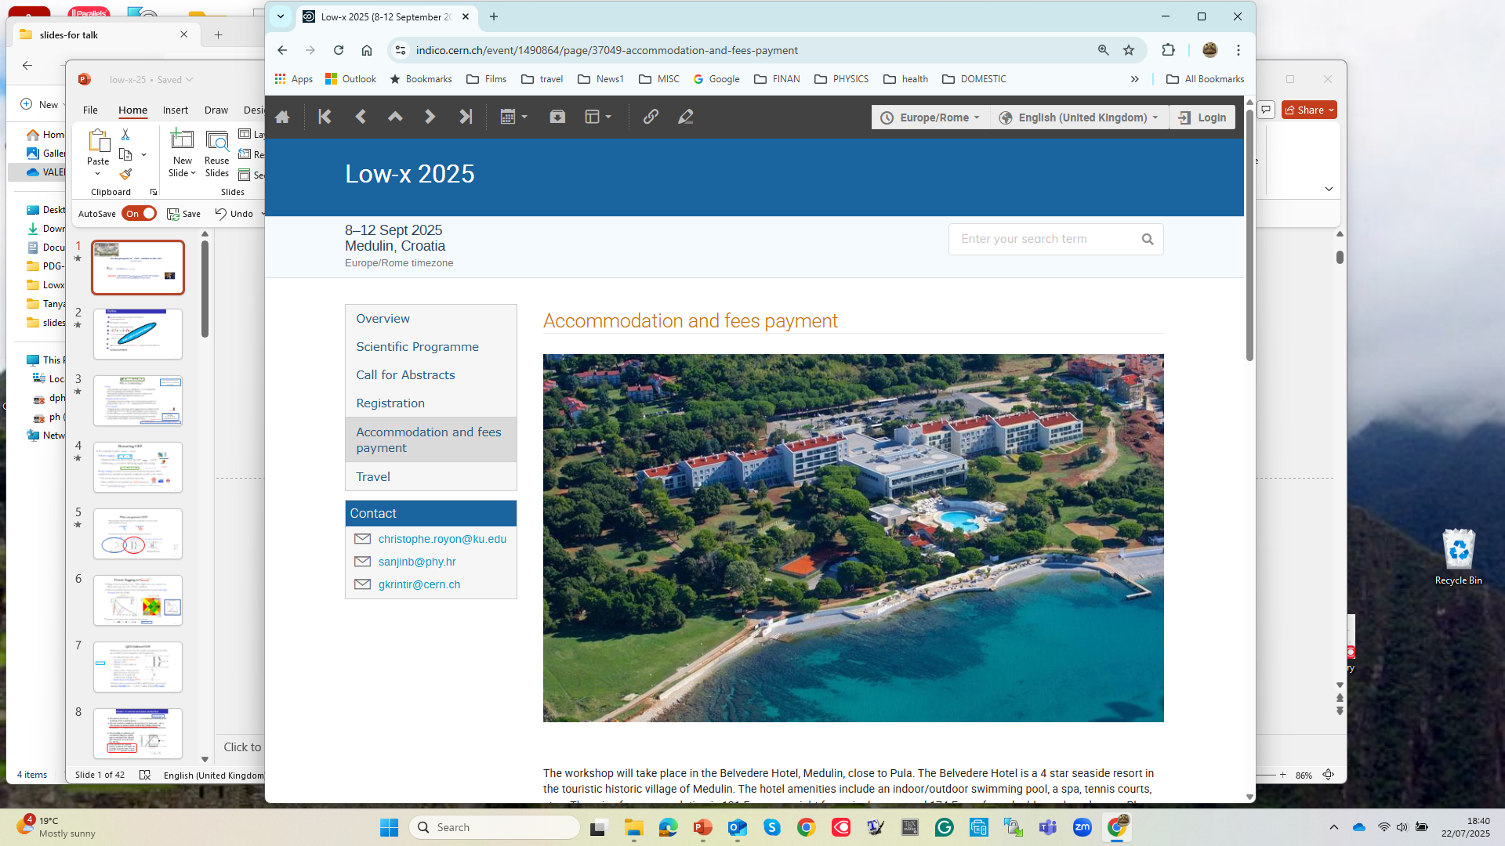
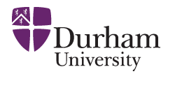

On the prospects of ‘CEP’ studies at the LHC
(selected topics)
V.A. Khoze (IPPP, Durham)
main aims: to illustrate the "diversity and inclusion" of the ‘CEP’ program
and to address the possibilities for the future.

Slide 2
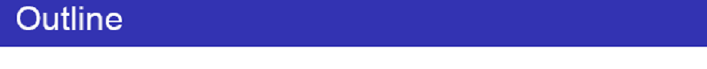

Motivation (why are we interested in CEP processes?)
CEP and Large RAP GAPS.
QCD-induced CEP mechanism.
Gluon –gluon vs photon-photon fusion.
CEP as a spin-parity analyser
, Dijet a bit of personal flavour
Higher precision constraints on the tau g − 2 photon–initiated production
Summary and Outlook
With a bit of personal flavour
Life, death and “resurrection” of ‘Diffractive Higgs’
Dijet CEP as a ‘gluon factory’
Special request

Slide 3



CEP
LRGs caused by Pomeron,
photon (W,Z) or Odderon exchanges
✶
.
(TOTEM/ALFA)
Possible plans for high runs in 2025-2026,
But a lot of the already accumulated data in 2018
$β∗$
Threshold scan.
${"η}_{t}$“ enhancement in the tt threshold region, KMR-2000
This Photo by Unknown Author is licensed under CC BY-NC

Slide 4
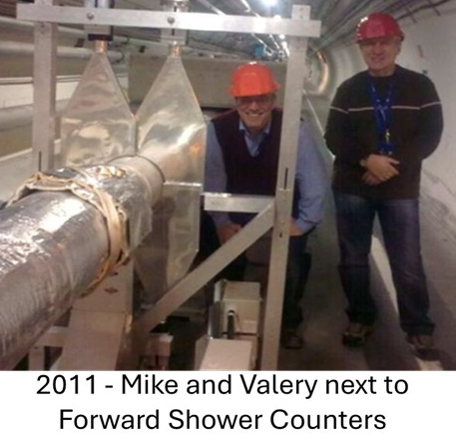


(Istvan Szanyi, Maciej Trzebinski, Javier Alberto Murillo Quijada )
‘exclusive’
X
~200m
AFP/PPS
(LHC runs 1,2,3)
(Michael Pitt)
(Krista Smith)
(ALICE-double Gap trigger), CMS-RGT special runs pp, HI- FSI ressurection
(M.Albrow et al, 0811.0120)

Slide 5
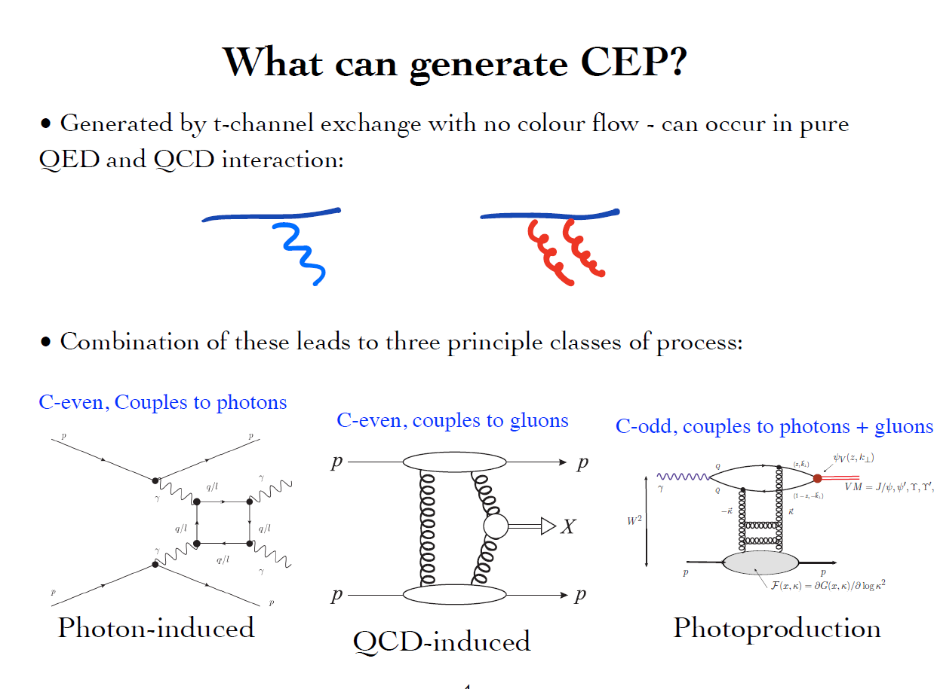
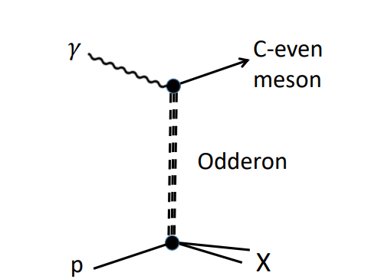

Slide 6
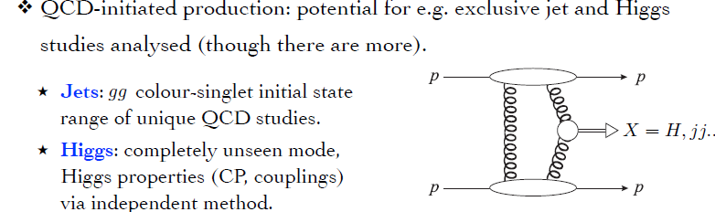
KMR-97-01

Slide 7
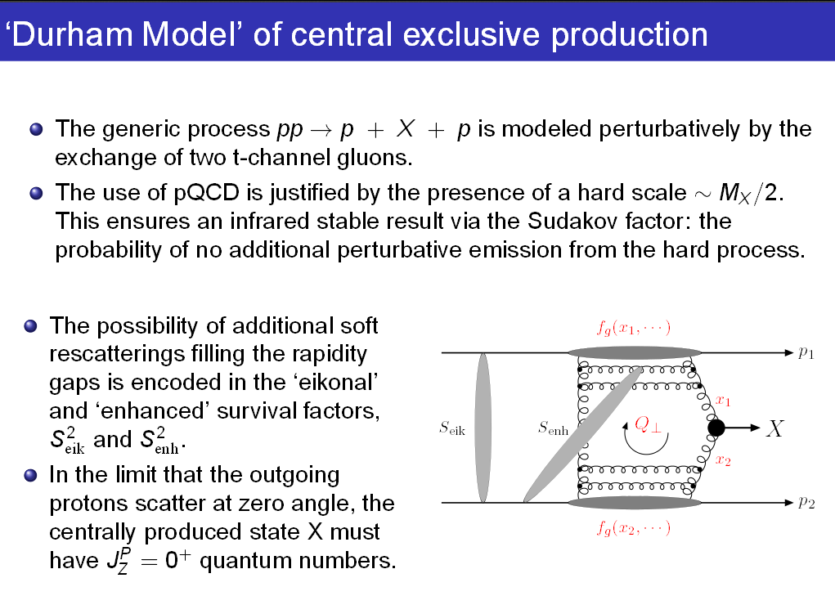
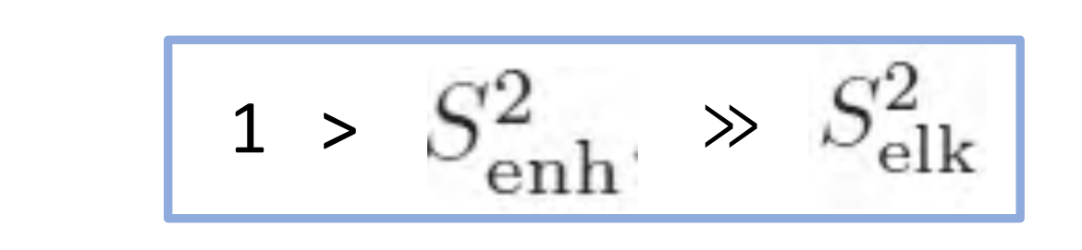
KMR-1997-2001

Slide 8
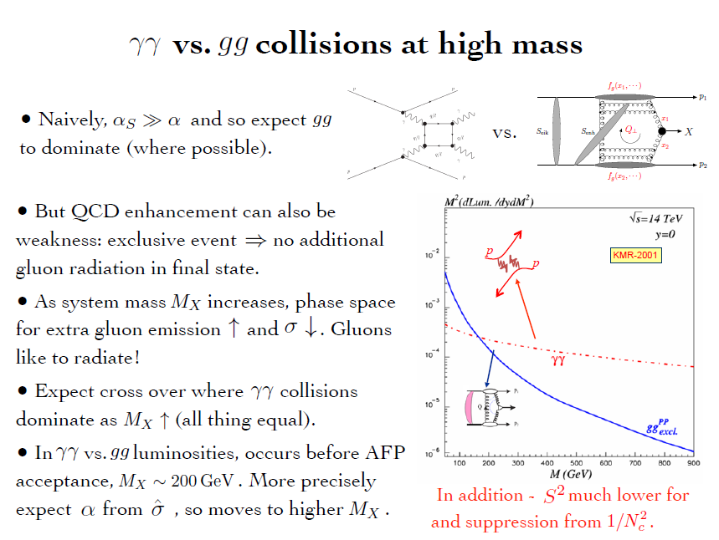
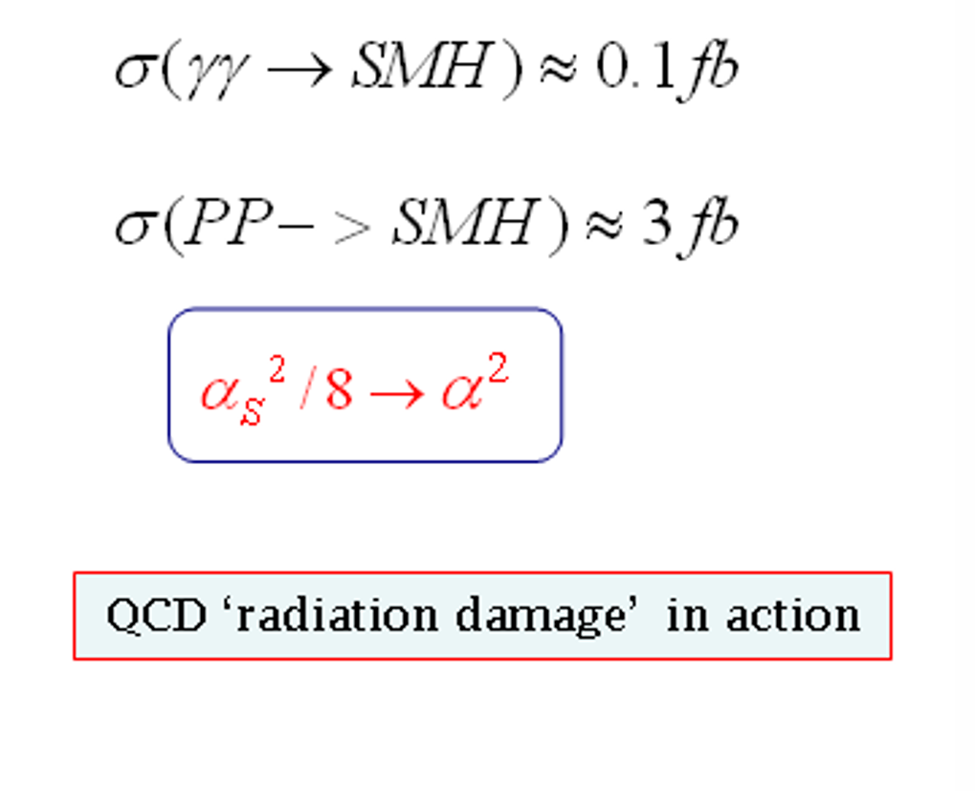
PPS
for gg.

Slide 9
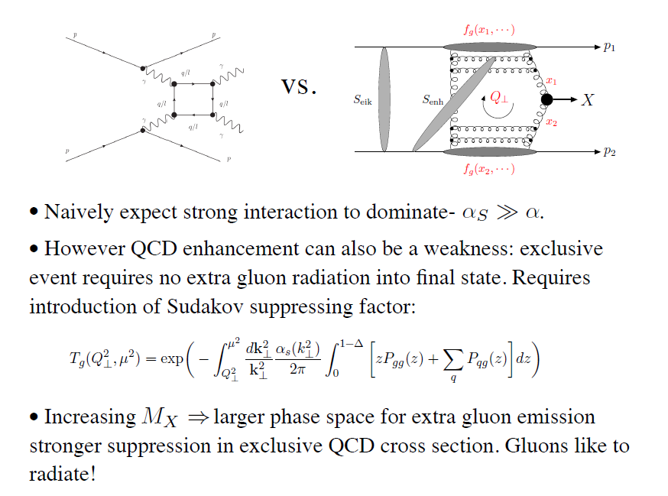
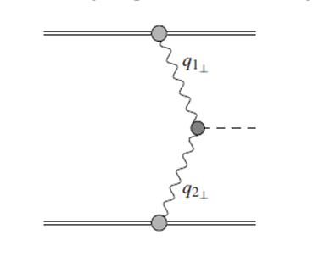


(Luis Alcerro Alcerro, Weronika Stanek-Maslouska -UPC)
γ
X
γ
The LHC is the high energy photon collider
X
‘Large’ Pomeron size in the
production of the small size objects.
+ absorptive/rescattering effects- survival factor

Slide 10
Life, Death and “Ressurection “ of ‘Diffractive Higgs’

Slide 11
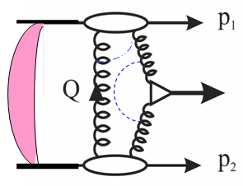

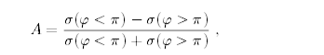
(
σ
φ < π
)
−
σ
(
φ > π
)
(
σ
(
φ < π
)
−
σ
φ > π
)
~p
∼
sin
~n
·
(
~p
×
)
φ
The main advantages of CEP Higgs production
• Prospects for high-accuracy mass measurement
(irrespectively of the decay mode).
• Quantum number filter/analyser.
( 0++ dominance; C,P-even)
 H ->bb opens up (Hbb Yukawa coupl.)
(gg)--,++  bb in LO ; NLO,NNLO, b- mass effects – controllable. M(+++-)=(M---+)=0
 For some scenarios, CEP may become a discovery channel
• A handle on the overlap backgrounds- Fast Timing Detectors (10-20 ps timing or better).
 New leverage –proton momentum correlations (probes of QCD dynamics , CP- violation effects…)
H
KMR-1997-2001
A
=
could open a way to measure H→cc (coplanarity…. cuts)
BSM
‘95 GeV anomaly’
Triple product correlation:
Integrated counting asymmetry (~10%)
0
1
⊥
2
⊥
φ < π
σ
(
) +
σ
(
φ > π
)
=
A
σ
(
φ < π
) +
σ
(
φ > π
)

Slide 12
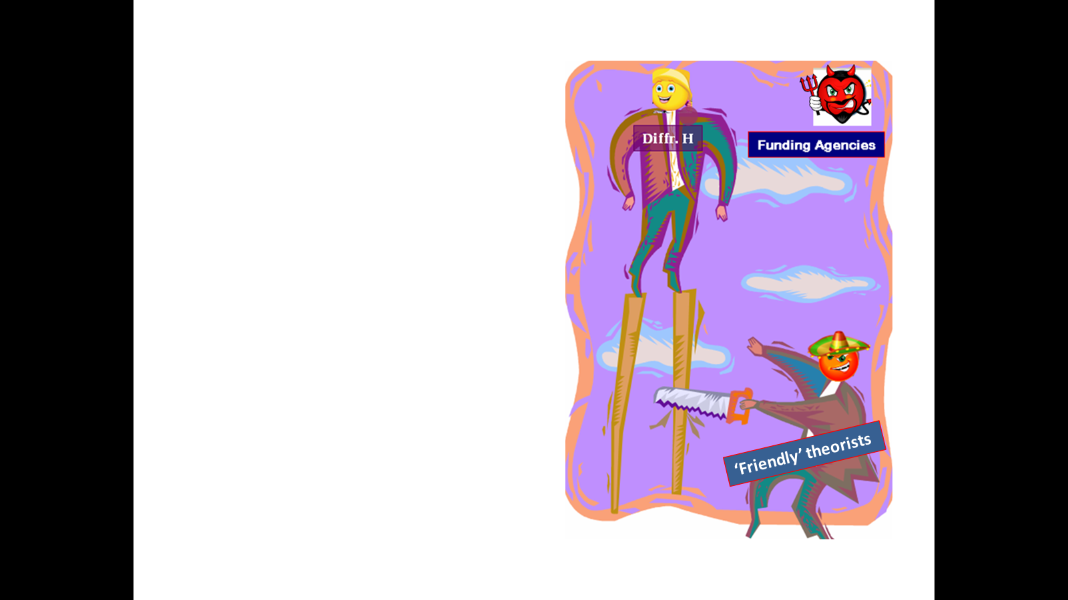
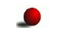
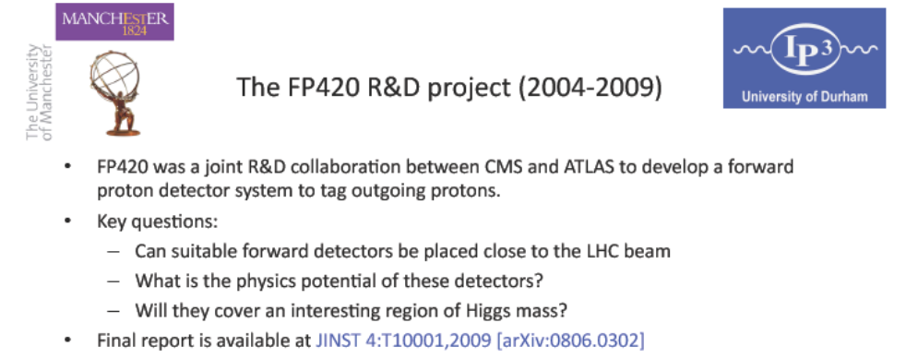
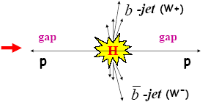
FP420 and Resurrection of ‘Diffractive HIggs’
(20 years on)
PPS2
searching for lower mass new objects in CEP requires far away (~400m) FDs
PPS/PPS2- new proposals, Diffraction and low-X 2024

Slide 13
CEP AS A SPIN-PARITY ANALYZER

Slide 14
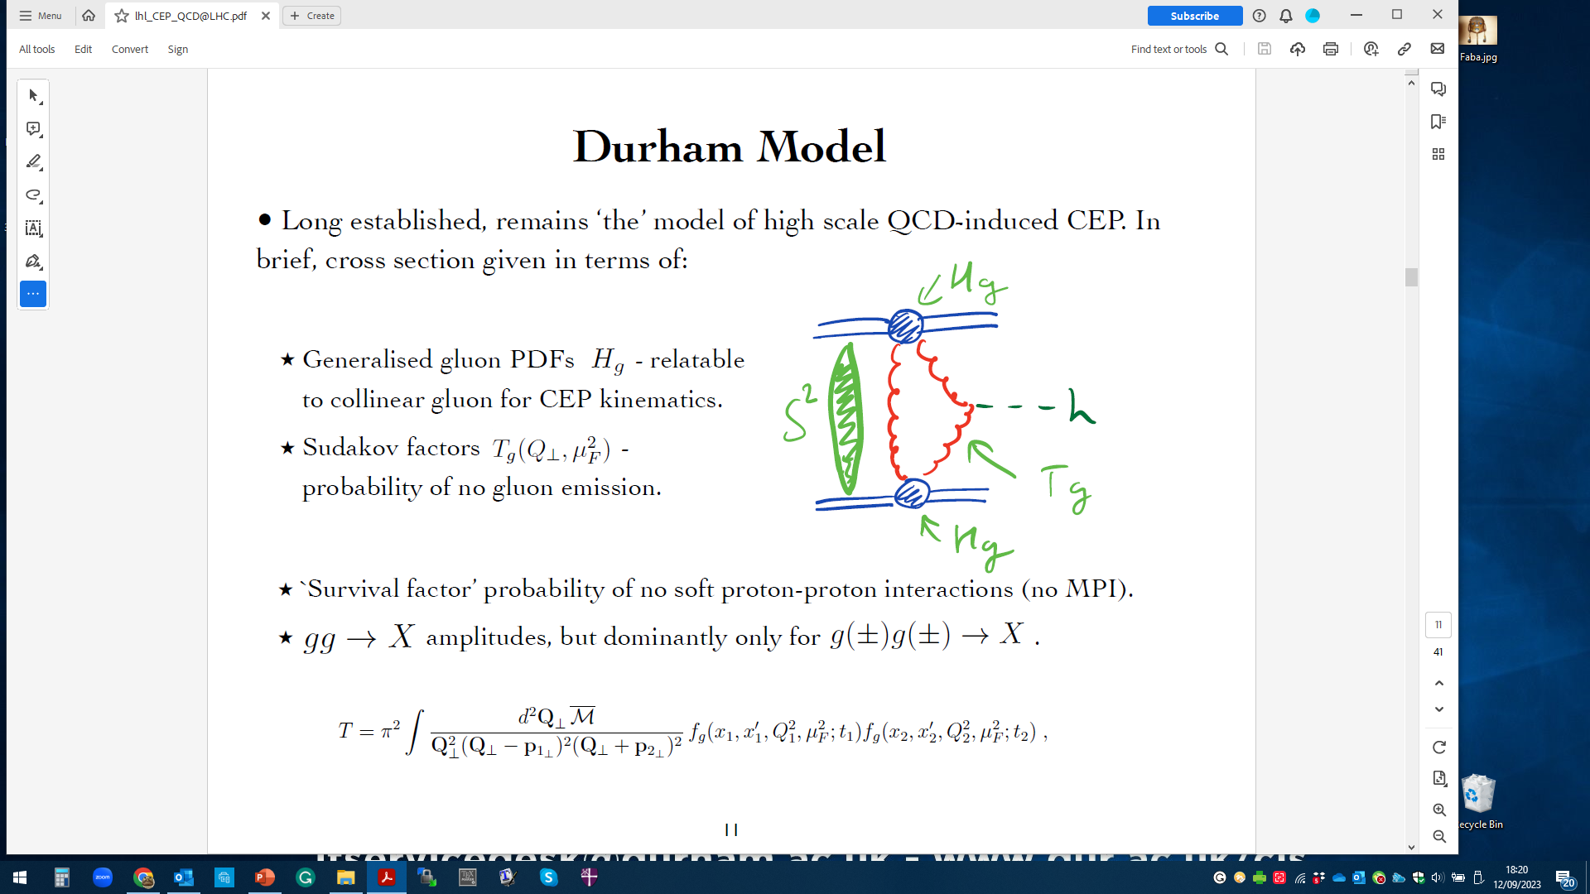
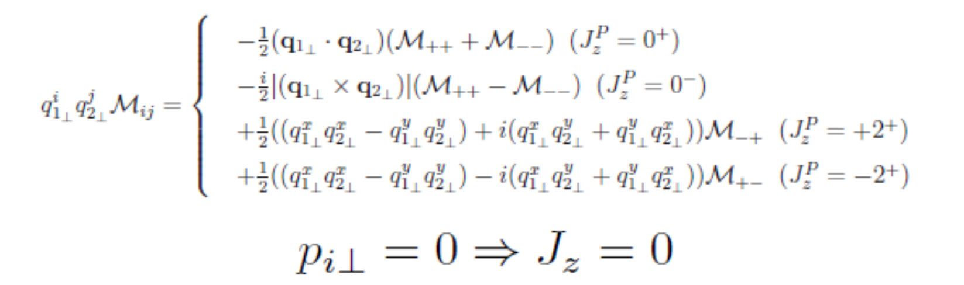
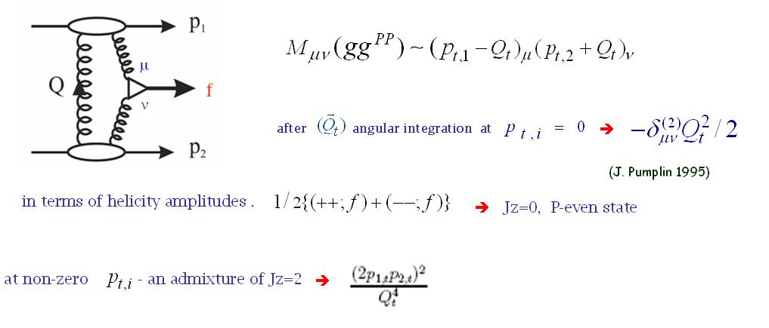
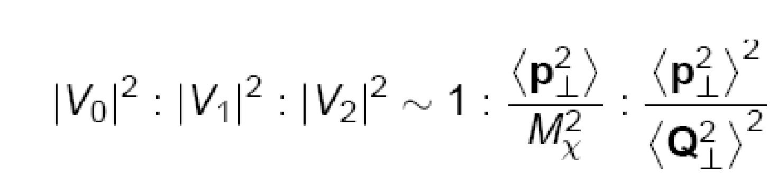
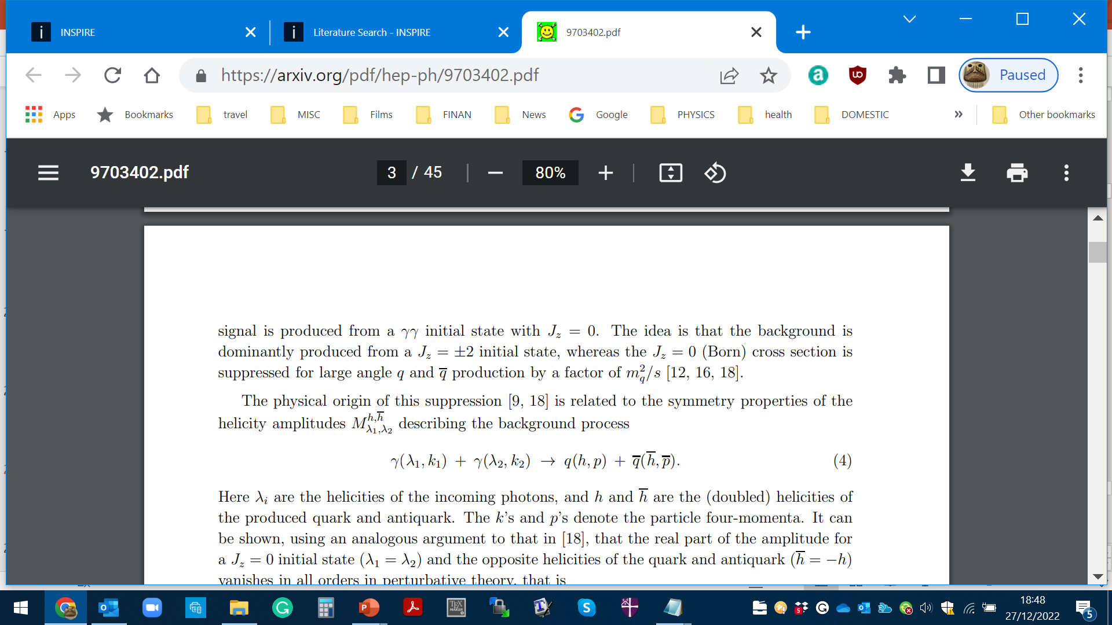
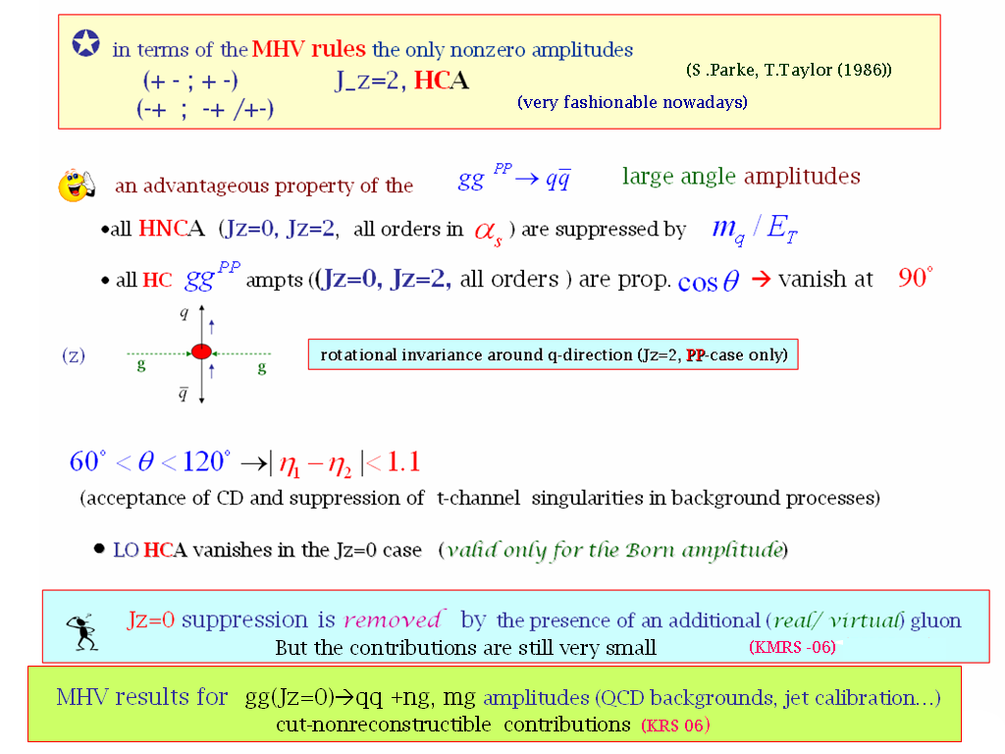


(HKRS-2010)
Important consequences for$H→b\overline{b.}$
Symmetry properties of the amplitude (FKM-97)
(++,+-) (--,+-)
(++,-+) (--,-+)
$$J_{Z}=0$$
(nullifies in the massless limit)
gg→qq
‘An Amplitude for n Gluon Scattering’

Slide 15
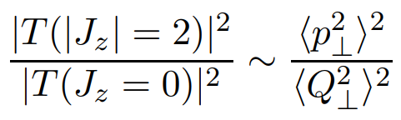
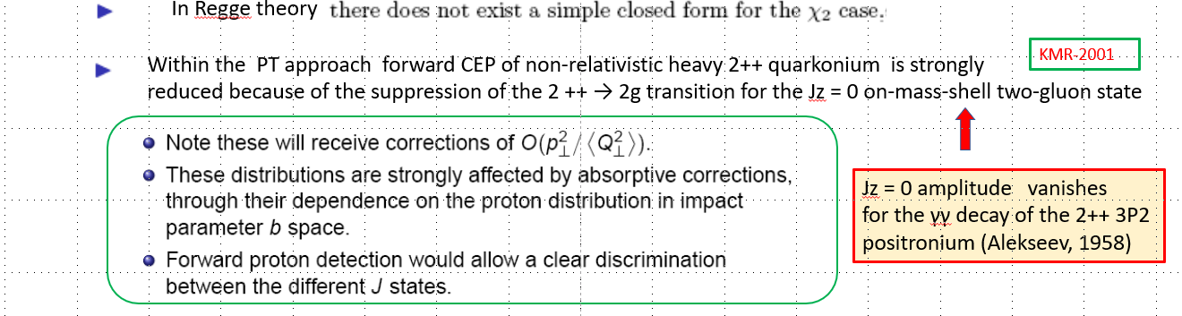
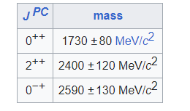
Jz = 0 amplitude vanishes
for the γγ decay of the 2++ 3P2
positronium (Tumanov, 53;Alekseev, 58)
Glueball filter ?
Lattice results
Eur.Phys.J.C 80 (2020) 11, 1077

Slide 16
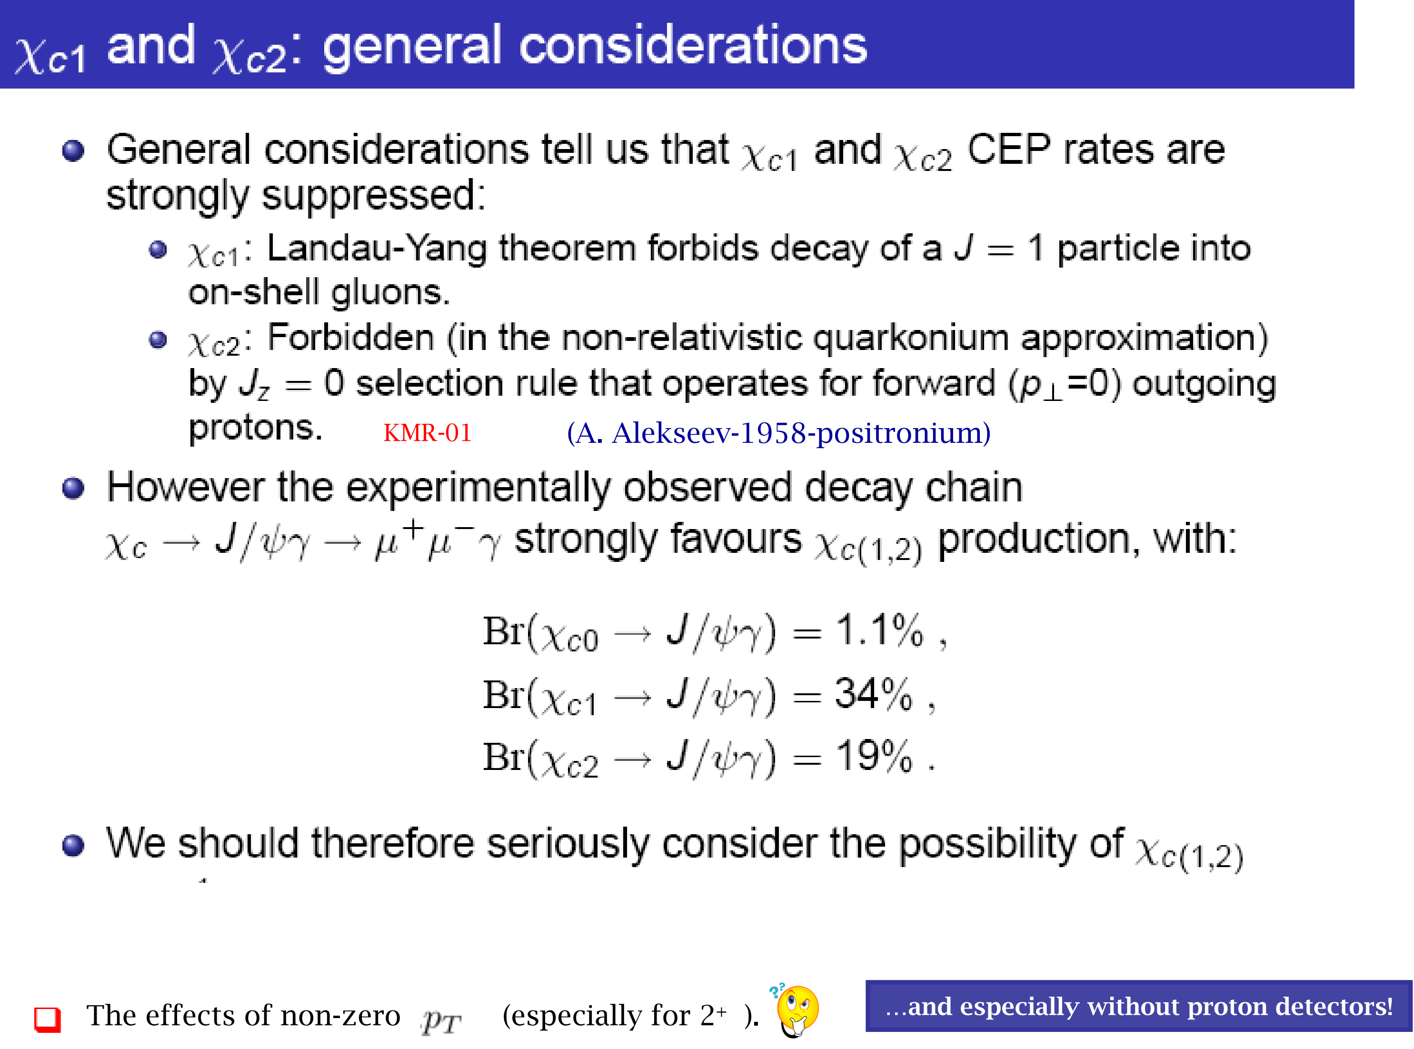

Slide 17
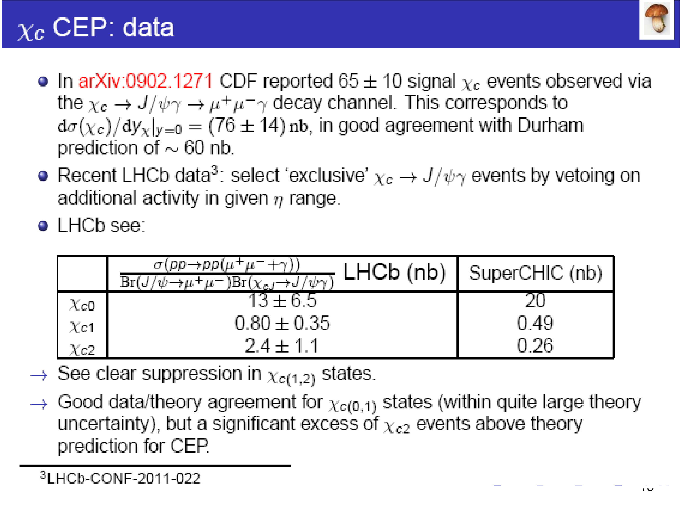

Slide 18
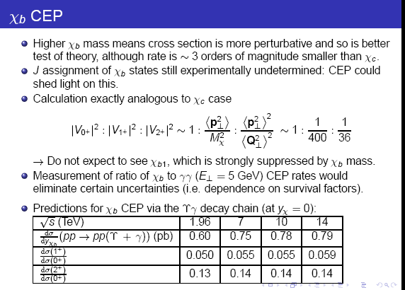
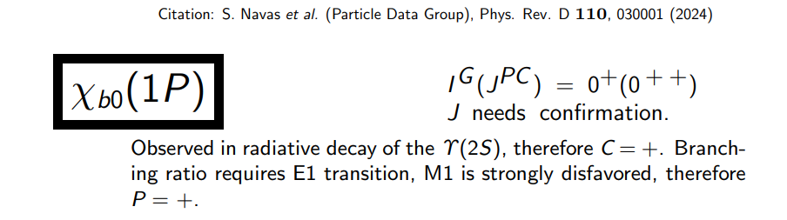

Slide 19
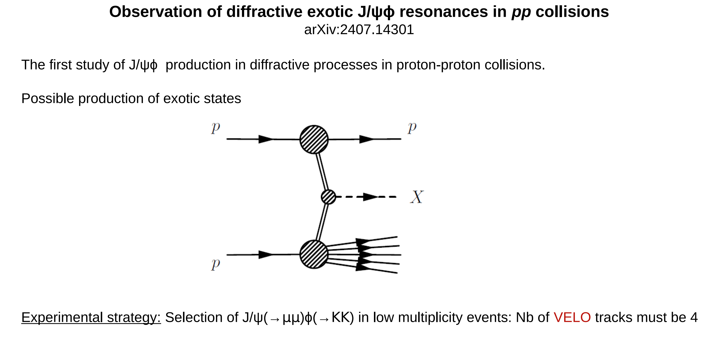


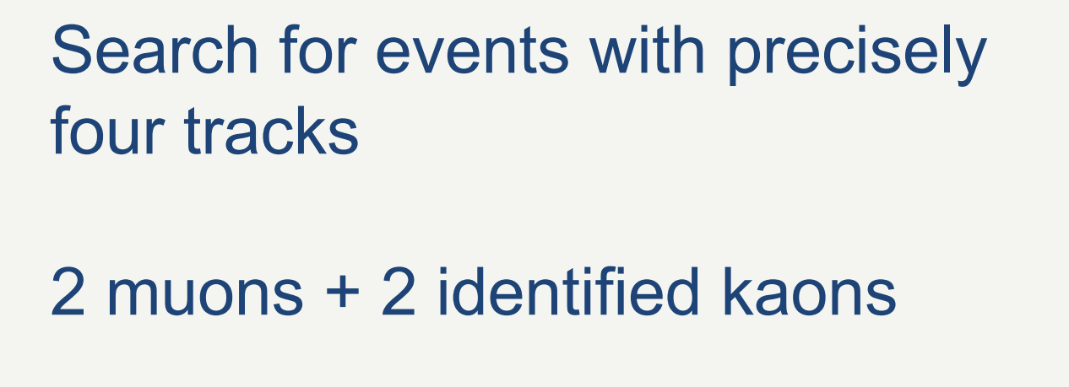

*
Currently Herschel not applied

Slide 20
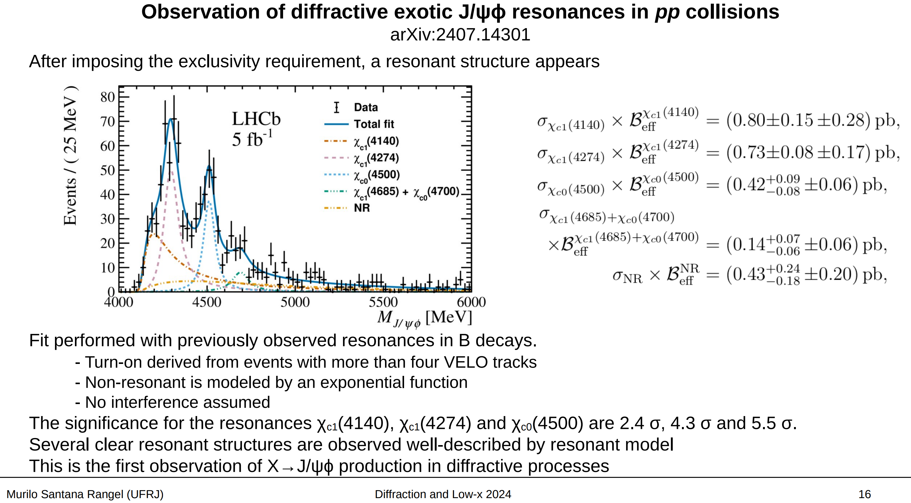

Slide 21

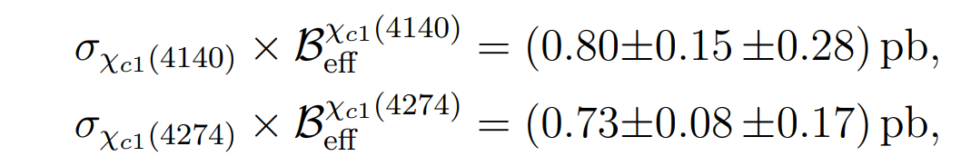


A bit puzzling: strong $1^{+}$ signal
For pure CEP within the PT (gg-fusion) picture- expect a factor of 100 suppression.
Ways out:
1. Huge difference in BR’s ?
2. (Unexpected) large contribution of high-mass proton dissociation.
3. Non-perturbative physics- molecules?
5. Misassignment (Herschel ??)
,
≫

Slide 22
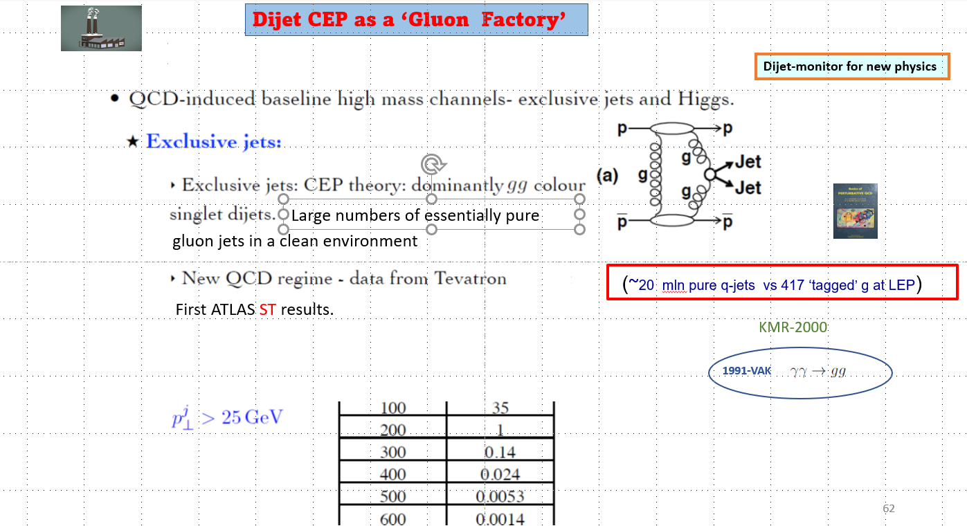
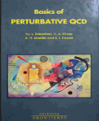
1991

Slide 23
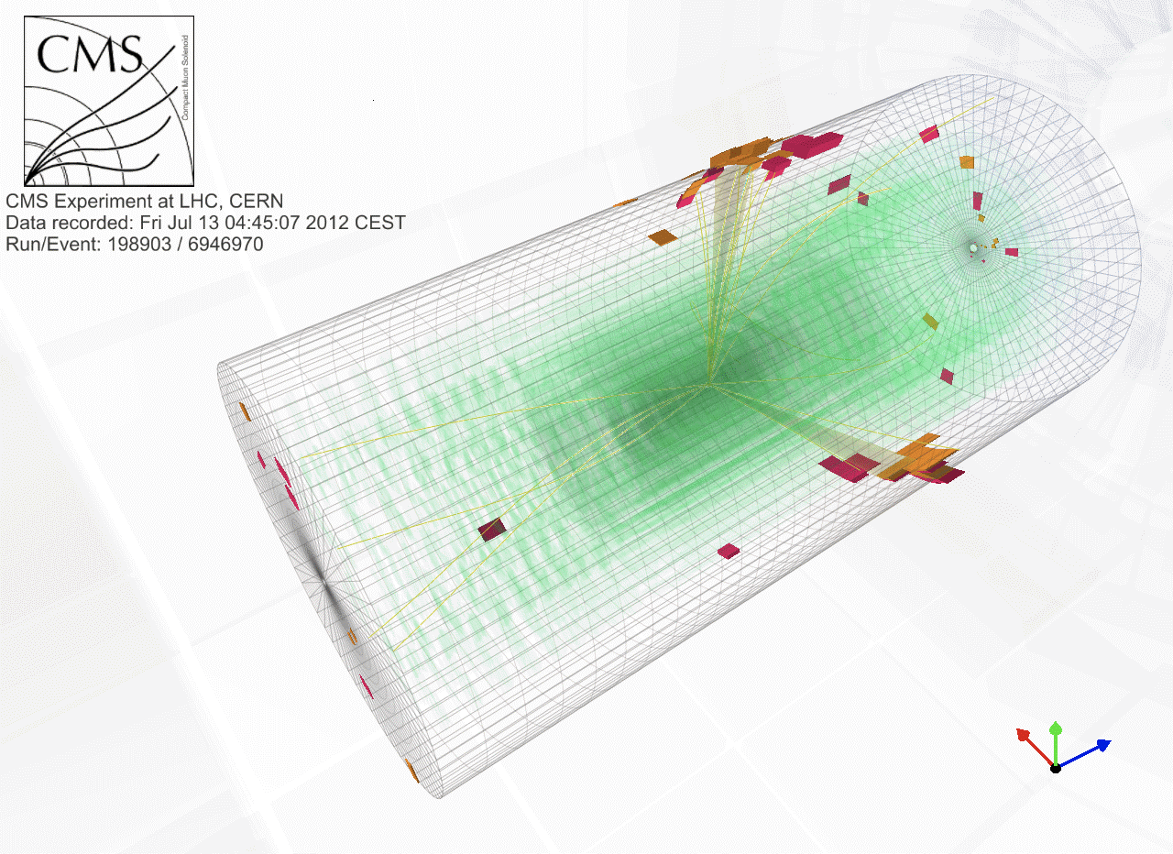
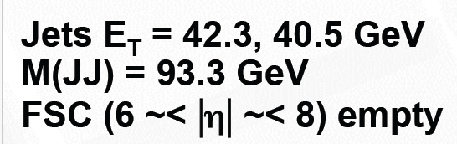
High E_{T} Jets and Pomerons
First CDF at Tevatron
then → CMS at LHC
The cleanest jet events you ever saw at a hadron collider! p + JJ + p
Thanks to TOTEM for protons, FSC for rapidity gaps, low pile-up running in 2012
“Rapidity Gap detectors” = FORWARD SHOWER COUNTERS (FSC) IN CMS
Mike Albrow (FNAL)

Slide 24
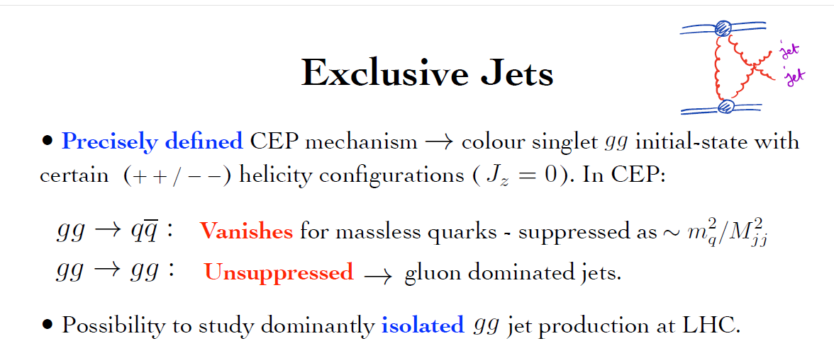
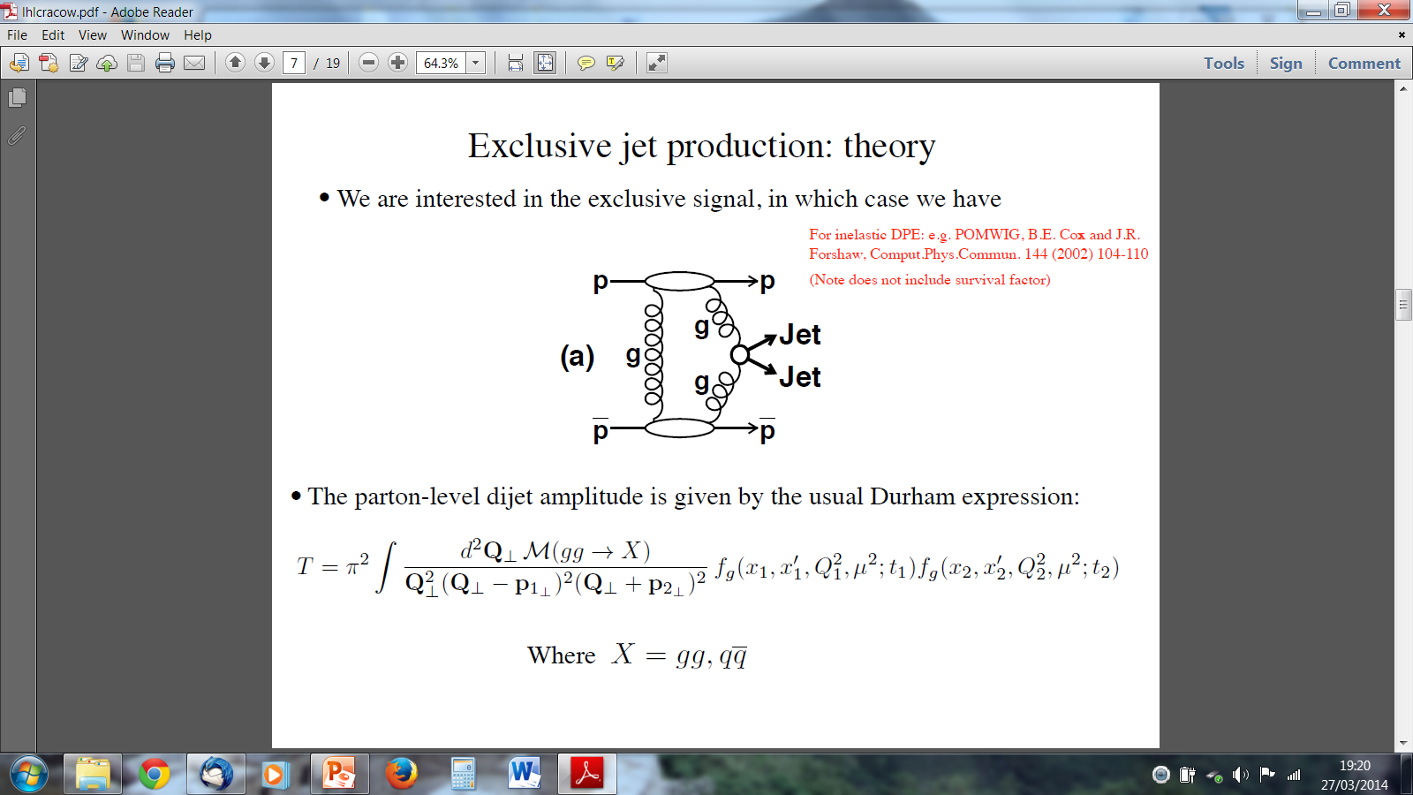
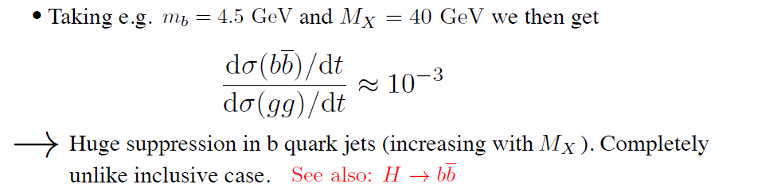
EXCLUSIVE JET PRODUCTION
Soft PT QCD lab
DW-2025
(first indications CDF-2008)

Slide 25
SuperChic-2

Slide 26

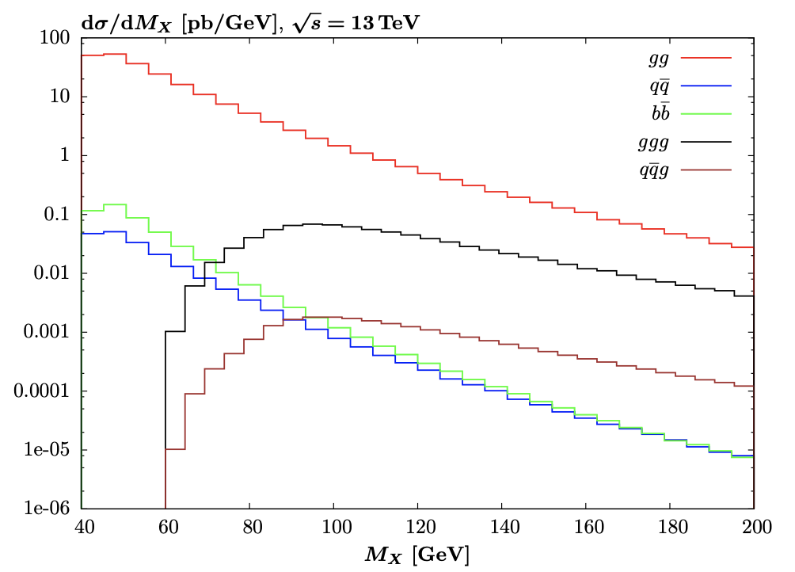
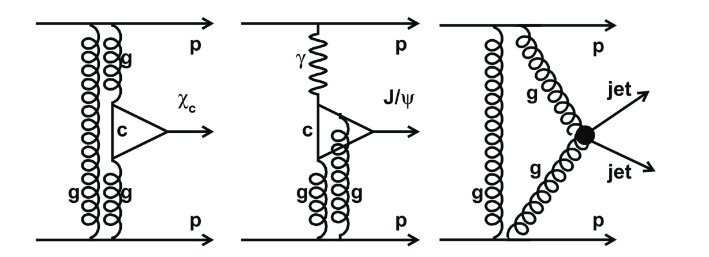
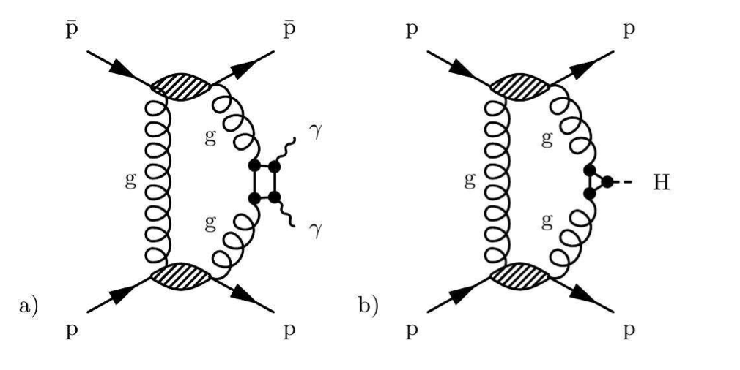
𝝌_{c} → J/ѱ + 𝛾 and 𝝌_{b} → Y + 𝛾
Exclusive 2-jets ET ~ 30 GeV 99% are g + g
1% are q+qbar mostly b + bbar

Slide 27
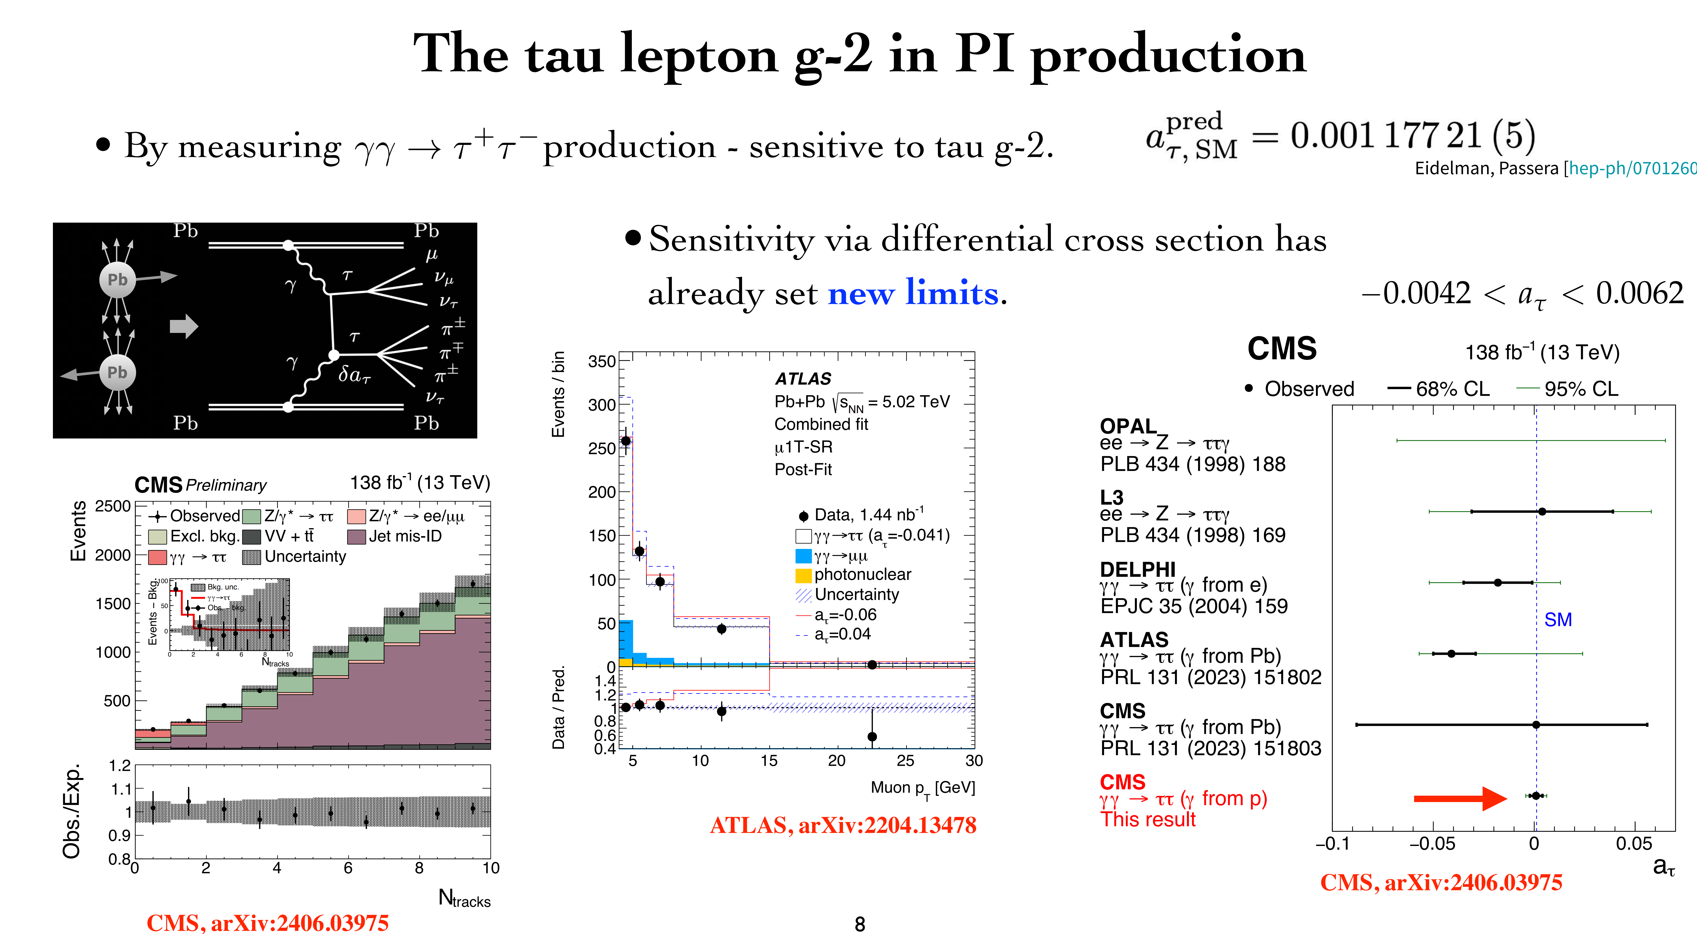
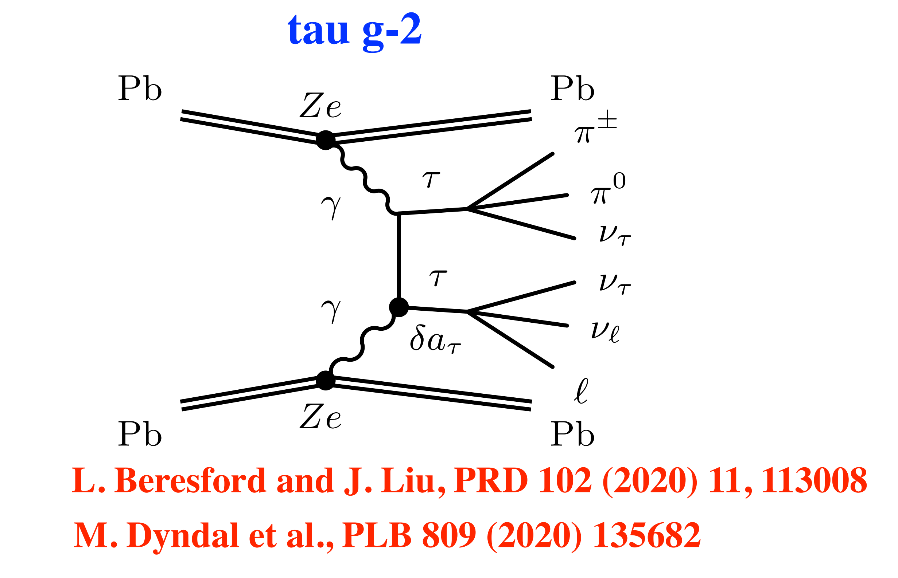
Higher precision constraints on the tau g − 2 in photon–initiated production

Slide 28
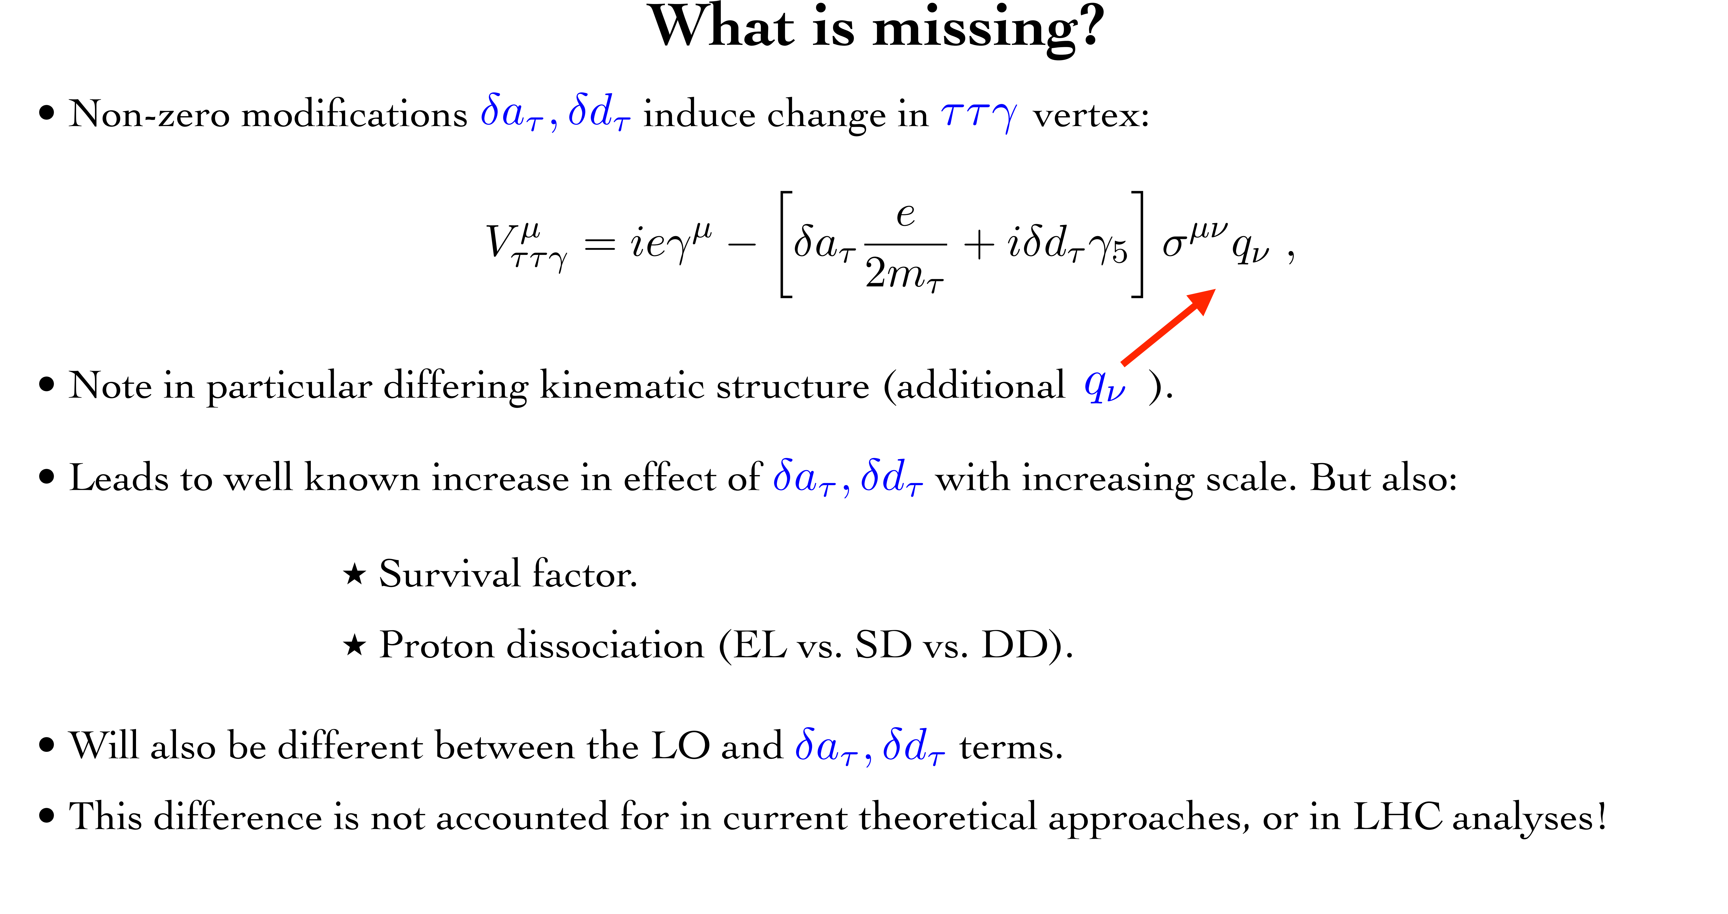

Higher precision constraints on the tau g−2 in LHC photon-initiated production: a full account of hadron dissociation and soft survival effects L.A. Harland-Lang, 2410.10978 [hep-ph]
Standard calculations assume that the nucleus (proton) is intact. The same $S^{2}$.
Notes:
S

Slide 29
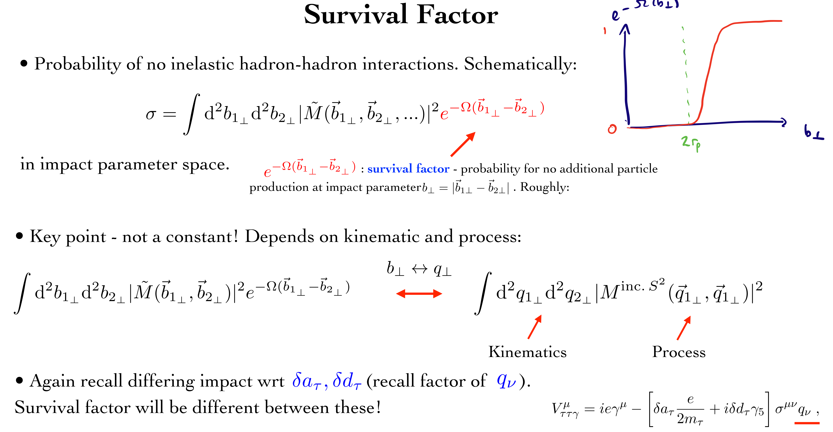
Note
KKM-2003 (Difference of survival for 0⁻ and 0⁺ CEP)

Slide 30

CEP measurements could significantly extend the physics reach of the LHC detectors by giving access to a wide
range of exciting new physics channels.
.
CEP could serve as a spin-parity analyser and offers a sensitive probe of the CP structure of the new states.
The theory of the CEP is in a reasonably healthy shape,
and dedicated MCs (such as SCs) are well developed
The predictions are backed by the series of CDF/D0 CEP-like measurements as well
as the RAP GAP measurements by the LHCb and ALICE +CEP results from ATLAS& CMS

Slide 31
The dedicated AFP and PPS detectors allow for the use of the timing.
The main issue is PU suppression, though some progress is foreseen,
in particular with the addition of timing from the CD.
But ATLAS has already decided not to run AFP at HL-LHC
(at least not in the foreseeable future)
10ps in Run 4
At large M_{Mmis}> 150-200 GeV, the photon-photon fusion dominates
over the gg. LHC is the photon-photon collider!
Such important measurements as the searches for the new Higgs-like states
as well as the moderately-heavy instantons, would require the 420 m stations.
The bulk of important physics (such as glueballs, instantons, and other new
state searches) would require low luminosity runs.

Slide 32


Slide 33


Slide 35


Slide 36


AFP & PPS
Standard HL runs. With precision tracking and timing detectors.
(0.02-0.15)

Slide 37

up to 1-2 TeV
Currently, pure CEP studies at the LHC are dominated (also HIC-UPC)

Slide 38
Process dependence
Fully differential implementation of soft survival factor – SuperChic 2 -5 MCs
for pp, pZ, and ZZ scattering

Slide 39


Slide 40


Slide 41


Recall:
the SM prediction for the tau g-2 is known to 5 d.p precision
2410.10978 [hep-ph]

Slide 42


Slide 43


Slide 44


Slide 45


