Slide 1

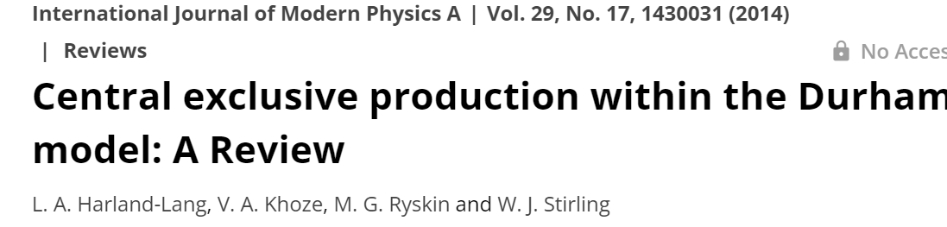
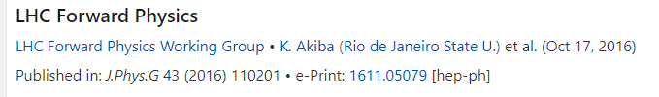

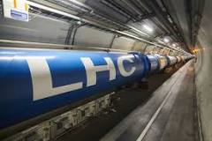
CENTRAL EXCLUSIVE PRODUCTION @ LHC
(selected topics)
Experiment
Paul Newman
Kenneth Osterberg
Christoph Royon

Slide 2
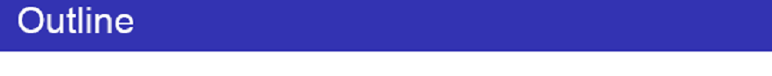
Introduction (why we are interested in CEP processes?)
CEP and Large RAP GAPS.
QCD-induced CEP mechanism.
CEP as a spin-parity analyzer
‘Diffractive Higgs’ revisited.
Standard Candle CEP reactions and experimental tests.
Gluon –gluon vs photon-photon fusion.
Dimeson Saga.
Other selected CEP topics
Summary and Outlook
‘
Summary and Outlook.

Slide 3
CEP and RAP GAPs

Slide 4
LRGs caused by Pomeron,
photon (W,Z) or Odderon exchanges

Slide 5

ALFA/TOTEM
(Radiation tolerance)
Threshold scan.

Slide 6

X
~200m
AFP/PPS
(LHC runs 1,2)
(ALICE-double Gap trigger, Runs 1 and 2)

Slide 7
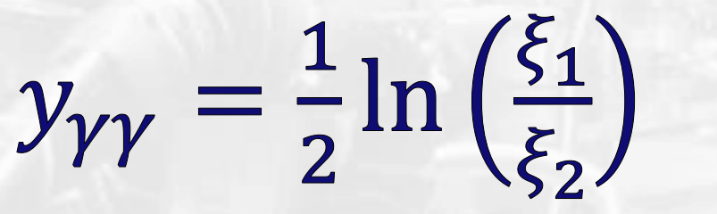


ALFA
TOTEM & ALFA
CMS/PPS & ATLAS/AFP
ALFA
The LHC is an excellent mass spectrometer
$$y_{M}$$
ALFA/TOTEM- radiation tolerance → low PU special runs

Slide 8
ISR, SPS
RHIC at 200, 500 GeV
■ Limited statistical precision
(28 candidate signal events, M<2GeV)
Not sufficient sensitivity to discriminate the theor. models (used DIME , GenEx)
■
■ Promising potential to measure CEP using FD@LHC

Slide 9
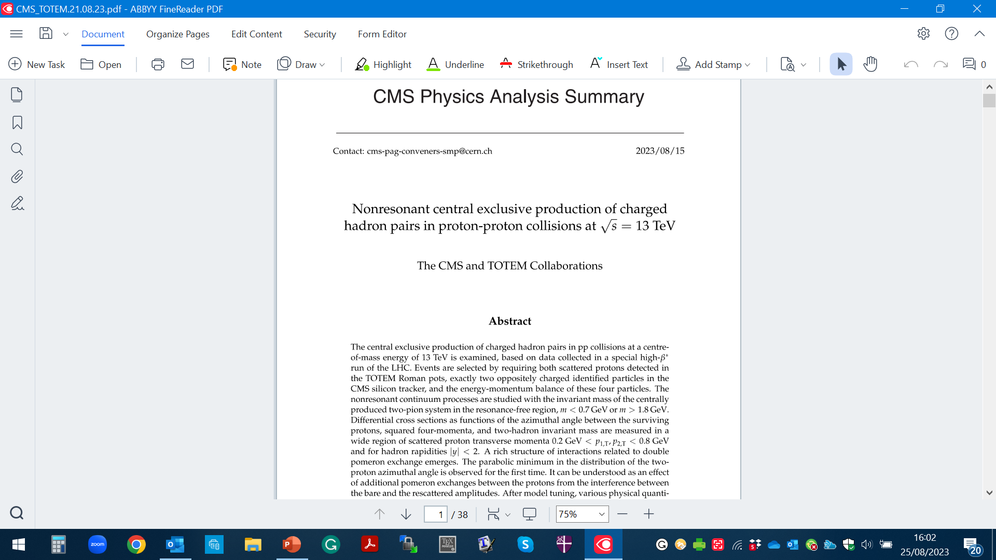
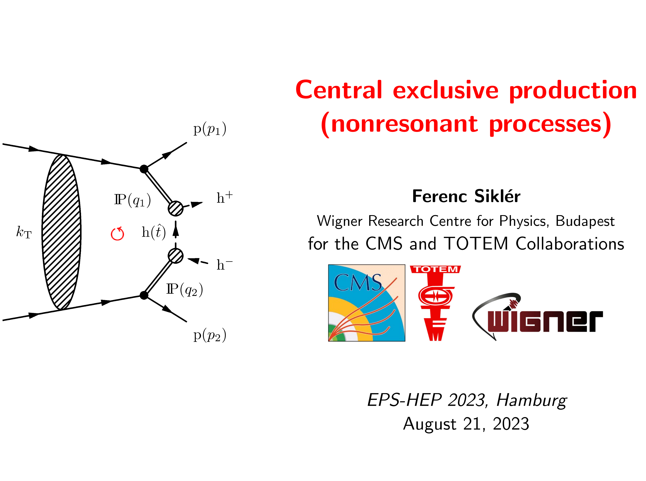
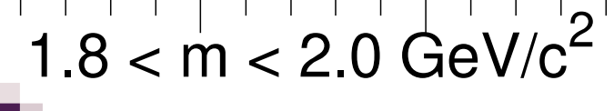
TOTEM&CMS
e-Print: 2401.14494 [hep-ex]
0.35 < m< 0.65 GeV

Slide 10
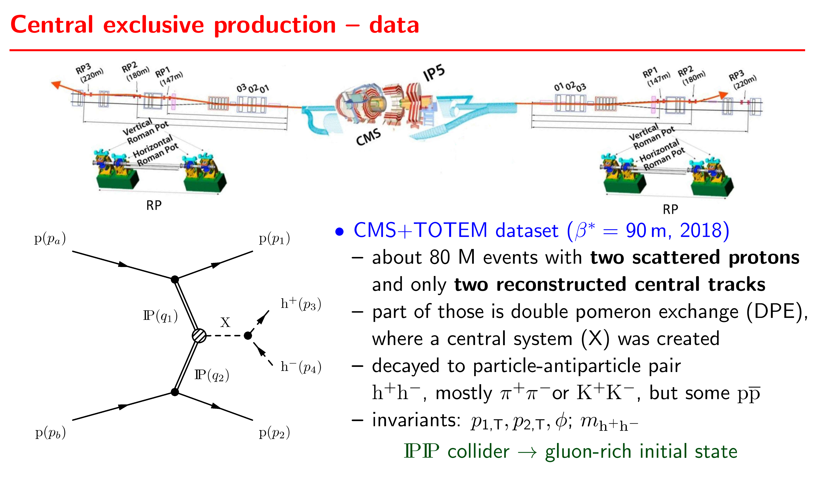

Slide 11
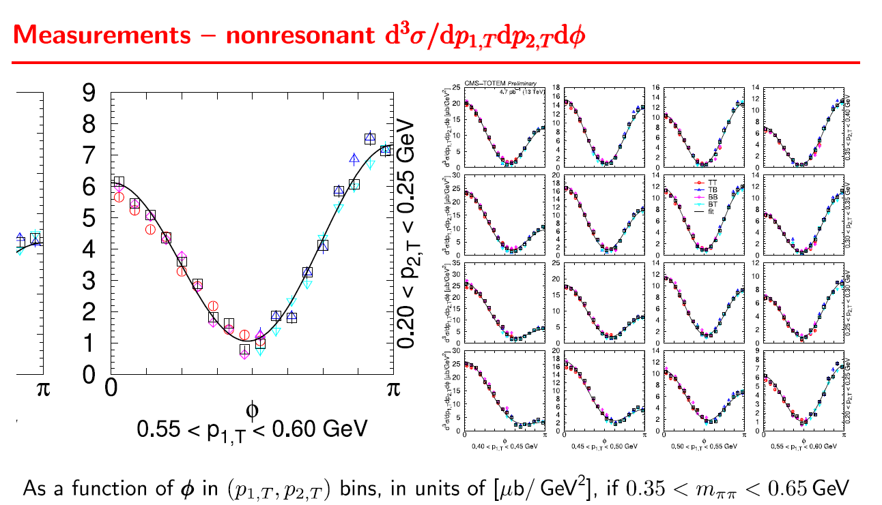
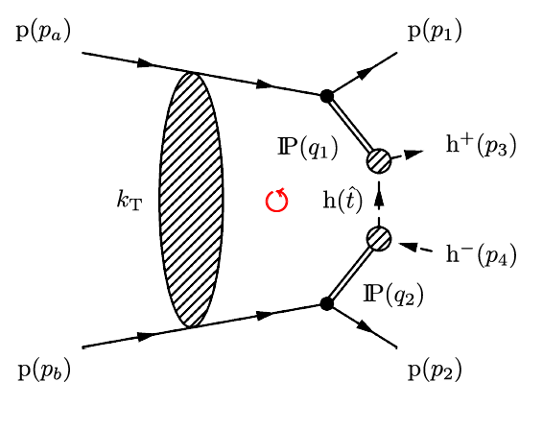

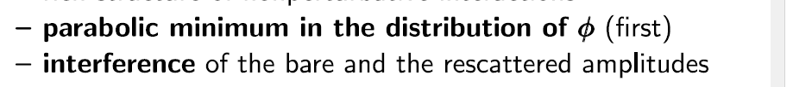
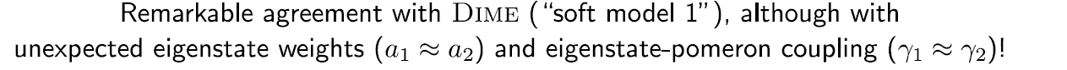

Slide 12
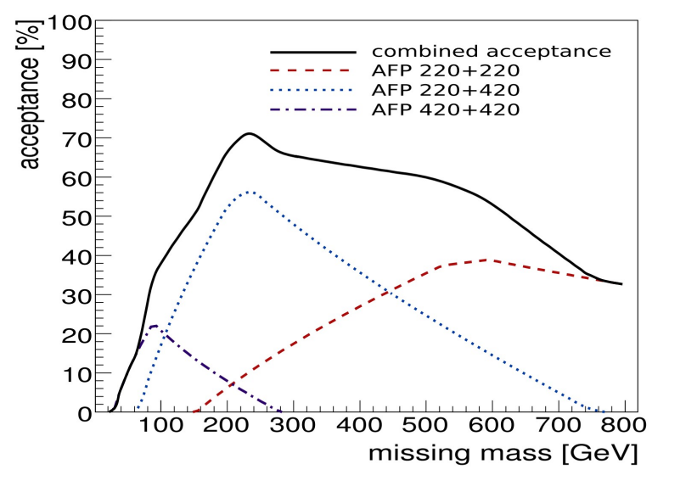
AFP & PPS
Standard HL runs. With precision tracking and timing detectors.
(0.02-0.15)

Slide 13
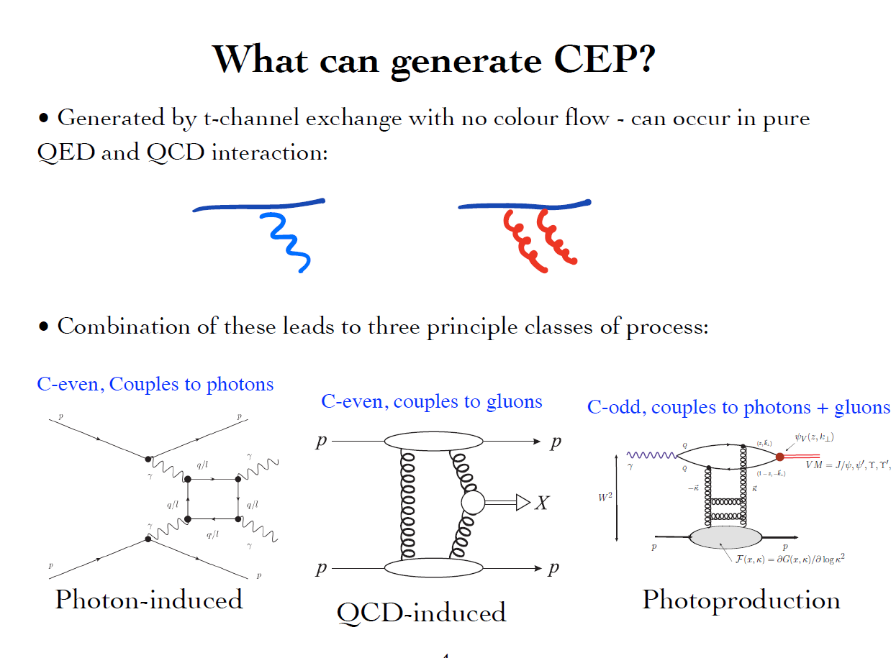
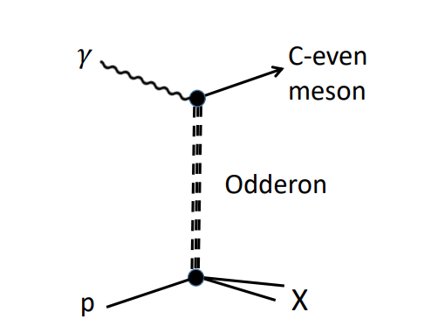
(ZZ, mixed,…)

Slide 14
QCD-induced CEP

Slide 15
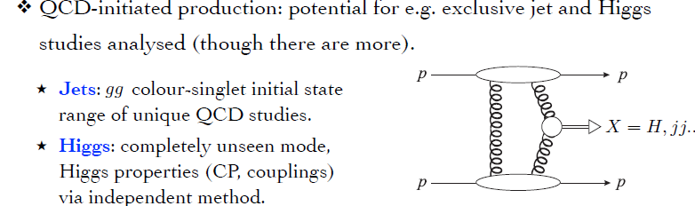

Slide 16
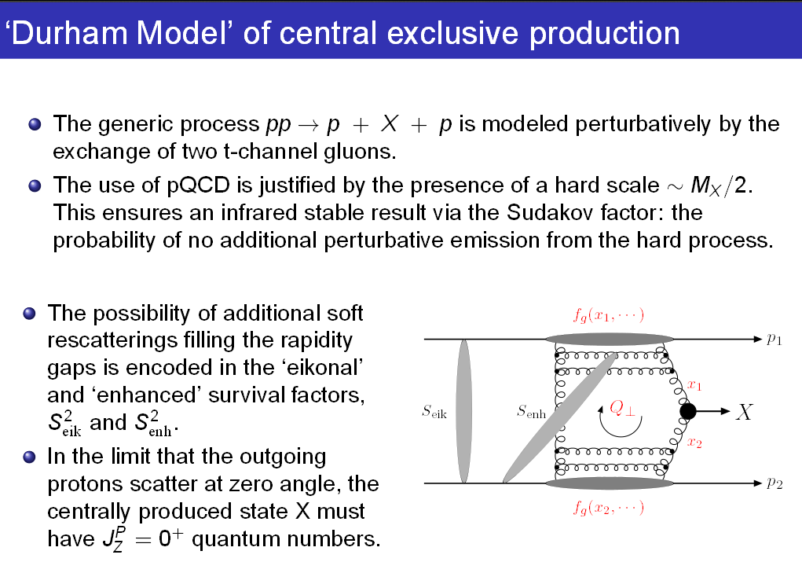
KMR-1997-2001

Slide 17
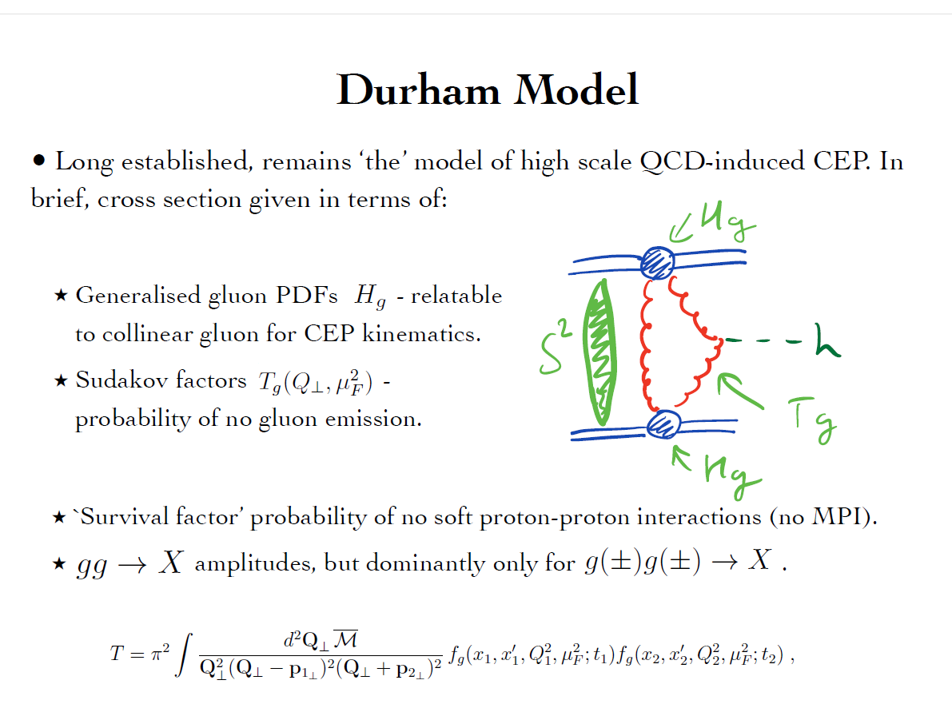

Slide 18
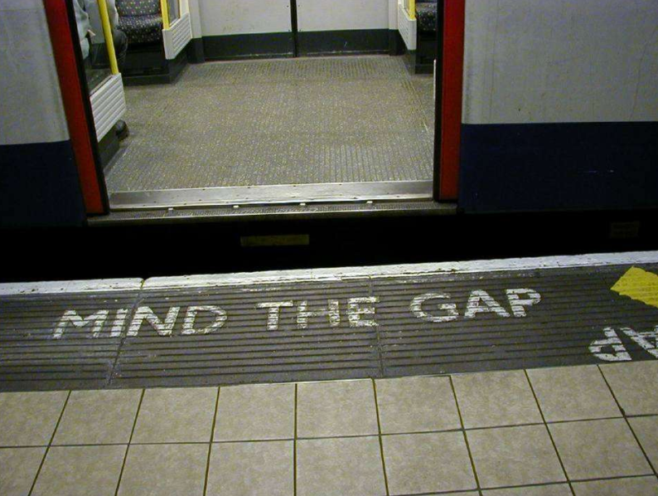


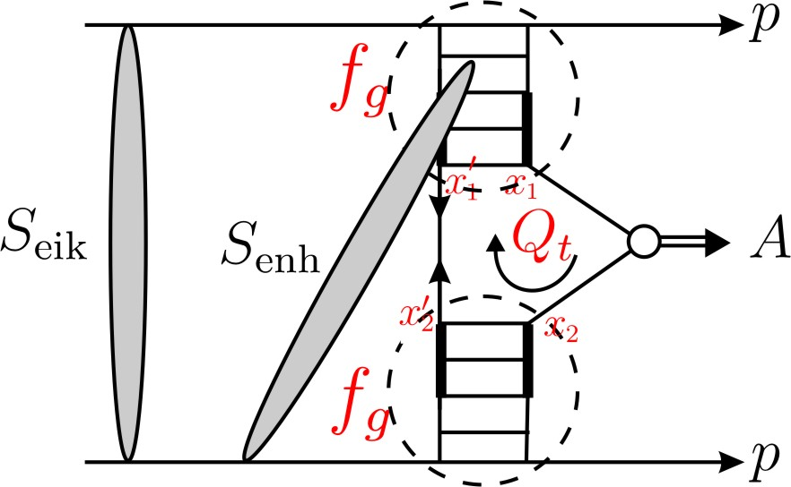
“soft” scattering can easily destroy the gaps
S² ➔ absorption effects -necessitated by unitarity
gap
M
gap
Eikonal rescatt: between protons
Semi-enhanced rescatt: involving intermediate partons
1 >
≫

Slide 19
Process dependence
First fully differential implementation of soft survival factor – SuperChic 2 MC
event generator- HKR, ArHiv:1508.02718
SC-3,4

Slide 20
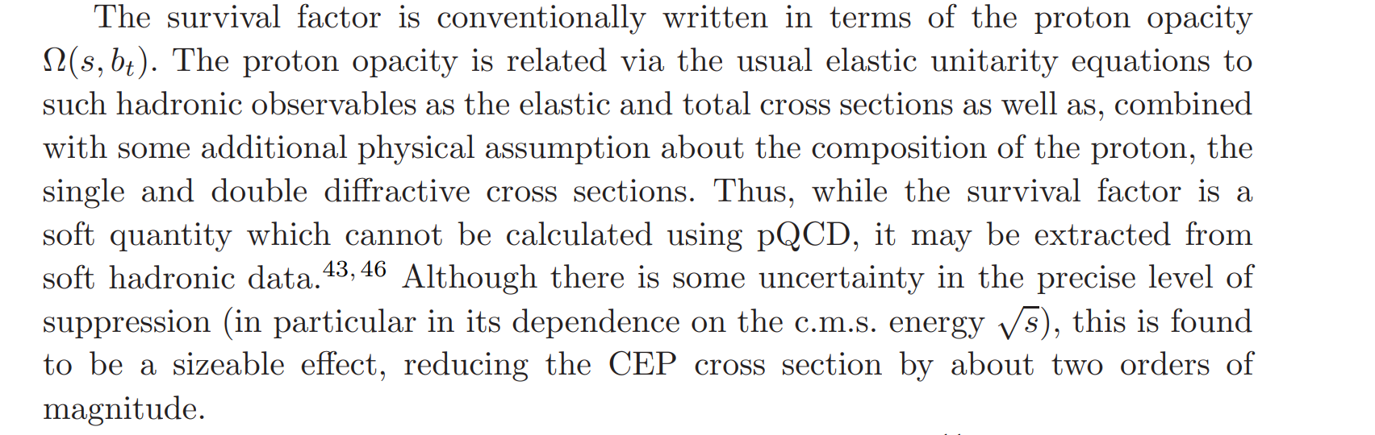

Well developed machinery
KMR (2000-2013)
GLM, FS, Ostapchenko
exp(−Ω(s, but)) probability that no inelastic scattering occurs at impact parameter bt,
depends only on proton transverse separation

Slide 21
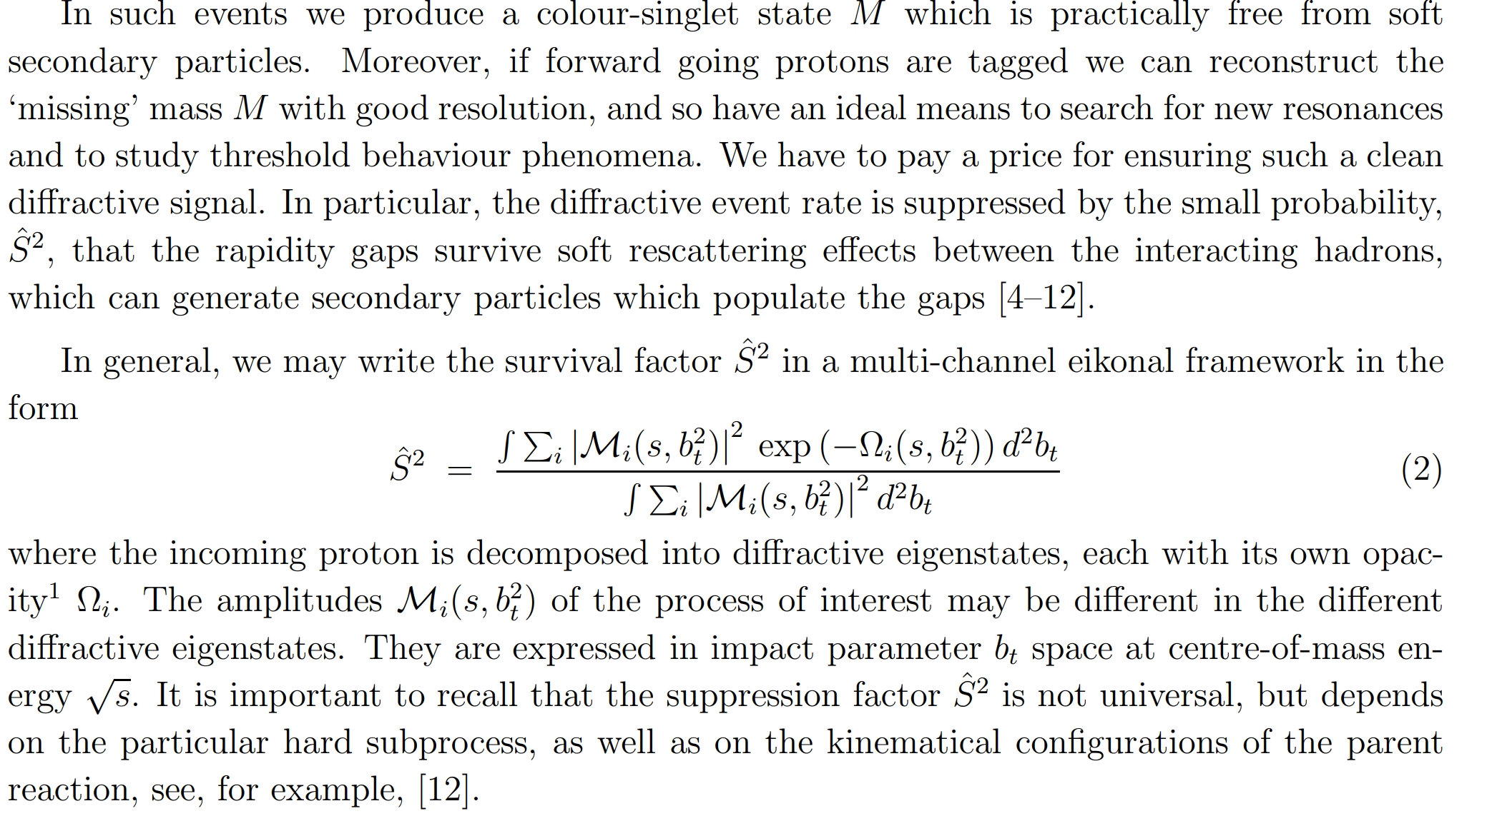
the possibility of (low mass) diffractive dissociation p → N* ∗

Slide 24
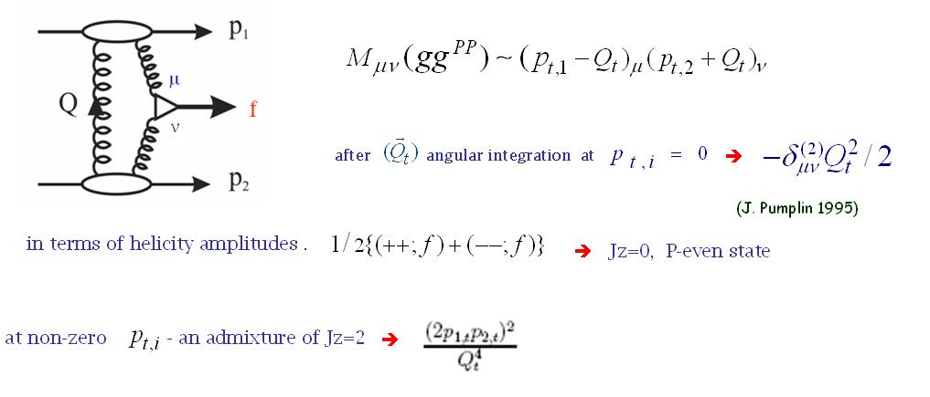
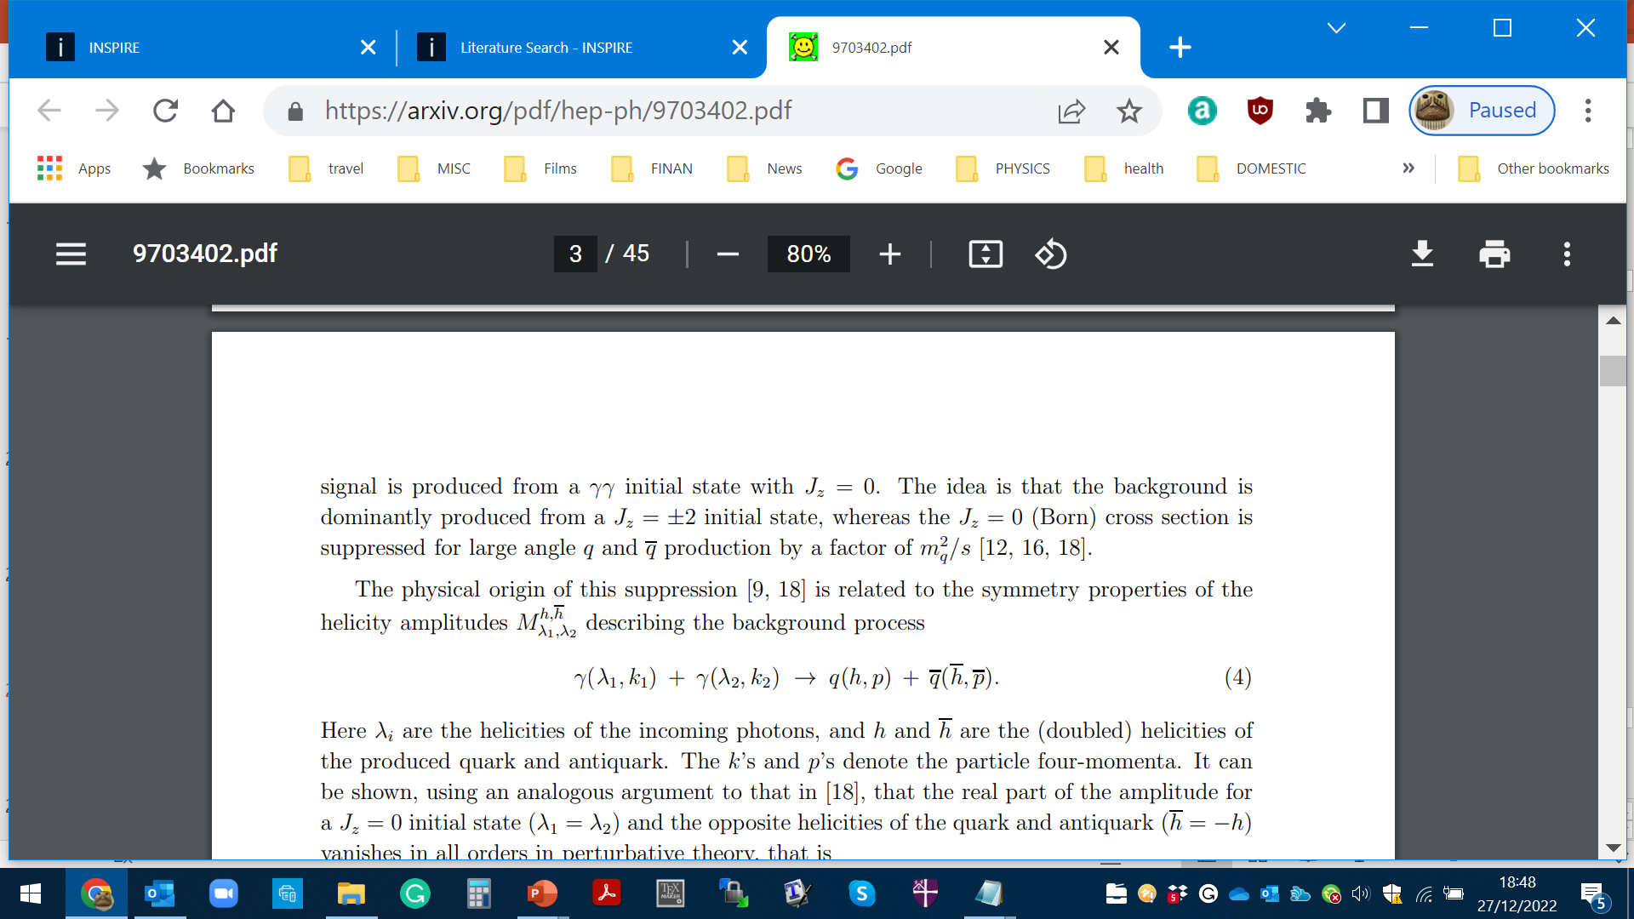
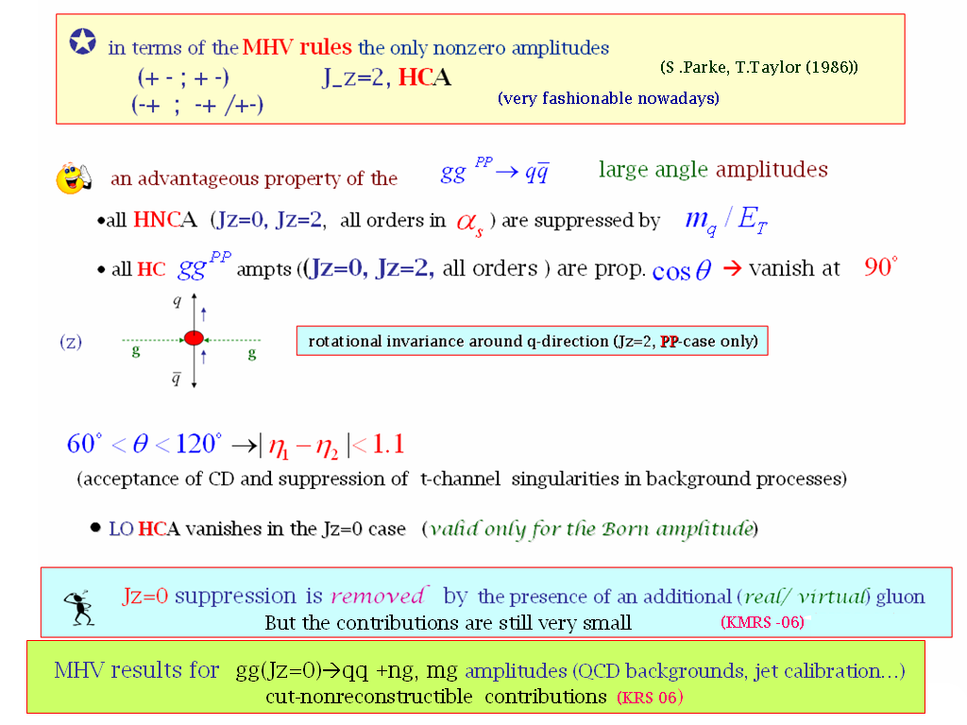


Important consequences for$H→b\overline{b}$
Symmetry properties of the amplitude (FKM-97)
(++,+-) (--,+-)
(++,-+) (--,-+)
$$J_{Z}=0$$
(nullifies in the massless limit)
gg→qq
‘An Amplitude for n Gluon Scattering’

Slide 25
CEP AS A SPIN-PARITY ANALYZER

Slide 26
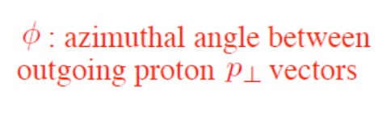
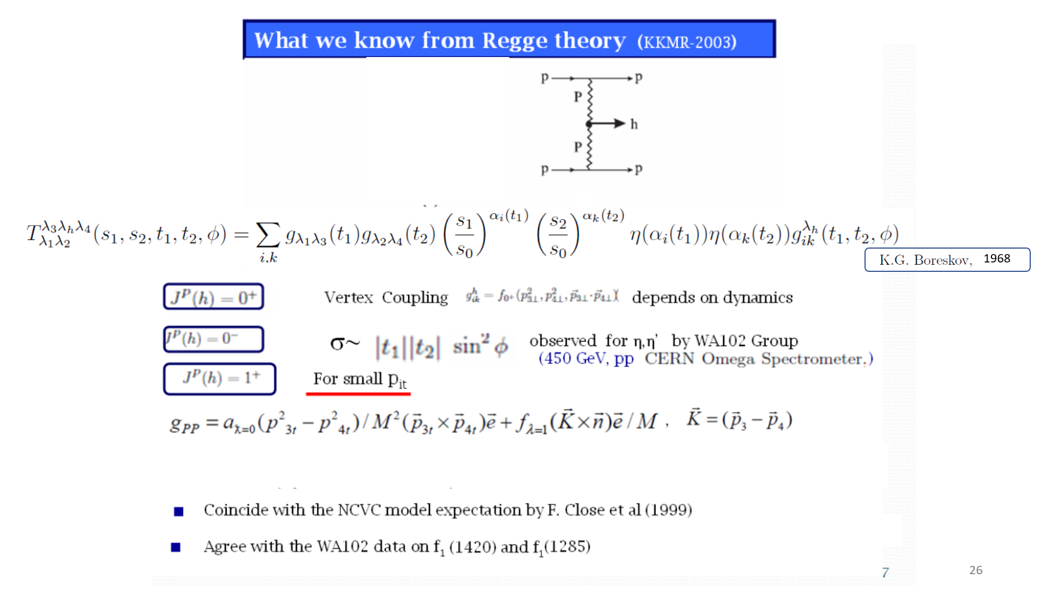
What is known from Regge Theory
K.Boreskov, 68
Kaidalov. Karnakov, 66,70
,
,
Follows from general principles

Slide 27
Pre-LHC studies
review: A. Kirk.
1408.1196[hep-ex]
1408.1196

Slide 28
Irrespective of the decay products
HKSR-10
1966, 1970 ,
1968

Slide 29
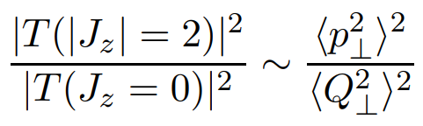
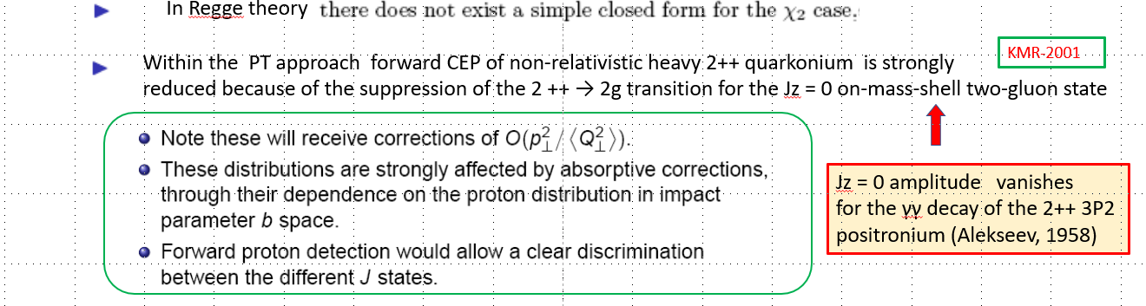
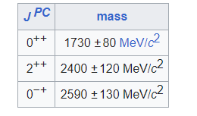

Jz = 0 amplitude vanishes
for the γγ decay of the 2++ 3P2
positronium (Tumanov, 53;Alekseev, 58)
Glueball filter ?
Lattice results
X(2370) @ BESIII strong evidence in favour of $0^{−}$
Eur.Phys.J.C 80 (2020) 11, 1077

Slide 30
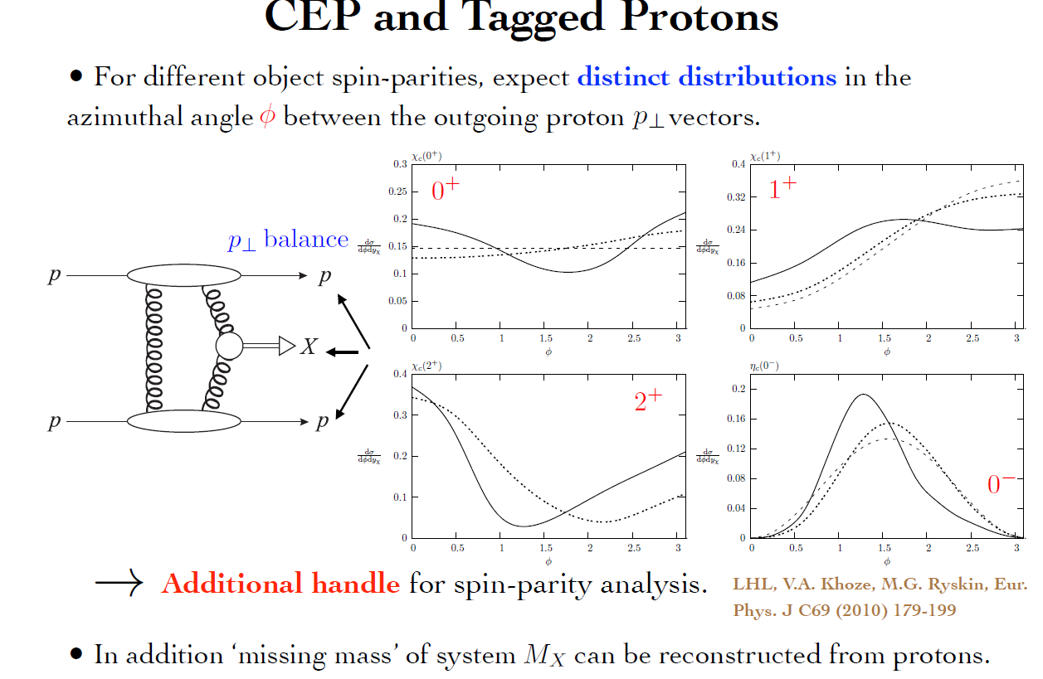
dotted curve- no S²

Slide 31
Life, Death and “Ressurection “ of ‘Diffractive Higgs

Slide 32

The early 2000s
✶

Slide 33

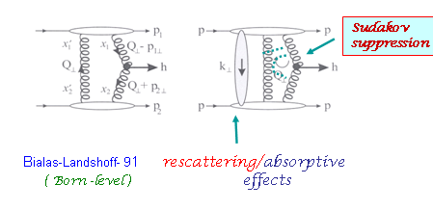
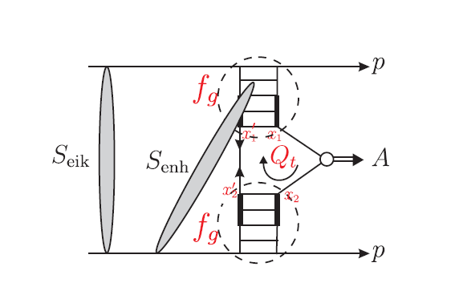

The basic ingredients of the thery approach (interplay between the soft and hard dynamics)
RG signature for Higgs hunting (DKT-1987). Bjorken (1992-93)
+ ….
h
^{With a bit of personal flavour}
Main requirements:
inelastically scattered protons remain intact
active gluons do not radiate in the course of evolution up to the scale M
<Qt> >>/\QCD in order to go by pQCD book
- 4
σ(CDPE) ~ 10 * σ (incl)

Slide 34

High price to pay for such a clean exclusive environment:
σ _{H}(CEP) ~ 10
-4
∗ σ_{H}( inclus.)
A. Bialas and P.V. Landshoff, Phys. Lett. B256 (1991) 540.
Rapidity Gaps should survive hostile hadronic radiation
damages and ‘partonic pile-up ‘
Excitement of the Tevatron community-
symbolically W = S² T²
Theory spread of 11 orders
Colour charges of the ‘digluon dipole’ are screened
only at rd ≥ 1/ (Qt)ch
GAP Keepers (Survival Factors) , protecting RG against:
• the debris of QCD radiation with 1/Qt≥ λ≥ 1/M (T)
• soft rescattering effects (necessitated by unitarity) (S)
KMR 1997
Factor ~3 since then
Forcing two camels to go through the eye
of a needle
H
P
P

Slide 35
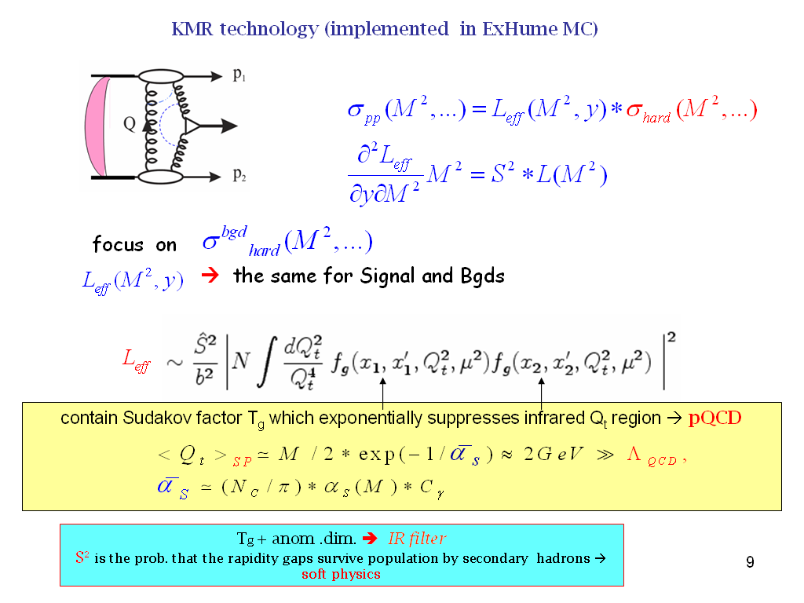
1997-2000)
σ(CEP) ~ 10⁻⁴ σ (incl)
Roughly

Slide 36
Sudakov - probability not emitting gluons with
DL
∎
no infrared divergency
∎
∎
increases with mass M_{H} and
‘skewed’ unintegrated PDF

Slide 37
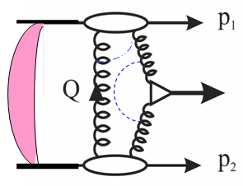

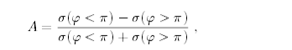
(
σ
φ < π
)
−
σ
(
φ > π
)
(
σ
(
φ < π
)
−
σ
φ > π
)
~p
∼
sin
~n
·
(
~p
×
)
φ
The main advantages of CEP Higgs production
• Prospects for high accuracy (~1%) mass measurement
(irrespectively of the decay mode).
• Quantum number filter/analyser.
( 0++ dominance;C,P-even)
 H ->bb opens up (Hbb Yukawa coupl.) 0
(gg)--,++  bb in LO ; NLO,NNLO, b- mass effects – controllable. M(+++-)=(M---+)=0
 For some scenarios CEP may become a discovery channel 😐
• A handle on the overlap backgrounds- Fast Timing Detectors (10-20 ps timing or better).
 New leverage –proton momentum correlations (probes of QCD dynamics , CP- violation effects…)
H
A
=
BSM
Triple product correlation:
Integrated counting asymmetry (~10%)
0
1
⊥
2
⊥
φ < π
σ
(
) +
σ
(
φ > π
)
=
A
σ
(
φ < π
) +
σ
(
φ > π
)

Slide 38
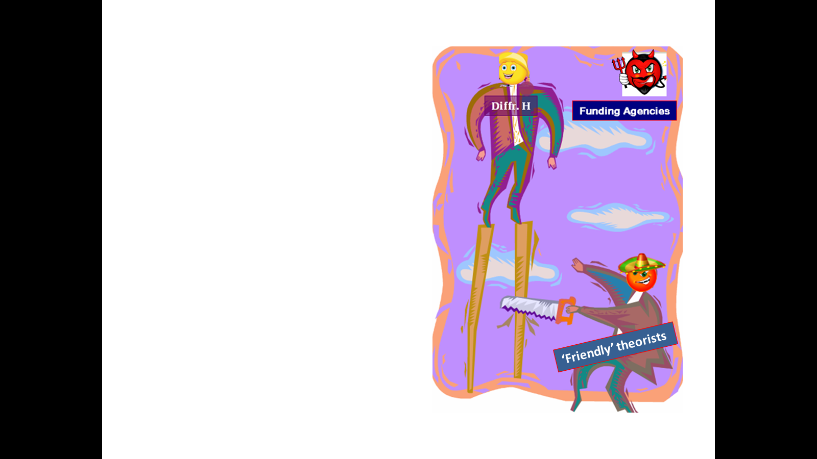
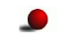
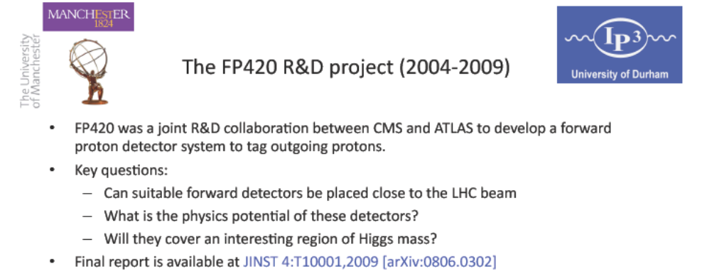
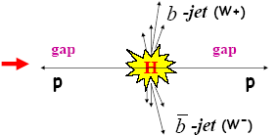
FP420 and Resurrection of ‘Diffractive HIggs’
(20 years on)
searching for lower mass new objects in CEP requires far away (~400m) FDs
96 GeV-’light Higgs’ indications
PPS/AFP- new proposals

Slide 39
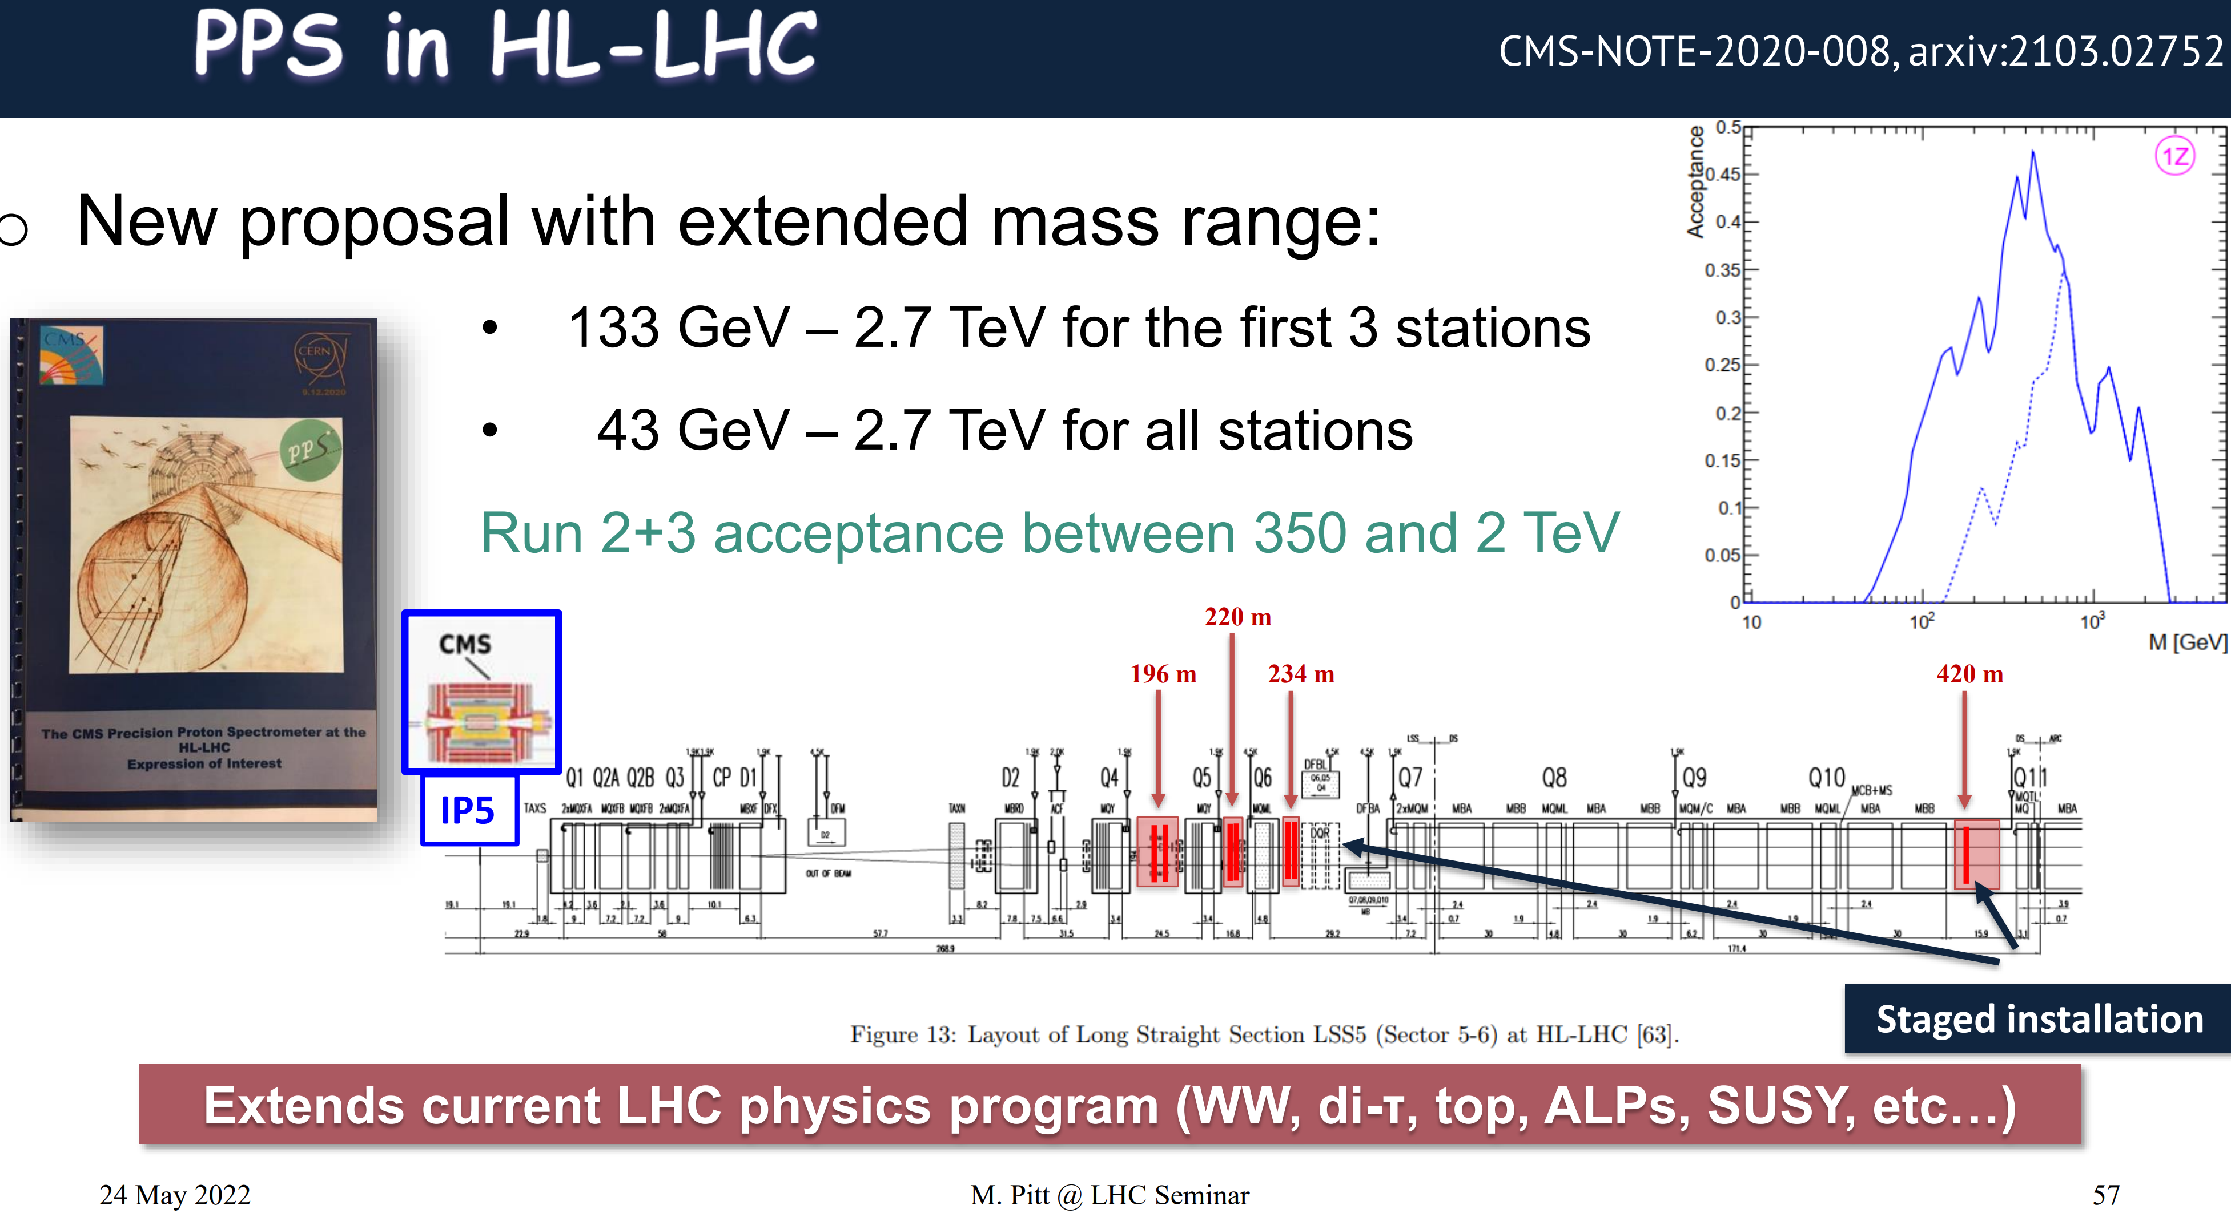

Slide 40
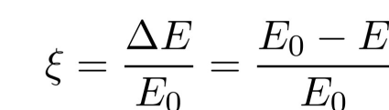


Slide 41
Photon vs Gluon fusion

Slide 42
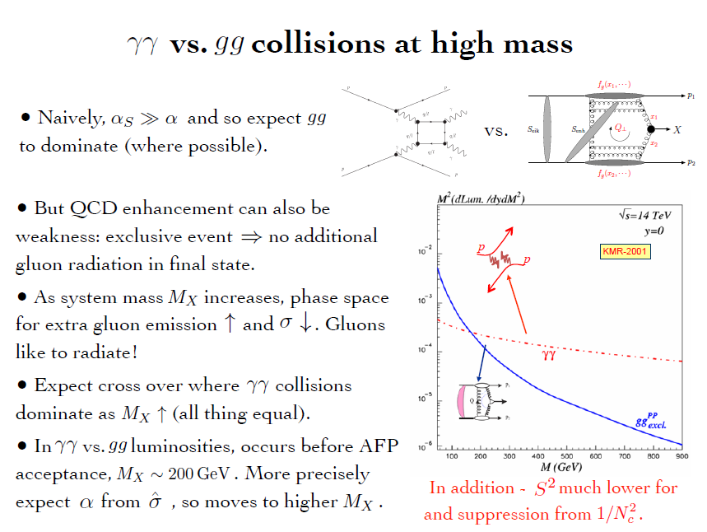

Slide 43
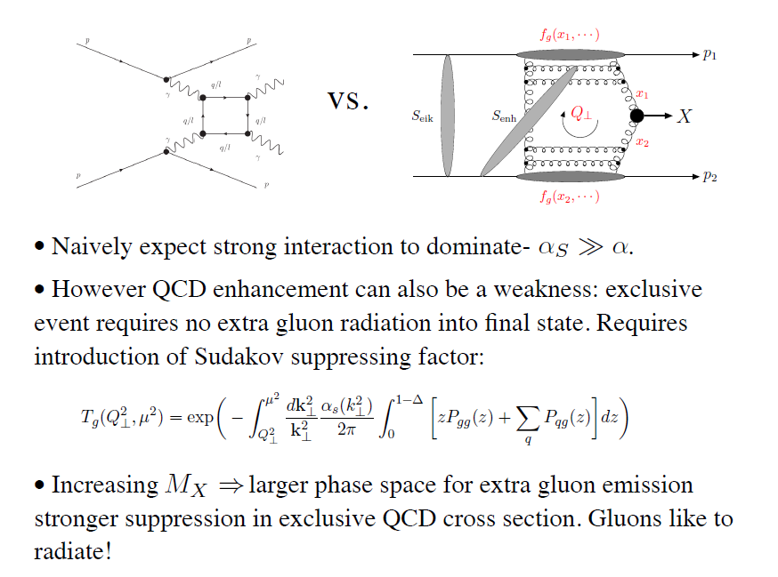
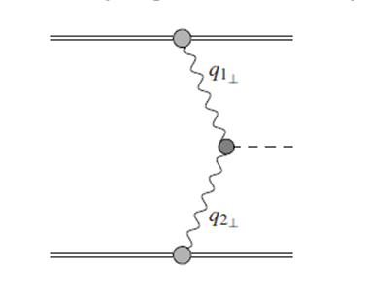


γ
X
γ
The LHC is the high energy photon collider
‘Large’ Pomeron size in the
production of the small size objects.
+ absorptive/rescattering effects- survival factor

Slide 44
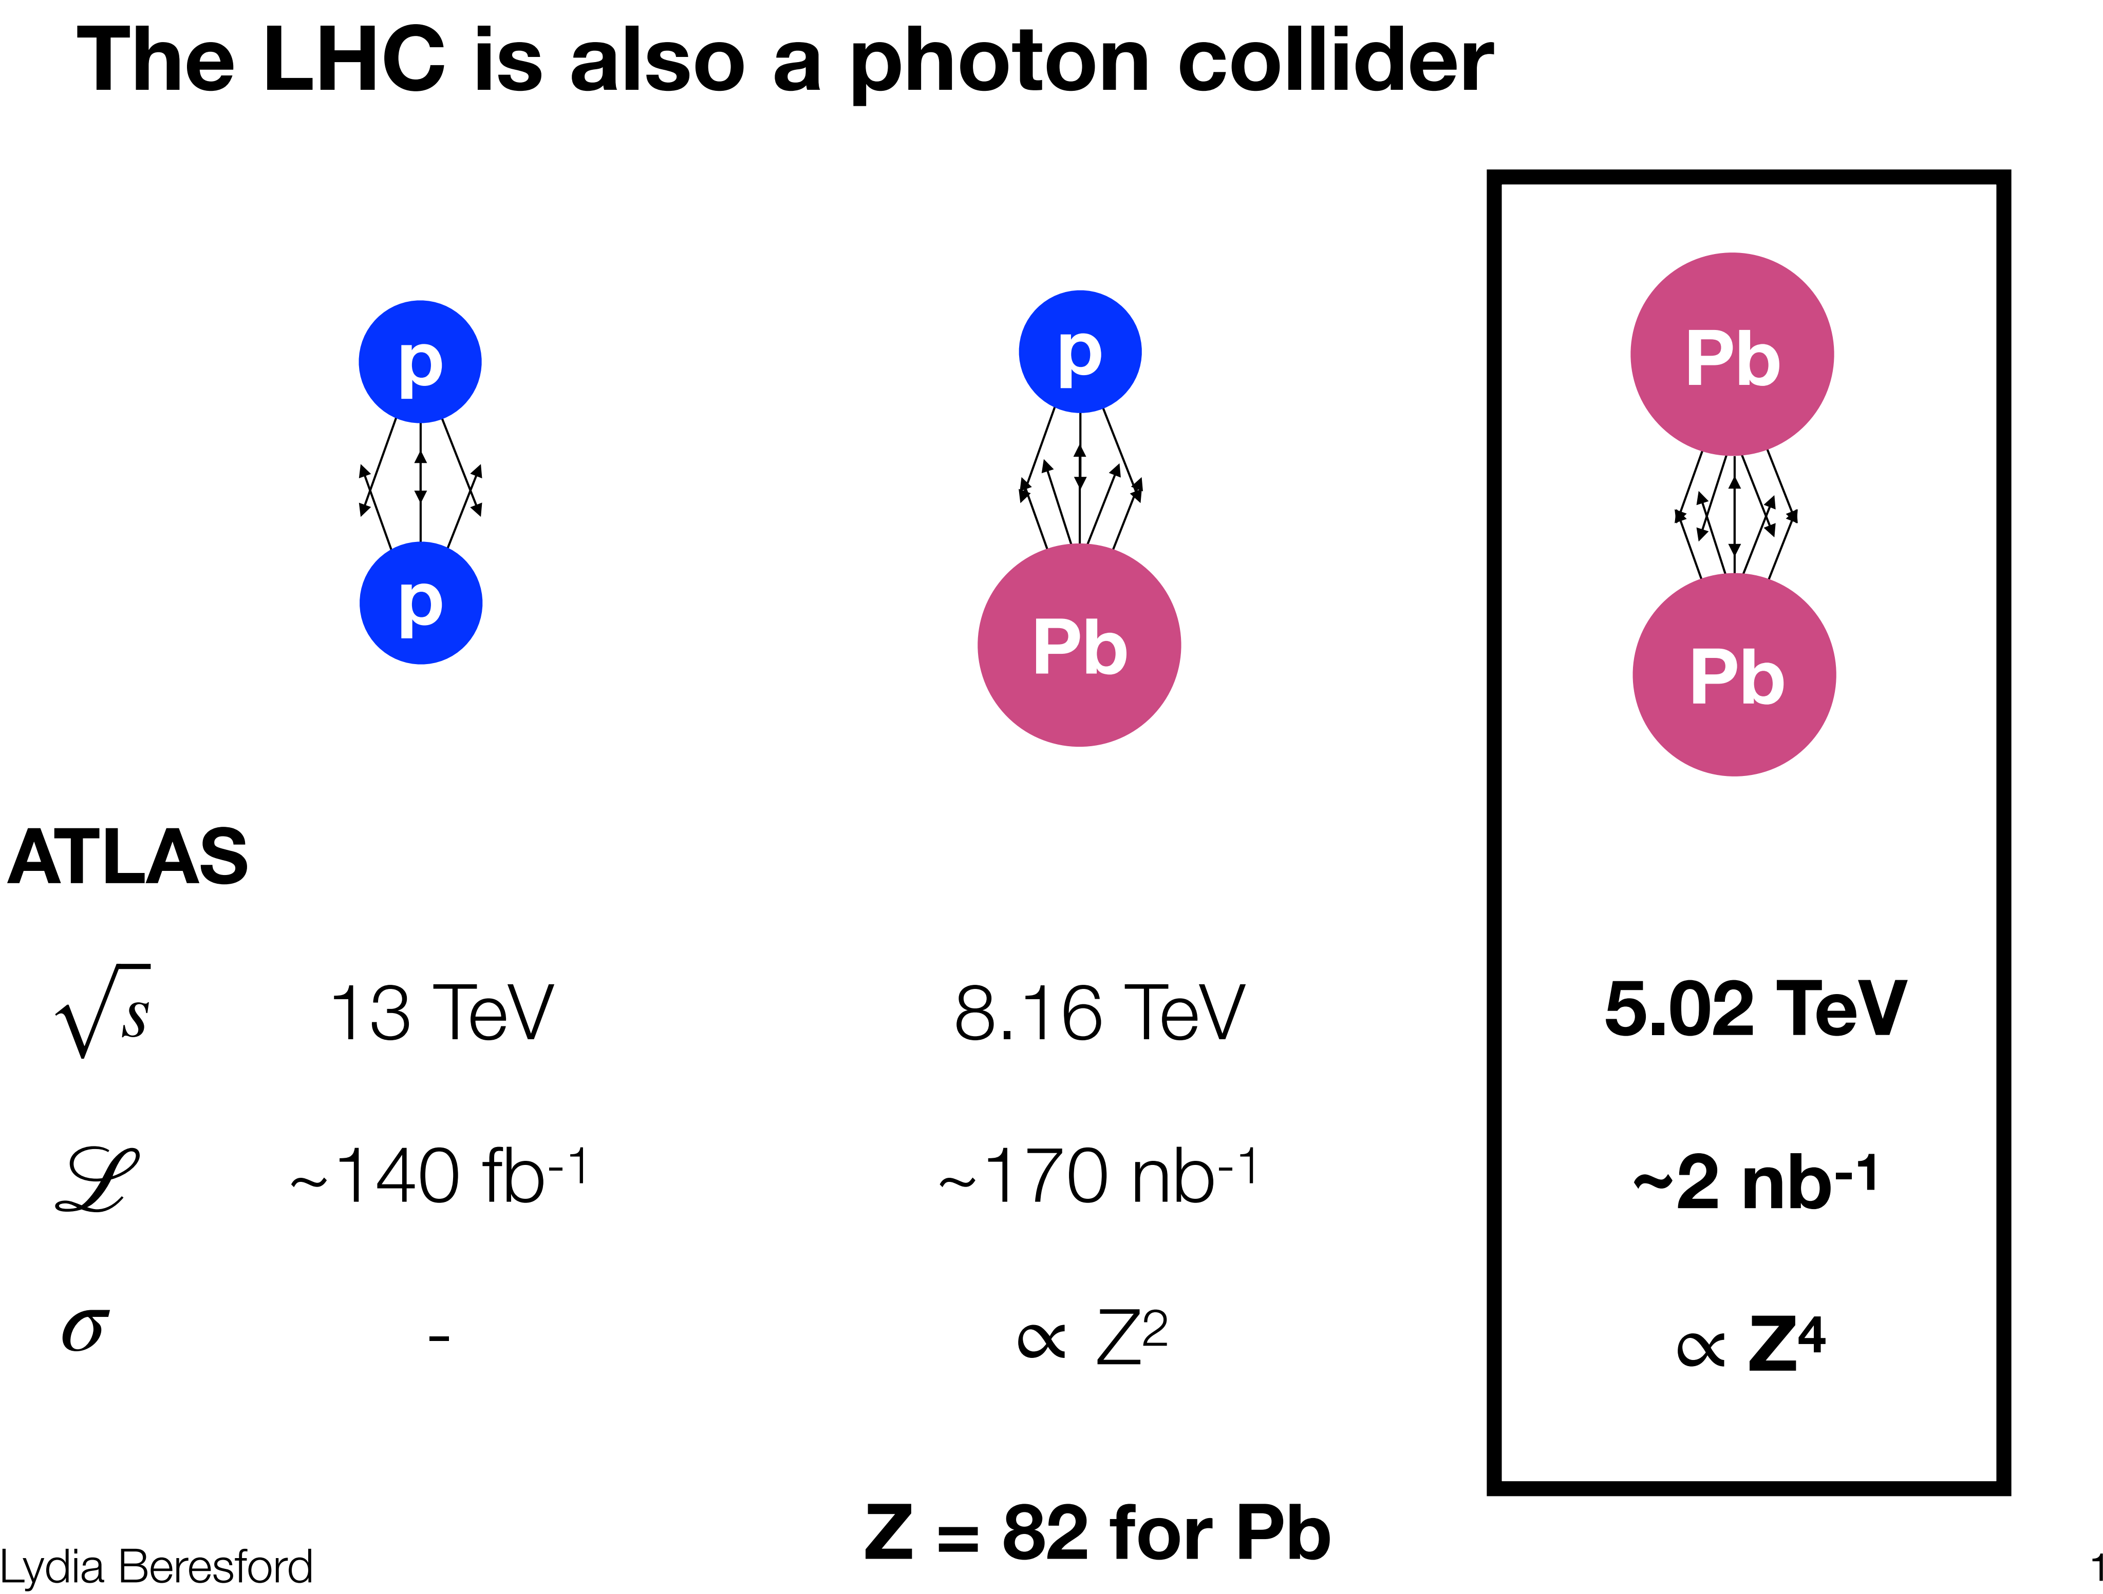

Slide 45
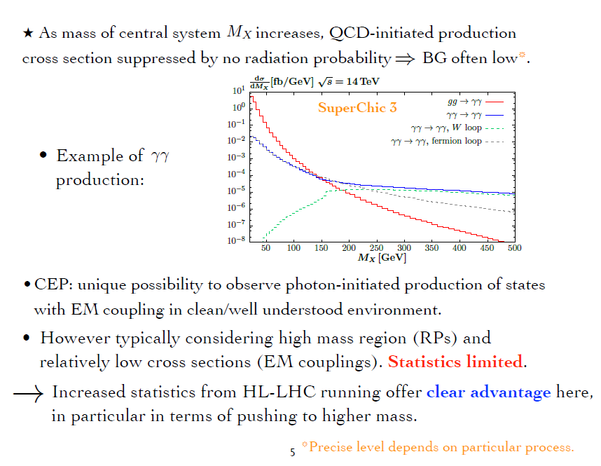
up to 1-2 TeV
Currently, pure CEP studies at the LHC are dominated (also HIC-UPC)

Slide 46
STANDARD CANDLES

Slide 47
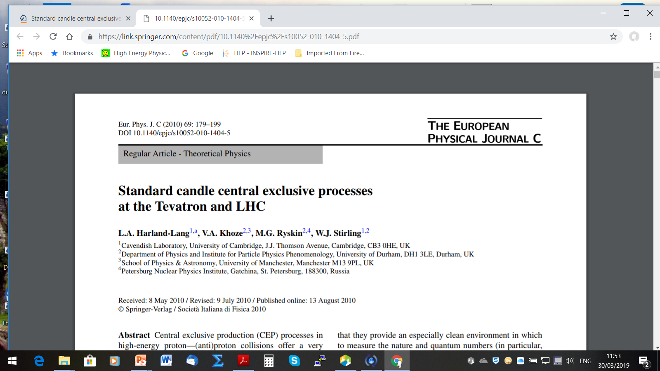

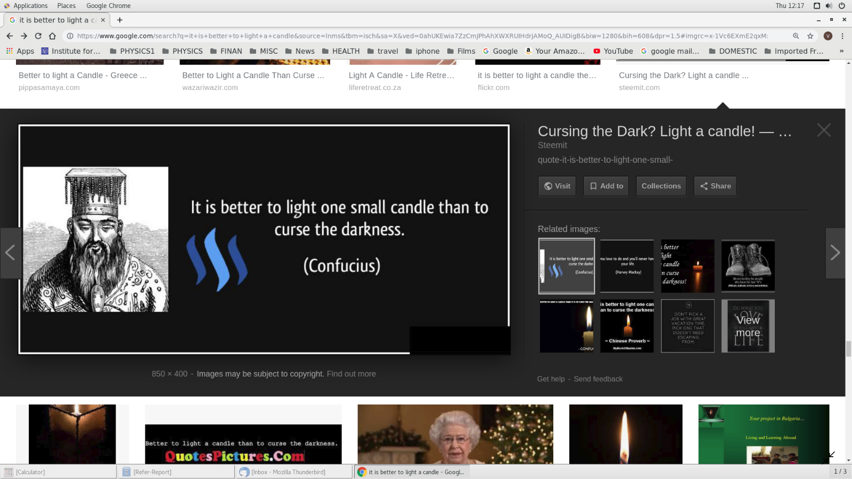


(spread of theory predictions)

Slide 48




( LHCb RG results)
and light

Slide 49
T. Aaltonen et al. (CDF Collaboration), Phys. Rev. Lett. 108, 081801 (2012)
43 events
Et>2.5 GeV
(KMRS-04)
(HKRS-10)
proved to be very small (CDF) ( in agreement with expectations)

Slide 50
RC-numerically suppressed
KMR-01
(Tumanov-1953,A. Alekseev-1958-positronium)
Glueball Filter ??

Slide 51


CDF
PRD-2008
D0-2010
Visualization of QCD Sudakov formfactor
Durham

Slide 52

Dimeson SAGA

Slide 54
40 diagrams (4 basic)


Slide 56
is this easy to understand ?
Was popular (among the more formal community) MHV- technique
Nowadays the enthusiasm has a bit faded away- other approaches

Slide 58


Slide 60


extracted from the transition form factors Fη(′)γ(Q2)

Slide 61
OTHER SELECTED CEP TOPICS

Slide 62


✴

Slide 63


Slide 64



EXCLUSIVE JET PRODUCTION
(CDF-2008)

Slide 65
SuperChic-2

Slide 66
Sphaleron-transition on top of an energy barrier

Slide 67
(Phys.Rev.D 68 (2003) 034001)
hep-ex/0205037
It may make sense to repeat this measurement at the LHC/RHIC ?
KKMTR, 2001-2002

Slide 68
Instantons have never been observed experimentally, however, they are
playing a very important role in the theoretical models of confinement and
chiral symmetry breaking
(V.Yu.Petrov, M.G.Ryskin)
one of the biggest challenges for particle physics to date
‘soft bombs’ –high-multiplicity spherically symmetric distributions of relatively soft particles
Extended objects in space-time
Effectively –a family of new multiparton vertices in Feynman diagrams

Slide 69
KKMRT-2021-2022
dominates
KMR-like
✶ Detecting two outgoing protons would allow placing an upper limit on Instanton mass.
✶
(‘hermiticity’)
state

Slide 70


Strong need for enthusiastic experimental experts to join the efforts, addressing such issues as detector effects, PU at high luminosity, and timing resolution…..
One of the main obstacle currently – PU at high luminosity
Possible directions for further studies
✵
Feasibility of searches for moderate mass Instantons in UPC
✵
Using good timing from Central Detectors for both ST and DT events.
✵
Identification of charm quark jets in the final state

Slide 71


Forward Proton Tagging significantly could extend the physics reach of the ATLAS and CMS detectors by giving access to a wide
range of exciting new physics channels.
FPT has the potential to make measurements that are unique at LHC.
FPT could serve as a spin-parity analyser and offers a sensitive probe of the CP structure of the new states.
There are a number of important measurements to be performed in the RG environment at LHCb and ALICE at low
μ.
The theory of the CEP is in a reasonably healthy shape,
and dedicated MCs (such as SCs) are well developed
The predictions are backed by the series of CDF/D0 CEP-like measurements as well
as the RAP GAP measurements by the LHCb and ALICE +CEP results from ATLAS& CMS

Slide 72
The dedicated AFP and PPS detectors allow uinge the timing.
The main issue is PU suppression, though some progress is foreseen,
in particular with the addition of timing from the CD.
But ATLAS has already decided not to run AFP at HL-LHC
(at least not in the foreseeable future)
10ps in Run 4
At large M_{Mmis}> 150-200 GeV the photon-photon fusion dominates
over the gg. LHC is the photon-photon collider!
Such important measurements as the searches for the new Higgs-like states
(e.g. resolving the 96 GeV puzzle) , as well as the moderately-heavy instantons, would require
the 420 m stations.
The bulk of important physics (such as glueball,instantons and other new
state searches) would require low luminosity runs.

Slide 74
Review: Int.J.Mod.Phys.A 29 (2014) 28, 1446014
PRE-LHC CEP STUDIES
new CDF dipion results

Slide 75


Slide 76


Slide 77



$$β$$
$$β$$
$β∗$distance from the IP to the point where the transverse area of the beam is twice as wide as that at the IP.

Slide 78


Slide 79



The ratio of high Et dijets in production with one and two rapidity gaps. CDF
CDF results on exclusive charmonium CEP, (CDF, PRL-09)
Hopes to continue with HERSCHEL

Slide 80
Pre-LHC studies
review: A. Kirk.
1408.1196[hep-ex]
1408.1196

