Slide 1
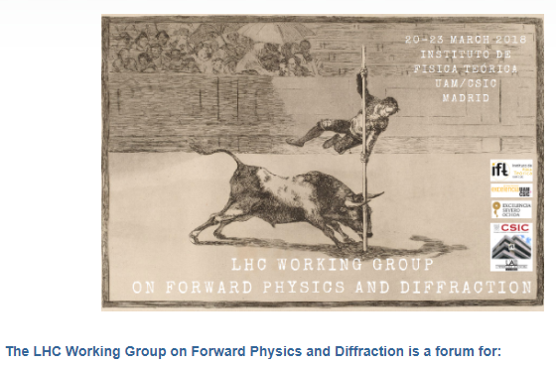
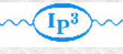

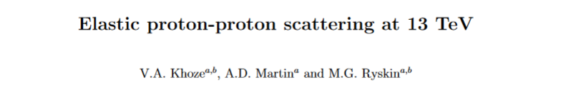
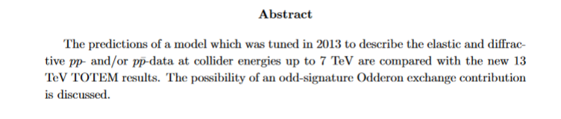

Elastic proton-proton scattering at 13 TeV in the theoretical perspective
Valery Khoze (IPPP, Durham & PNPI, St.Petersburg.)
(in collaboration with Alan Martin and Misha Ryskin)
 | arXiv:1712.00325- revisited

Slide 2
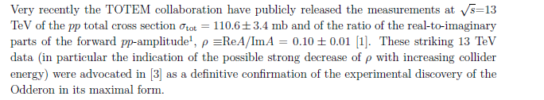
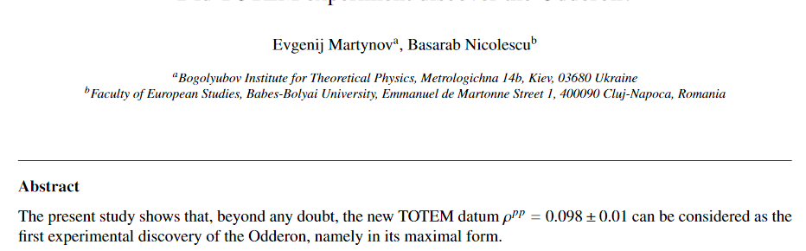
(Valentina’s talk)
(MO)
(Evgenij’s talk)
arXiv:1711.03288

Slide 3
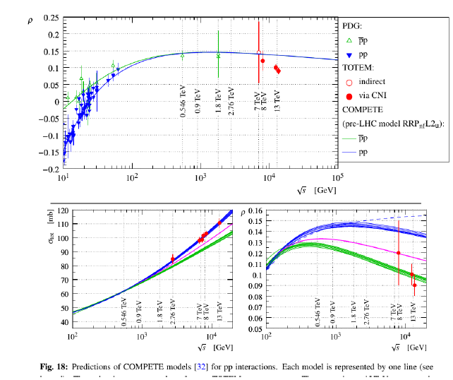


Slide 4
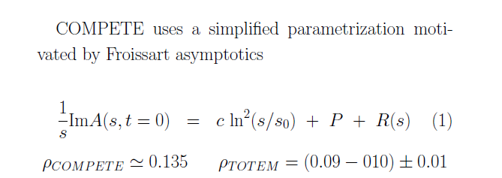
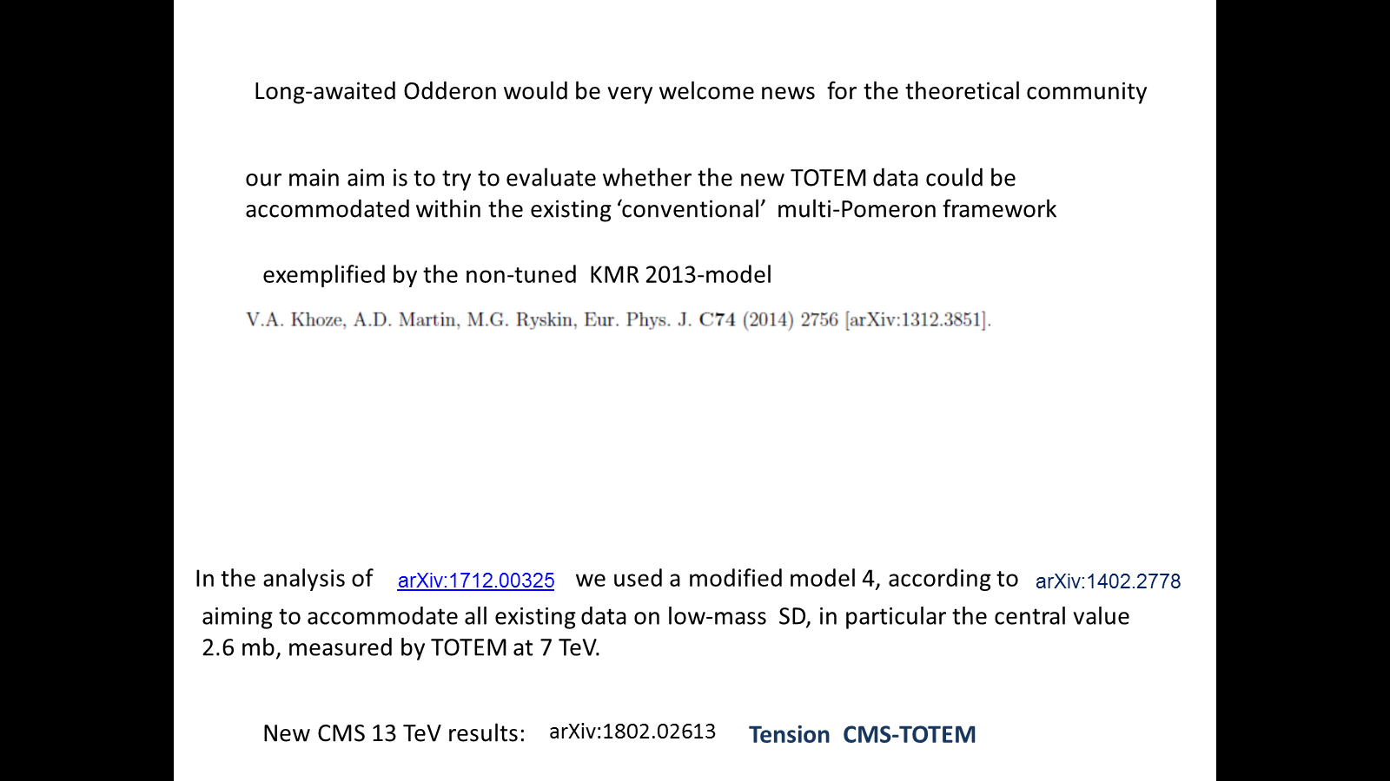
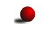

=110.6 mb
Tension in CMS-TOTEM data

Slide 5






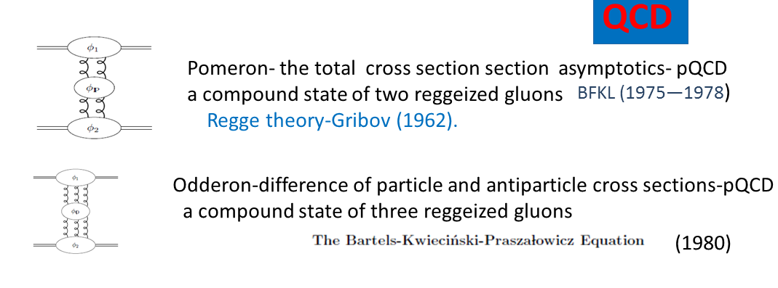
Not a MUST !
Odderon in asymptotic theories , L .Lukaszuk , B.Nicolescu-1973
BKP
Until very recently no firm experimental observation

Slide 6
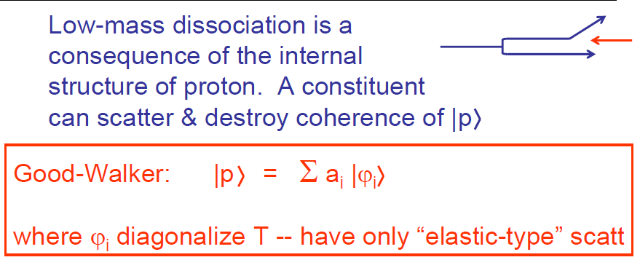
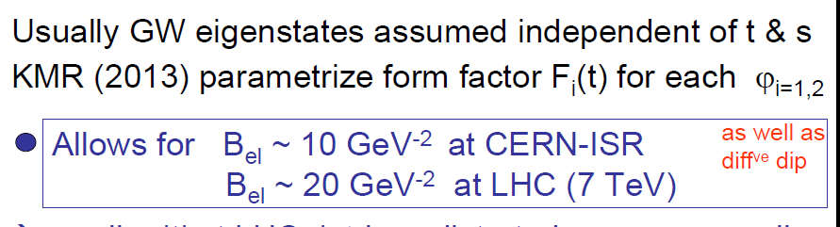
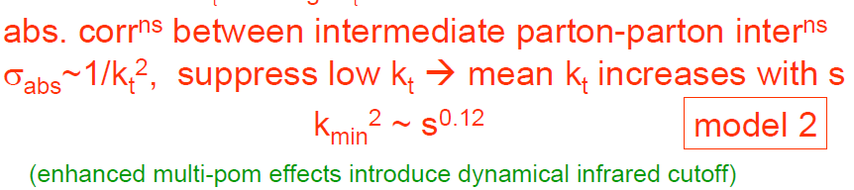

KMR-2013
Models (1-4)
(1960)
0.28
✶ Conventional RFT assumed all limited and small.

Slide 7
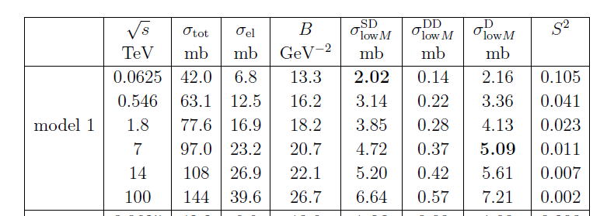

Slide 8
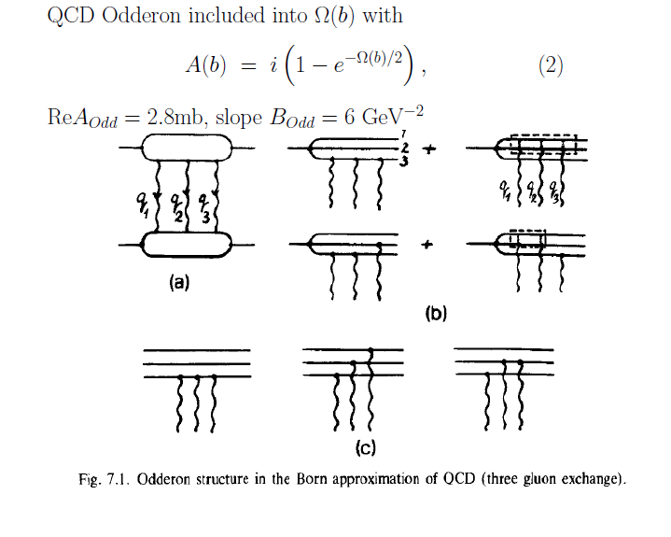
Simplified Model for Odderon:
E.M. Levin, M.G. Ryskin, Phys. Rept. 189 (1990) 267 (sect.7).
general solution of unirarity equation
Absorptive effects

Slide 9





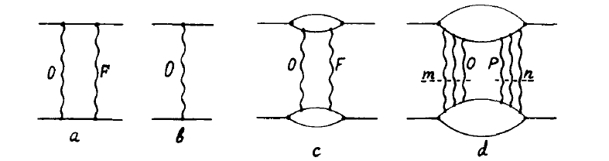



~


Decreases the Odderon contribution
Asymptotically Pomeron → black absolutely absorptive disc

Slide 10
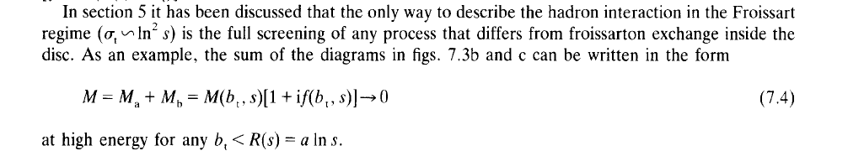
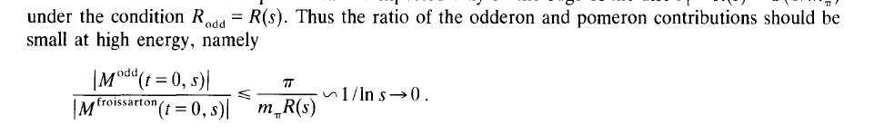

Slide 11
Non-tuned 2013 predictions, model 1
TOTEM-2017 data

Slide 12
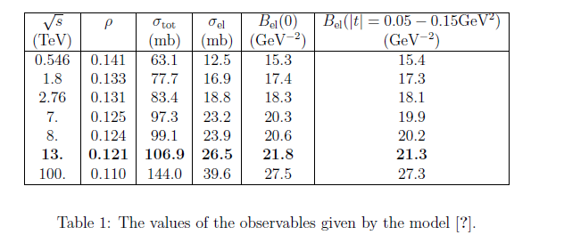

1.
TOTEM
results
=
Model 1- 4.72 mb at 7 TeV

Slide 13
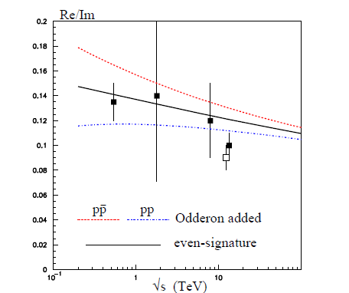
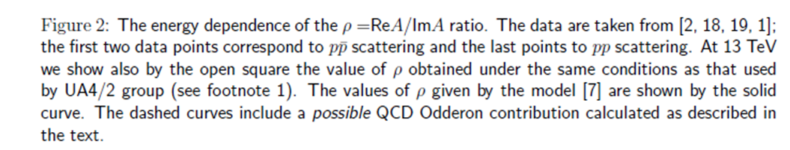

Slide 14
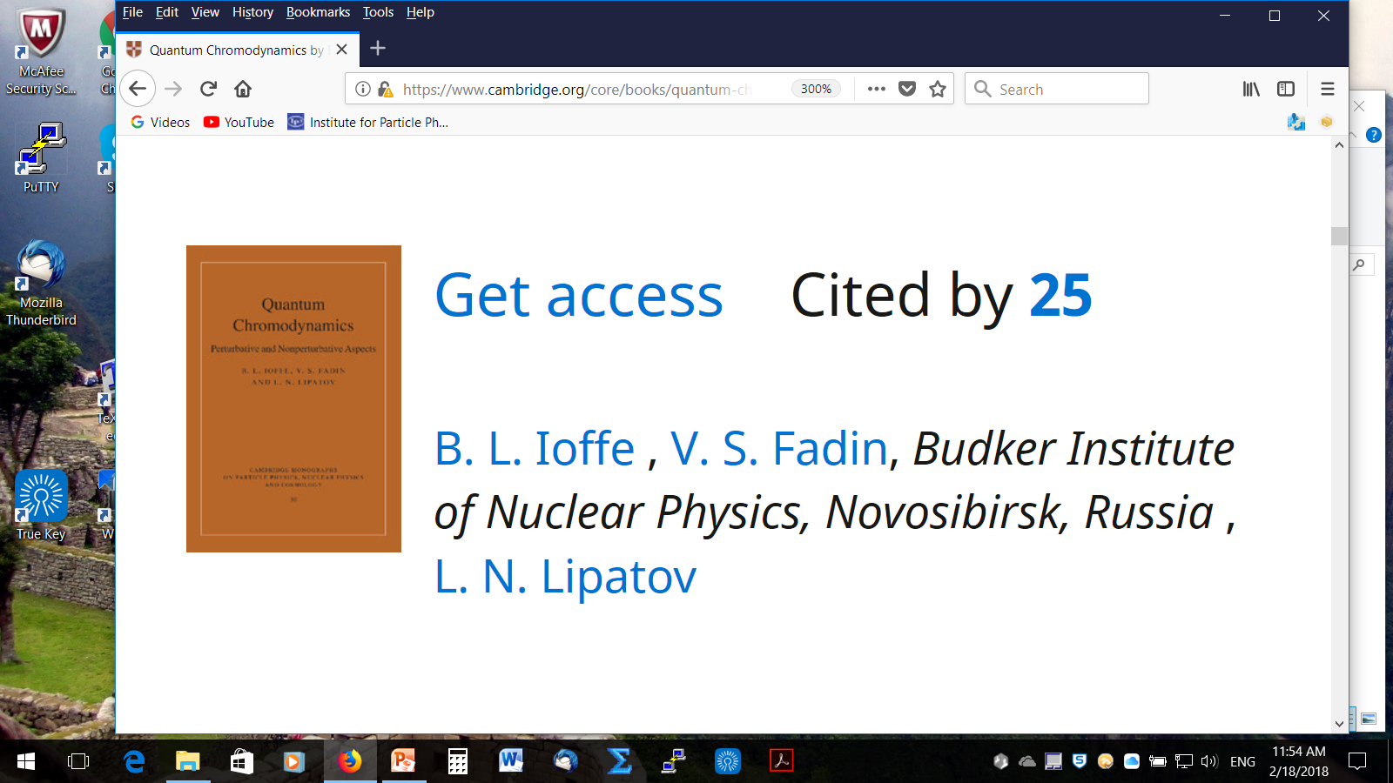
ODDERON-1973 –asymptotic theorems
1975
MO
z=
QCD
Very intensive theoretical discussions :
reviews

Slide 15
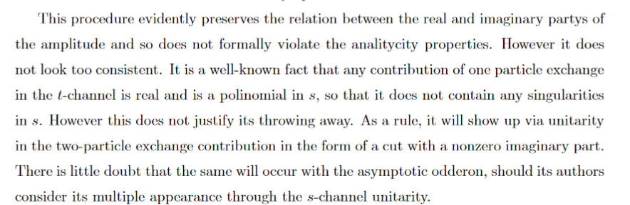
Some comments on MO
■
M. Braun, hep-ph/9805394
■
In CGC models the odderon contribution is decreasing with energy due to saturation effects
For example
■
Problems with the multi-particle unitarity: KMR-17

Slide 16
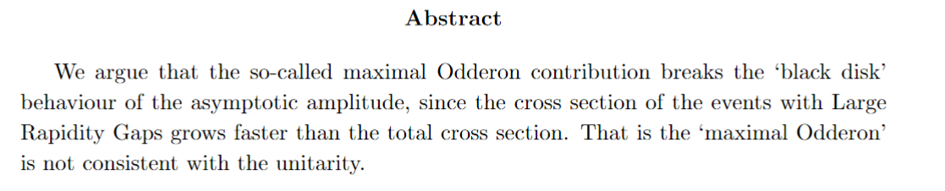

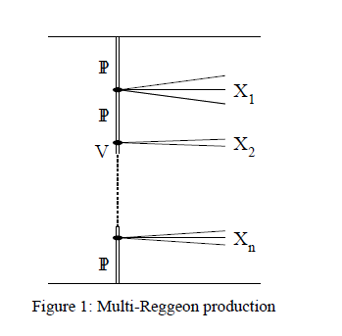


KMR arXiv:1801.07065
Black disk, maximal Odderon and unitarity
■
Finkilstein-Kajantie disease

Slide 17
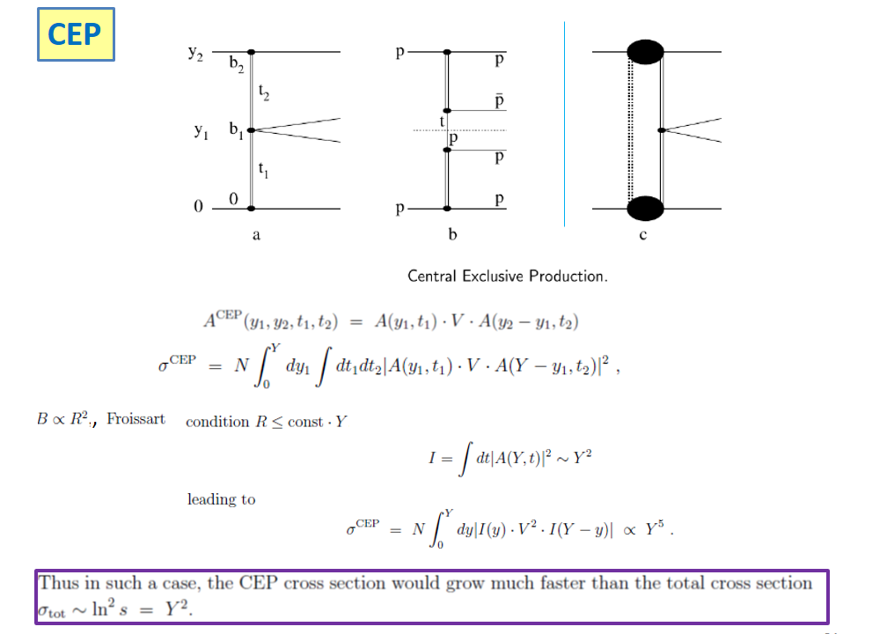

Slide 18
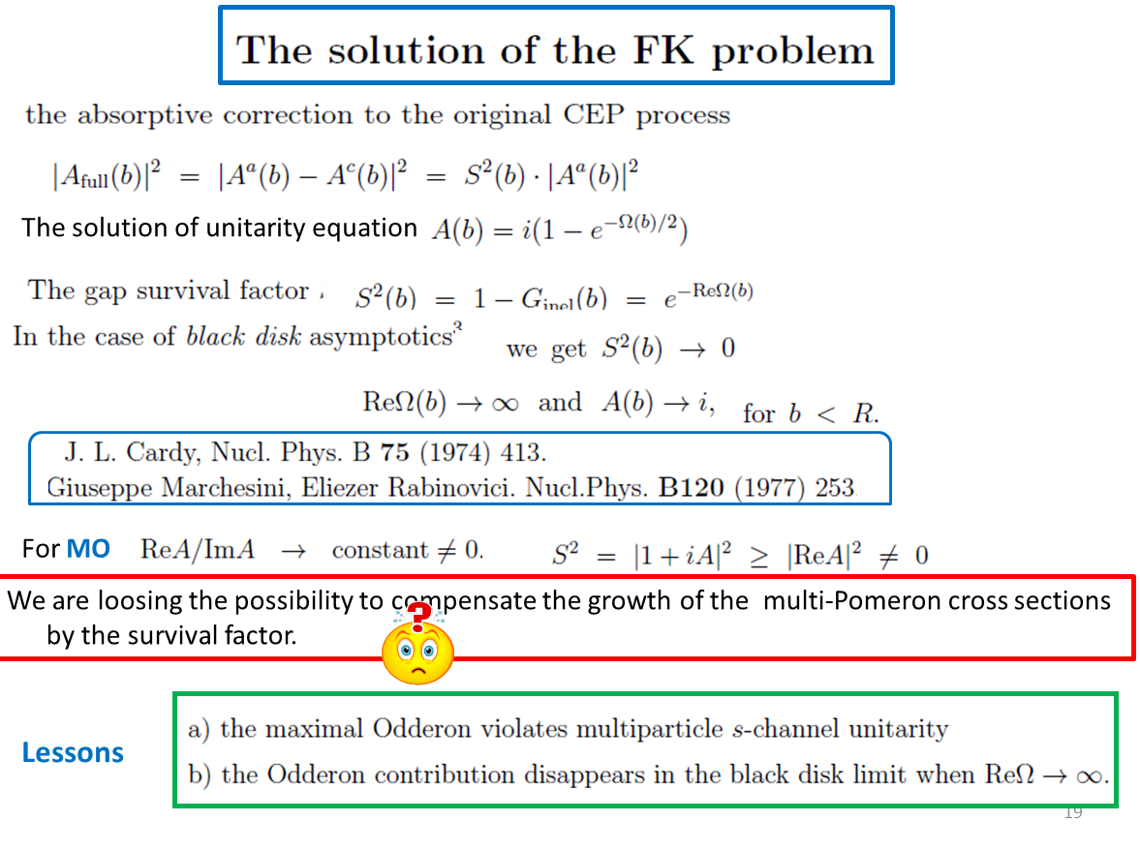
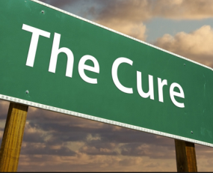

Slide 19


Preliminary conclusions
Either the total cross section above 13 TeV starts slowing down or
there is a sizeable Odderon contribution at 13 TeV .
New precise data on Re/Im at 7-8 TeV and
especially at 0.9 TeV would be very useful.
The possible Odderon contribution at 0.9 TeV could be quite significant.
High statistics TOTEM data on elastic cross-section
in the dip-bump region are very welcome.
In order to resolve a tension between the Totem and CMS results
on low mass SD more experimental studies are needed.
(Per’s talk)
The data at 540 GeV strongly restrict the Odderon contribution.

Slide 20


