Slide 1

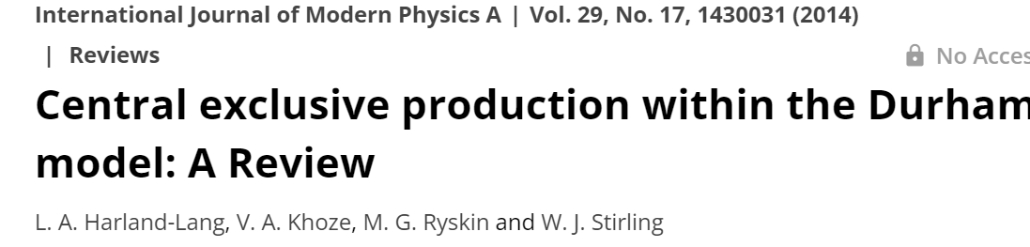
CENTRAL EXCLUSIVE PRODUCTION @ LHC
(selected topics)
Valery Khoze
DISCLAIMER
With a bit of personal flavour
What and what for to measure (in the spirit of LR-KHOLERA – Leningrad –mid-seventies,
rather than how to calculate

Slide 2
ISR, SPS
RHIC at 200, 500 GeV
■ Limited statistical precision
(28 candidate signal events, M<2GeV)
Not sufficient sensitivity to discriminate the theor. models (used DIME , GenEx)
■
■ Very promising potential to measure CEP using FD@LHC

Slide 3
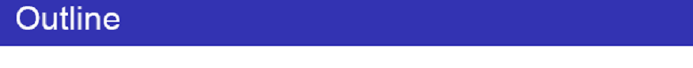
Introduction (why we are interested in CEP processes?)
CEP and RAP GAPS.
QCD-induced CEP mechanism.
CEP as a spin-parity analyzer
‘Diffractive Higgs’ revisited.
Standard Candle CEP reactions and experimental tests.
Gluon –gluon vs photon-photon fusion.
Dimeson Saga.
Other selected CEP topics
Summary and Outlook
‘
Summary and Outlook.

Slide 4
CEP and RAP GAPs

Slide 5
Yu.L. lectures
LRGs caused by Pomeron,
photon (W,Z) or Odderon exchanges

Slide 6
ALFA/TOTEM
(Radiation tolerance)
Threshold scan.

Slide 7

AFP/PPS
(LHC run I)

Slide 8
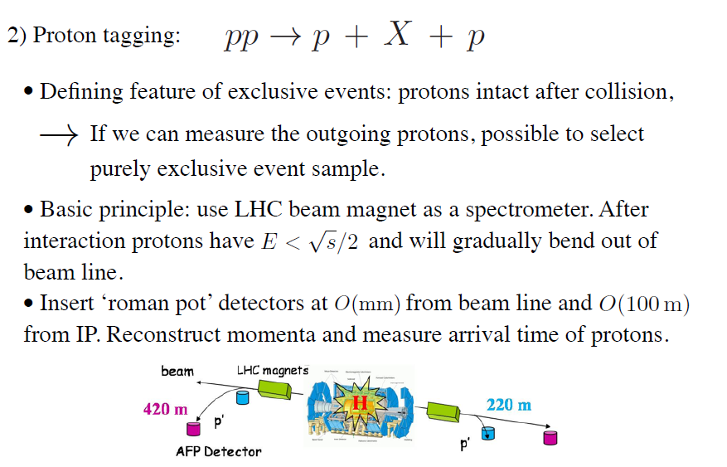
The LHC is an excellent mass spectrometer
CT-PPS,

Slide 9

ALFA
TOTEM & ALFA
CMS/PPS & ATLAS/AFP
ALFA
ALFA/TOTEM- radiation tolerance → low PU special runs

Slide 10
AFP & PPS
Standard HL runs. With precision tracking and timing detectors.

Slide 12
Pre-LHC studies
review: A. Kirk.
1408.1196[hep-ex]
1408.1196

Slide 13
PRE-LHC CEP STUDIES

Slide 14
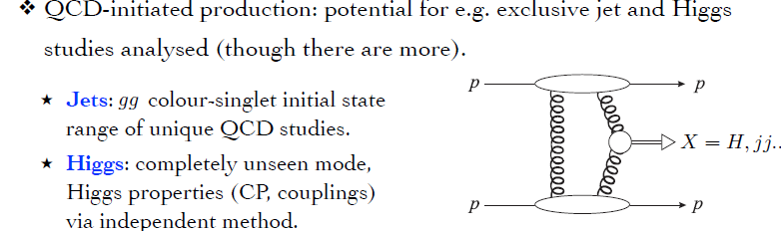
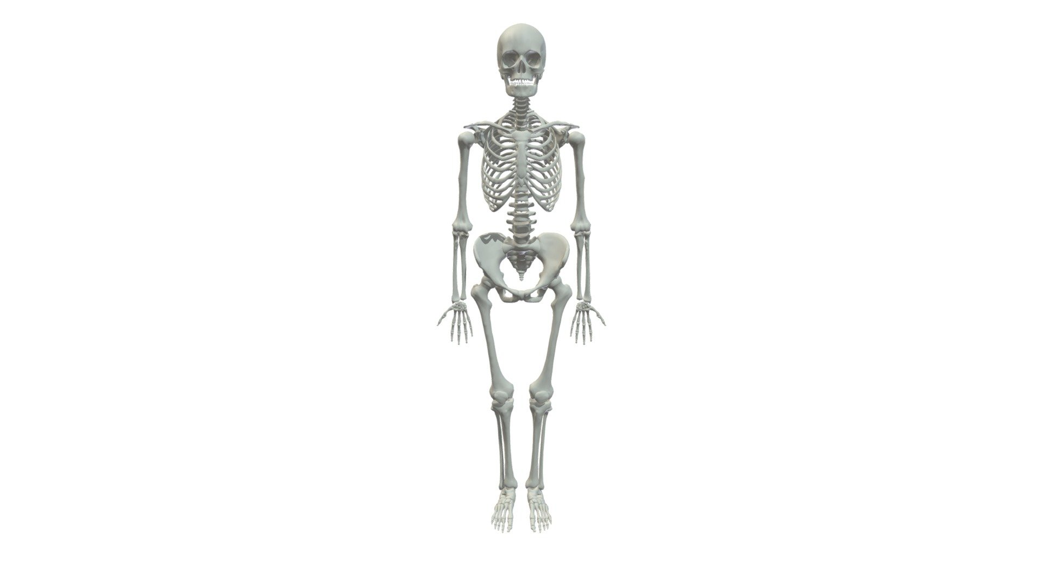
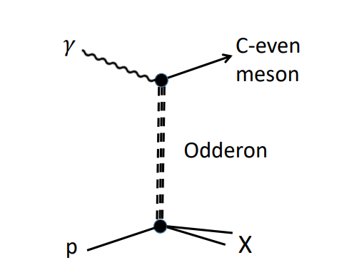
This Photo by Unknown Author is licensed under CC BY

Slide 15
QCD-induced CEP

Slide 17
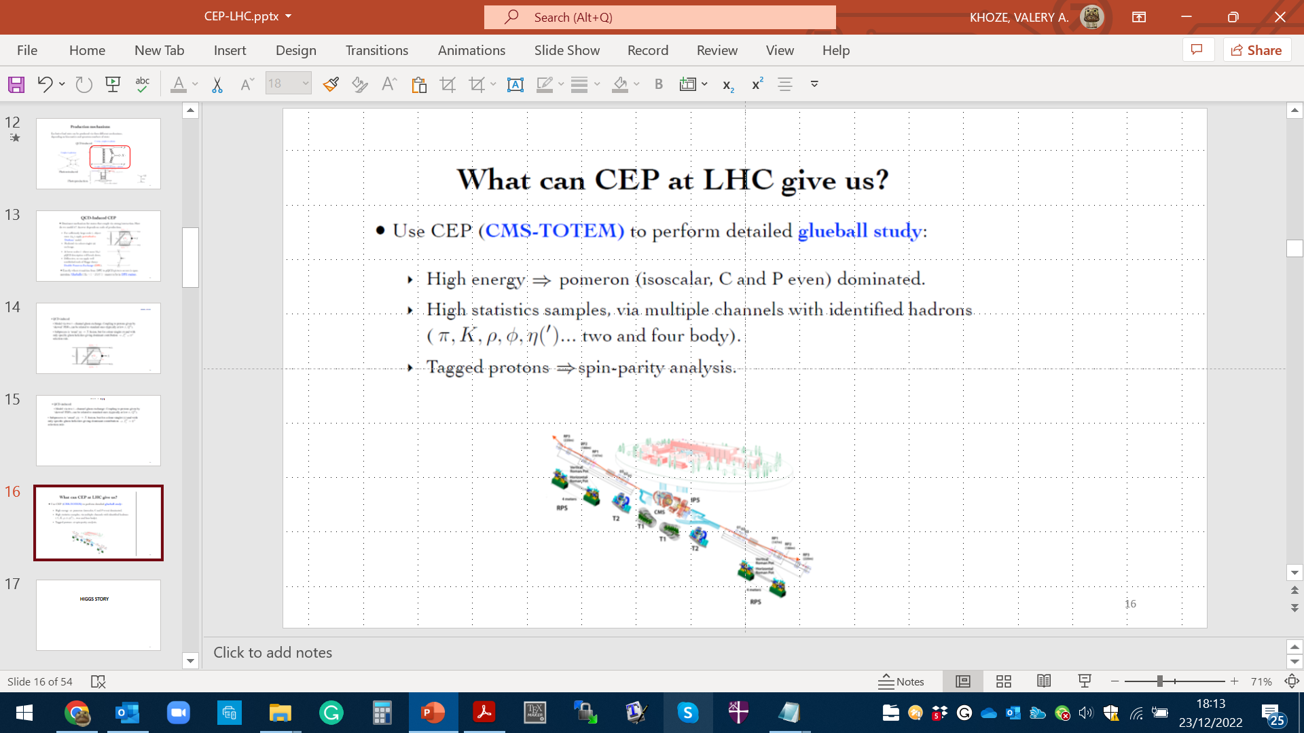
KMR-2000

Slide 18
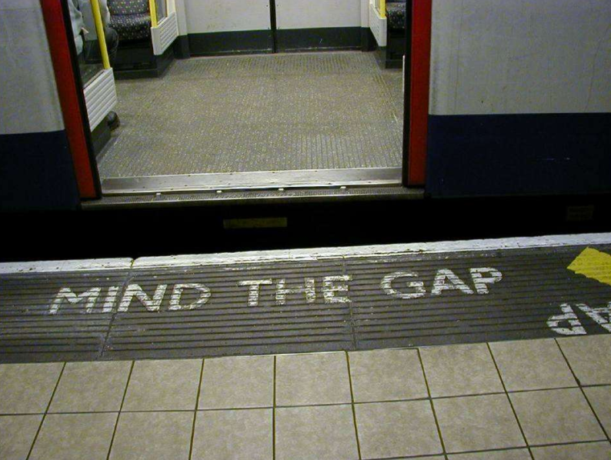

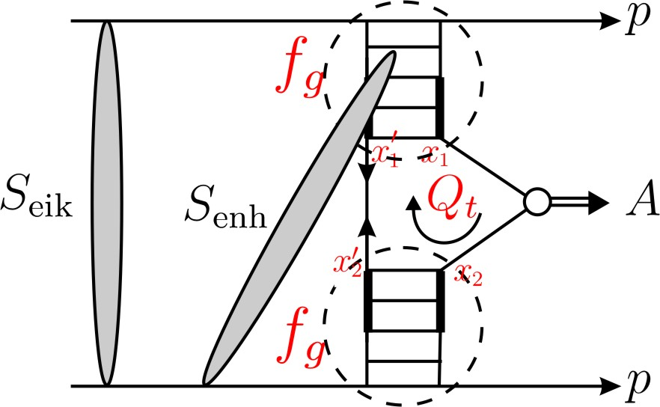
“soft” scattering can easily destroy the gaps
S² ➔ absorption effects -necessitated by unitarity
gap
M
gap
Eikonal rescatt: between protons
Semi-enhanced rescatt: involving intermediate partons
1 >
≫

Slide 19

Process dependence
First fully differential implementation of soft survival factor – SuperChic -2 MC
event generator- HKR, ArHiv:1508.02718
SC-(3-4)

Slide 20
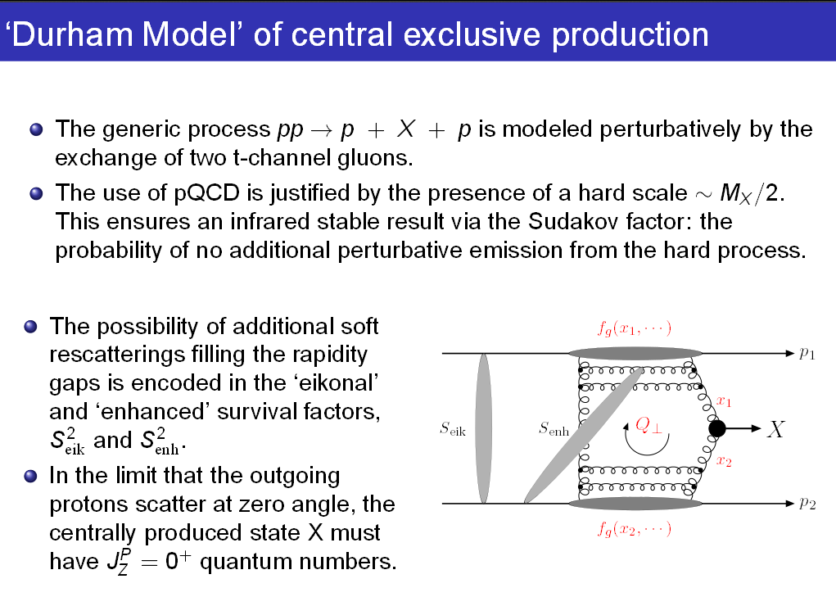
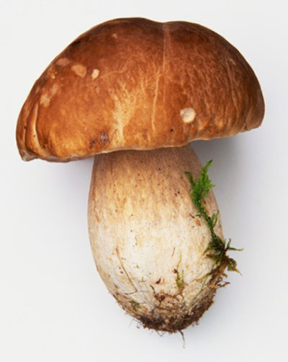

Slide 23
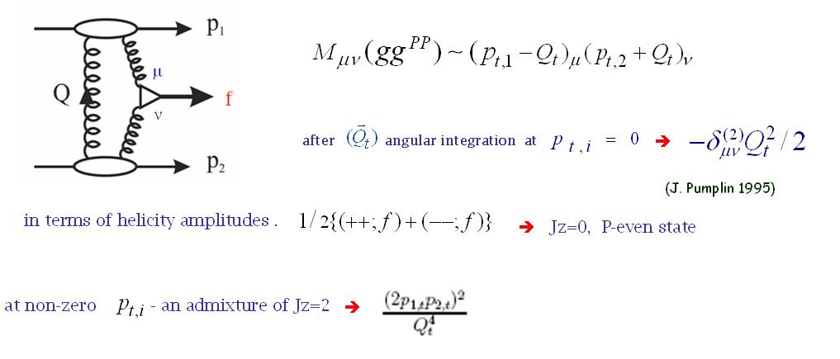
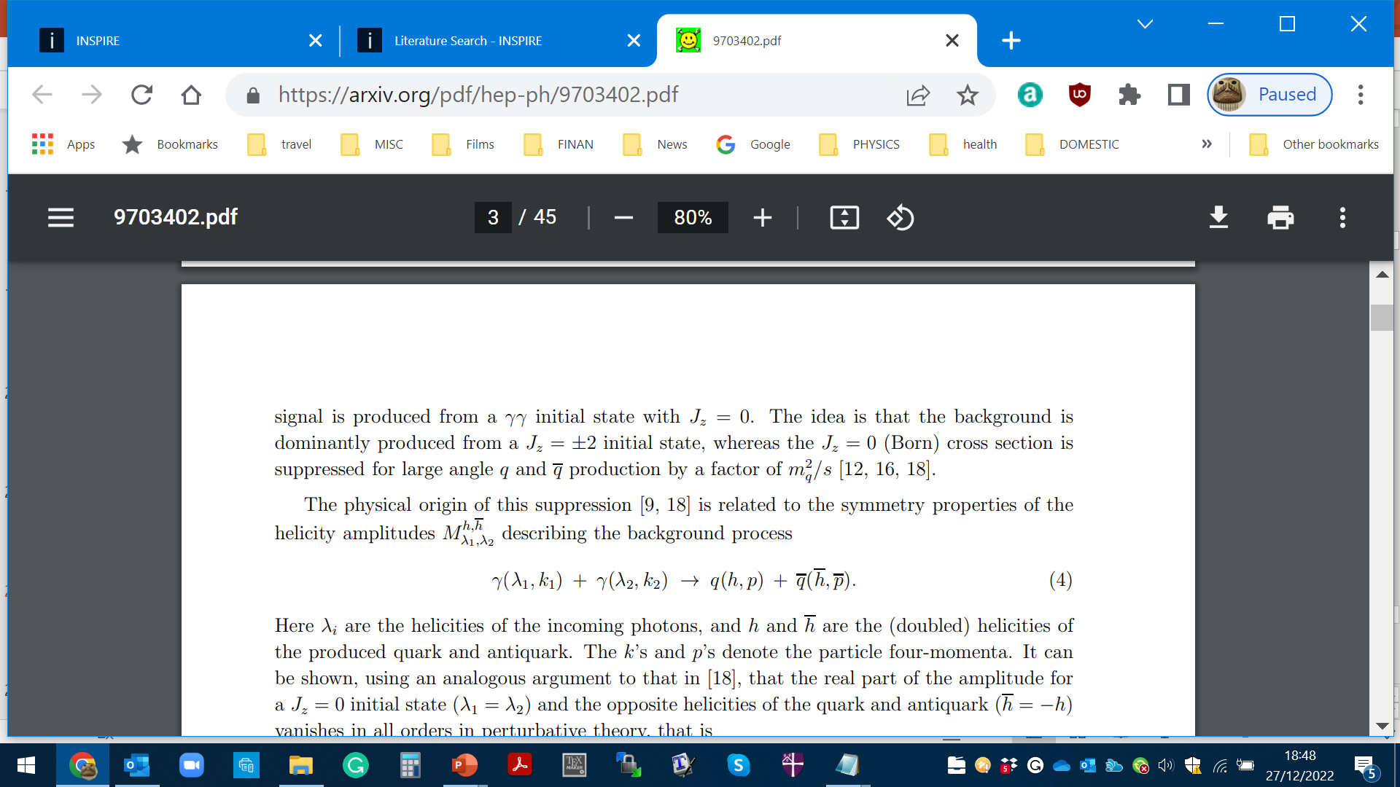
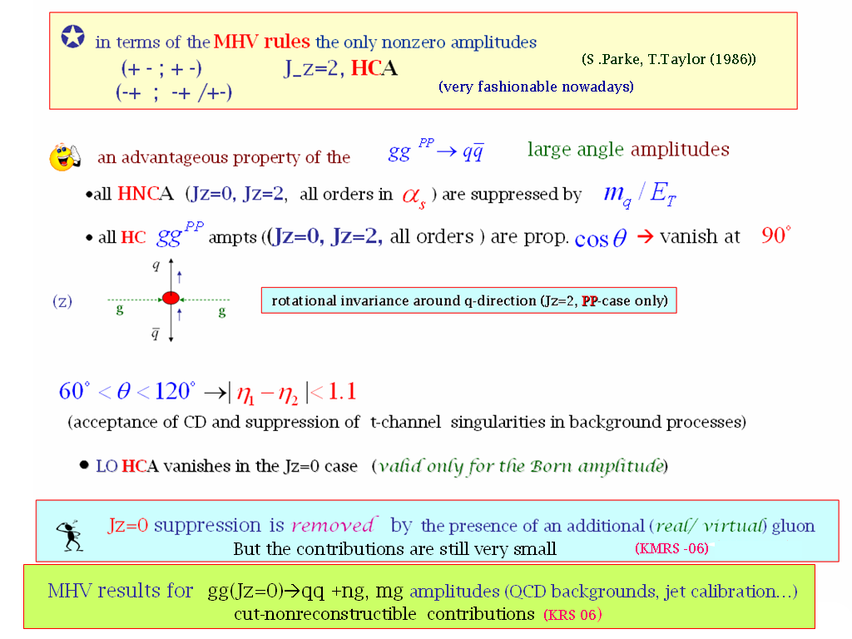
Symmetry properties of the amplitude (FKM-97)
gg→qq

Slide 24
CEP AS A SPIN-PARITY ANALYZER

Slide 25
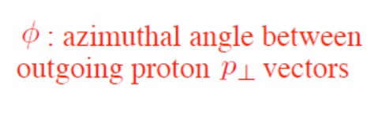
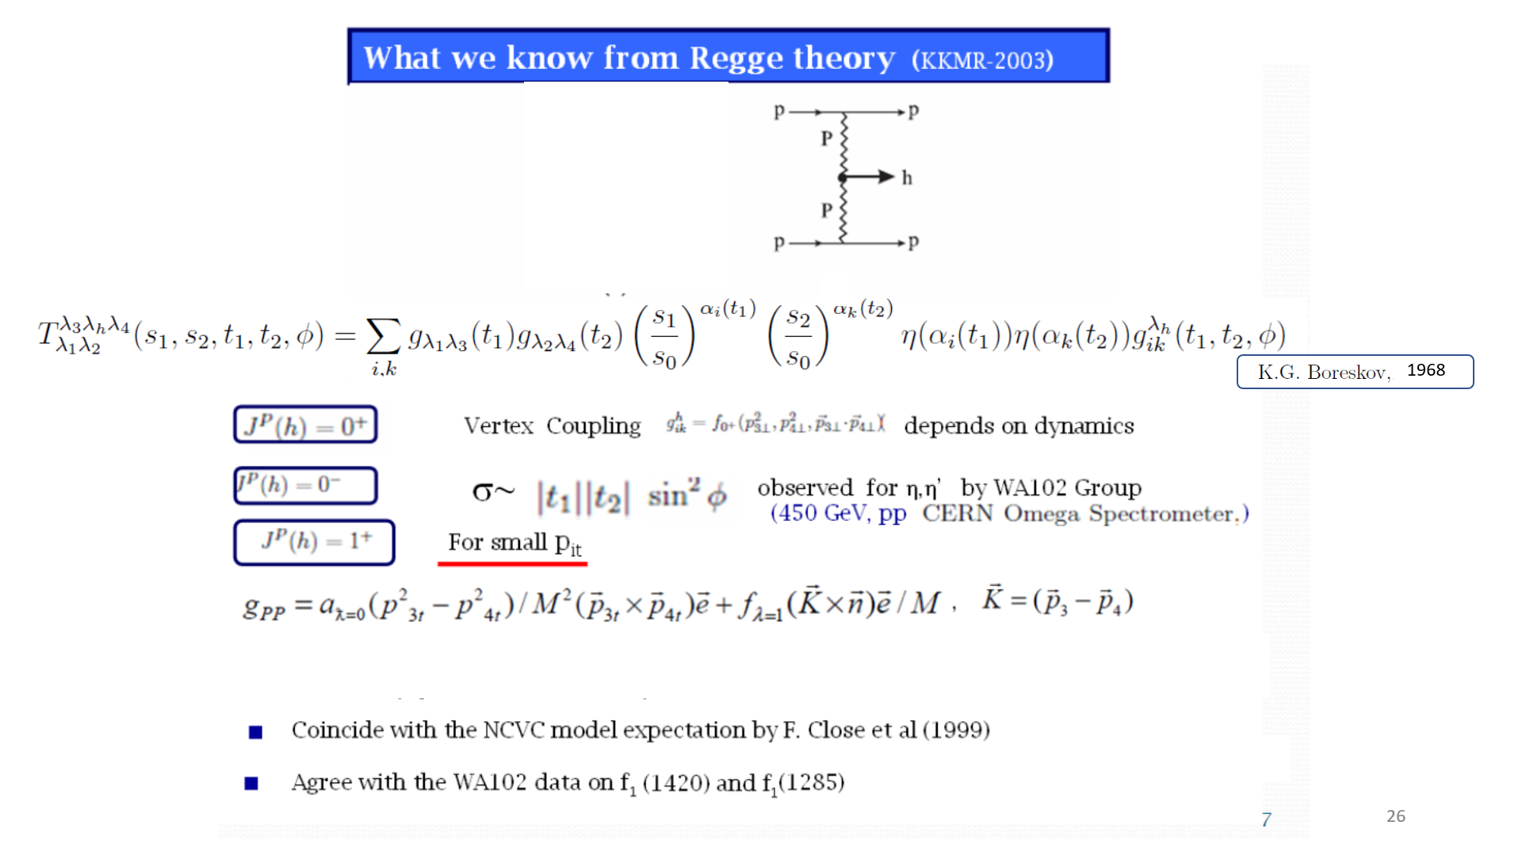
What is known from Regge Theory (KKMR-03)
K.Boreskov, 68
Kaidalov. Karnakov, 66,70
,
,
,
Follows from general principles

Slide 26
Irrespectively to the decay products
HKSR-10
1966, 1970 ,
1968

Slide 27
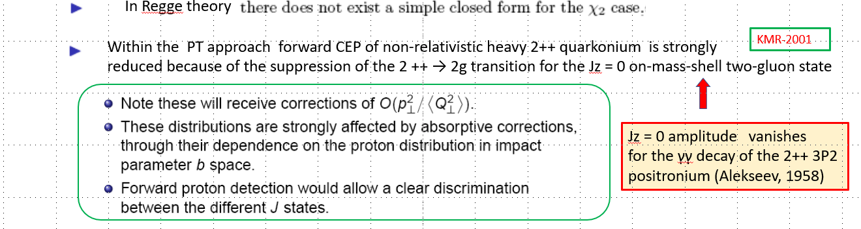
Jz = 0 amplitude vanishes
for the γγ decay of the 2++ 3P2
positronium (Tumanov, 53;Alekseev, 58)
Glueball filter ?

Slide 28
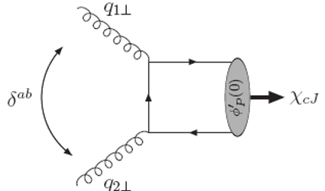
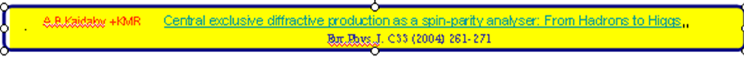
P_{t} ~(03-0.5) GeV

Slide 29
Life, Death and “Ressurection “ of ‘Diffractive Higgs’

Slide 30

Durham Group
1997-2013

Slide 31
Durham Group
1997-2013
SM Higgs- detectors at 420m needed

Slide 32
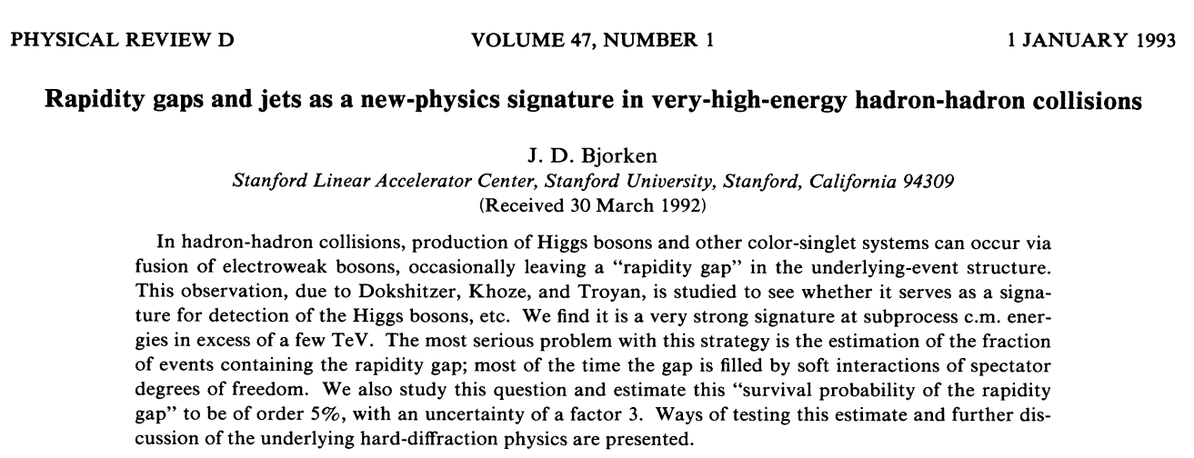
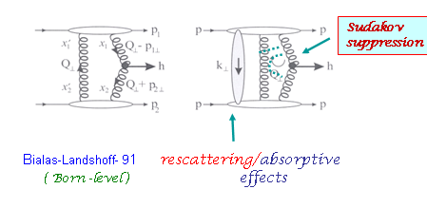
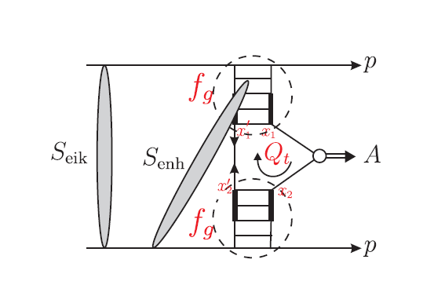
The basic ingredients of the Durham approach (KMR 1997-2000)
Interplay between the soft and hard dynamics
RG signature for Higgs hunting (Dokshitzer, Khoze, Troyan, 1987). Advanced and promoted by Bjorken (1992-93)
+ ….
h
Main requirements:
inelastically scattered protons remain intact
active gluons do not radiate in the course of evolution up to the scale M
<Qt> >>/\QCD in order to go by pQCD book
Further development (KKMR-01-04)
DKS-91 (PYTHIA MC)
- 4
σ(CDPE) ~ 10 * σ (incl)

Slide 33

High price to pay for such a clean exclusive environment:
σ _{H}(CEP) ~ 10
-4
∗ σ_{H}( inclus.)
A. Bialas and P.V. Landshoff, Phys. Lett. B256 (1991) 540.
Rapidity Gaps should survive hostile hadronic radiation
damages and ‘partonic pile-up ‘
Excitement of the Tevatron community-
symbolically W = S² T²
Theory spread of 11 orders
Colour charges of the ‘digluon dipole’ are screened
only at rd ≥ 1/ (Qt)ch
GAP Keepers (Survival Factors) , protecting RG against:
• the debris of QCD radiation with 1/Qt≥ λ≥ 1/M (T)
• soft rescattering effects (necessitated by unitarity) (S)
KMR 1997
Factor ~3 since then
Forcing two camels to go through the eye
of a needle
H
P
P

Slide 34
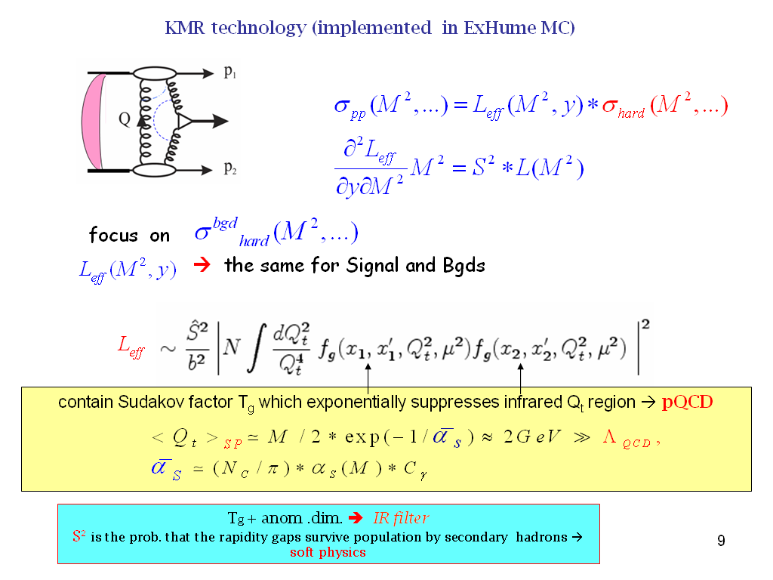
KMR technology
(KMR 1997-2000)
-4
σ(CEP) ~ 10 σ (incl)
schematically
DL

Slide 35
(1997-2000)

Slide 36
KMR-1997
Sudakov - probability not emitting gluons with
DL
∎
no infrared divergency
∎
∎
increases with mass M_{H} and
‘skewed’ unintegrated PDF

Slide 37
a bit outdated PDFs

Slide 38
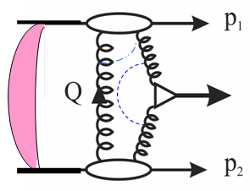

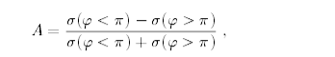
(
σ
φ < π
)
−
σ
(
φ > π
)
(
σ
(
φ < π
)
−
σ
φ > π
)
~p
∼
sin
~n
·
(
~p
×
)
φ
The main advantages of CEP Higgs production
• Prospects for high accuracy (~1%) mass measurement
(irrespectively of the decay mode).
• Quantum number filter/analyser.
( 0++ dominance;C,P-even)
 H ->bb opens up (Hbb Yukawa coupl.) 0
(gg)--,++  bb in LO ; NLO,NNLO, b- mass effects – controllable. M(+++-)=(M---+)=0
 For some scenarios CEP may become a discovery channel 😐
• A handle on the overlap backgrounds- Fast Timing Detectors (10-20 ps timing or better).
 New leverage –proton momentum correlations (probes of QCD dynamics , CP- violation effects…)
H
A
=
BSM
Triple product correlation:
Integrated counting asymmetry (~10%)
0
1
⊥
2
⊥
φ < π
σ
(
) +
σ
(
φ > π
)
=
A
σ
(
φ < π
) +
σ
(
φ > π
)

Slide 39
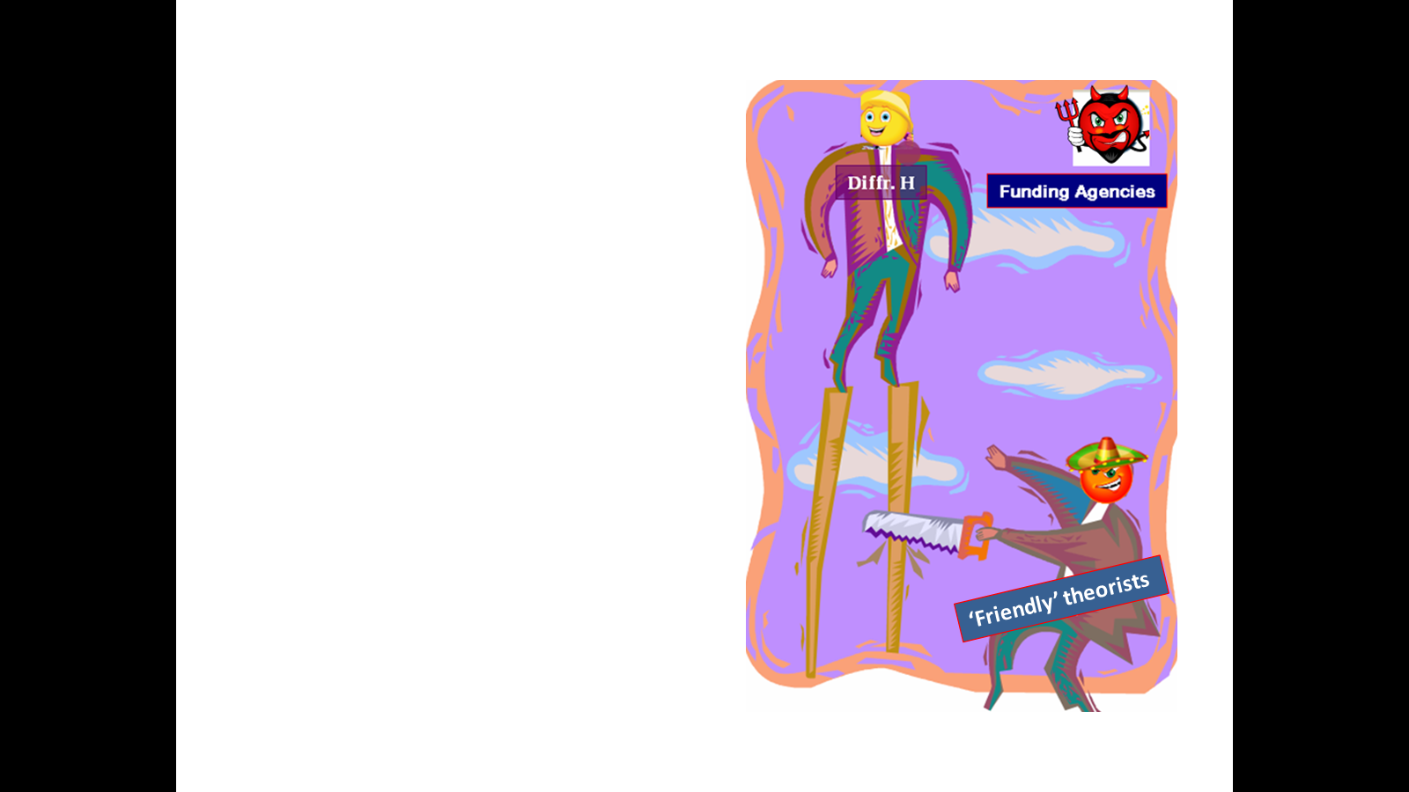
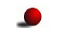
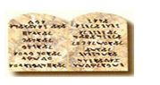
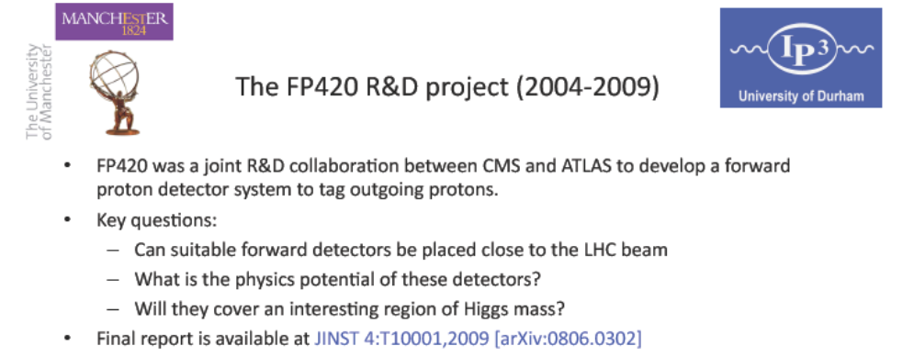
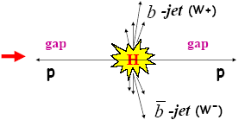
FP420 and Resurrection of ‘Diffractive HIggs’
(25 years on)
searching for lower mass new objects in CEP requires far away (~400m) FDs
Thou shalt not annoy machine people.
96 GeV-’light Higgs’ indications
PPS/AFP- new proposals

Slide 41
Photon vs Gluon fusion

Slide 42
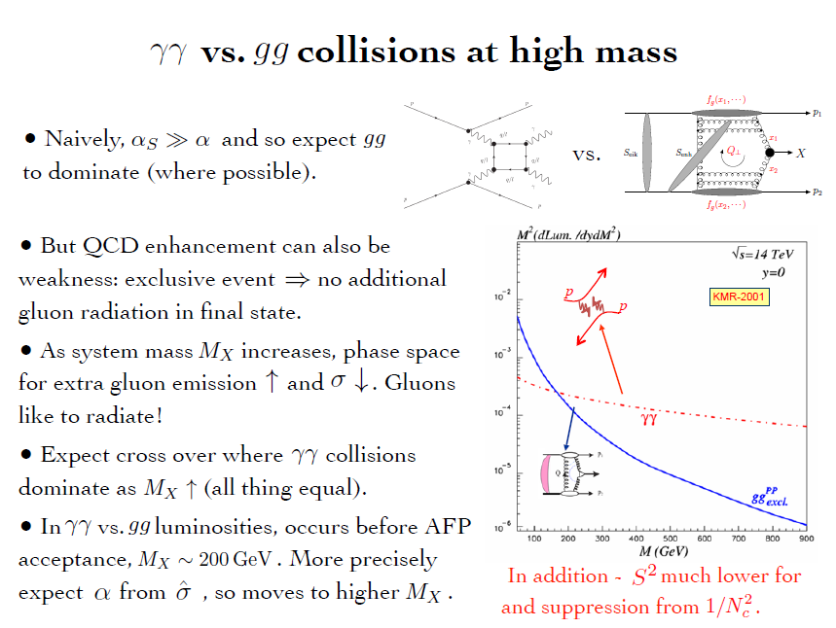

Slide 43
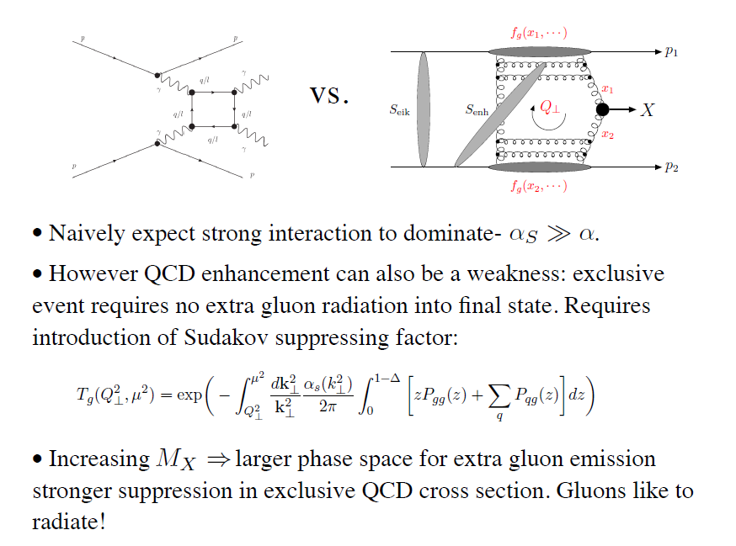
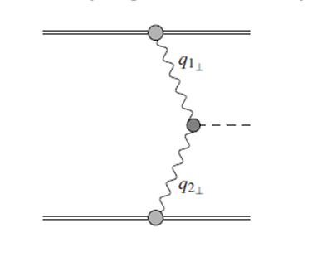


γ
X
γ
The LHC is the high energy photon collider
‘Large’ Pomeron size in the
production of the small size objects.
+ absorptive/rescattering effects- survival factor

Slide 44
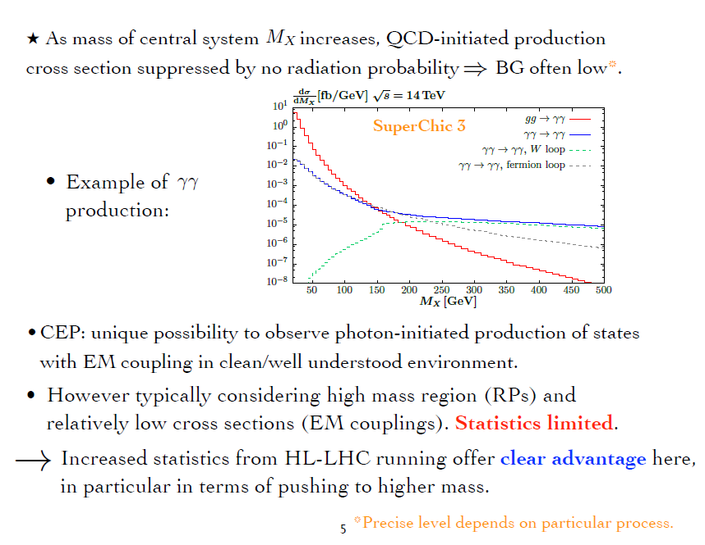
up to 1-2 TeV
Currently, CEP studies at the LHC are dominated (also HIC-UPC)

Slide 45
STANDARD CANDLES

Slide 46
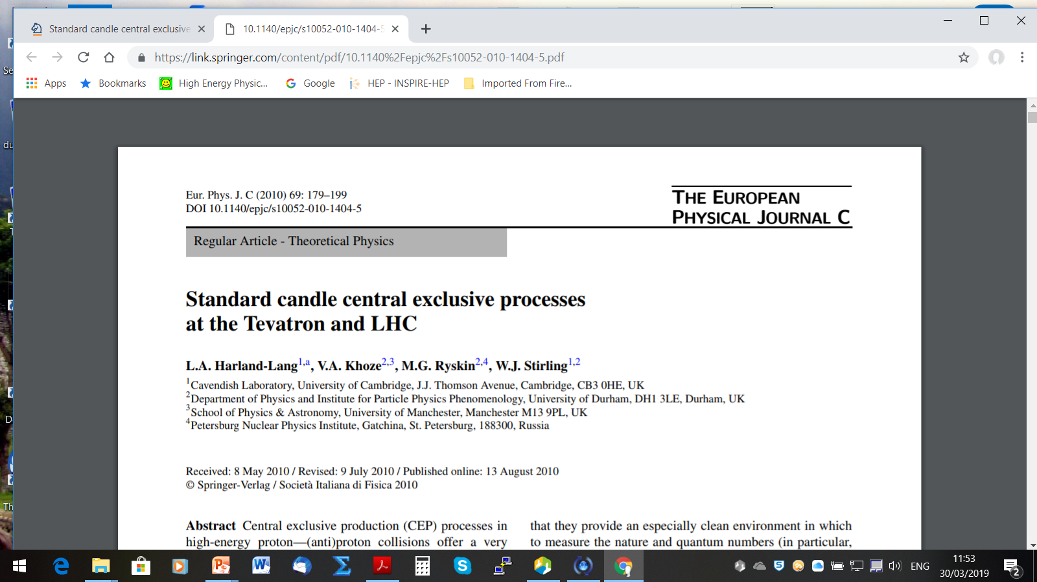

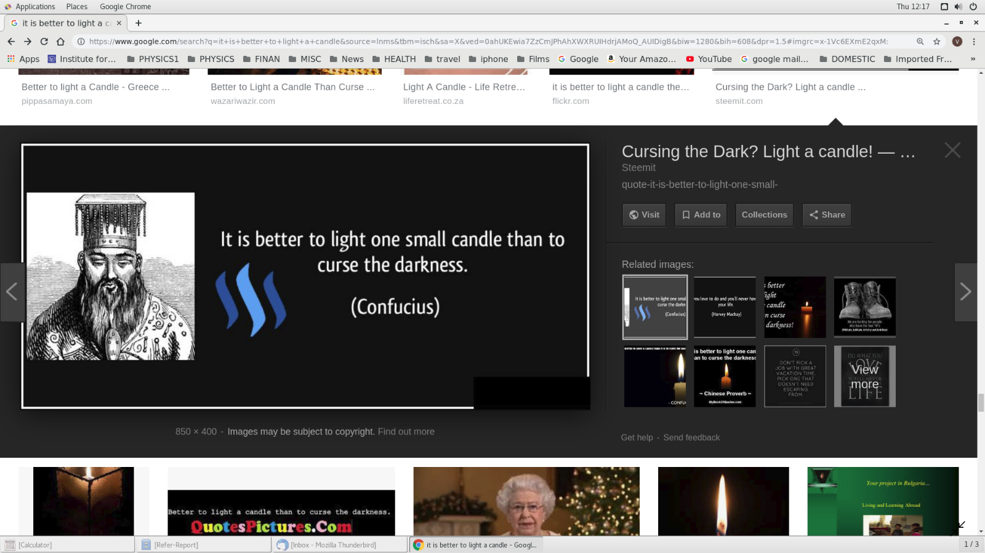
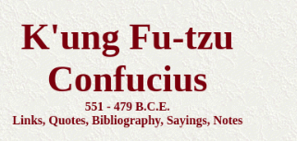
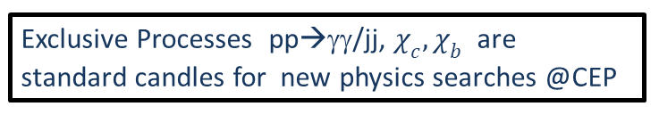
(wide spread of theory predictions)

Slide 47
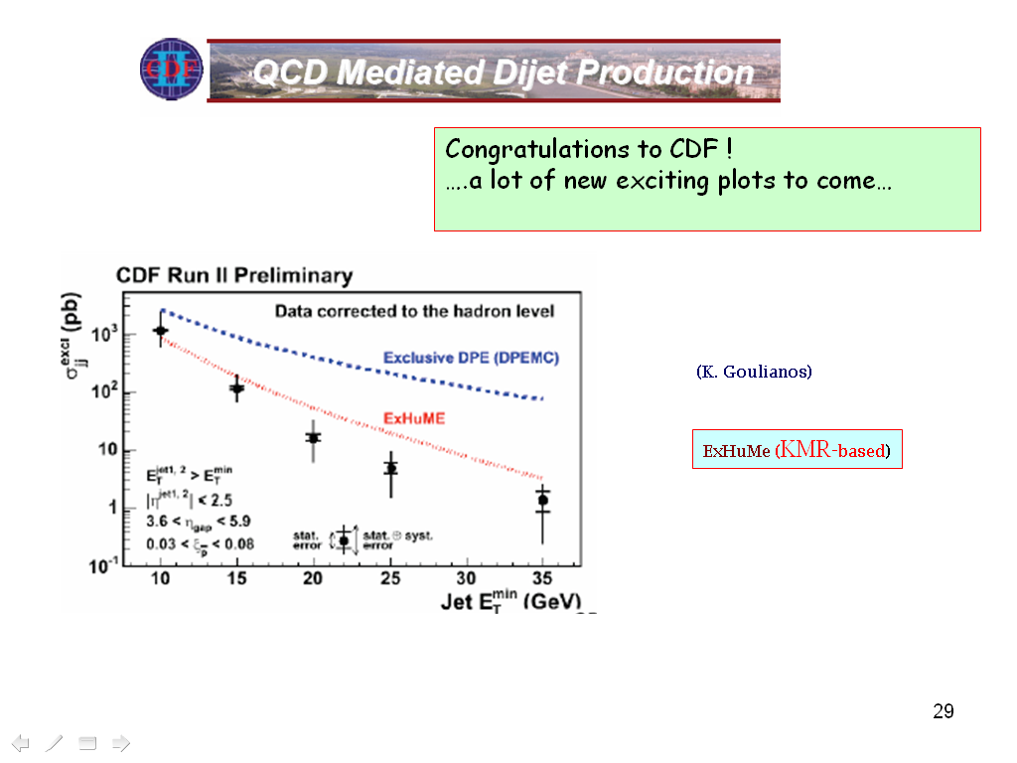
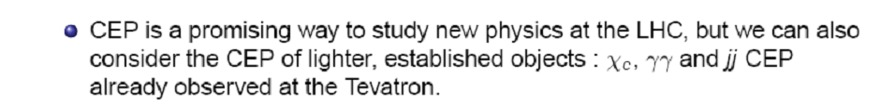
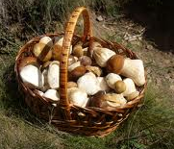
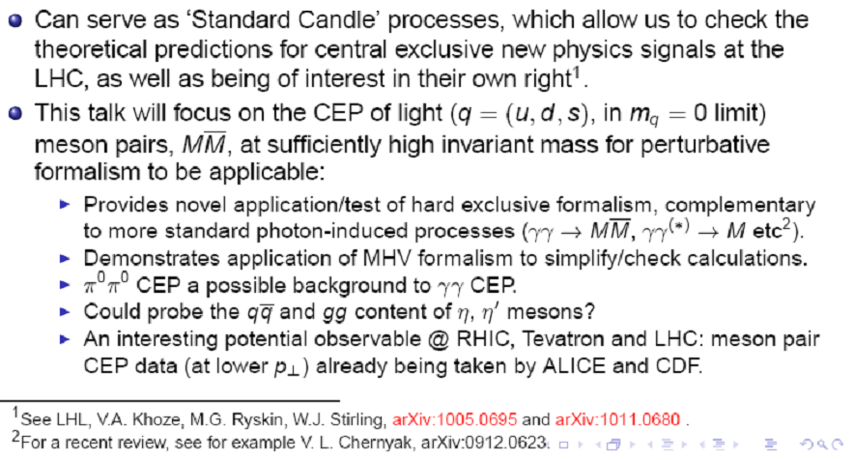
( LHCb RG results)
and light

Slide 48
Very close to Pure CEP

Slide 49
T. Aaltonen et al. (CDF Collaboration), Phys. Rev. Lett. 108, 081801 (2012)
43 events
Et>2.5 GeV
(KMRS-04)
(HKRS-10)
proved to be very small (CDF) in agreement with the Durham expectations)

Slide 50
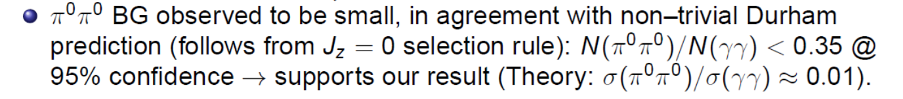
2012
D0-2010-dijets, new
CEP RHIC and
LHCb ( , 22 )
✶

Slide 51
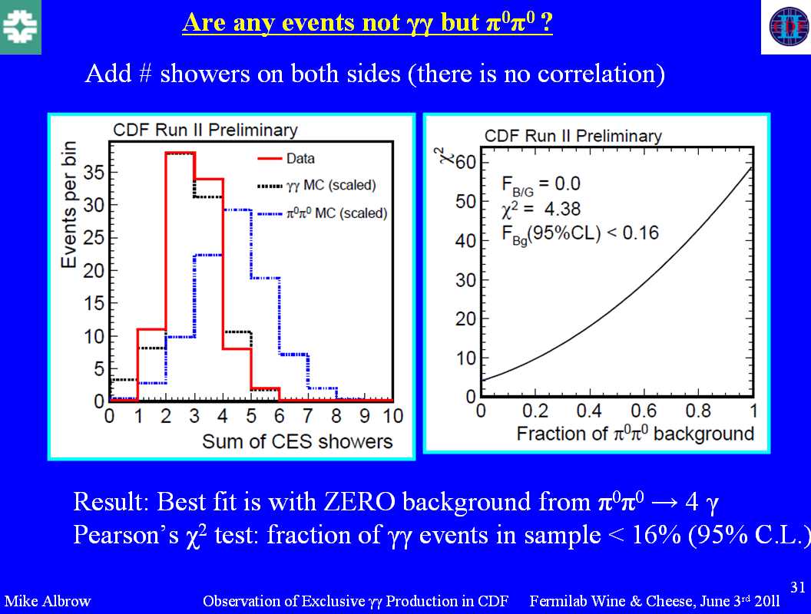

Slide 52
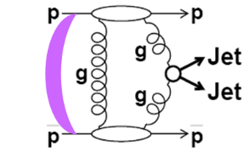
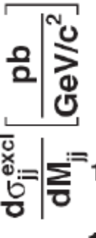
CDF
PRD-2008
D0-2010
Visualization of QCD Sudakov formfactor
Durham

Slide 54
RC-numerically suppressed
KMR-01
(A. Alekseev-1958-positronium)
Glueball Filter

Slide 55
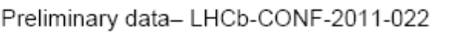


The ratio of high Et dijets in production with one and two rapidity gaps. CDF
CDF results on exclusive charmonium CEP, (CDF, PRL-09)
Hopes to continue with HERSCHEL

Slide 56
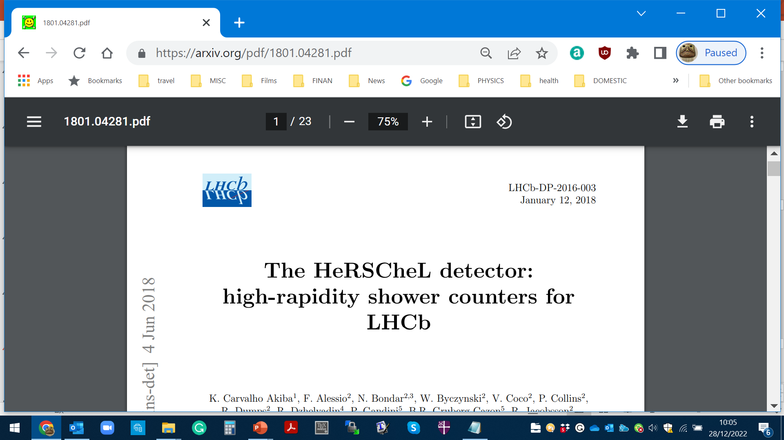
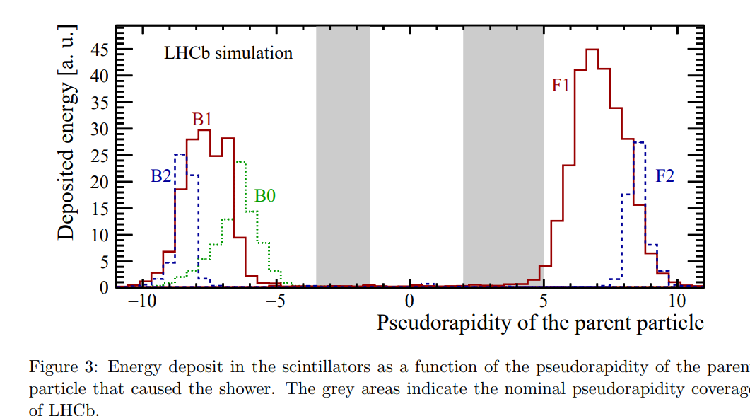

Slide 57

Dimeson SAGA

Slide 59
40 diagrams (4 basic)

(M.Benayoun,V.Chernyak,-1990)

Slide 61
is this easy to understand ?
Was popular (among the more formal community) MHV- technique
Nowadays the enthusiasm has a bit faded away- other approaches

Slide 62
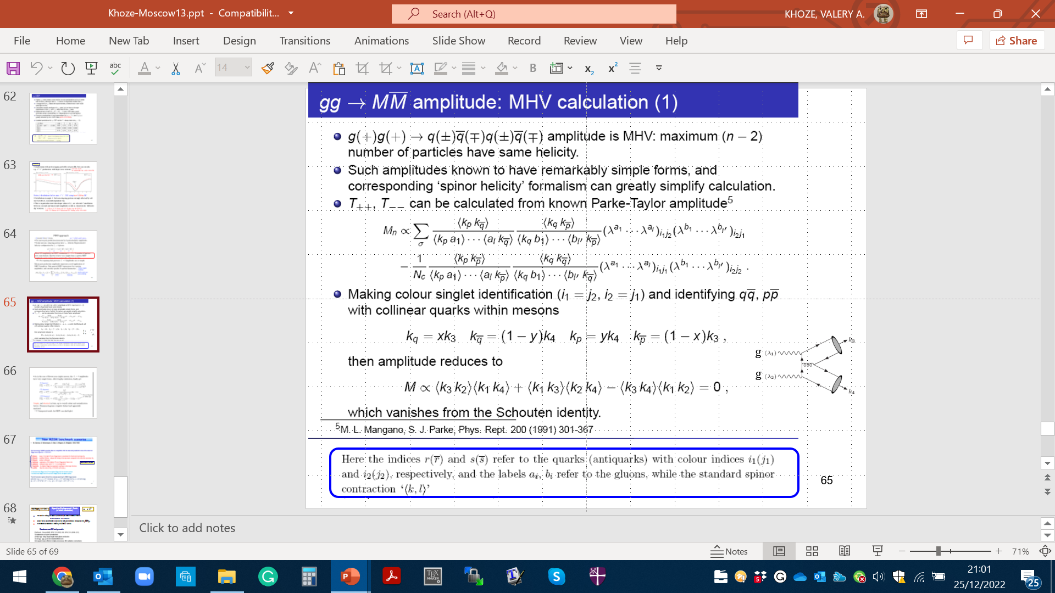

Slide 68
Of special interest: searching for the structures in
J/ψJ/ψ spectrum in the CEP environment.

Slide 69
OTHER SELECTED CEP TOPICS

Slide 70


Slide 71



EXCLUSIVE JET PRODUCTION
(CDF-2008)
2/27
71

Slide 72

(Very interesting effects
In the 3jet qqg events)
72

Slide 74

(2012)
Dijet CEP as a gluon factory
74

Slide 75
E.Kryshen

Slide 80
✴

Slide 81


✴
HKRS-10

Slide 82

1 : 0.03 : 0.08

Slide 84
(Phys.Rev.D 68 (2003) 034001)
hep-ex/0205037
It may make sense to repeat this measurement at the LHC/RHIC ?

Slide 85
Instantons have never been observed experimentally, however, they are
playing very important role in the theoretical models of confinement and
chiral symmetry breaking
(about 1800 titles)
one of the biggest challenges for particle physics to date
‘soft bombs’ –high-multiplicity spherically symmetric distributions of relatively soft particles
Extended objects in space-time
Effectively –a family of new multiparton vertices in Feynman diagrams

Slide 86
KKMRT-2021-2022
dominates
KMR-like
✶ Detecting two outgoing protons would allow placing an upper limit on Instanton mass.
✶
(‘hermiticity’)
state

Slide 87
SUPERCHIC MCs

Slide 92
SC3-4 pp/pA/AA

Slide 93
HTKR

Slide 94


Forward Proton Tagging significantly extends the physics reach of the ATLAS and CMS detectors by giving access to a wide
range of exciting new physics channels.
FPT has the potential to make measurements that are unique at LHC and sometimes challenging even at an ILC.
FPT could serve as a spin-parity analyser and offers a sensitive probe of the CP structure of the new states.
There are a number of important measurements to be performed in the RG environment at LHCb and ALICE at low
μ.
The theory of the CEP is in a reasonably healthy shape,
and dedicated MCs (such as SC) are well developed
The predictions are backed by the series of CDF CEP-like measurements as well
as the RAP GAP measurements by the LHCb and ALICE.

Slide 95
The dedicated AFP and PPS detectors are allowed to use the timing.
The main issue is PU suppression, though some progress is foreseen, in particular with the addition of timing from the CD.
But ATLAS has already decided not to run AFP at HL-LHC
At large M_{Mmis}> 150-200 GeV the photon-photon fusion dominates
over the gg. LHC is the photon-photon collider!
Such important measurements as the searches for the new Higgs-like states (e.g. resolving the
96 GeV puzzle) as well as the moderately-heavy instantons would require
the 420 m stations.
The bulk of important physics (such as glueball and other new
state searches) would require low luminosity runs.

Slide 96


Slide 97
97
97
97
97

Slide 100
KMR-2000

Slide 102
KMR-2000

Slide 105

KMR-2000
DDT-80
KMR-99

Slide 106
KMR(2000)- an extension of the results by DDT(1980)
A.Shuvaev et al 1999

Slide 109


Slide 111

Signal-to-Background Ratio
(a brief reminder)
SM Higgs, 125 GeV
✴
The largest signal, but large background and (most) difficult trigger
(other channels –too low rate).
Major theor. uncertainties cancel in the ratio, in particular survival factors, PDFs,..
Experimental efficiencies (trigger, b-tagging..) cancel.
Dominant non-PU backgrounds:
✴
✴
Main characteristics:
2007 (HKRTSW) values
Mass window ~4 GeV.
g-b misID ~ 1.3%
cone size ~0.5.
S/B ≈1
(420+420)
Could be improved by a factor of 2 or so.

Slide 112

What we expect within the framework of the Perturbative Durham formalism
(KMR-01, KKMR-03, KMRS-04, HKRS-10)
Example, O++ -case
*K_{NLO}
Strong sensitivity to the polarization structure of the vertex in the bare amplitude.
Absorption is sizeably distorted by the polarization structure (affects the b-space distr.)
KMR-01
KMR-02, KKMR-03,
HKRS 09-10
(Gap size
KMR-02
Forward proton distributions& correlations- possibility to test diffraction dynamics

Slide 113
g_{PP}

Slide 114
Irrespectively to the decay products
KKMR-03
~
In Regge theory
KMR-2001
Within the PT approach forward CEP of non-relativistic heavy 2++ quarkonium is strongly
reduced because of the suppression of the 2 ++ → 2g transition for the Jz = 0 on-mass-shell two-gluon state
Jz = 0 amplitude vanishes
for the γγ decay of the 2++ 3P2
positronium (Tumanov, 53;Alekseev, 58)

Slide 115
1968

Slide 116


Slide 117


