Slide 1
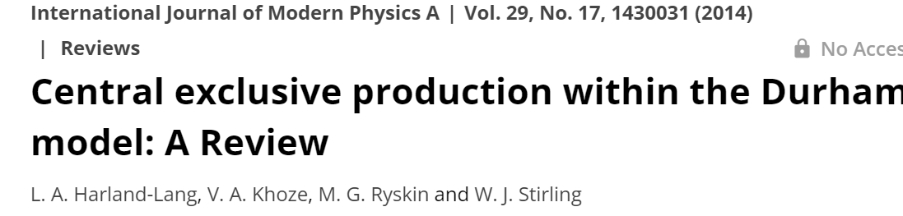
CENTRAL EXCLUSIVE PRODUCTION @ LHC
(selected topics)
Valery Khoze
DISCLAIMER
With a bit of personal flavour
What and what for to measure (in the spirit of LR-KHOLERA – Leningrad –mid-seventies,
rather than how to calculate
Гатчина
19.10.2023

Slide 2
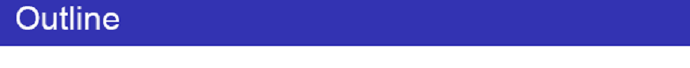
Introduction (why we are interested in CEP processes?)
CEP and Large RAP GAPS.
QCD-induced CEP mechanism.
CEP as a spin-parity analyzer
‘Diffractive Higgs’ revisited.
Standard Candle CEP reactions and experimental tests.
Gluon –gluon vs photon-photon fusion.
Dimeson Saga.
Other selected CEP topics
Summary and Outlook
‘
Summary and Outlook.

Slide 3
CEP and RAP GAPs

Slide 4
LRGs caused by Pomeron,
photon (W,Z) or Odderon exchanges

Slide 5

ALFA/TOTEM
(Radiation tolerance)
Threshold scan.

Slide 6
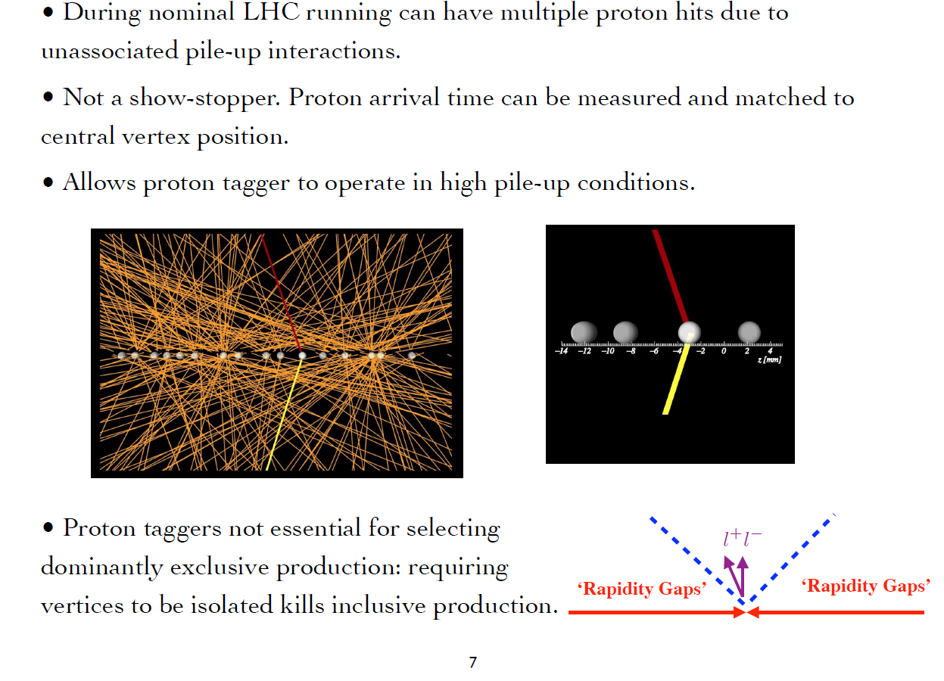
Low Lumi

Slide 7

X
~200m
AFP/PPS
(LHC runs 1,2)
(ALICE-double Gap trigger, Runs 1 and 2)

Slide 8
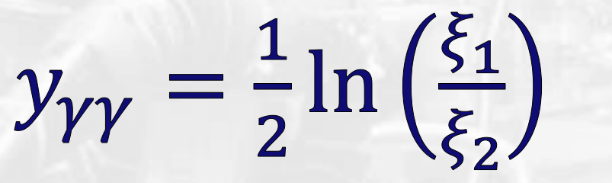


ALFA
TOTEM & ALFA
CMS/PPS & ATLAS/AFP
ALFA
The LHC is an excellent mass spectrometer
$$y_{M}$$
ALFA/TOTEM- radiation tolerance → low PU special runs

Slide 9
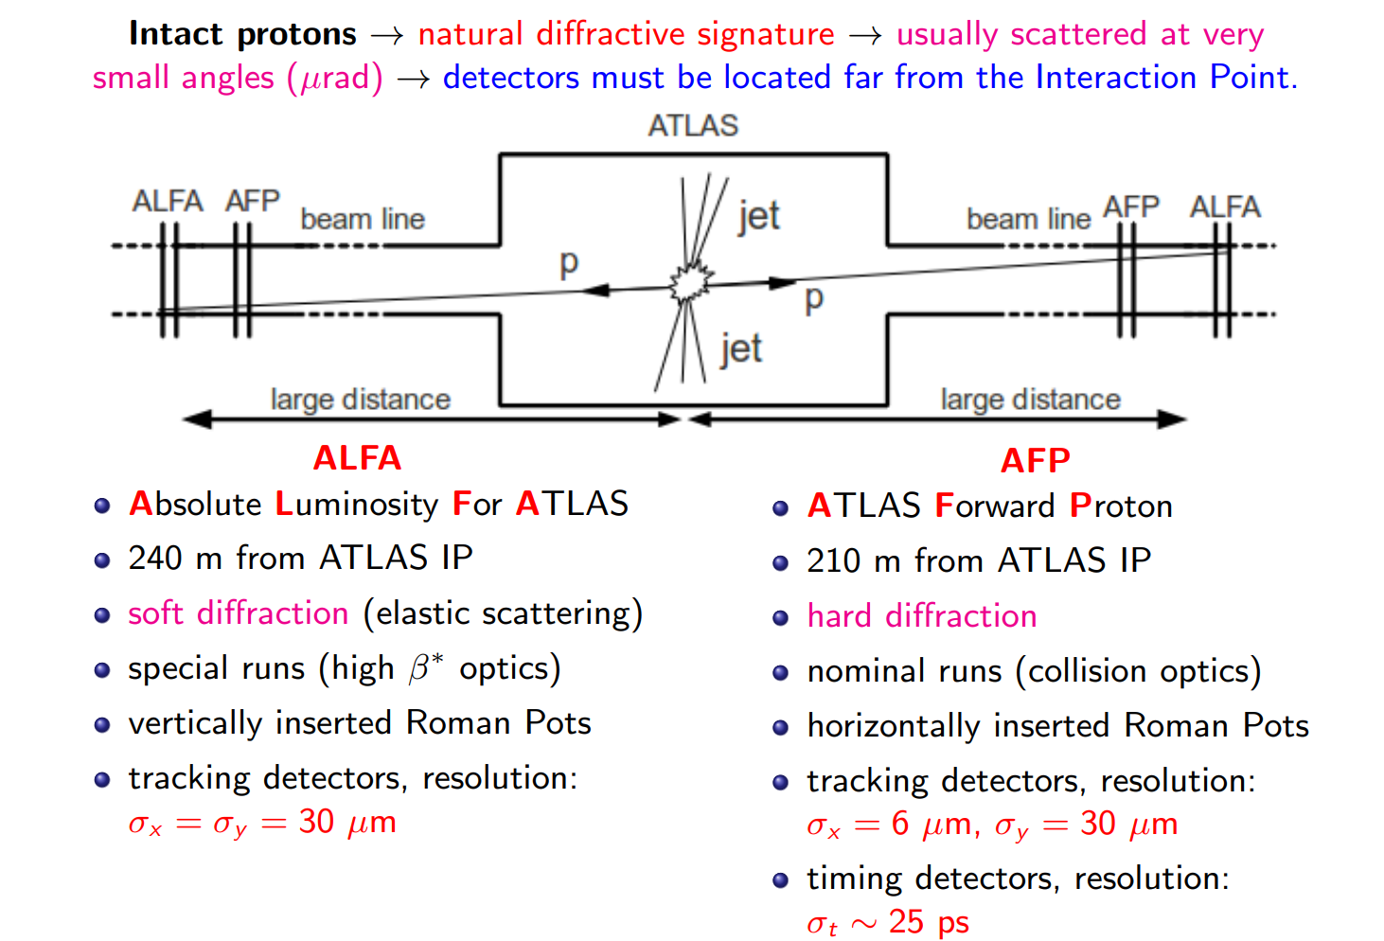

Slide 10
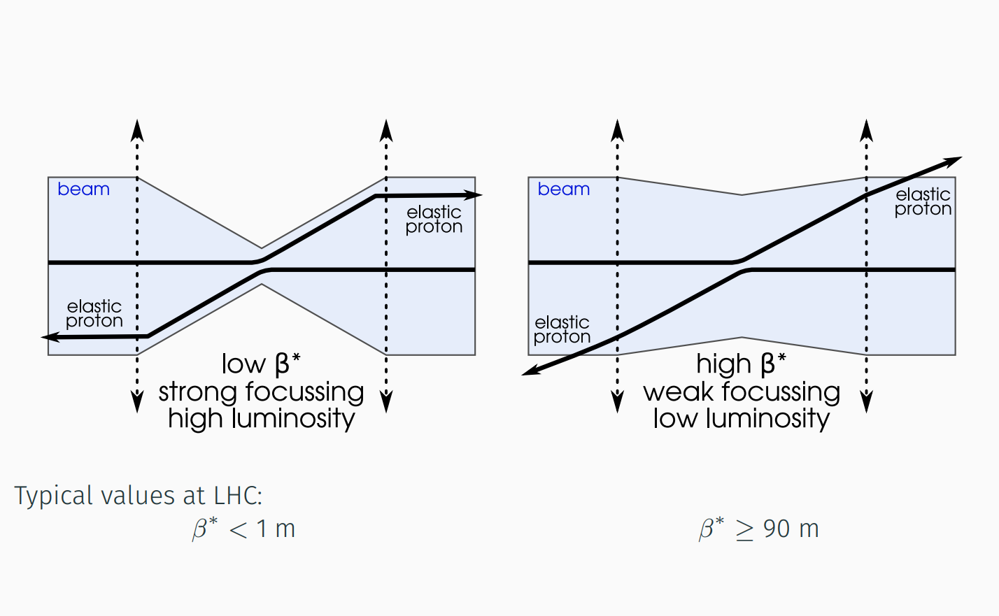
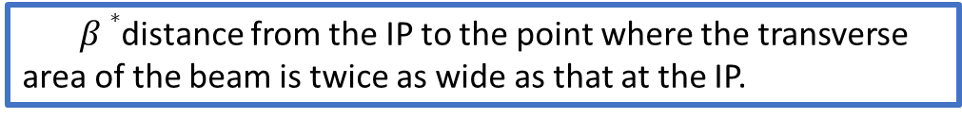

$$β$$
$$β$$
$β∗$distance from the IP to the point where the transverse area of the beam is twice as wide as that at the IP.

Slide 11
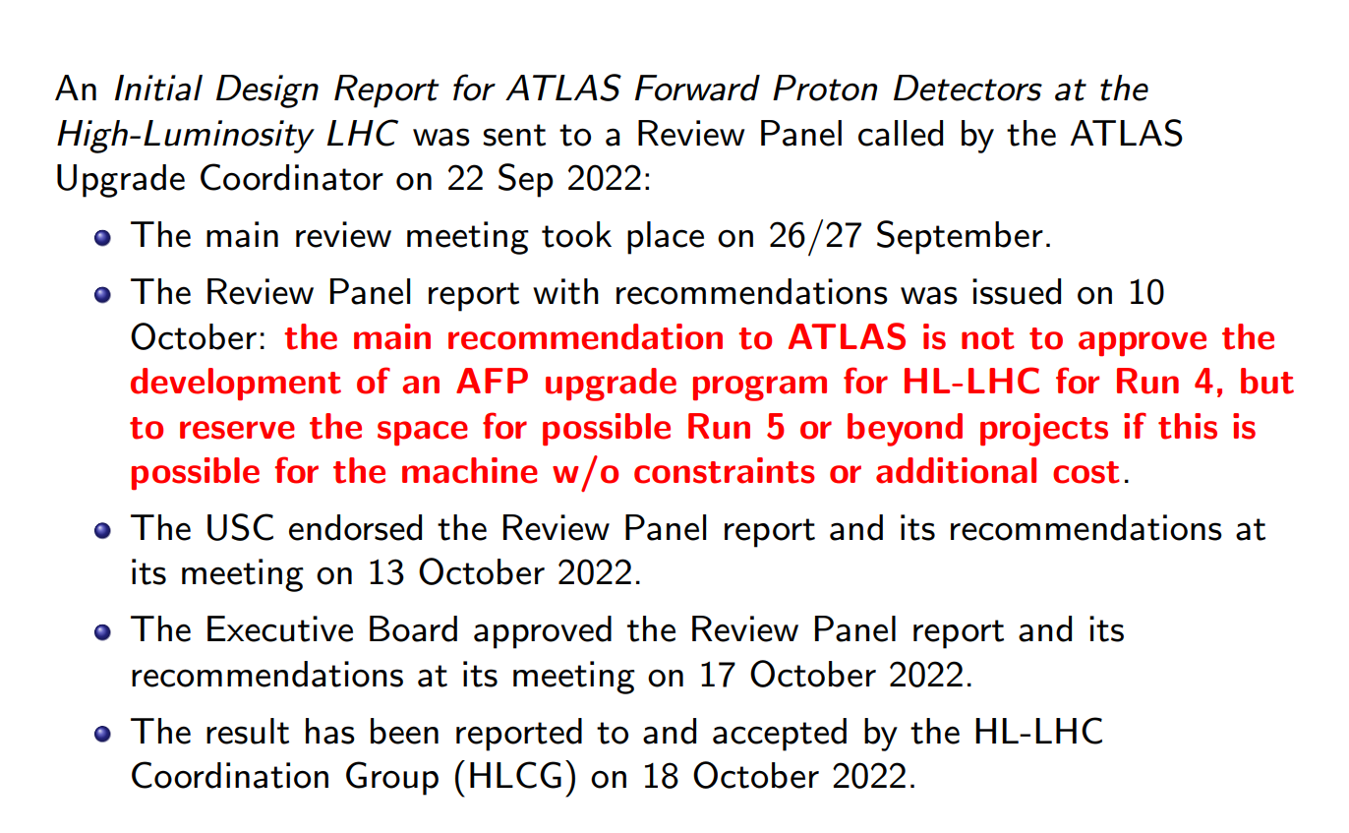

Slide 12
ISR, SPS
RHIC at 200, 500 GeV
■ Limited statistical precision
(28 candidate signal events, M<2GeV)
Not sufficient sensitivity to discriminate the theor. models (used DIME , GenEx)
■
■ Promising potential to measure CEP using FD@LHC

Slide 13
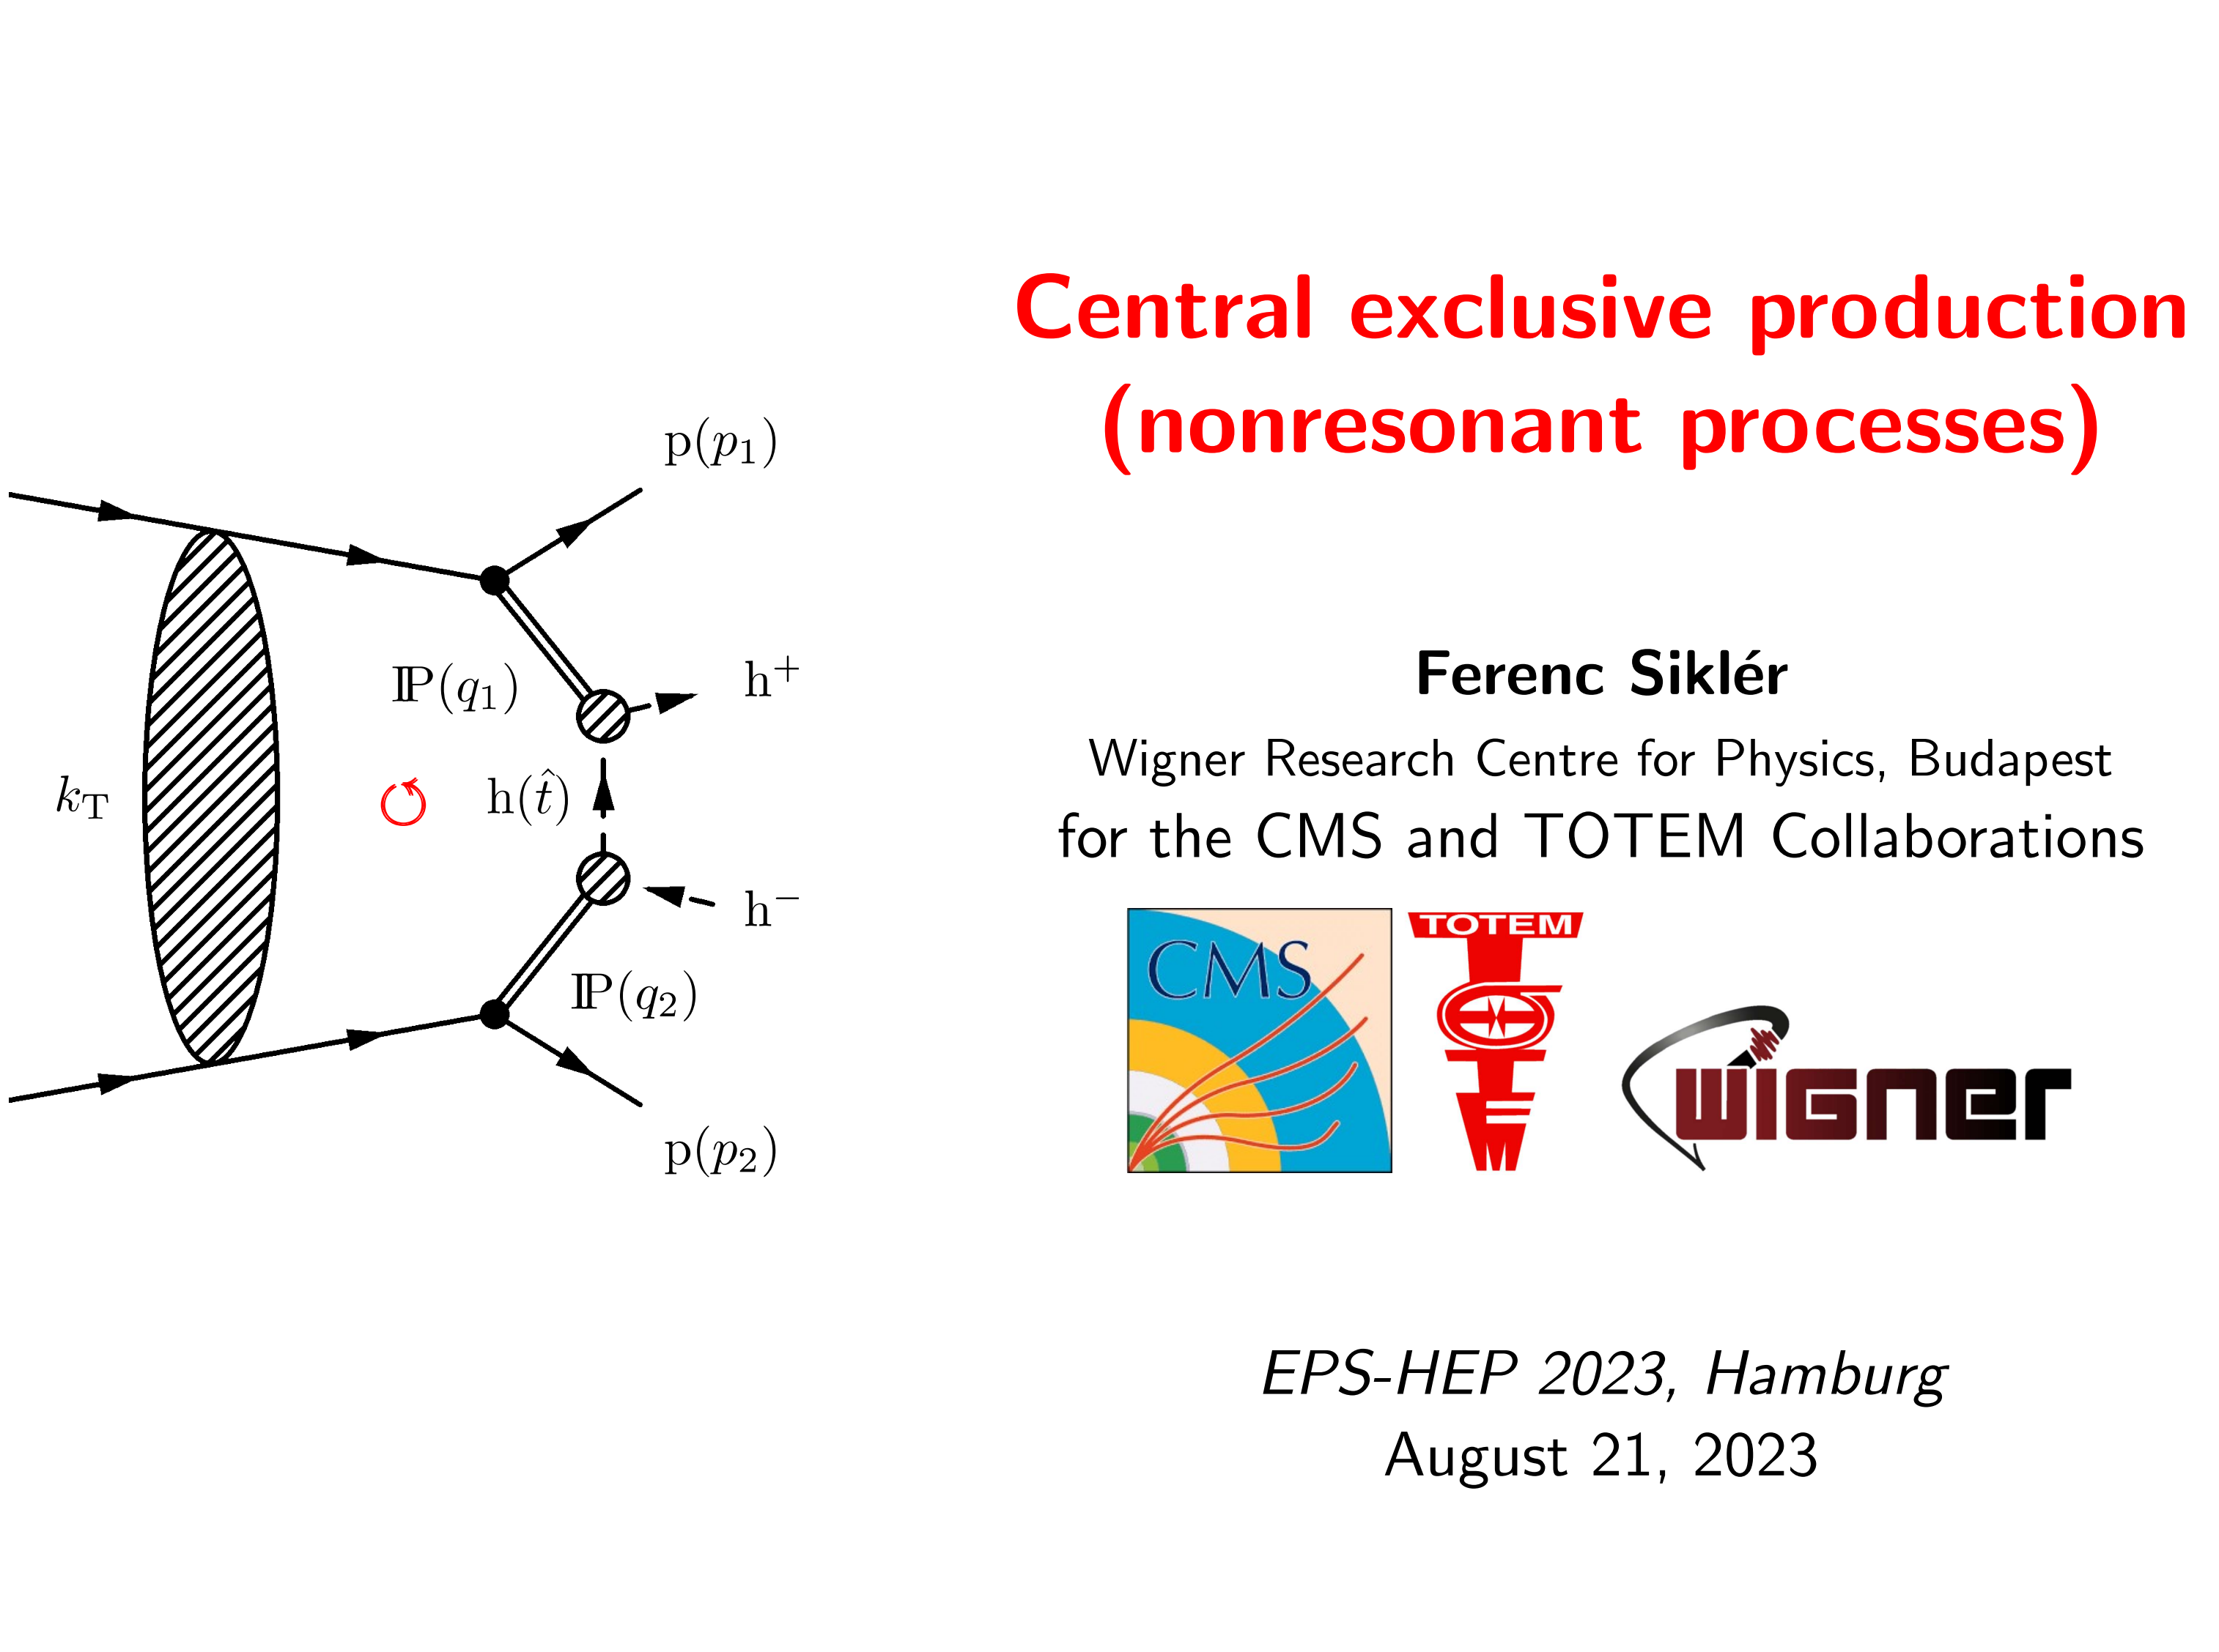
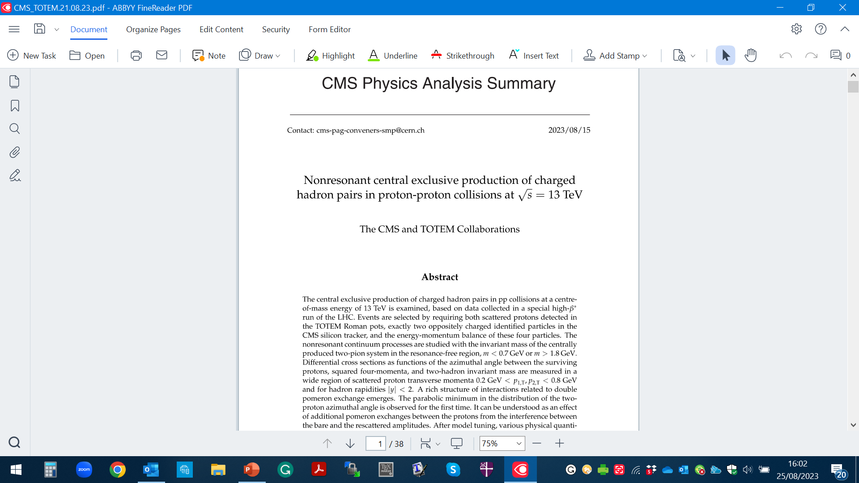
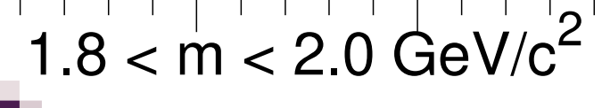
0.35 < m< 0.65 GeV

Slide 14
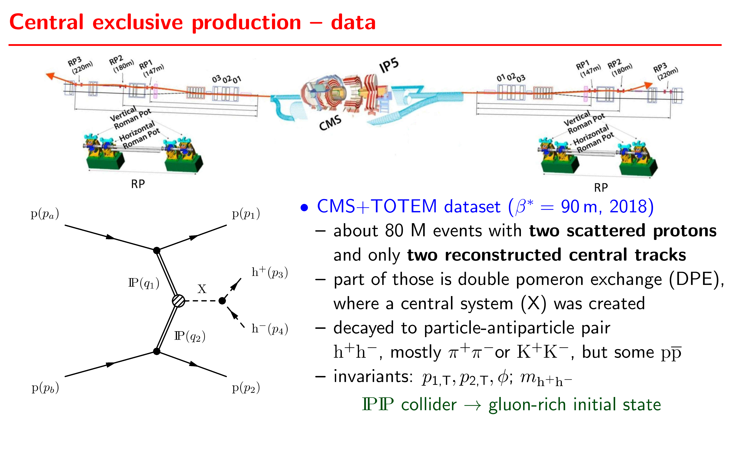

Slide 15
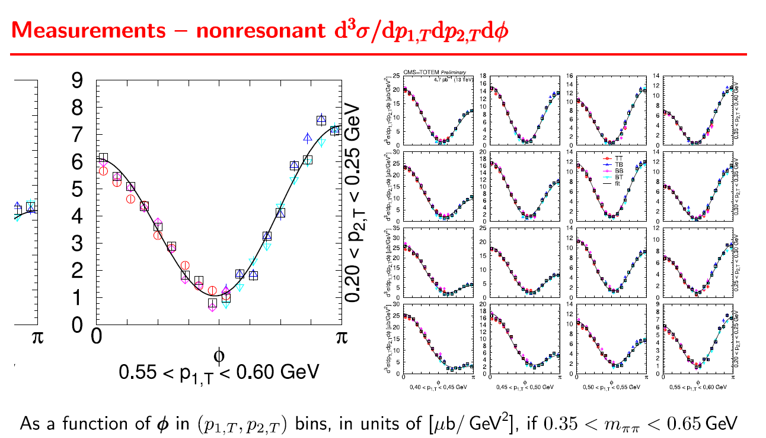
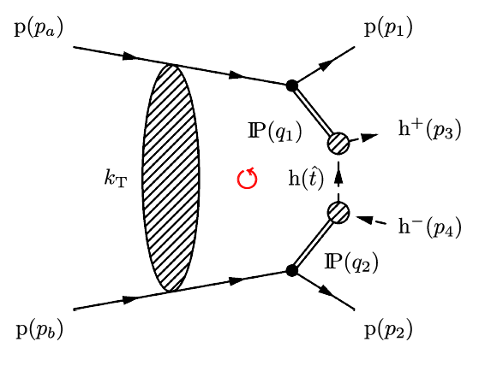

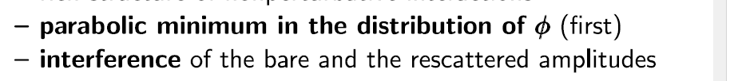
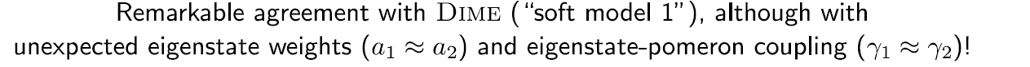

Slide 16
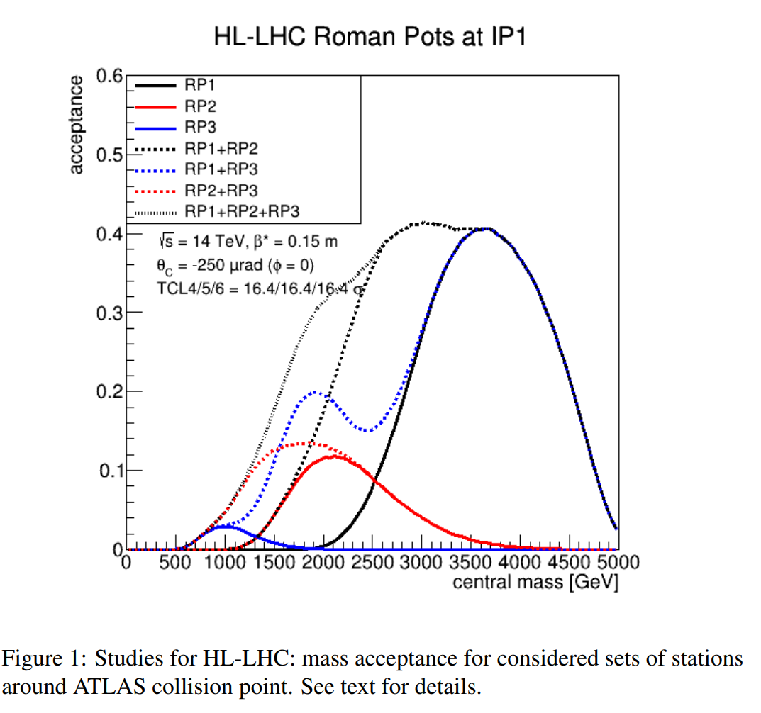
AFP & PPS
Standard HL runs. With precision tracking and timing detectors.
(0.02-0.15)

Slide 17
Pre-LHC studies
review: A. Kirk.
1408.1196[hep-ex]
1408.1196

Slide 18
Review: Int.J.Mod.Phys.A 29 (2014) 28, 1446014
PRE-LHC CEP STUDIES
new CDF dipion results

Slide 19
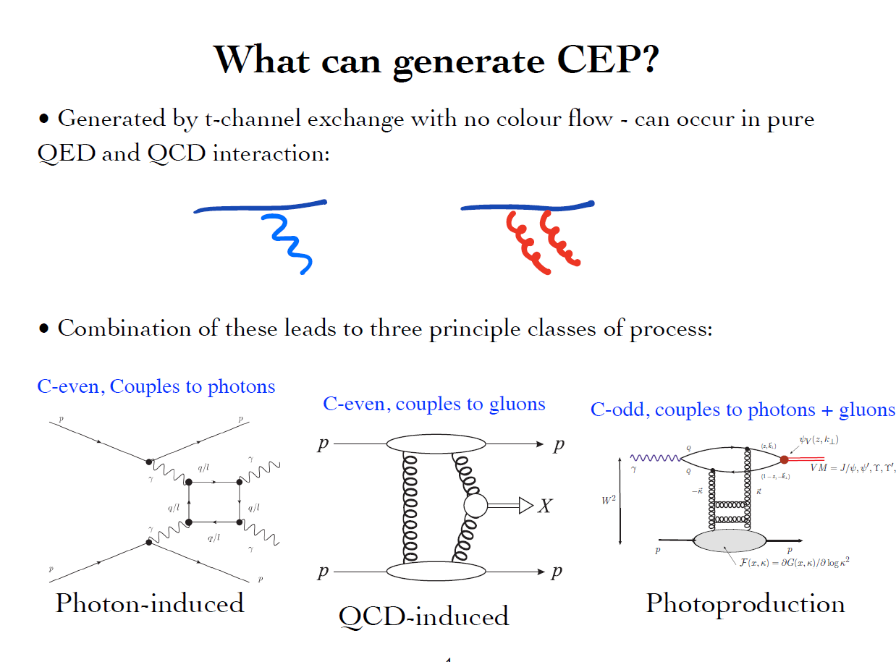
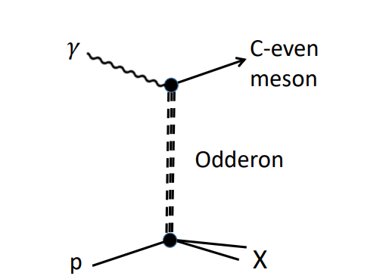

Slide 20
QCD-induced CEP

Slide 21
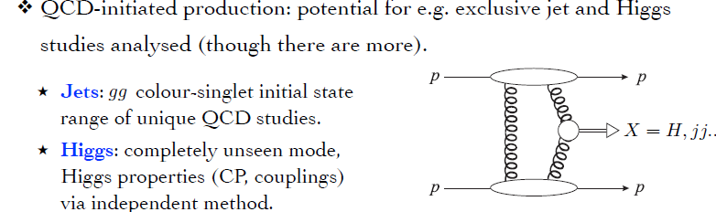
KMR-97-01

Slide 22
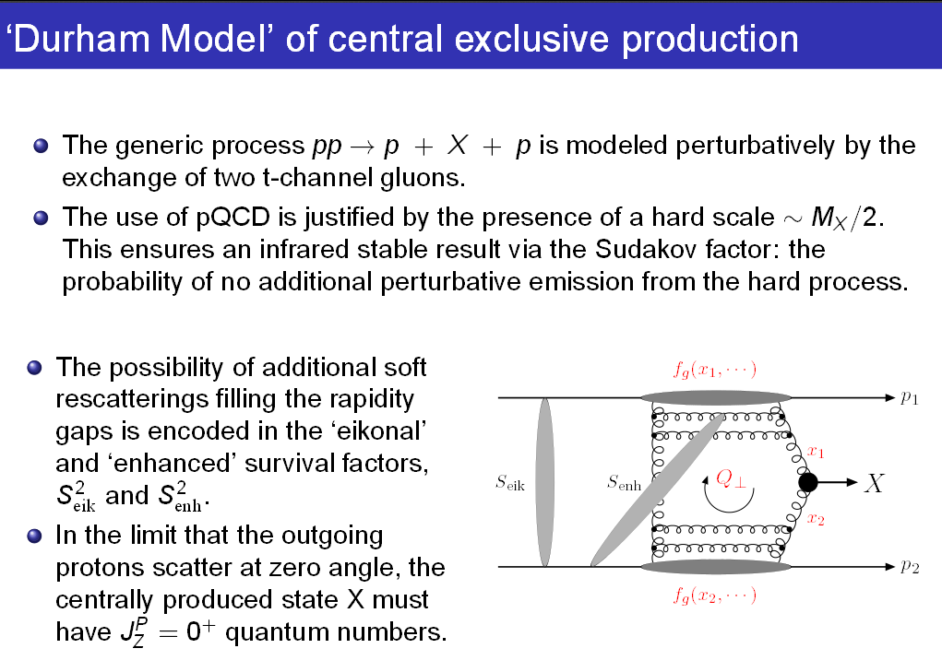
KMR-1997-2001

Slide 23
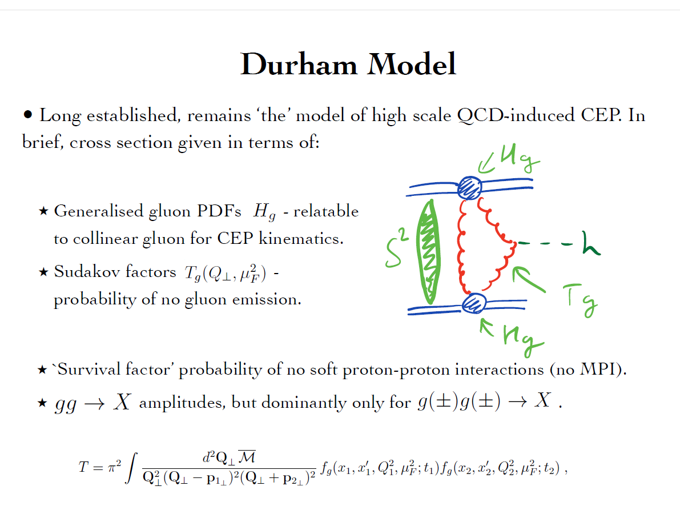
DURHAM (KMR) MODEL

Slide 24
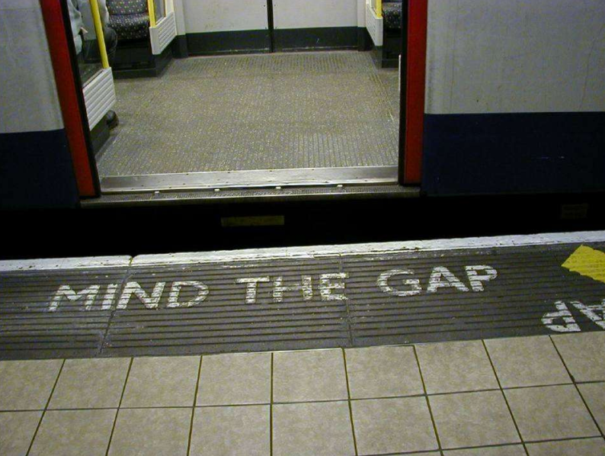


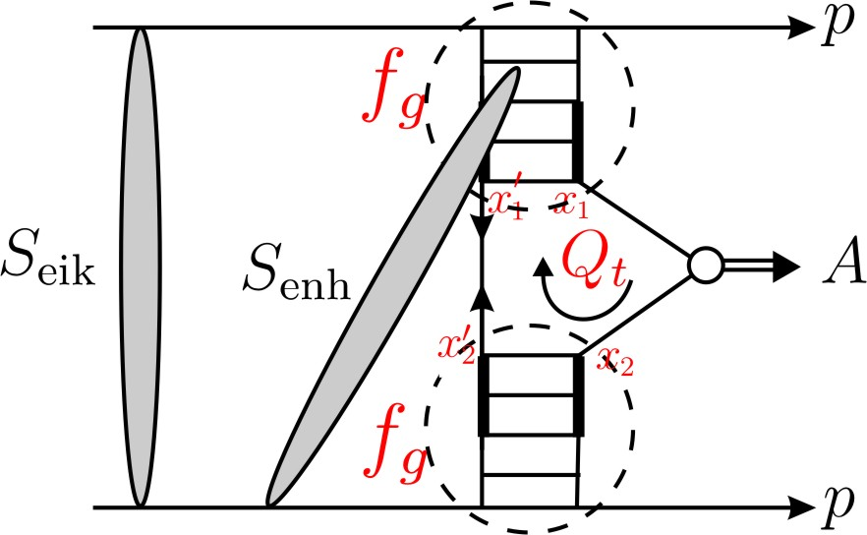
“soft” scattering can easily destroy the gaps
S² ➔ absorption effects -necessitated by unitarity
gap
M
gap
Eikonal rescatt: between protons
Semi-enhanced rescatt: involving intermediate partons
1 >
≫

Slide 25
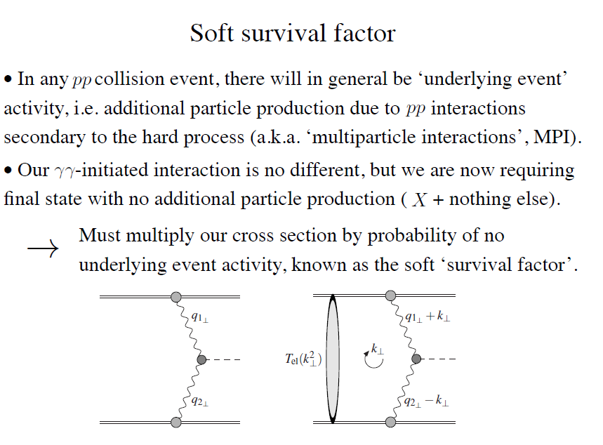

Slide 26
Process dependence
First fully differential implementation of soft survival factor – SuperChic 2 MC
event generator- HKR, ArHiv:1508.02718
SC-3,4

Slide 27
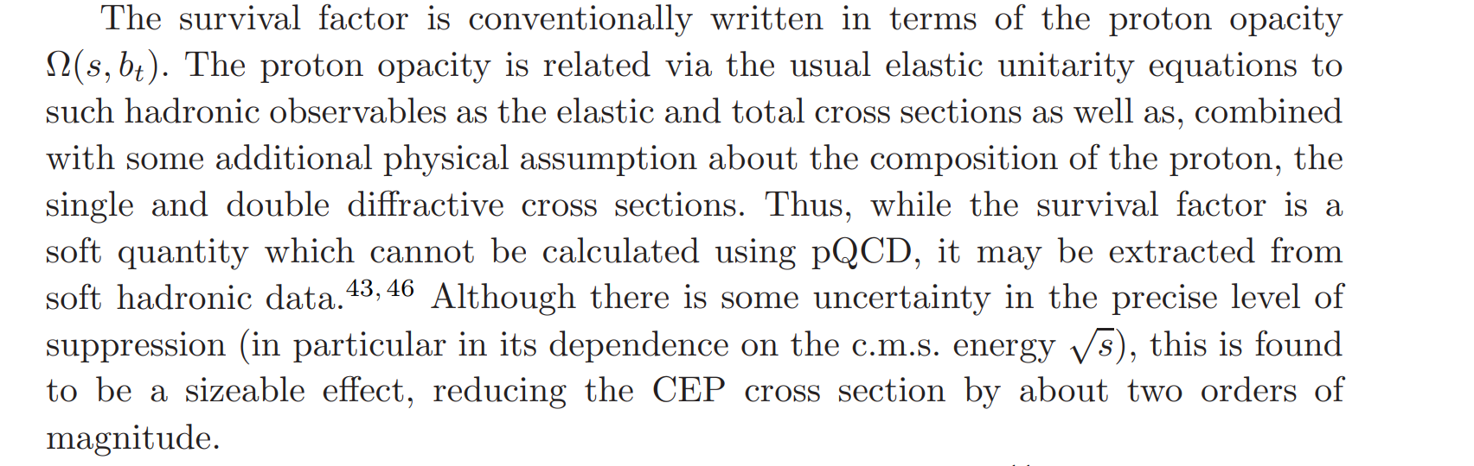

Well developed machinery
KMR (2000-2013)
GLM, FS, Ostapchenko
exp(−Ω(s, but)) probability that no inelastic scattering occurs at impact parameter bt,
depends only on proton transverse separation

Slide 28
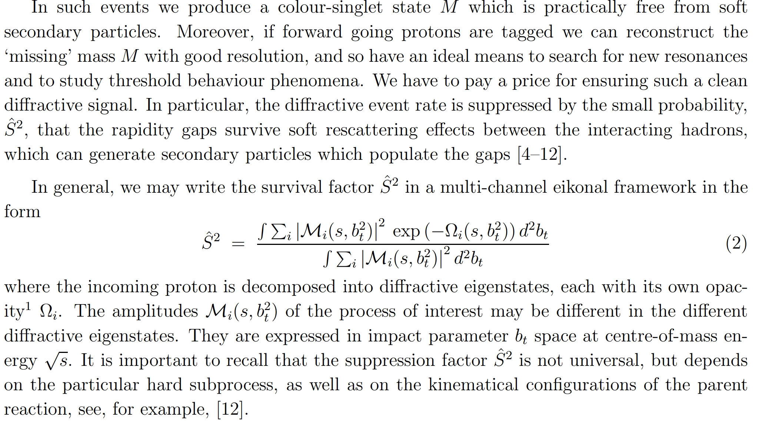
the possibility of (low mass) diffractive dissociation p → N* ∗

Slide 31
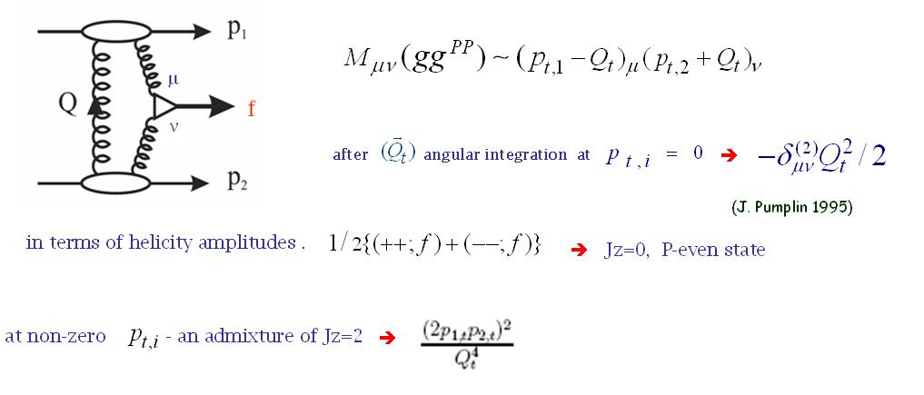
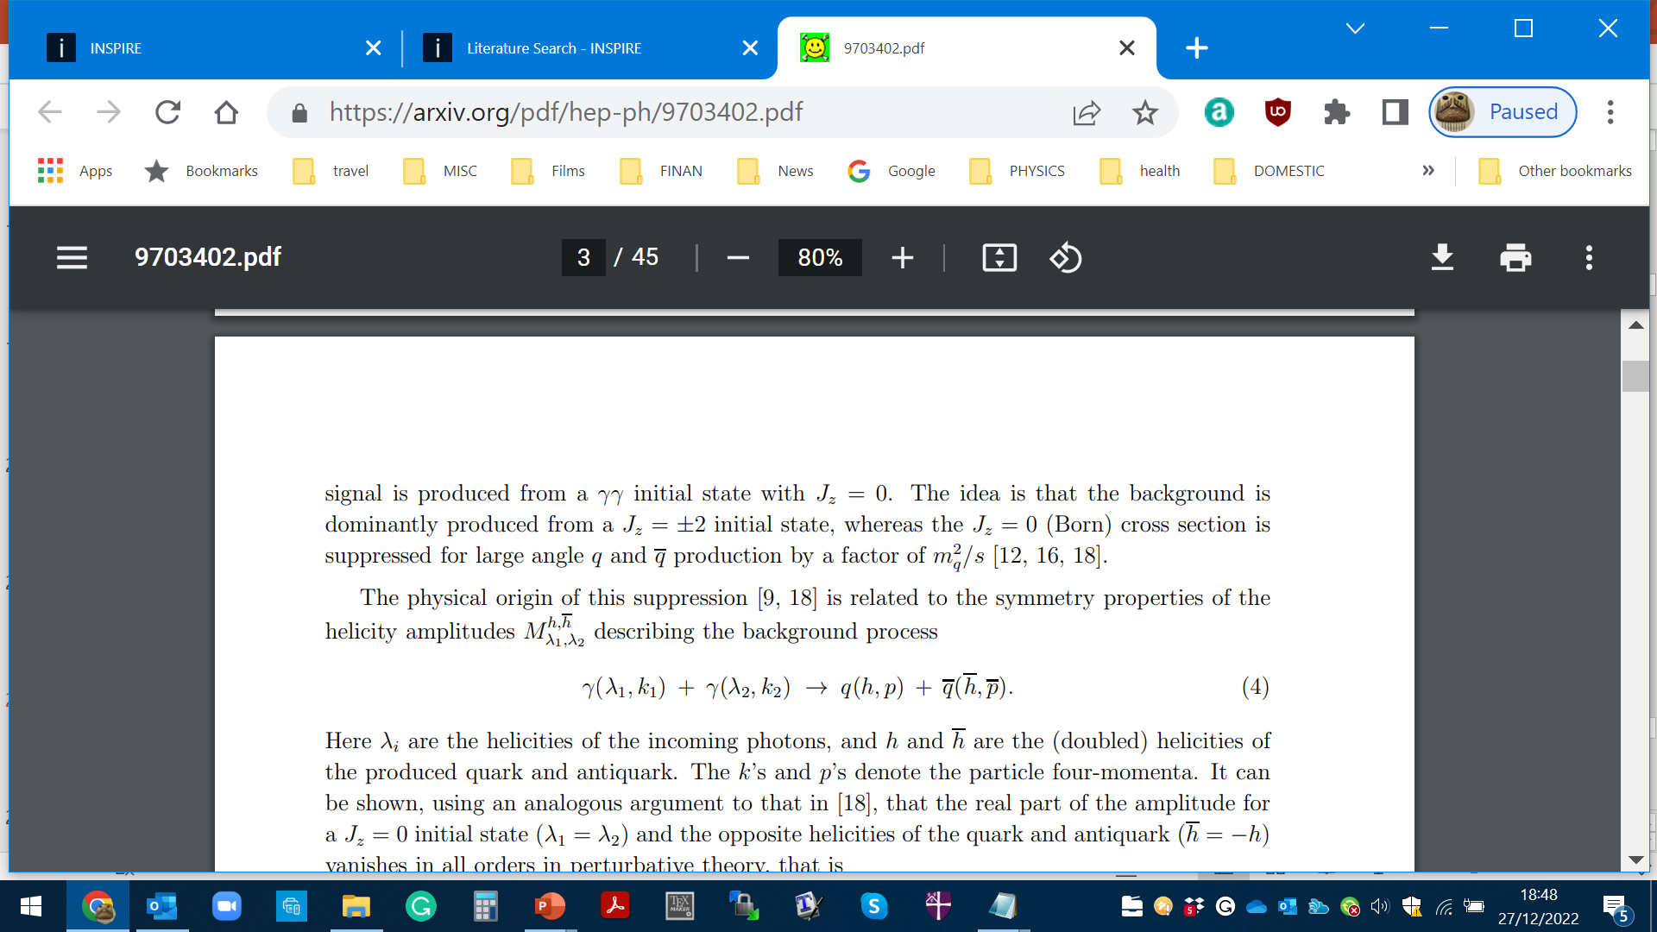
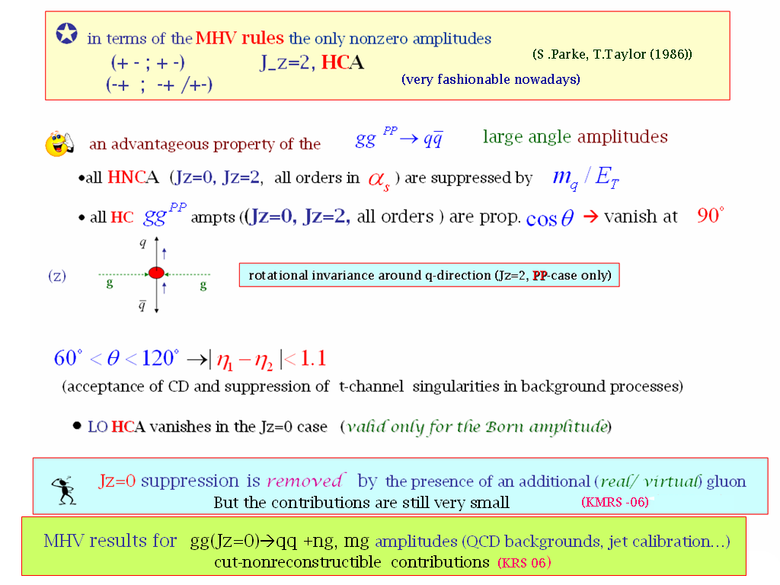


Important consequences for$H→b\overline{b}$
Symmetry properties of the amplitude (FKM-97)
(++,+-) (--,+-)
(++,-+) (--,-+)
$$J_{Z}=0$$
(nullifies in the massless limit)
gg→qq
‘An Amplitude for n Gluon Scattering’

Slide 32
CEP AS A SPIN-PARITY ANALYZER

Slide 33
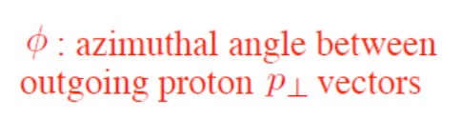
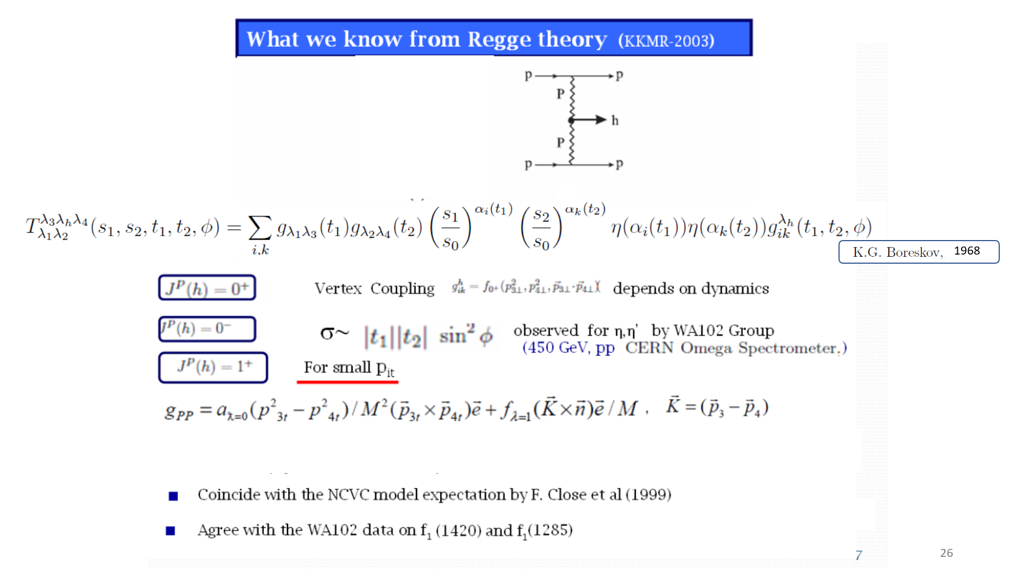
What is known from Regge Theory (KKMR-03)
K.Boreskov, 68
Kaidalov. Karnakov, 66,70
,
,
Follows from general principles

Slide 34
Irrespectively to the decay products
HKSR-10
1966, 1970 ,
1968

Slide 35
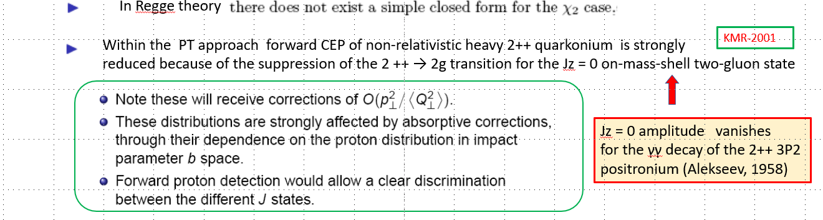
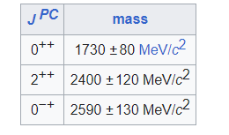
Jz = 0 amplitude vanishes
for the γγ decay of the 2++ 3P2
positronium (Tumanov, 53;Alekseev, 58)
Glueball filter ?
Eur.Phys.J.C 80 (2020) 11, 1077
(could be outdated)

Slide 36
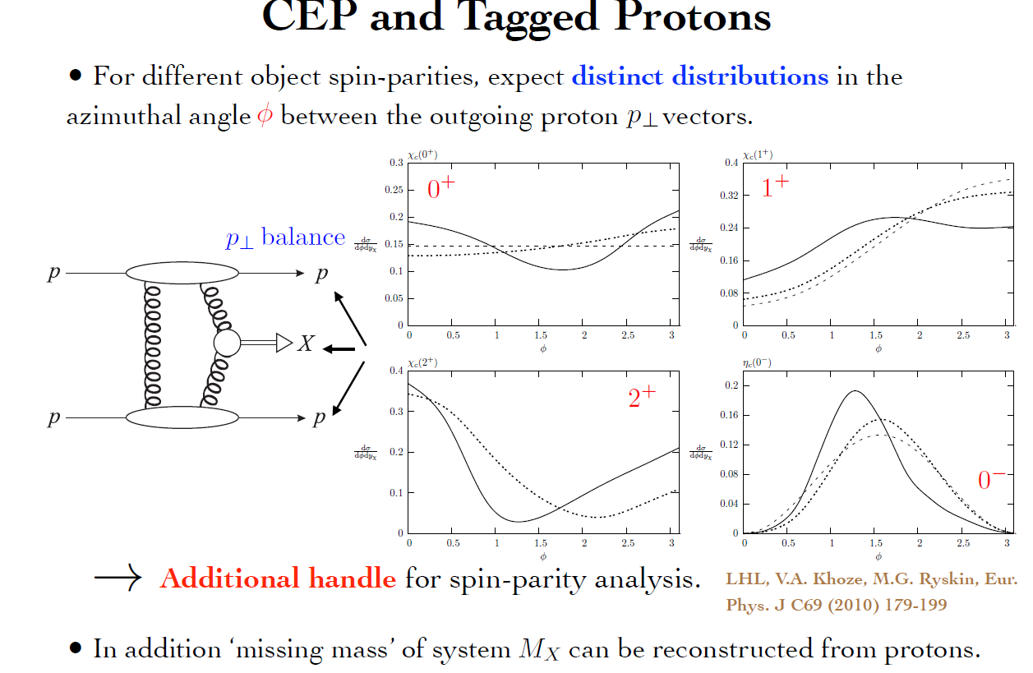
dotted curve- no S²

Slide 37
Life, Death and “Ressurection “ of ‘Diffractive Higgs’

Slide 38

Durham Group
1997-2013
✶

Slide 39
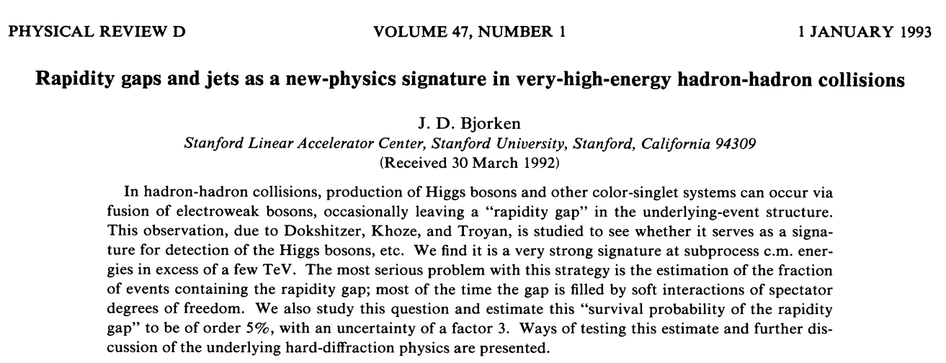
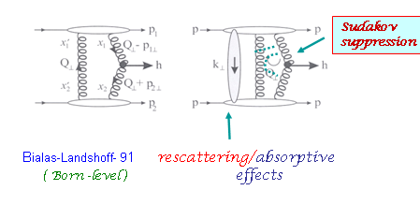
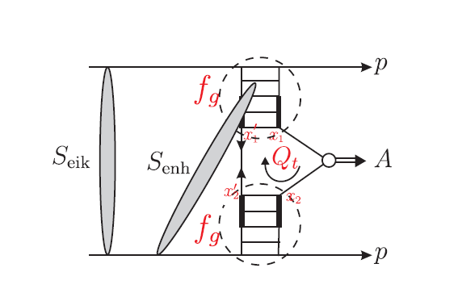

The basic ingredients of the Durham approach (interplay between the soft and hard dynamics)
RG signature for Higgs hunting (Dokshitzer, Khoze, Troyan, 1987). Advanced and promoted by Bjorken (1992-93)
+ ….
h
Main requirements:
inelastically scattered protons remain intact
active gluons do not radiate in the course of evolution up to the scale M
<Qt> >>/\QCD in order to go by pQCD book
DKS-91 (PYTHIA MC)
Further development (KKMR-01-04)
- 4
σ(CDPE) ~ 10 * σ (incl)

Slide 40

High price to pay for such a clean exclusive environment:
σ _{H}(CEP) ~ 10
-4
∗ σ_{H}( inclus.)
A. Bialas and P.V. Landshoff, Phys. Lett. B256 (1991) 540.
Rapidity Gaps should survive hostile hadronic radiation
damages and ‘partonic pile-up ‘
Excitement of the Tevatron community-
symbolically W = S² T²
Theory spread of 11 orders
Colour charges of the ‘digluon dipole’ are screened
only at rd ≥ 1/ (Qt)ch
GAP Keepers (Survival Factors) , protecting RG against:
• the debris of QCD radiation with 1/Qt≥ λ≥ 1/M (T)
• soft rescattering effects (necessitated by unitarity) (S)
KMR 1997
Factor ~3 since then
Forcing two camels to go through the eye
of a needle
H
P
P

Slide 41
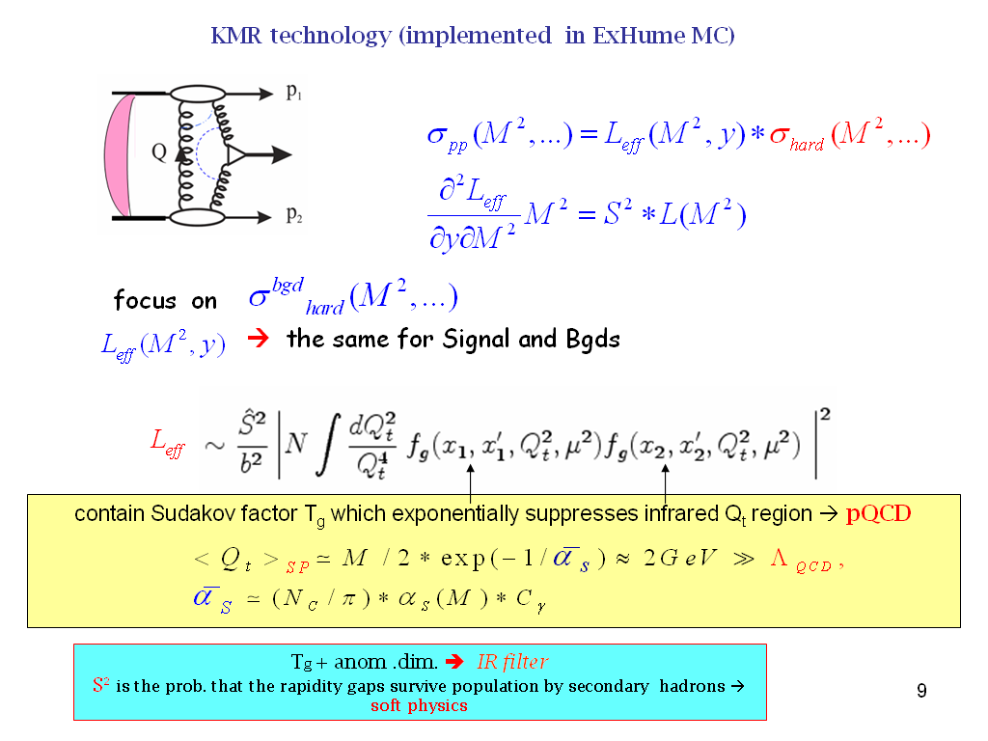
1997-2000)
σ(CEP) ~ 10⁻⁴ σ (incl)
Roughly

Slide 42
Sudakov - probability not emitting gluons with
DL
∎
no infrared divergency
∎
∎
increases with mass M_{H} and
‘skewed’ unintegrated PDF

Slide 43
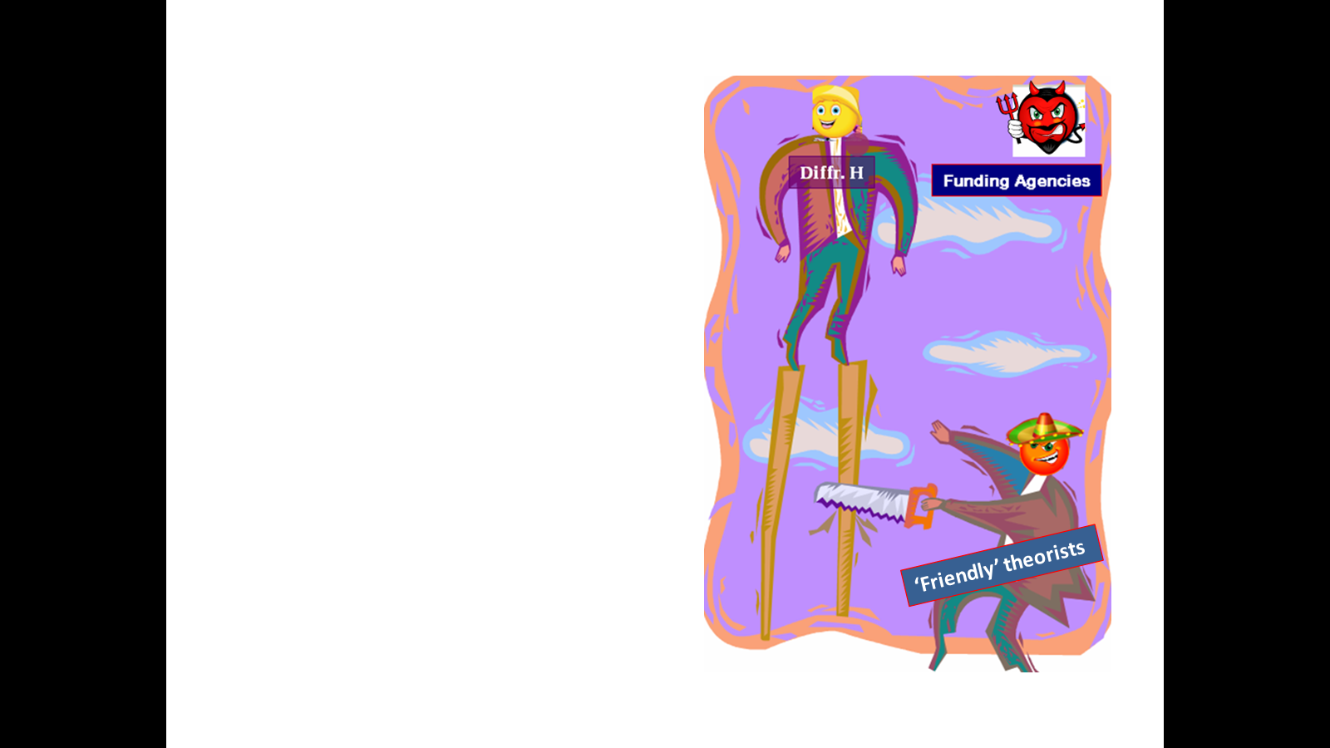
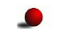
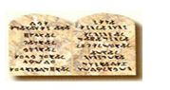
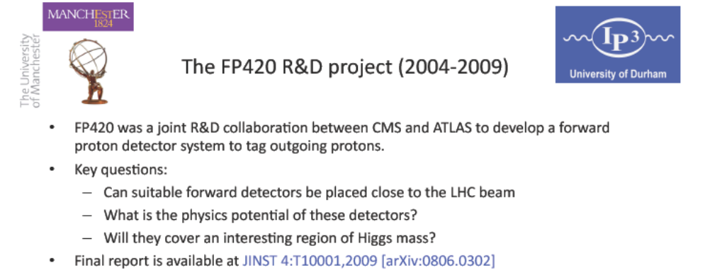
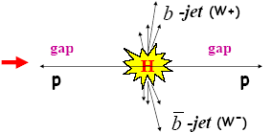
FP420 and Resurrection of ‘Diffractive HIggs’
(20 years on)
searching for lower mass new objects in CEP requires far away (~400m) FDs
Thou shalt not annoy machine people.
96 GeV-’light Higgs’ indications
PPS/AFP- new proposals

Slide 45
Photon vs Gluon fusion

Slide 46
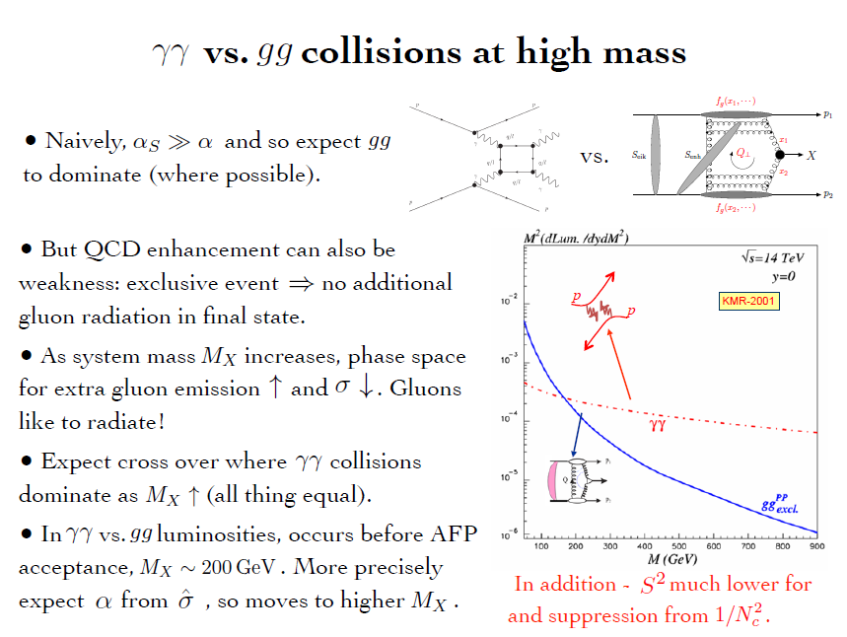

Slide 47
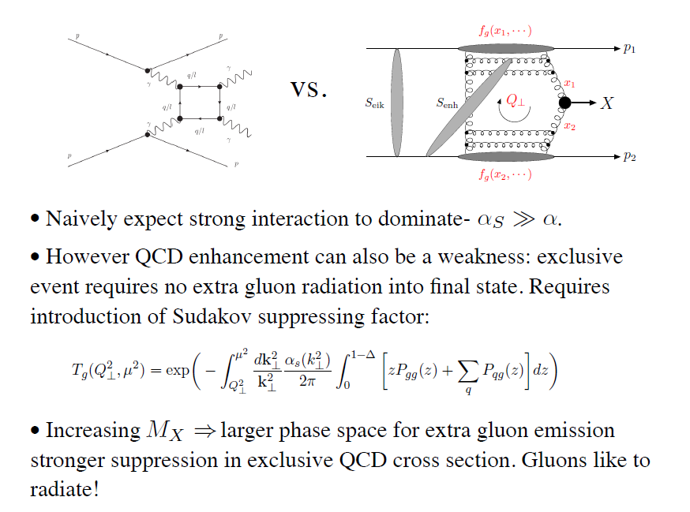
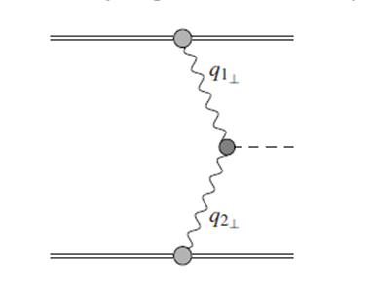


γ
X
γ
The LHC is the high energy photon collider
‘Large’ Pomeron size in the
production of the small size objects.
+ absorptive/rescattering effects- survival factor

Slide 48
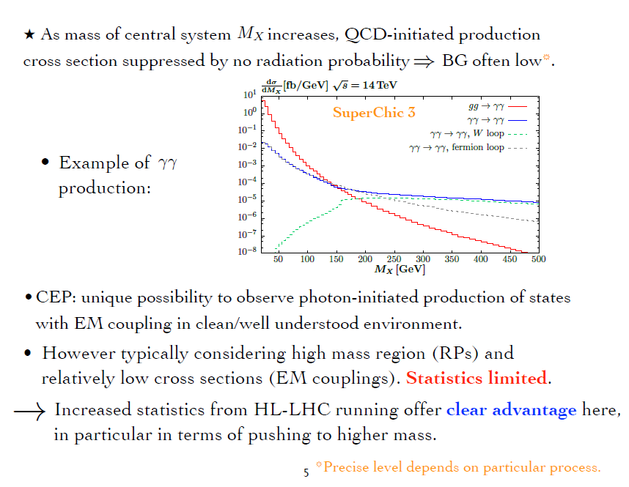
up to 1-2 TeV
Currently, CEP studies at the LHC are dominated (also HIC-UPC)

Slide 49
STANDARD CANDLES

Slide 50
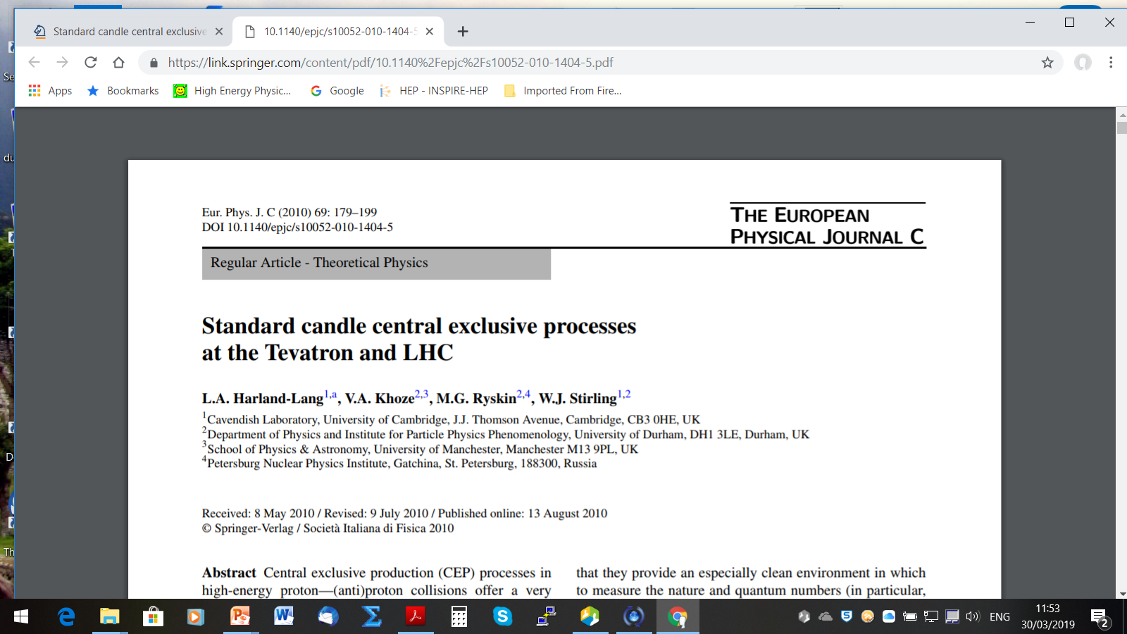


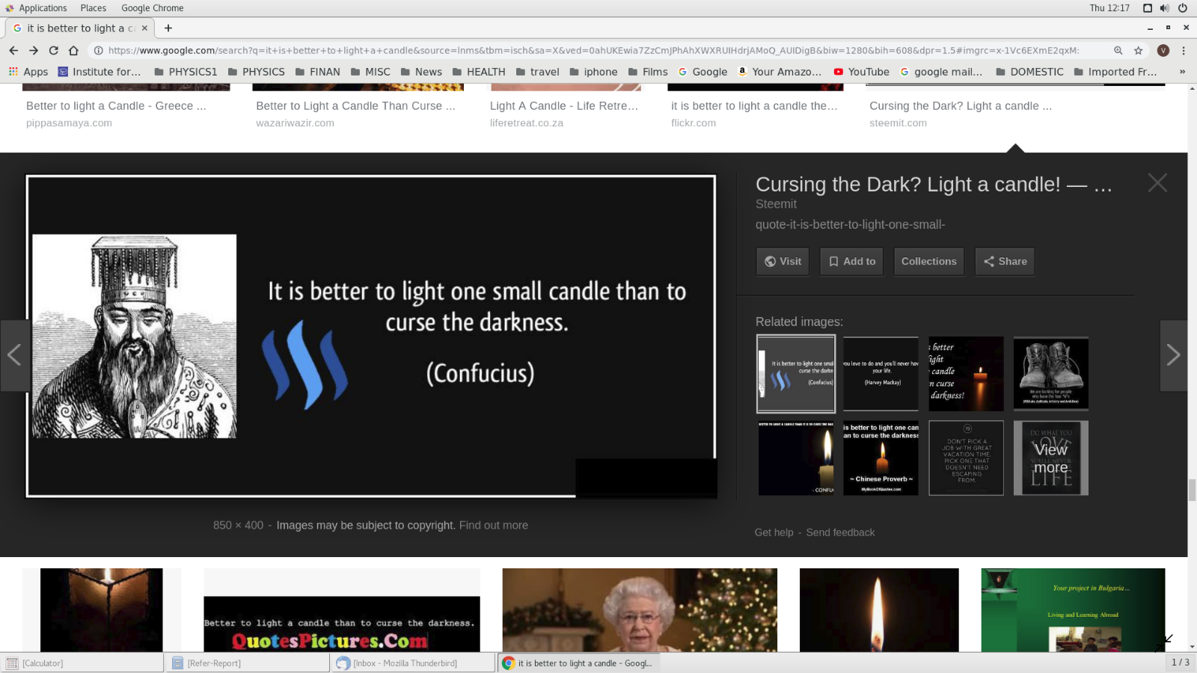


(spread of theory predictions)

Slide 52




( LHCb RG results)
and light

Slide 53


CDF
PRD-2008
D0-2010
Visualization of QCD Sudakov formfactor
Durham

Slide 54
T. Aaltonen et al. (CDF Collaboration), Phys. Rev. Lett. 108, 081801 (2012)
43 events
Et>2.5 GeV
(KMRS-04)
(HKRS-10)
proved to be very small (CDF) ( in agreement with expectations)

Slide 55


2012
D0-2010-dijets, new
CEP RHIC and
LHCb ( , 22 )
✶

Slide 56
RC-numerically suppressed
KMR-01
(Tumanov-1953,A. Alekseev-1958-positronium)
Glueball Filter ??

Slide 57



The ratio of high Et dijets in production with one and two rapidity gaps. CDF
CDF results on exclusive charmonium CEP, (CDF, PRL-09)
Hopes to continue with HERSCHEL

Slide 58

Dimeson SAGA

Slide 60
40 diagrams (4 basic)

(M.Benayoun,V.Chernyak,-1990)

Slide 62
is this easy to understand ?
Was popular (among the more formal community) MHV- technique
Nowadays the enthusiasm has a bit faded away- other approaches

Slide 63


Slide 67
Of special interest: searching for the structures in
J/ψJ/ψ spectrum in the CEP environment.

Slide 68
OTHER SELECTED CEP TOPICS

Slide 70

1 : 0.03 : 0.08

Slide 71


✴
HKRS-10

Slide 72



Slide 73
✴

Slide 75


Slide 76



EXCLUSIVE JET PRODUCTION
(CDF-2008)

Slide 77
SuperChic-2

Slide 78
(Phys.Rev.D 68 (2003) 034001)
hep-ex/0205037
It may make sense to repeat this measurement at the LHC/RHIC ?
KKMTR, 2001-2002

Slide 79
(V.Yu.Petrov, M.G.Ryskin)
Sphaleron-transition on top of an energy barrier

Slide 80
Instantons have never been observed experimentally, however, they are
playing a very important role in the theoretical models of confinement and
chiral symmetry breaking
(V.Yu.Petrov, M.G.Ryskin)
one of the biggest challenges for particle physics to date
‘soft bombs’ –high-multiplicity spherically symmetric distributions of relatively soft particles
Extended objects in space-time
Effectively –a family of new multiparton vertices in Feynman diagrams

Slide 81
(M.G. Ryskin)

Slide 82
KKMRT-2021-2022
dominates
KMR-like
✶ Detecting two outgoing protons would allow placing an upper limit on Instanton mass.
✶
(‘hermiticity’)
state

Slide 83
Dominant
Fig.2
~ hundreds of pb
but Z²
Fig.3
UPC-no PU nightmare
HIC
Full set of analytical formulas for the partonic processes, calculated for the first time

Slide 84
CENTRAL PRODUCTION
TMKR arXiv:2208.14089 [hep-ph]
✶
pb
✶
The x-
✶

Slide 87


CONCLUSION
The direct experimental observation of Instanton-induced processes would be a real breakthrough in particle physics.
(lower end of partonic energies 20-80 GeV).
An existing lack of evidence by no means leads to the conclusion that QCD instanton
“does not exist”, but rather that their actual production rate is on the low end of predictions.
Potential for large sources of theoretical uncertainties covering orders of magnitude.
A practical point for future progress is to test theory normalization of predicted instanton rate with data.
Searches for the signal in non-diffractive events are very challenging: modeling the detailed final state, background suppression, and separation from the possible SM and BSM sources of the “hedgehog-like ” events. Events with a large pT signature are too rare.
Diffraction (single tag, CEP) promises some attractive advantages: cleaner signal, suppressed
‘standard’ backgrounds (MPI).
Currently, after accounting for the detector effects the distributions are sufficiently washed out, and it becomes quite challenging to extract the pure instanton signal. On top of this, the PU background turns out to be large, especially for the case with two tagged protons requiring work at lower luminosities.

Slide 88


Strong need for enthusiastic experimental experts to join the efforts, addressing such issues as detector effects, PU at high luminosity, and timing resolution…..
(Marek Tasevsky et al)
One of the main obstacle currently – PU at high luminosity
Possible directions for further studies
✵
Feasibility of searches for moderate mass Instantons in UPC
✵
Using good timing from Central Detectors for both ST and DT events.
✵
Identification of charm quark jets in the final state

Slide 89

Forward Proton Tagging significantly could extend the physics reach of the ATLAS and CMS detectors by giving access to a wide
range of exciting new physics channels.
FPT has the potential to make measurements that are unique at LHC.
FPT could serve as a spin-parity analyser and offers a sensitive probe of the CP structure of the new states.
There are a number of important measurements to be performed in the RG environment at LHCb and ALICE at low
μ.
The theory of the CEP is in a reasonably healthy shape,
and dedicated MCs (such as SCs) are well developed
The predictions are backed by the series of CDF/D0 CEP-like measurements as well
as the RAP GAP measurements by the LHCb and ALICE +CEP results from ATLAS& CMS

Slide 90
The dedicated AFP and PPS detectors are allowed to use the timing.
The main issue is PU suppression, though some progress is foreseen,
in particular with the addition of timing from the CD.
But ATLAS has already decided not to run AFP at HL-LHC
(at least not in the foreseeable future)
10ps in Run 4
At large M_{Mmis}> 150-200 GeV the photon-photon fusion dominates
over the gg. LHC is the photon-photon collider!
Such important measurements as the searches for the new Higgs-like states
(e.g. resolving the 96 GeV puzzle) , as well as the moderately-heavy instantons, would require
the 420 m stations.
The bulk of important physics (such as glueball,instantons and other new
state searches) would require low luminosity runs.

Slide 91


