Slide 1



VALERY A. KHOZE
(IPPP, Durham University)
Tuesday, October 13th, Class B, Exact Science
Presentation of major current activities
Very special properties of the Top quark
Searches for new ways to confirm the existence of the Odderon.
Searches for Instantons

Slide 2
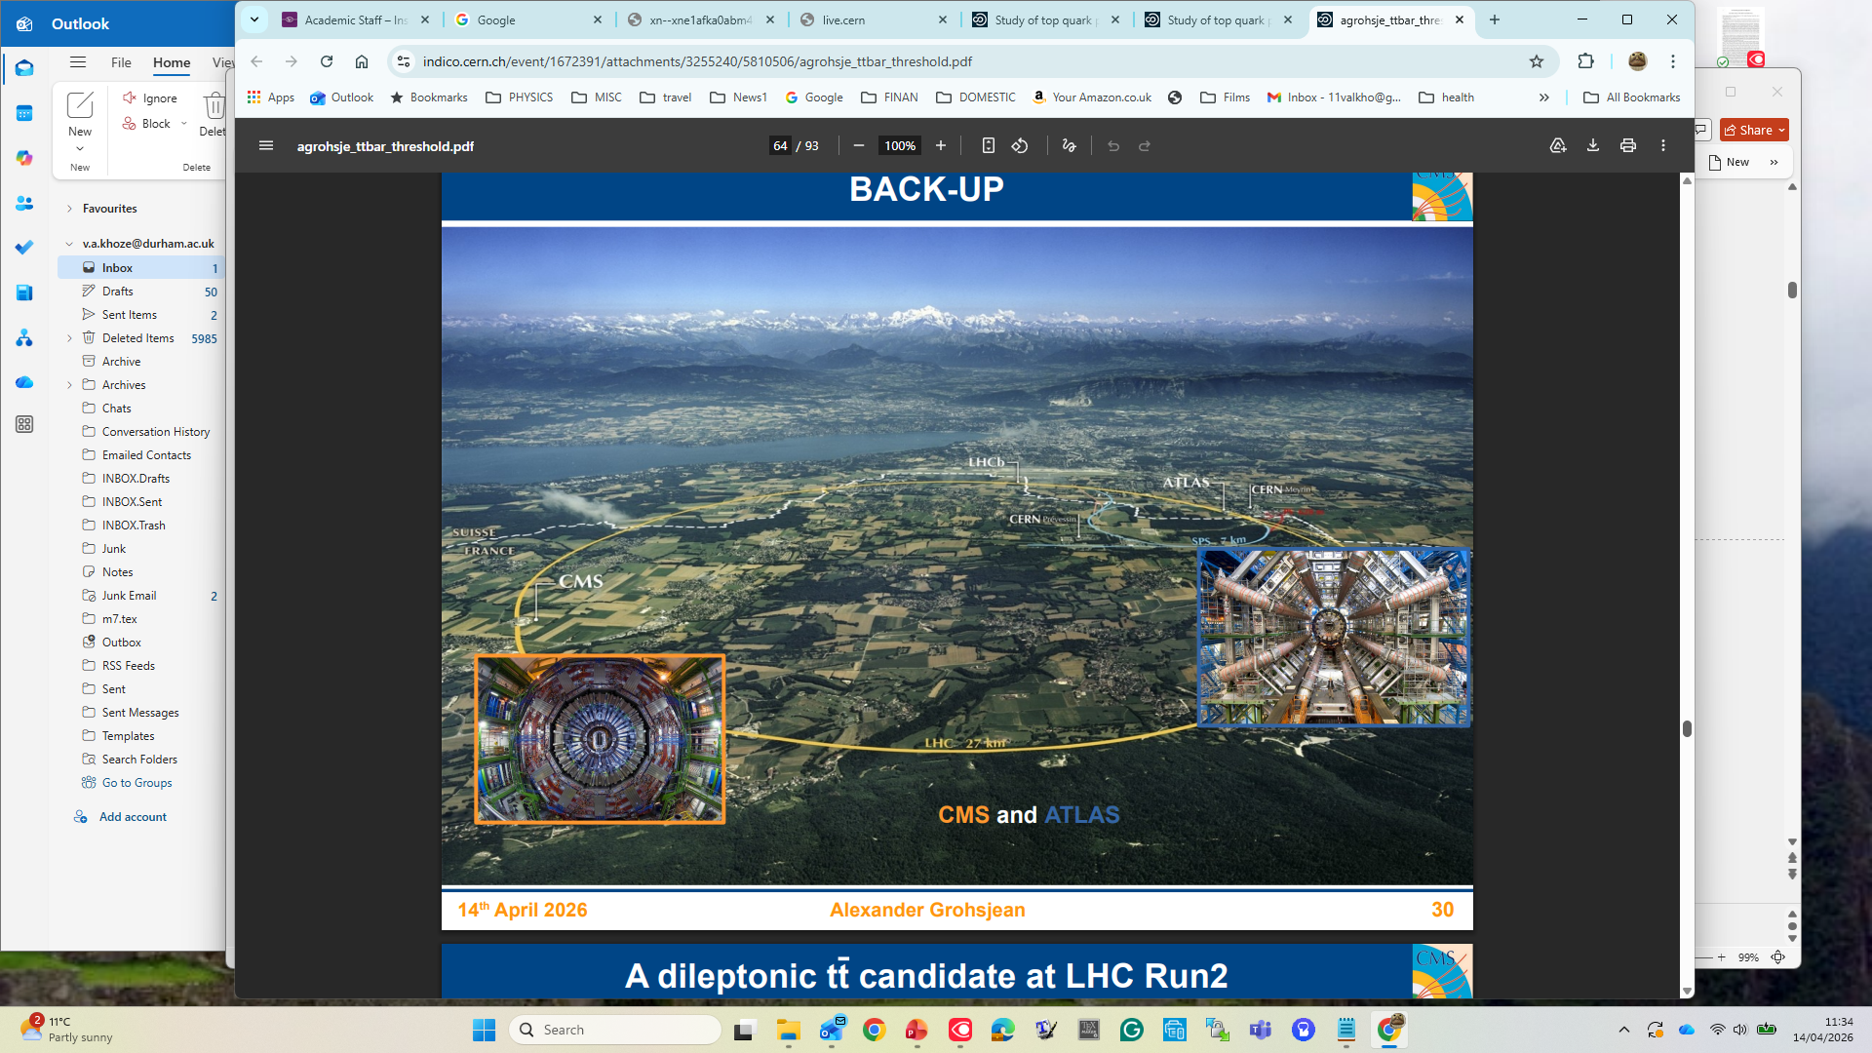

Colliding Energy 13.6 e+12 electron volts

Slide 3
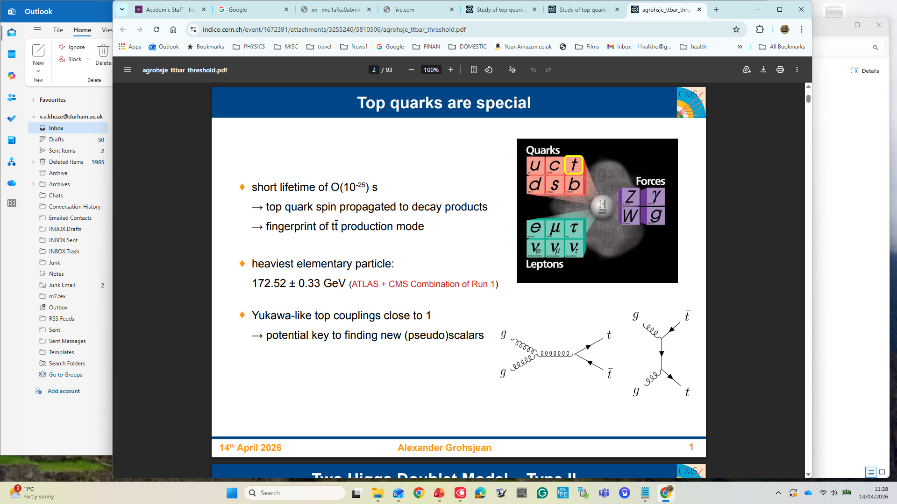
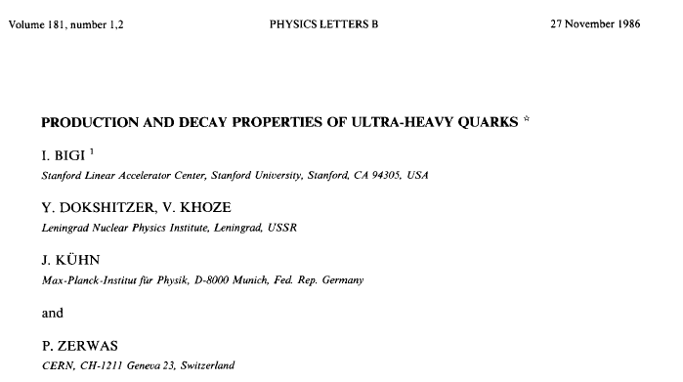
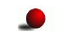



semi-weak decay
10 years prior to the top quark experimental discovery
A top quark decays long before it can be hadronized. No dressed hadronic states containing top (t-flavoured hadrons).
WWW
The characteristics of top production and of accompanying hadrons could be analytically calculable.
Top mass-an important ingredient for SM precision analyses.
Equivalent to the mass of an atom of gold
Stability of the Universe.
Stability of the
‘Toponium’
Quasi-bound state

Slide 4
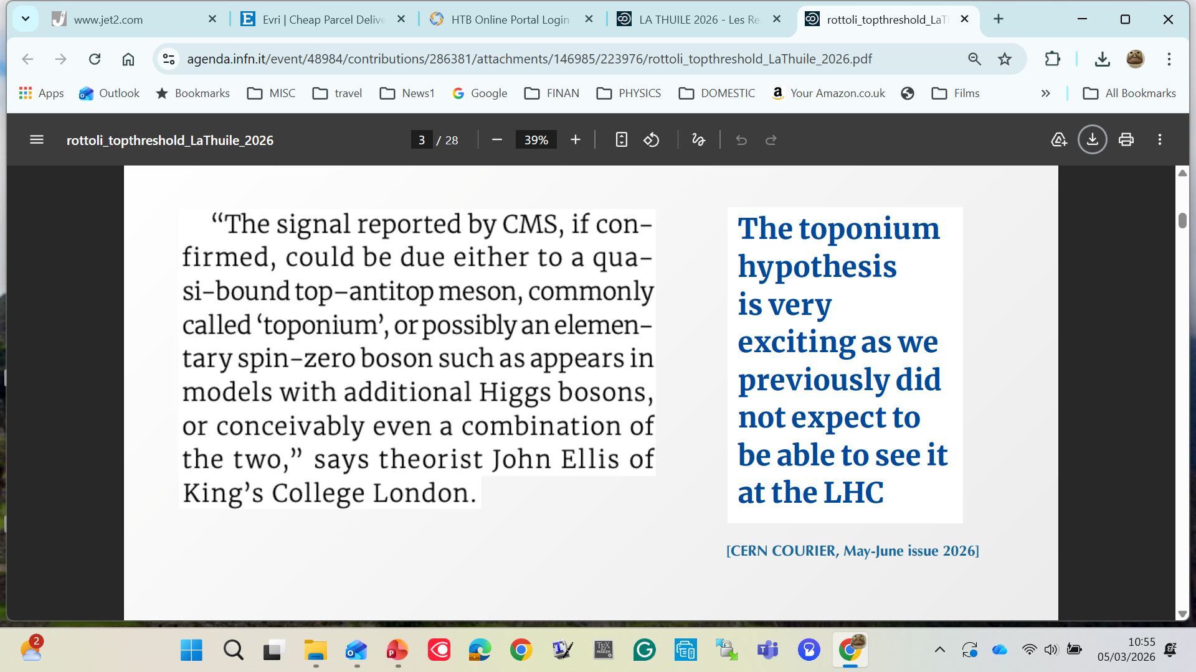
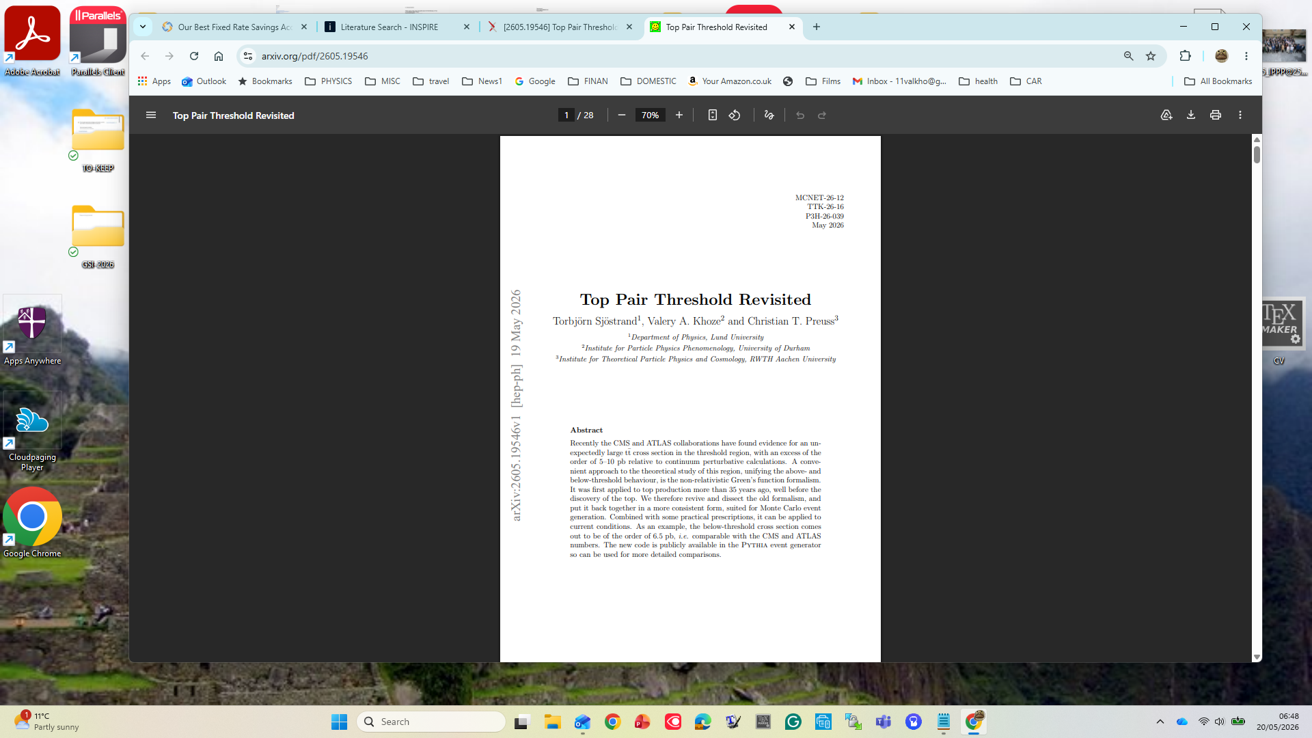
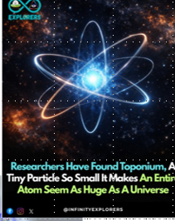
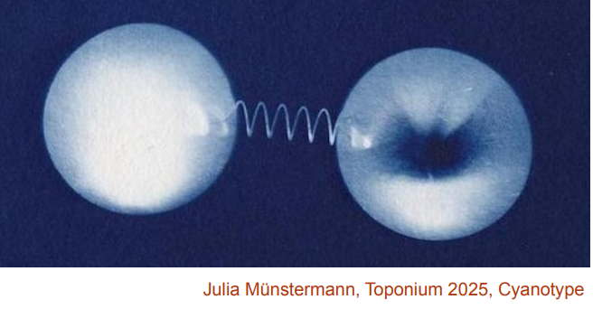
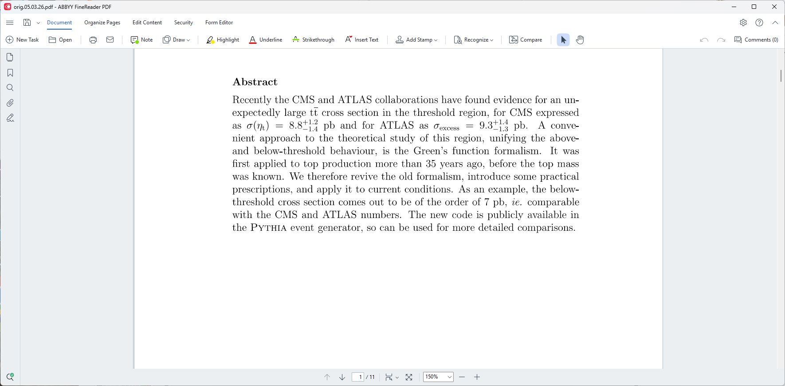
?
LHC nicknamed a ‘Top Factory’-
hundreds of millions of top quarks quarks
First analytic calculation of the top quark threshold production at hadron colliders
Sjostrand, Fadin, Khoze 1990.
Top quark discovery at Fermilab 1995.
Observation of the top-pair threshold enhancement at the LHC 2025-2026.
Implementation of analytic results in the Pythia event generator SKP, 2026
May 2026
SKP-26 6.5 pb

Slide 5
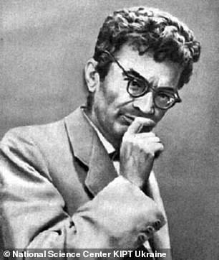
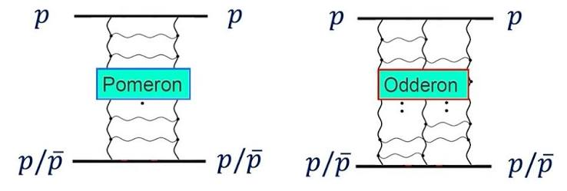
ODDERON
Pomeranchuk theorem (1958): at very high energies, the difference in interaction of an elementary particle and antiparticle with the target particle vanishes
I.Ya. Pomeranchuk, 1913-1966
Łukaszuk; Nicolescu 1973
Firm prediction of Quantum Chromodynamics
In QCD the Odderon exchange amplitude is expected to be very small, quite challenging to observe
Totem collaboration at the LHC claims experimental discovery, 2018- 2021.
New experimental confirmations are still needed.
Some non-conventional methods are proposed by VK and collaborators (2018-2026)

Slide 6


Imagine a ball sitting in a valley. A hill separates it from another valley.
Normally, if the ball doesn't have enough energy to climb the hill, it stays where it is.
In quantum physics, however, there is another possibility: the ball can appear on the other side of the hill without going over it. This is quantum tunnelling.
An instanton is a mathematical description of a particularly important kind of quantum tunnelling event. A. A. Belavin, A. M. Polyakov, A. S. Schwartz and Y. S. Tyupkin, Phys. Lett. 59B 85 (1975).
QCD instantons were either directly responsible for generating or contributed to many fundamental aspects of low-energy dynamics of strong interactions
Instanton-based phenomenological models provide at least a qualitative description of the QCD vacuum.
Observation of Instantons is one of the biggest challenges for particle physics to date
Effectively –a family of new multiparticle vertices in hadron collisions
Appearance of the ‘fireballs’ with multiple particles in the final state
Our motivation is to search for QCD instanton events directly in scattering experiments at the LHC. VK and collaborators (2021-2026). We proposed searches in a special type of events, where severe backgrounds are strongly suppressed.
In the past, in the context of deep inelastic ep scattering, QCD instanton contributions were searched for (but not observed) at the HERA collider

