Slide 1
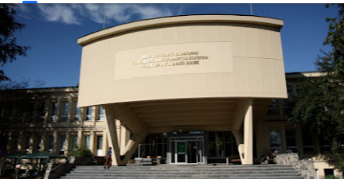

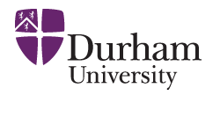
On the prospects of ‘CEP’ studies at the LHC
(selected topics)
V.A. Khoze (IPPP, Durham)
main aims: to illustrate the "diversity and inclusion" of the ‘CEP’ program
and to address the possibilities for the future.

Slide 2


Slide 3
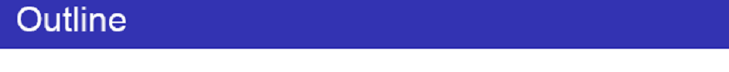

Motivation (why are we interested in CEP processes?)
CEP and Large RAP GAPS.
QCD-induced CEP mechanism.
Gluon –gluon vs photon-photon fusion.
CEP as a spin-parity analyser
, Dijet a bit of personal flavour
Higher precision constraints on the tau g − 2 photon–initiated production
Summary and Outlook
Life, death and “resurrection” of ‘Diffractive Higgs’
With a bit of personal flavour
Dijet CEP as a ‘gluon factory’

Slide 4


LRGs caused by Pomeron,
photon (W,Z) or Odderon exchanges
.
(TOTEM/ALFA)
No plans for high runs in 2025-2026,
But a lot of already accumulated data in 2018
$β∗$
Threshold scan.
${"η}_{t}$“ enhancement in the tt threshold region, KMR-2000
This Photo by Unknown Author is licensed under CC BY-NC

Slide 5


‘exclusive’
X
~200m
(Maciej Trzebinski)
AFP/PPS
(LHC runs 1,2,3)
(ALICE-double Gap trigger)

Slide 6
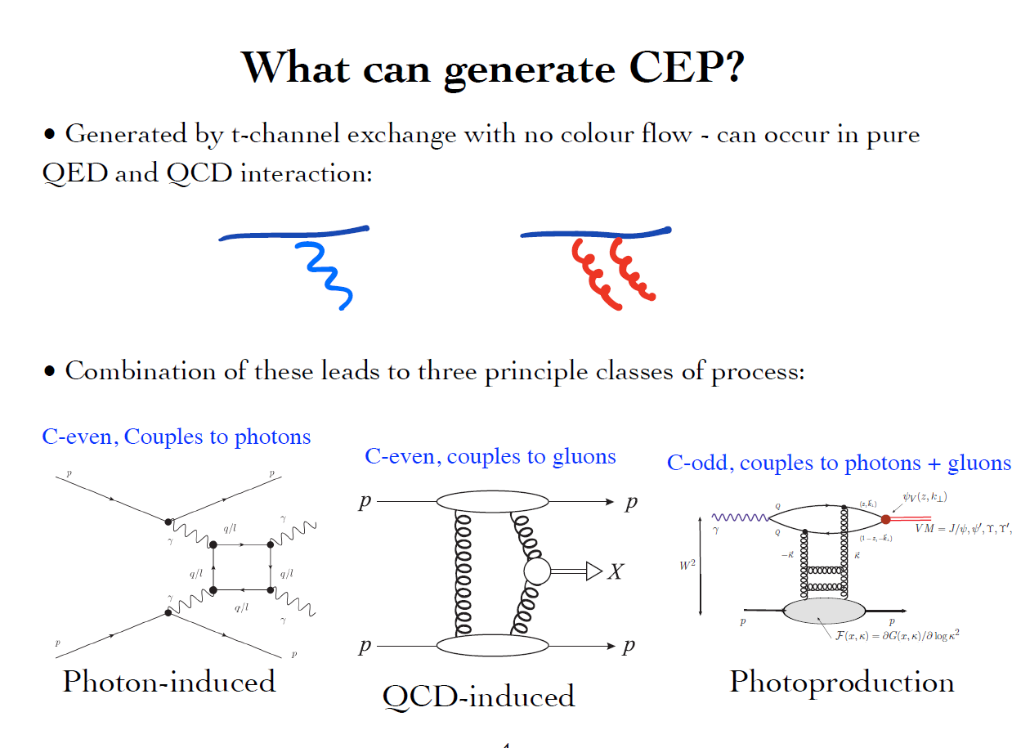
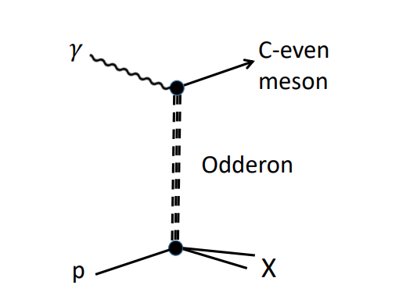

Slide 7
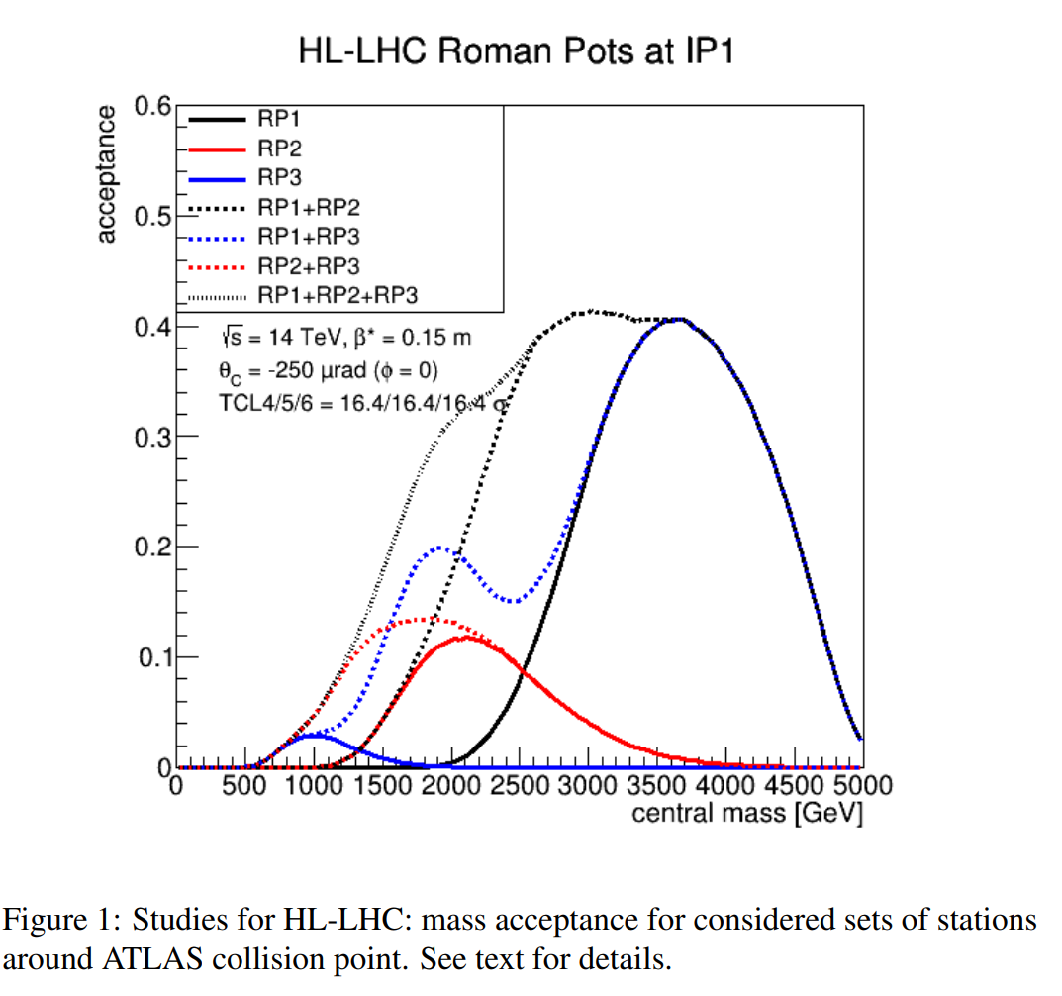
AFP & PPS
(Maciej Trzebinski)
Standard HL runs. With precision tracking and timing detectors.
(0.02-0.15)

Slide 8
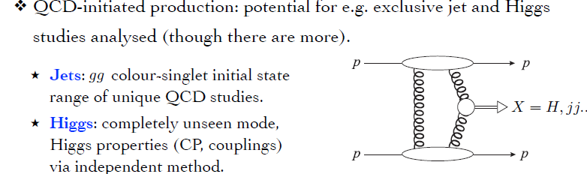
KMR-97-01

Slide 9
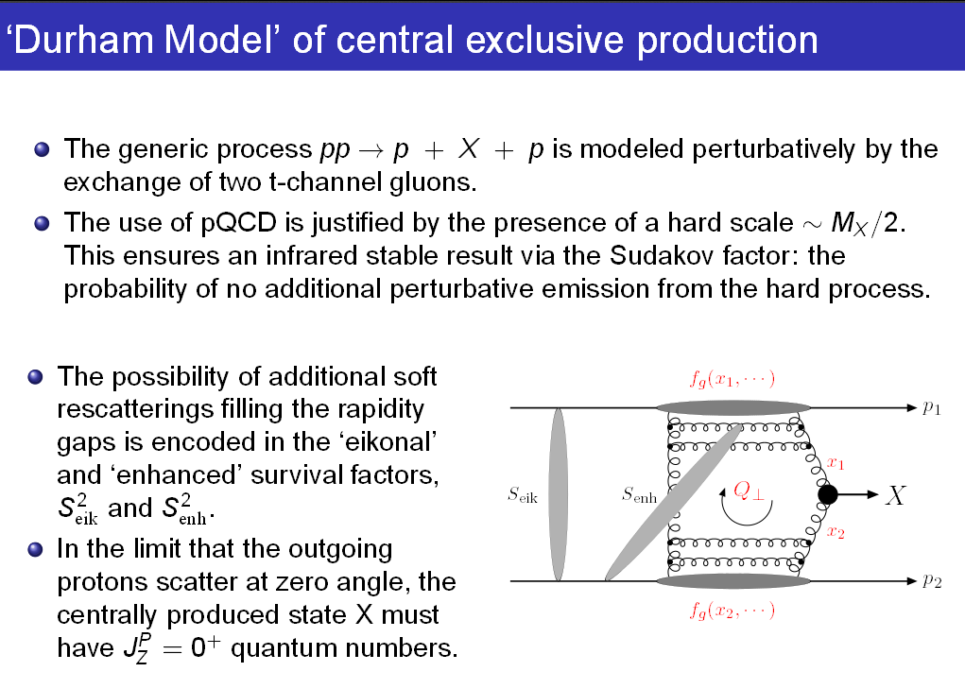
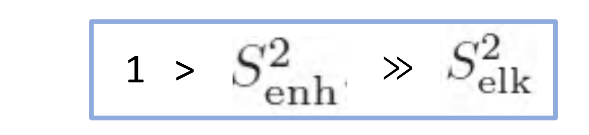
KMR-1997-2001

Slide 10
Process dependence
Fully differential implementation of soft survival factor – SuperChic 2 -5 MCs
for pp, pZ, and ZZ scattering

Slide 11
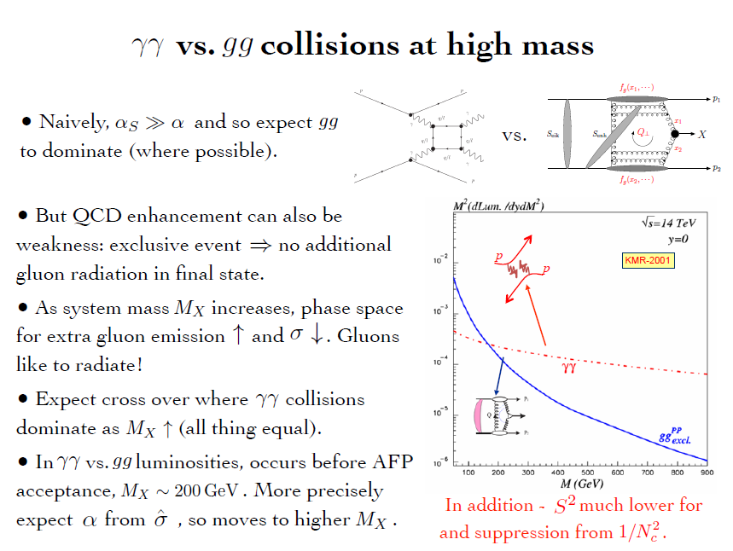
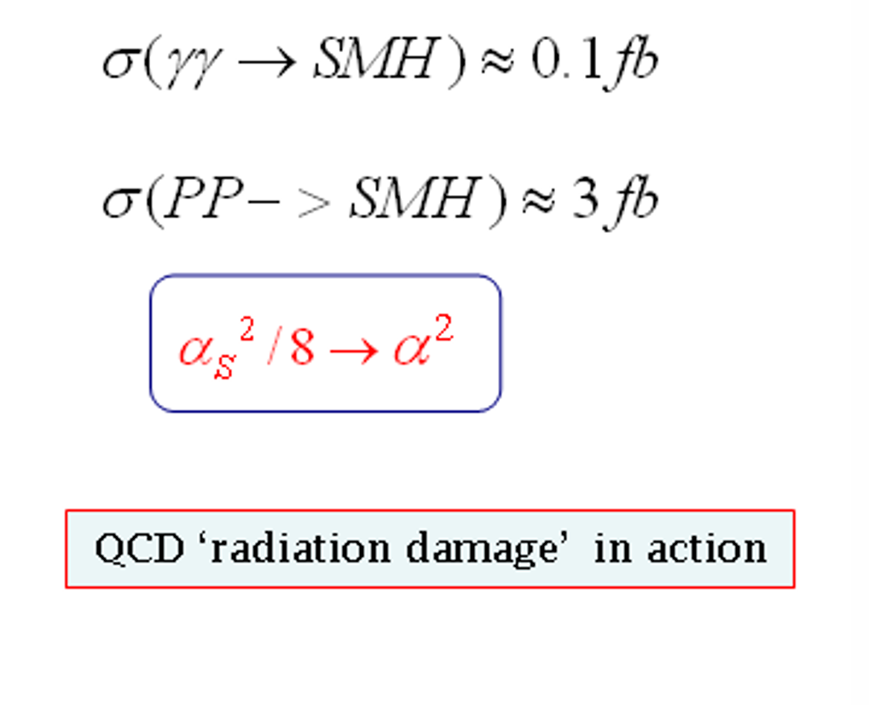
for gg.

Slide 12
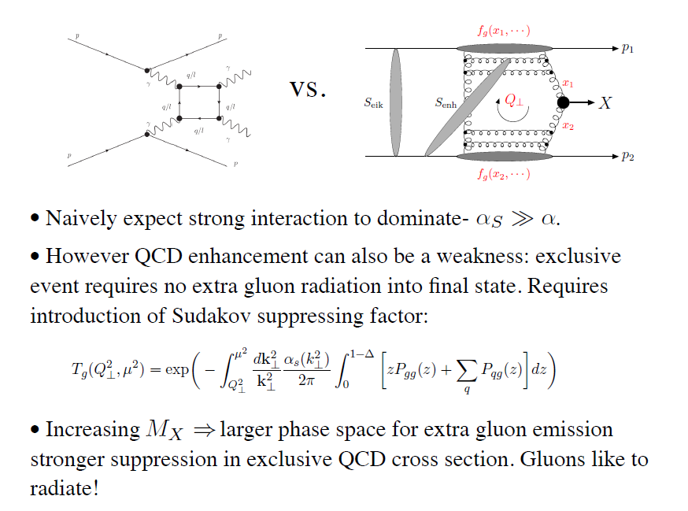
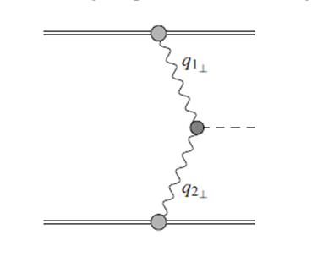


γ
X
γ
The LHC is the high energy photon collider
H
‘Large’ Pomeron size in the
production of the small size objects.
+ absorptive/rescattering effects- survival factor
Exp. Issues Artur Kalinowski

Slide 13
Life, Death and “Ressurection “ of ‘Diffractive Higgs’

Slide 14
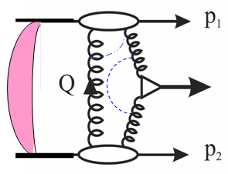

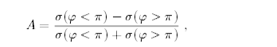
(
σ
φ < π
)
−
σ
(
φ > π
)
(
σ
(
φ < π
)
−
σ
φ > π
)
~p
∼
sin
~n
·
(
~p
×
)
φ
The main advantages of CEP Higgs production
• Prospects for high-accuracy mass measurement
(irrespectively of the decay mode).
• Quantum number filter/analyser.
( 0++ dominance; C,P-even)
 H ->bb opens up (Hbb Yukawa coupl.)
(gg)--,++  bb in LO ; NLO,NNLO, b- mass effects – controllable. M(+++-)=(M---+)=0
 For some scenarios, CEP may become a discovery channel
• A handle on the overlap backgrounds- Fast Timing Detectors (10-20 ps timing or better).
 New leverage –proton momentum correlations (probes of QCD dynamics , CP- violation effects…)
H
KMR-1997-2001
A
=
could open a way to measure H→cc (coplanarity…. cuts)
BSM
‘95 GeV anomaly’
Triple product correlation:
Integrated counting asymmetry (~10%)
0
1
⊥
2
⊥
φ < π
σ
(
) +
σ
(
φ > π
)
=
A
σ
(
φ < π
) +
σ
(
φ > π
)

Slide 15
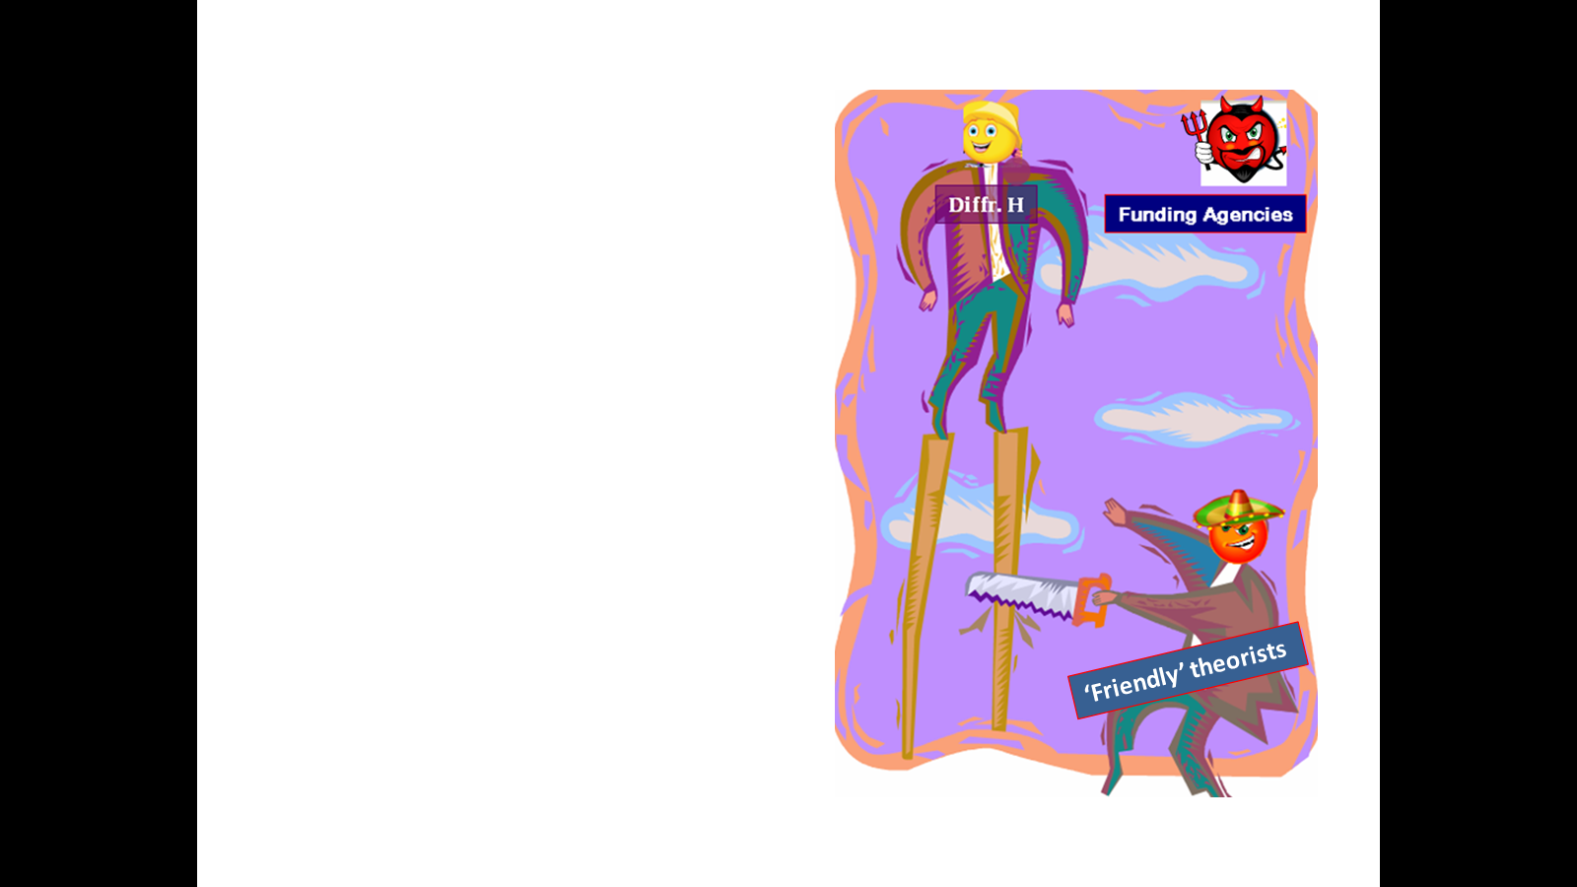

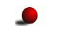
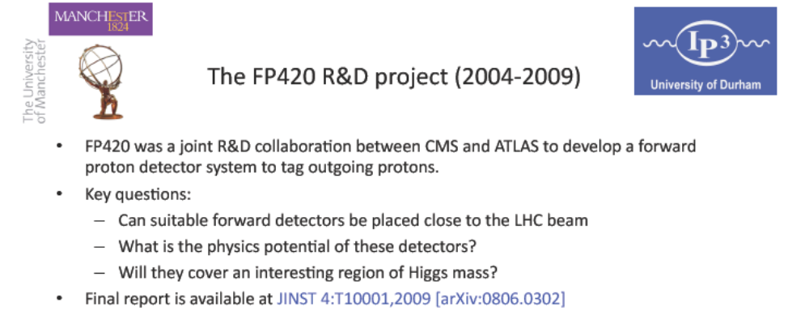
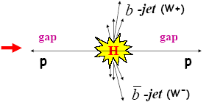
FP420 and Resurrection of ‘Diffractive HIggs’
(20 years on)
searching for lower mass new objects in CEP requires far away (~400m) FDs
PPS/PPS2- new proposals

Slide 16
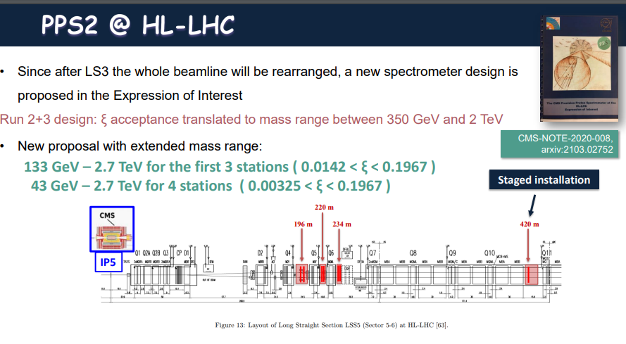

Slide 17
CEP AS A SPIN-PARITY ANALYZER

Slide 18
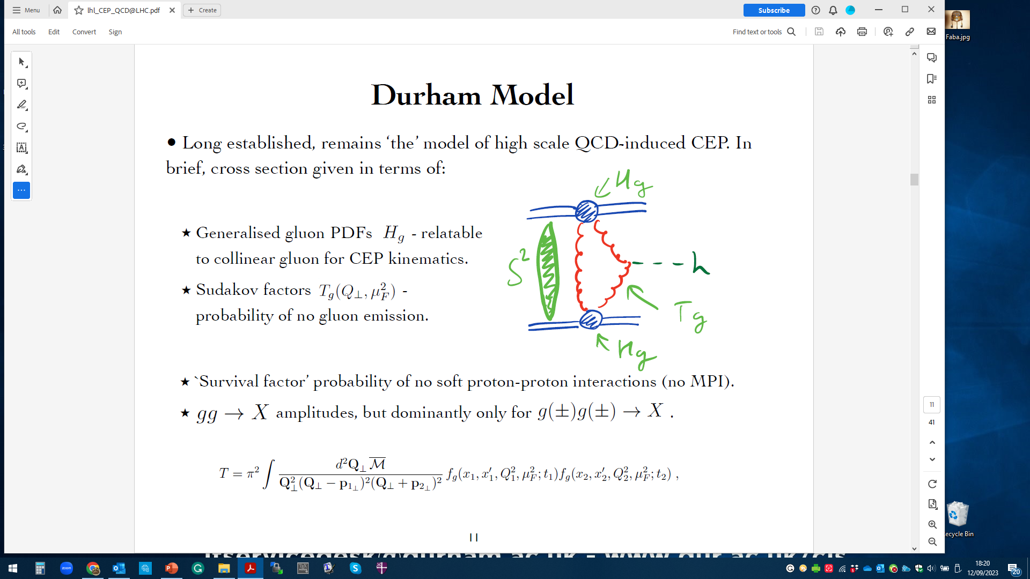
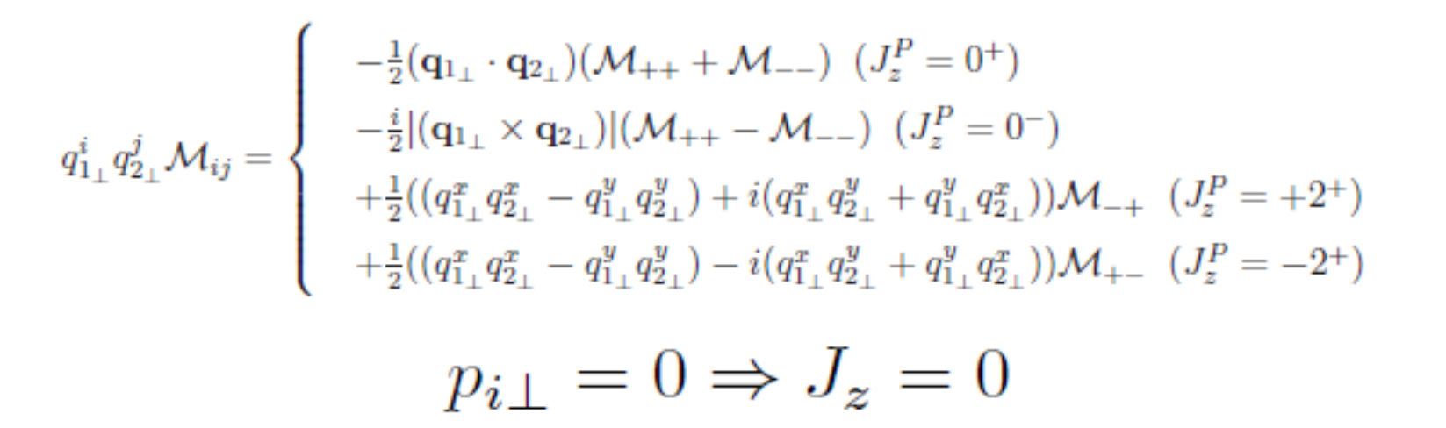
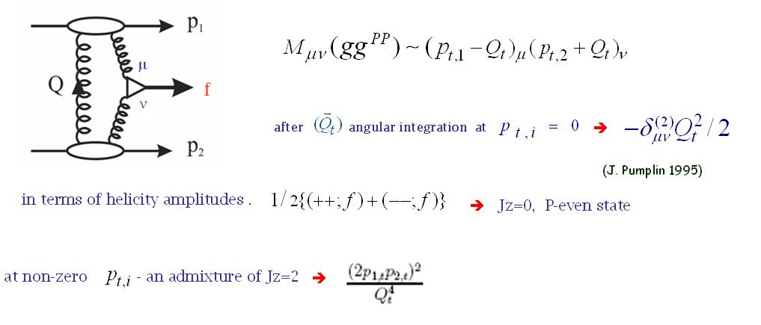
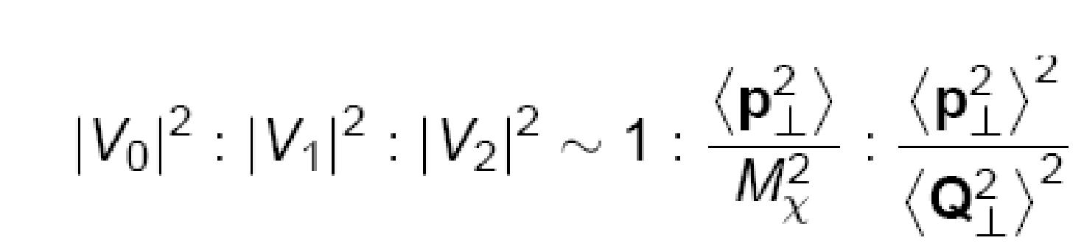
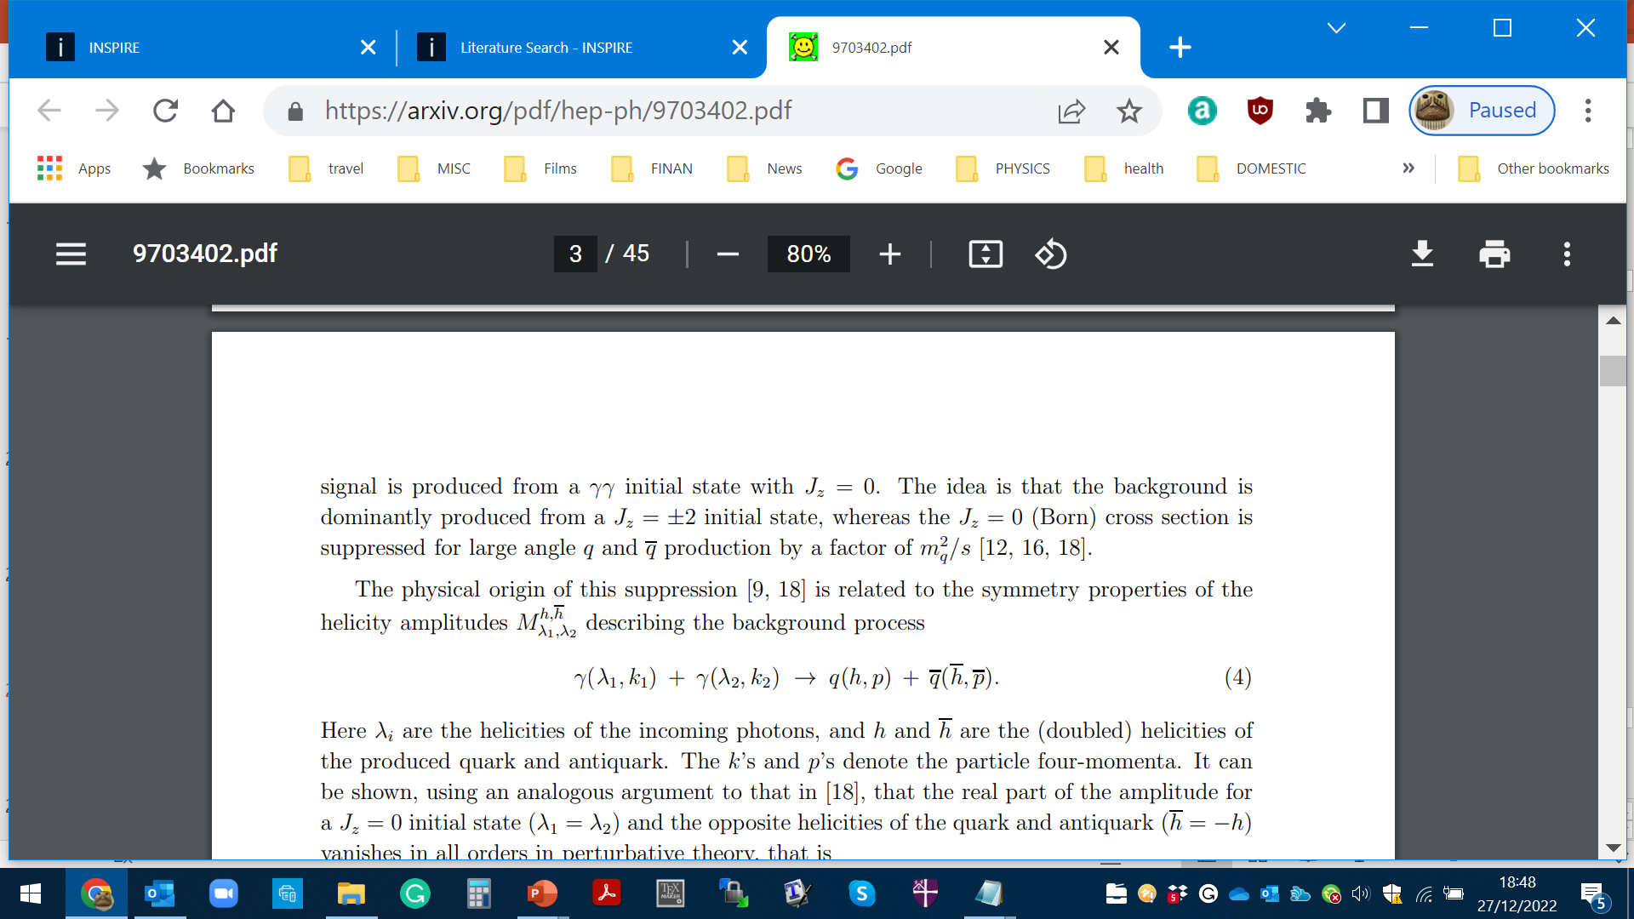
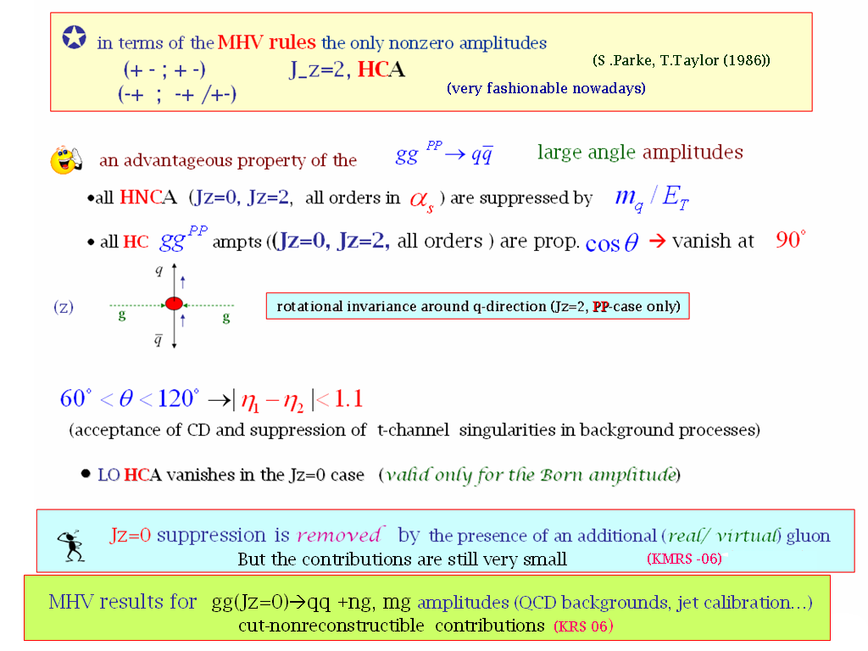


(HKRS-2010)
Important consequences for$H→b\overline{b.}$
Symmetry properties of the amplitude (FKM-97)
(++,+-) (--,+-)
(++,-+) (--,-+)
$$J_{Z}=0$$
(nullifies in the massless limit)
gg→qq
‘An Amplitude for n Gluon Scattering’

Slide 19
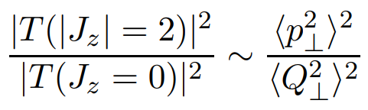
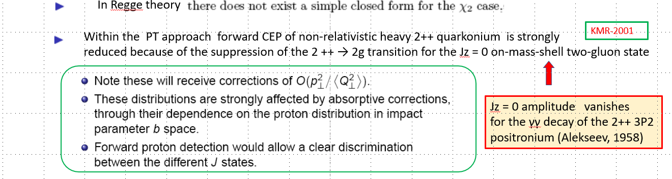
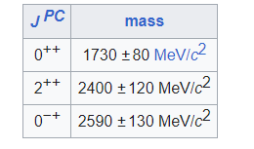
Jz = 0 amplitude vanishes
for the γγ decay of the 2++ 3P2
positronium (Tumanov, 53;Alekseev, 58)
Glueball filter ?
Lattice results
Eur.Phys.J.C 80 (2020) 11, 1077

Slide 20
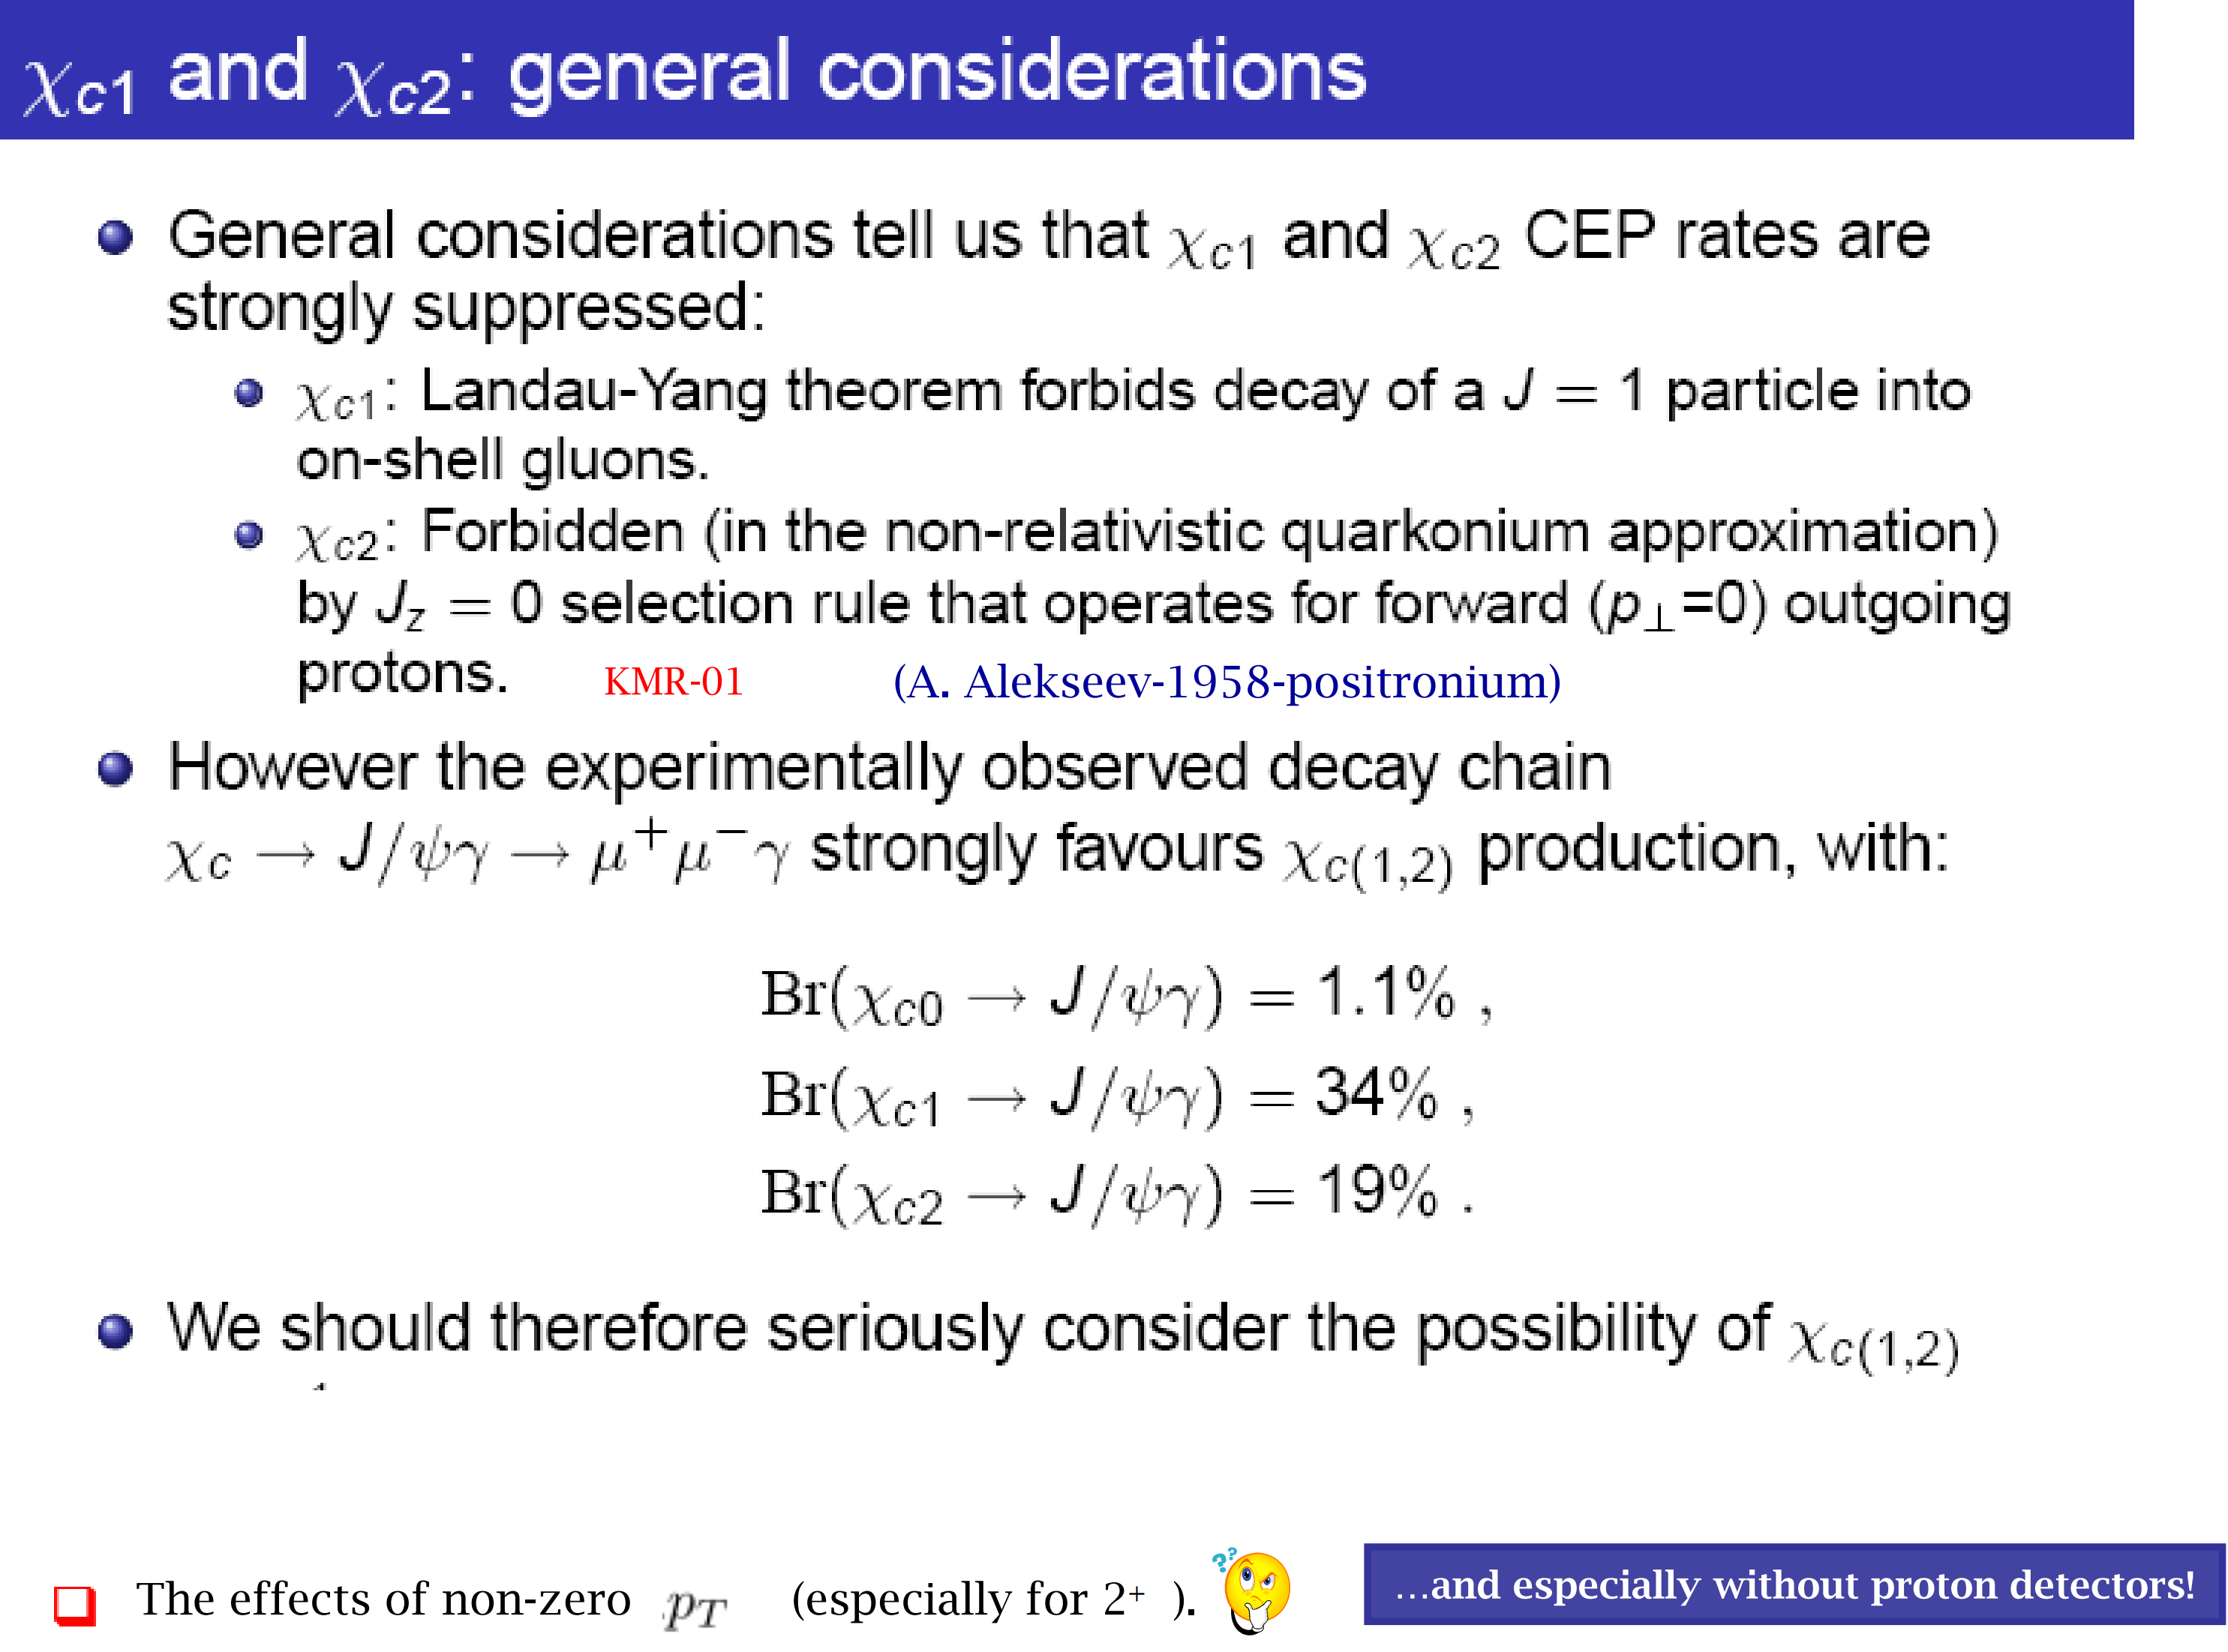

Slide 21
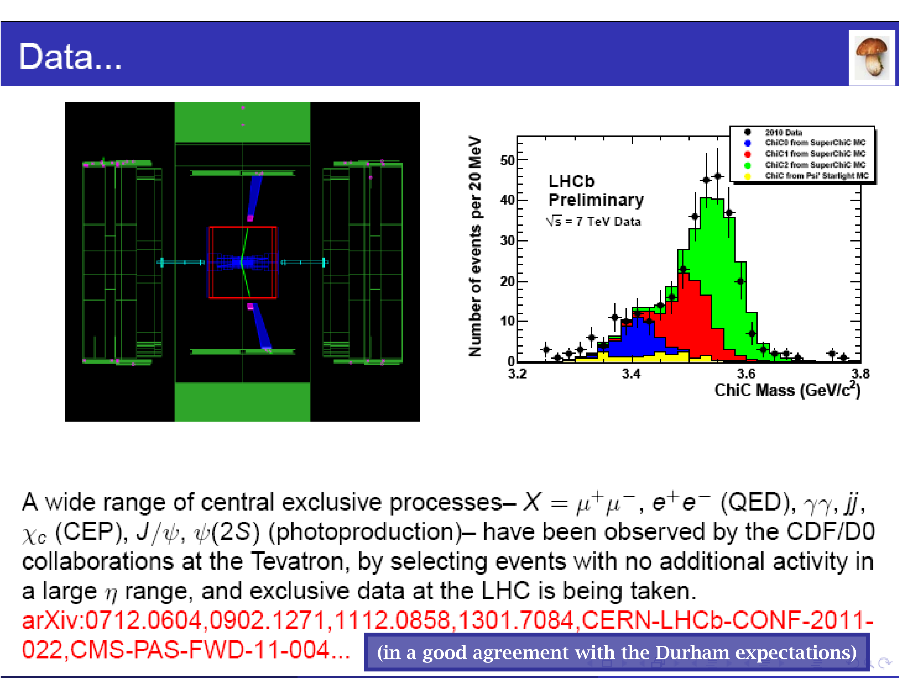

Slide 22
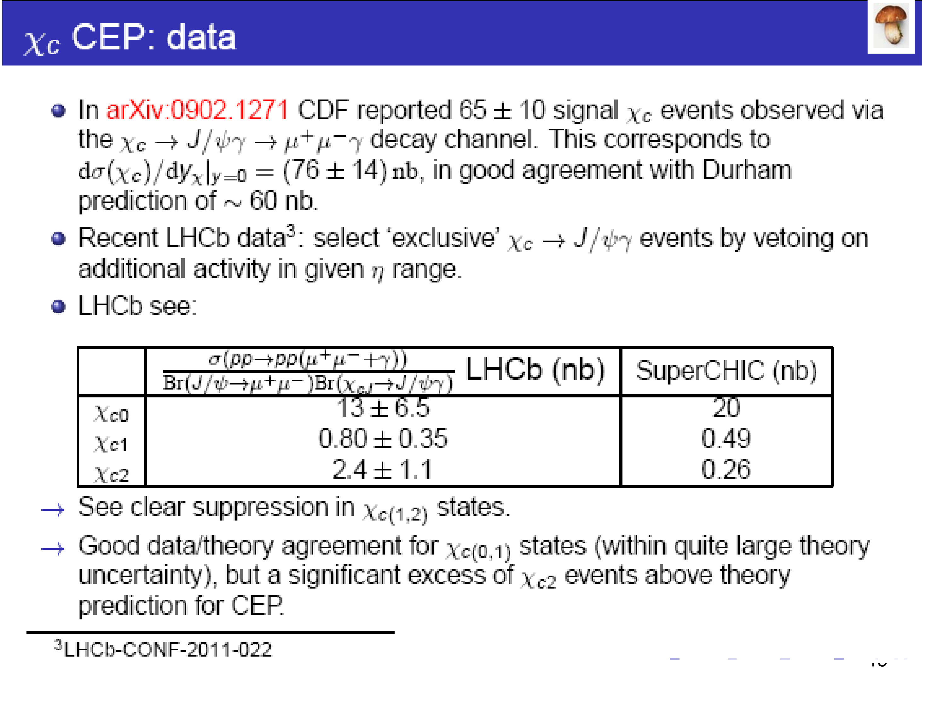

Slide 23
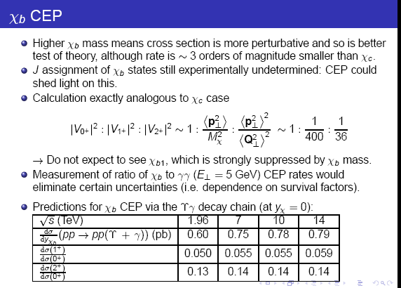
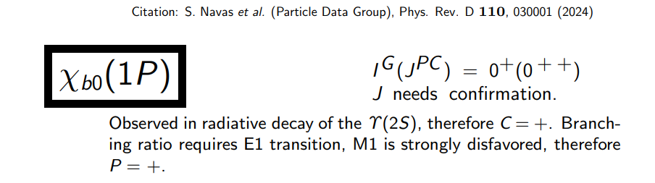

Slide 24
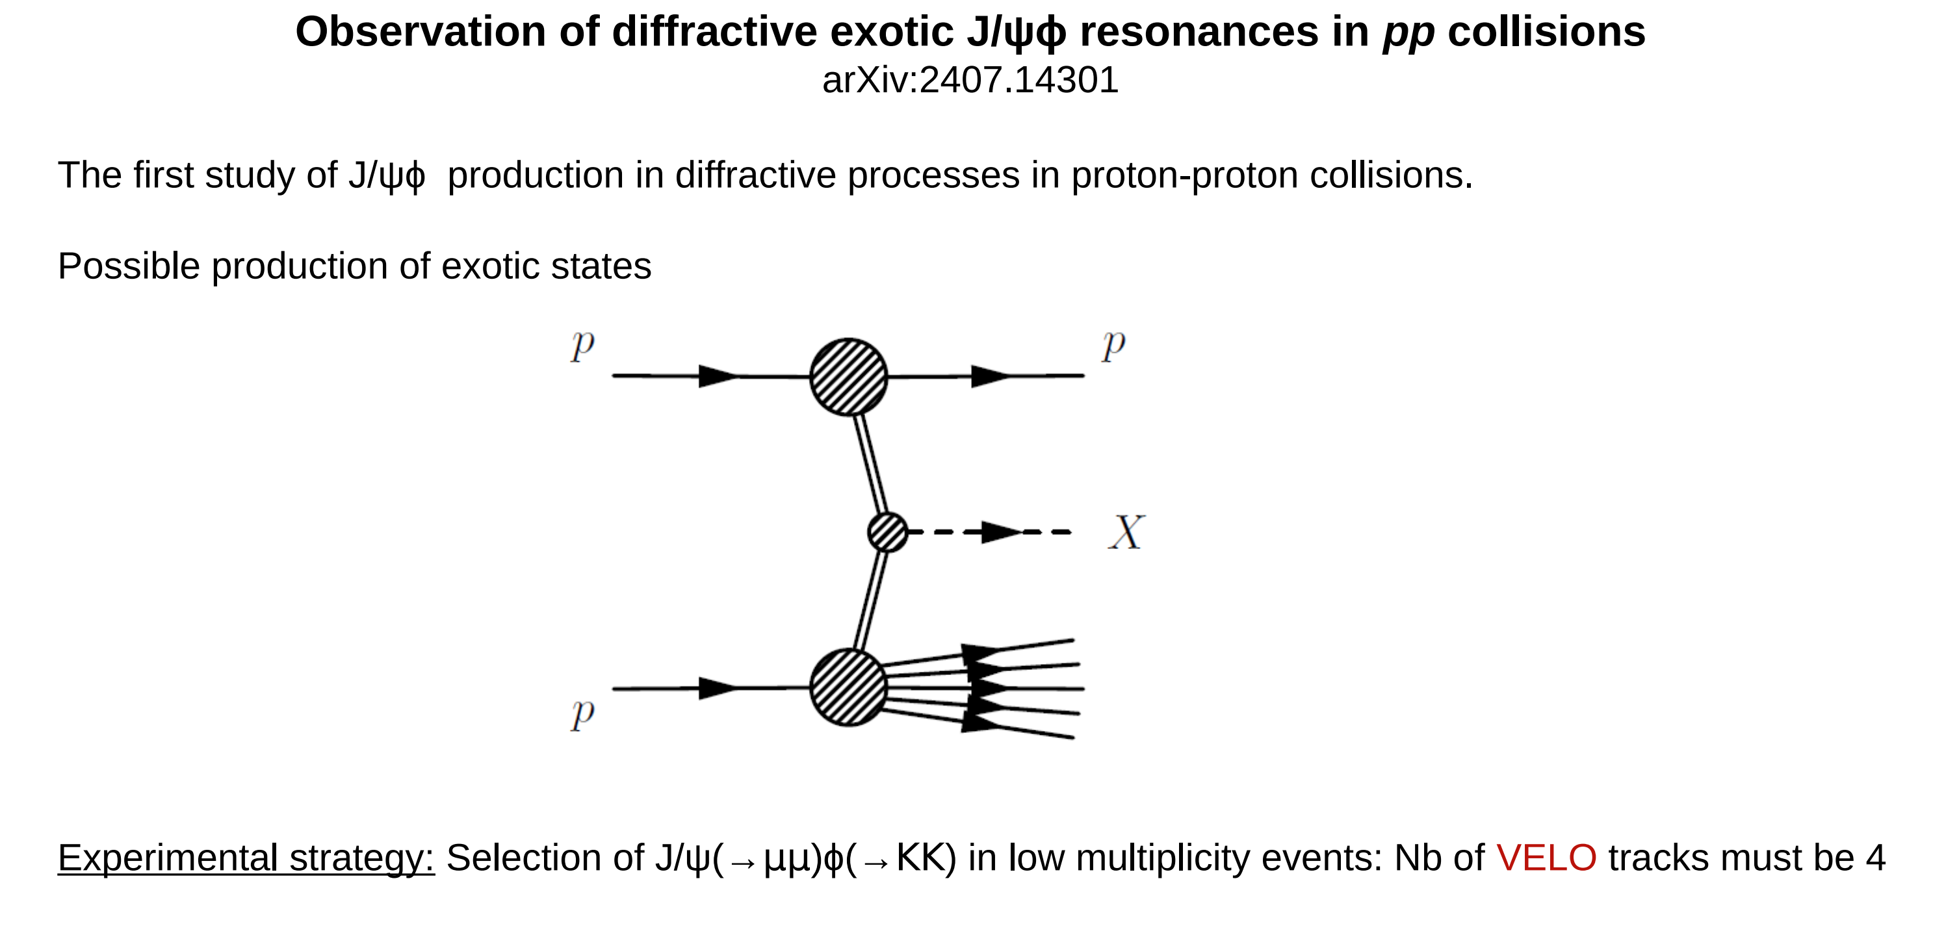


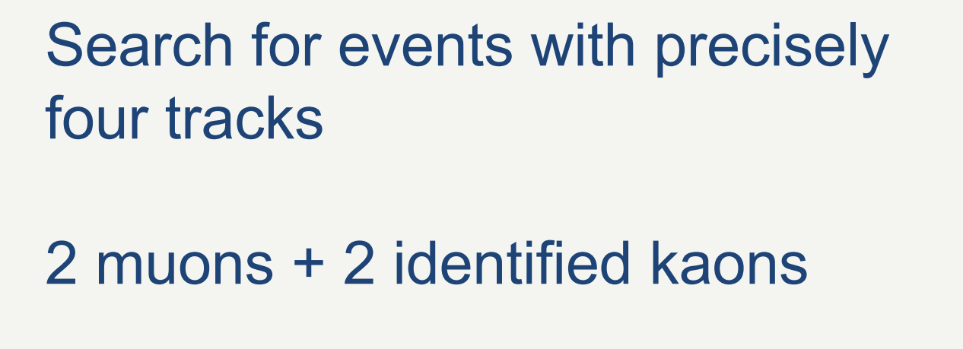

*
Currently Herschel not applied

Slide 25
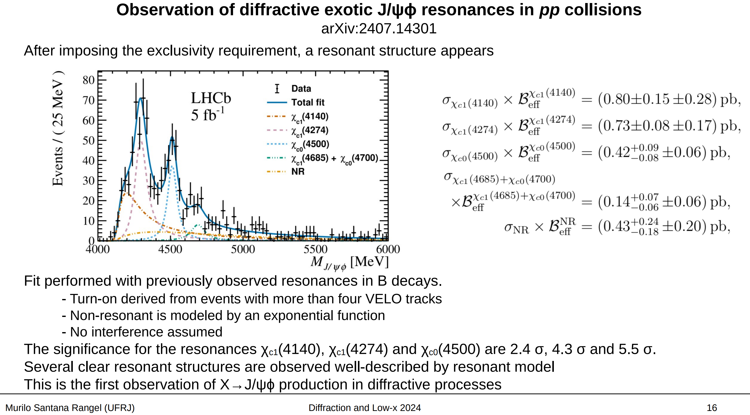

Slide 26

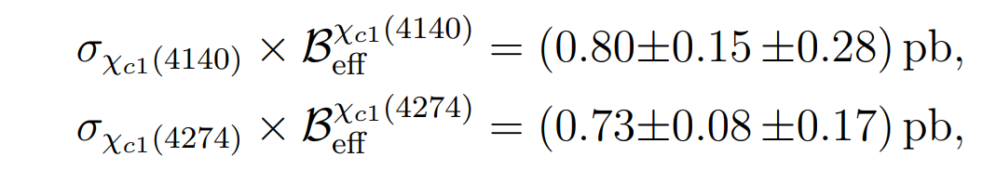


A bit puzzling: strong $1^{+}$ signal
For pure CEP within the PT (gg-fusion) picture- expect a factor of 100 suppression.
Ways out:
1. Huge difference in BR’s ?
2. (Unexpected) large contribution of high-mass proton dissociation.
3. Non-perturbative physics- molecules?
5. Misassignment (Herschel ??)
,
≫

Slide 27
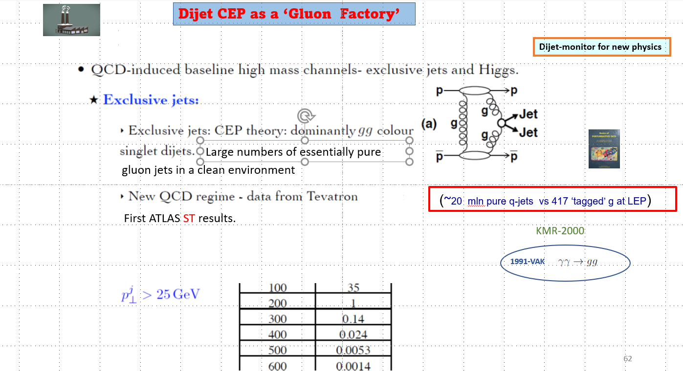

Slide 28
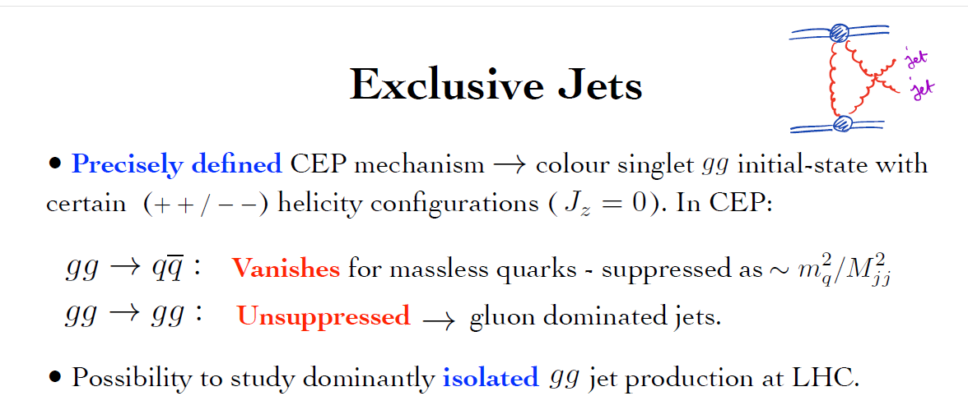
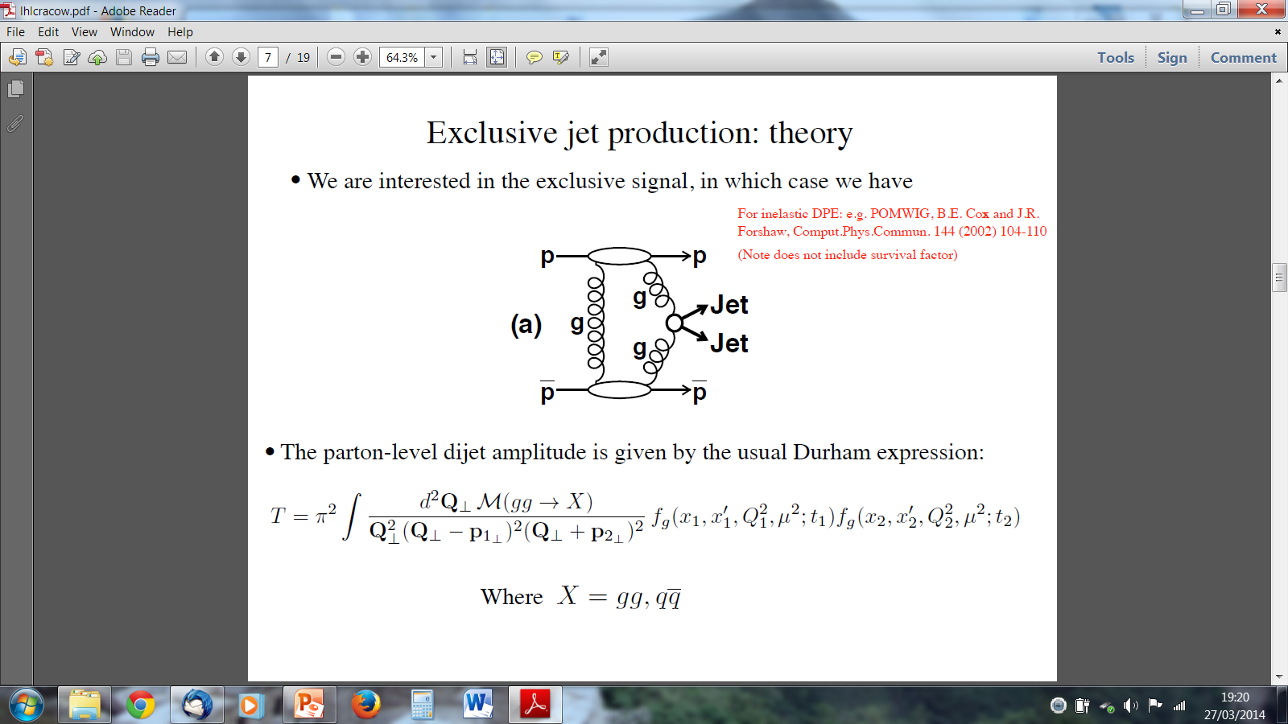
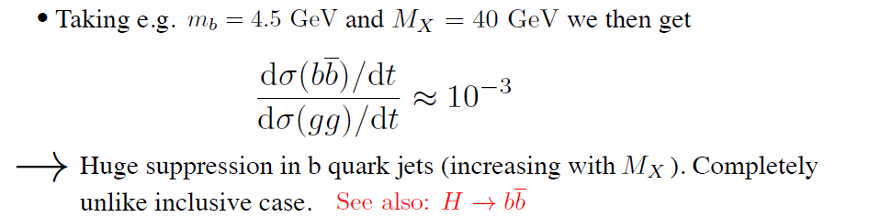
EXCLUSIVE JET PRODUCTION
Soft PT QCD lab
(first indications CDF-2008)

Slide 29
SuperChic-2

Slide 30
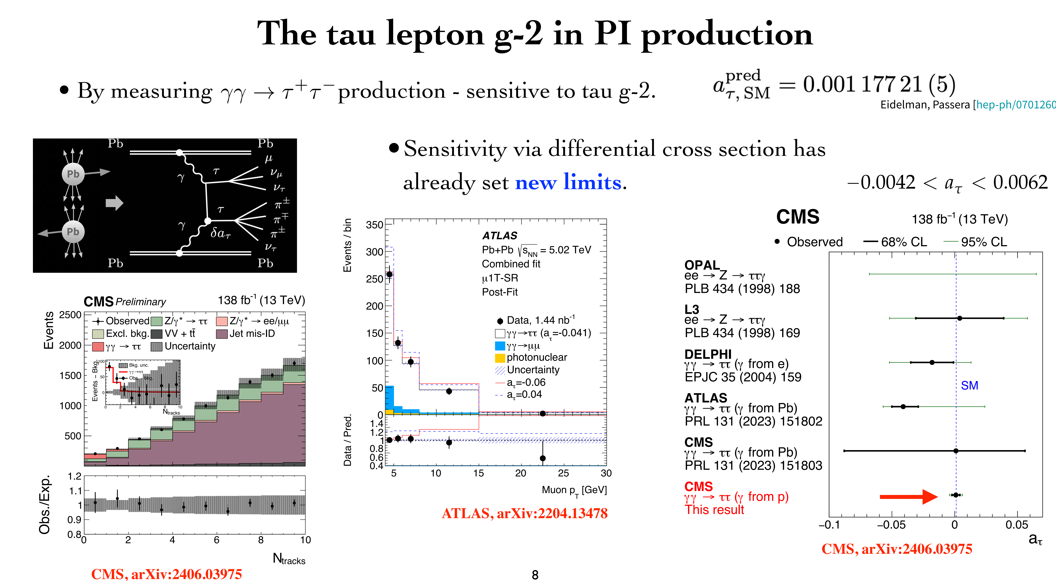
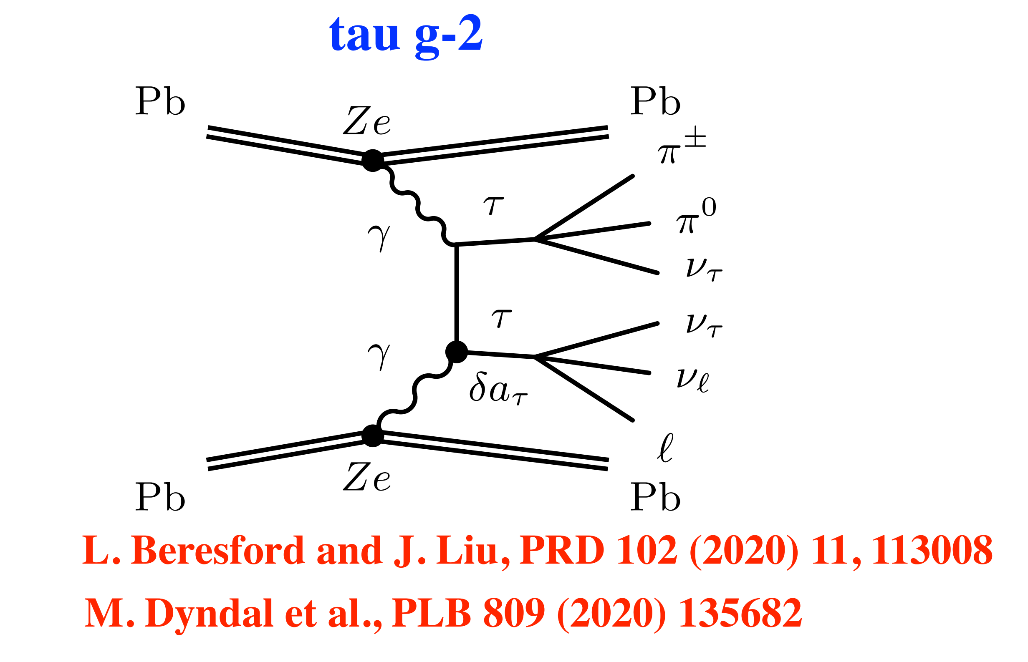
Higher precision constraints on the tau g − 2 in photon–initiated production
Artur Kalinowski

Slide 31
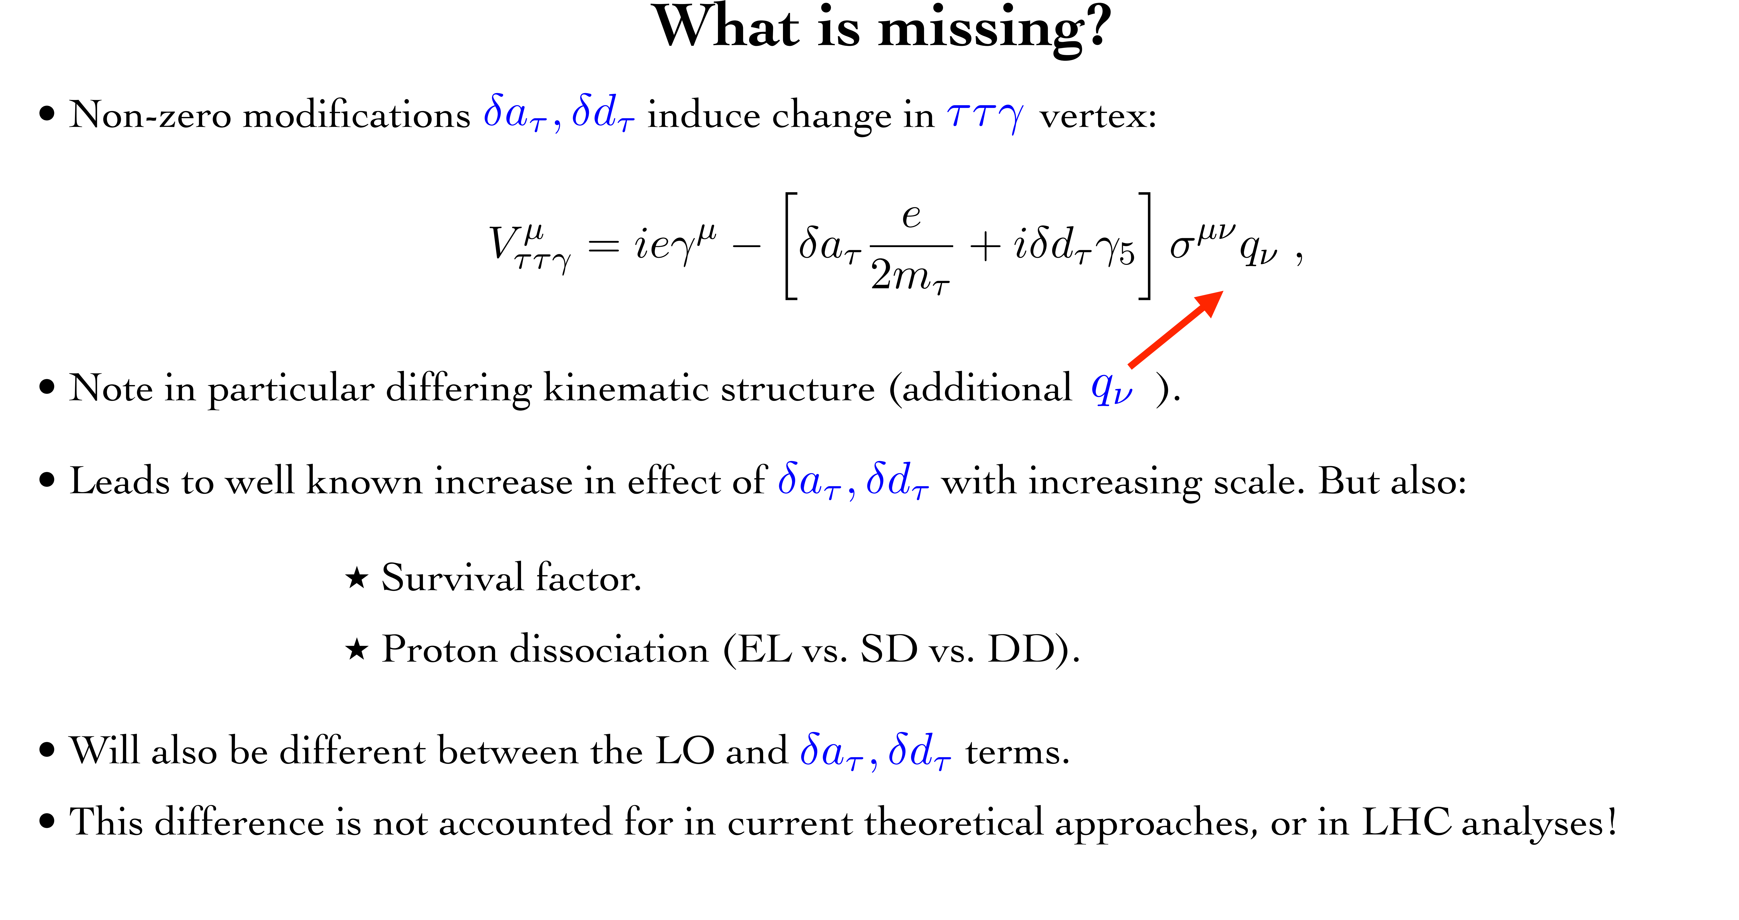

Higher precision constraints on the tau g−2 in LHC photon-initiated production: a full account of hadron dissociation and soft survival effects L.A. Harland-Lang, 2410.10978 [hep-ph]
Standard calculations assume that the nucleus (proton) is intact. The same $S^{2}$.
Notes:
S

Slide 32
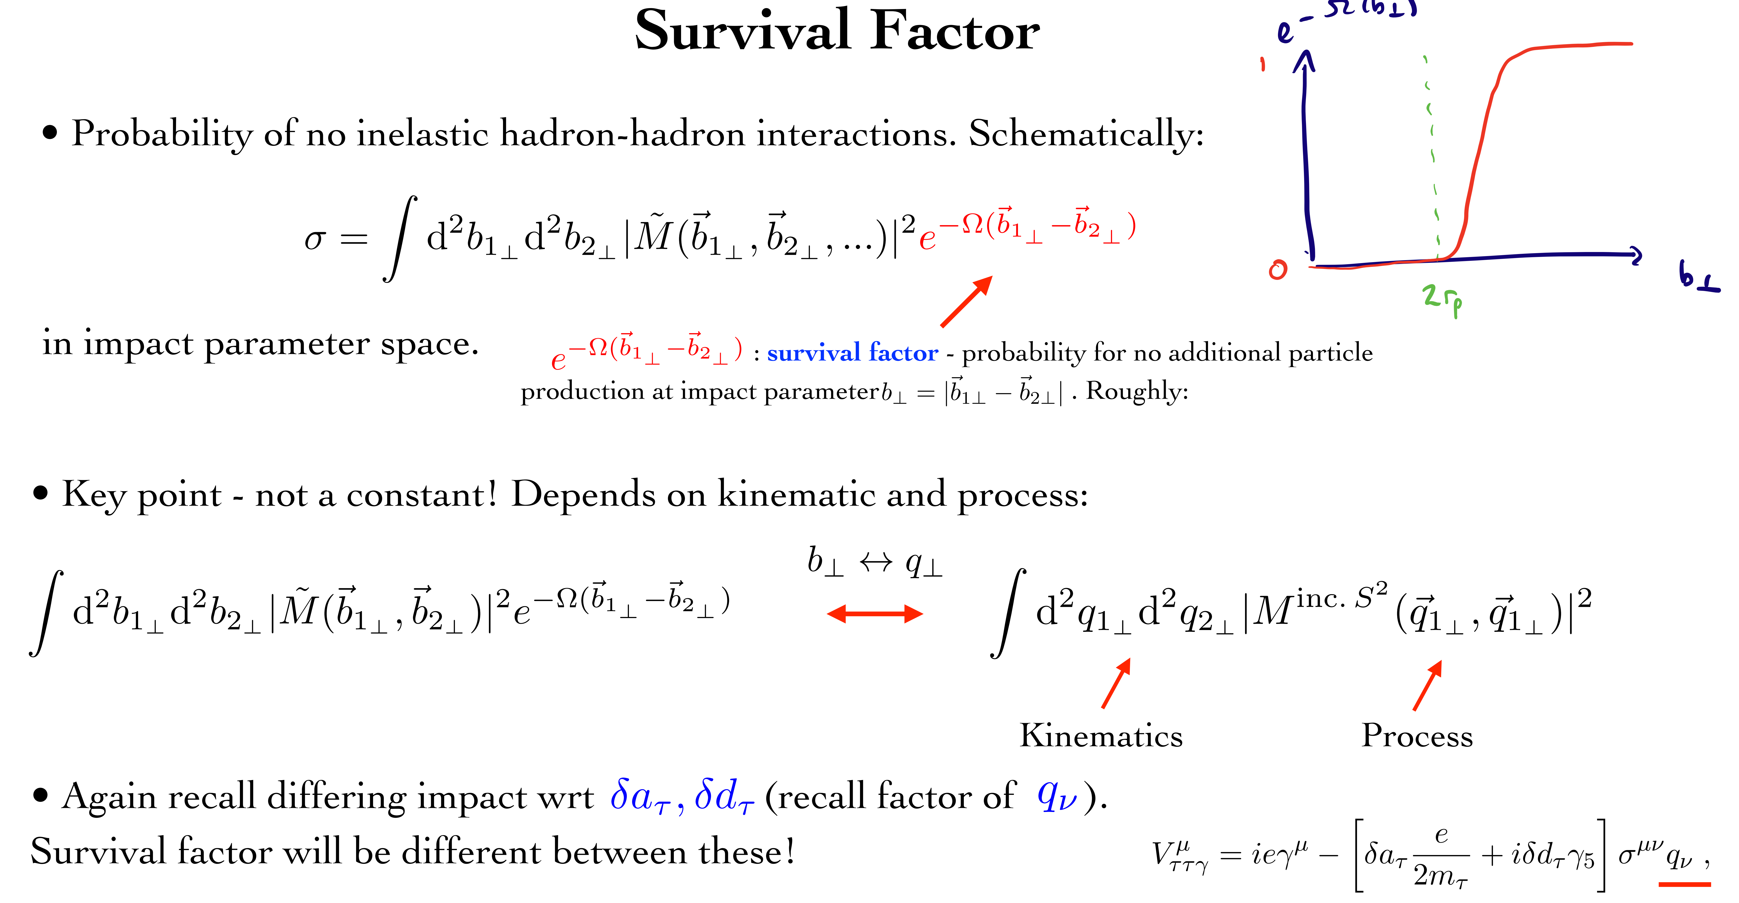
Note
KKM-2003 (Difference of survival for 0⁻ and 0⁺ CEP)

Slide 33
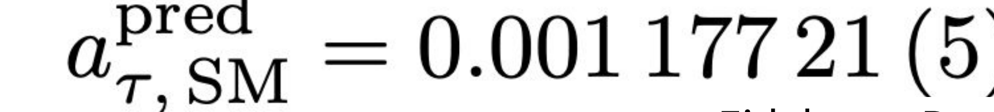
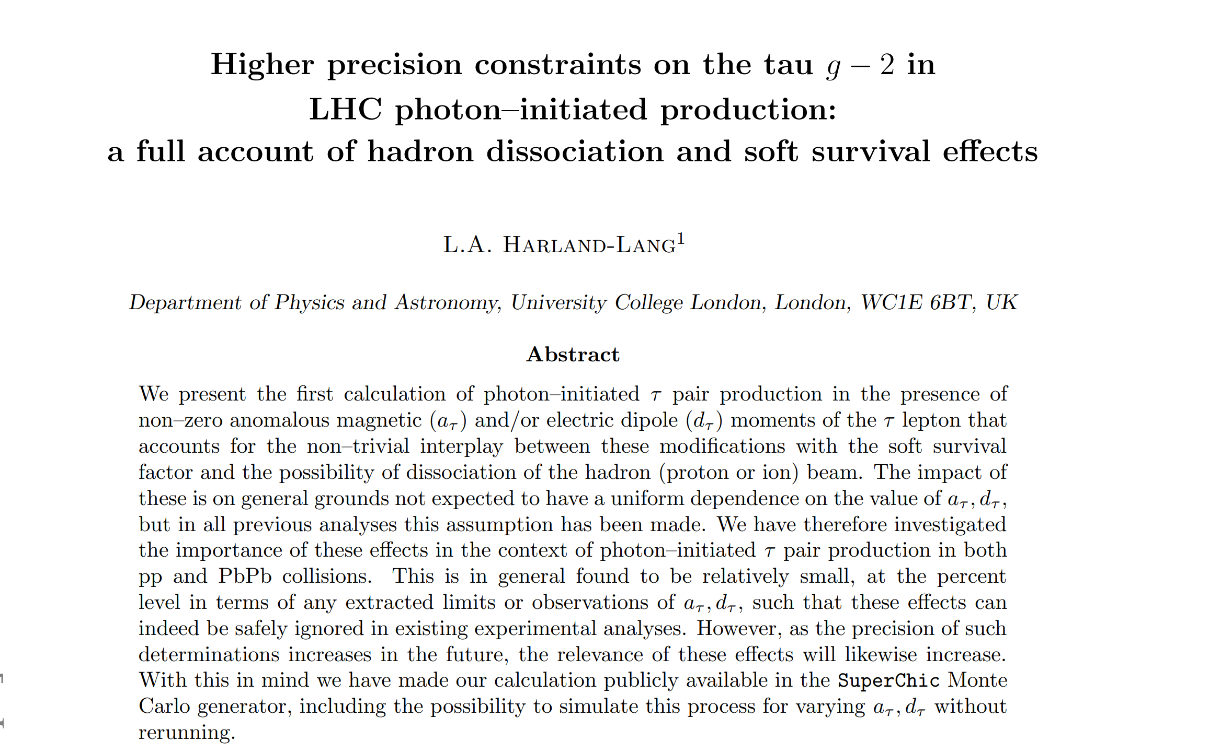
Recall:
the SM prediction for the tau g-2 is known to 5 d.p precision
2410.10978 [hep-ph]

Slide 34
Sphaleron-transition on top of an energy barrier
KKMR, Phys.Rev.D 104 (2021) 5, 054013

Slide 35
Instantons have never been observed experimentally, however, they are
playing a very important role in the theoretical models of confinement and
chiral symmetry breaking
one of the biggest challenges for particle physics to date
‘soft bombs’ –high-multiplicity spherically symmetric distributions of relatively soft particles
Extended objects in space-time
Effectively –a family of new multiparton vertices in Feynman diagrams

Slide 36


Strong need for enthusiastic experimental experts to join the efforts, addressing such issues as detector effects, PU at high luminosity, and timing resolution…..
TKMR, Eur.Phys. J.C 83 (2023) 1
One of the main obstacle currently – PU at high luminosity
Possible directions for further studies
✵
Feasibility of searches for moderate mass Instantons in UPC
✵
Using good timing from Central Detectors for both ST and DT events.
✵
Identification of charm quark jets in the final state

Slide 37

CEP measurements could significantly extend the physics reach of the LHC detectors by giving access to a wide
range of exciting new physics channels.
.
μ.
CEP could serve as a spin-parity analyser and offers a sensitive probe of the CP structure of the new states.
The theory of the CEP is in a reasonably healthy shape,
and dedicated MCs (such as SCs) are well developed
The predictions are backed by the series of CDF/D0 CEP-like measurements as well
as the RAP GAP measurements by the LHCb and ALICE +CEP results from ATLAS& CMS

Slide 38
The dedicated AFP and PPS detectors allow uingue the timing.
The main issue is PU suppression, though some progress is foreseen,
in particular with the addition of timing from the CD.
But ATLAS has already decided not to run AFP at HL-LHC
(at least not in the foreseeable future)
10ps in Run 4
At large M_{Mmis}> 150-200 GeV the photon-photon fusion dominates
over the gg. LHC is the photon-photon collider!
Such important measurements as the searches for the new Higgs-like states
as well as the moderately-heavy instantons, would require the 420 m stations.
The bulk of important physics (such as glueballs, instantons, and other new
state searches) would require low luminosity runs.

Slide 41
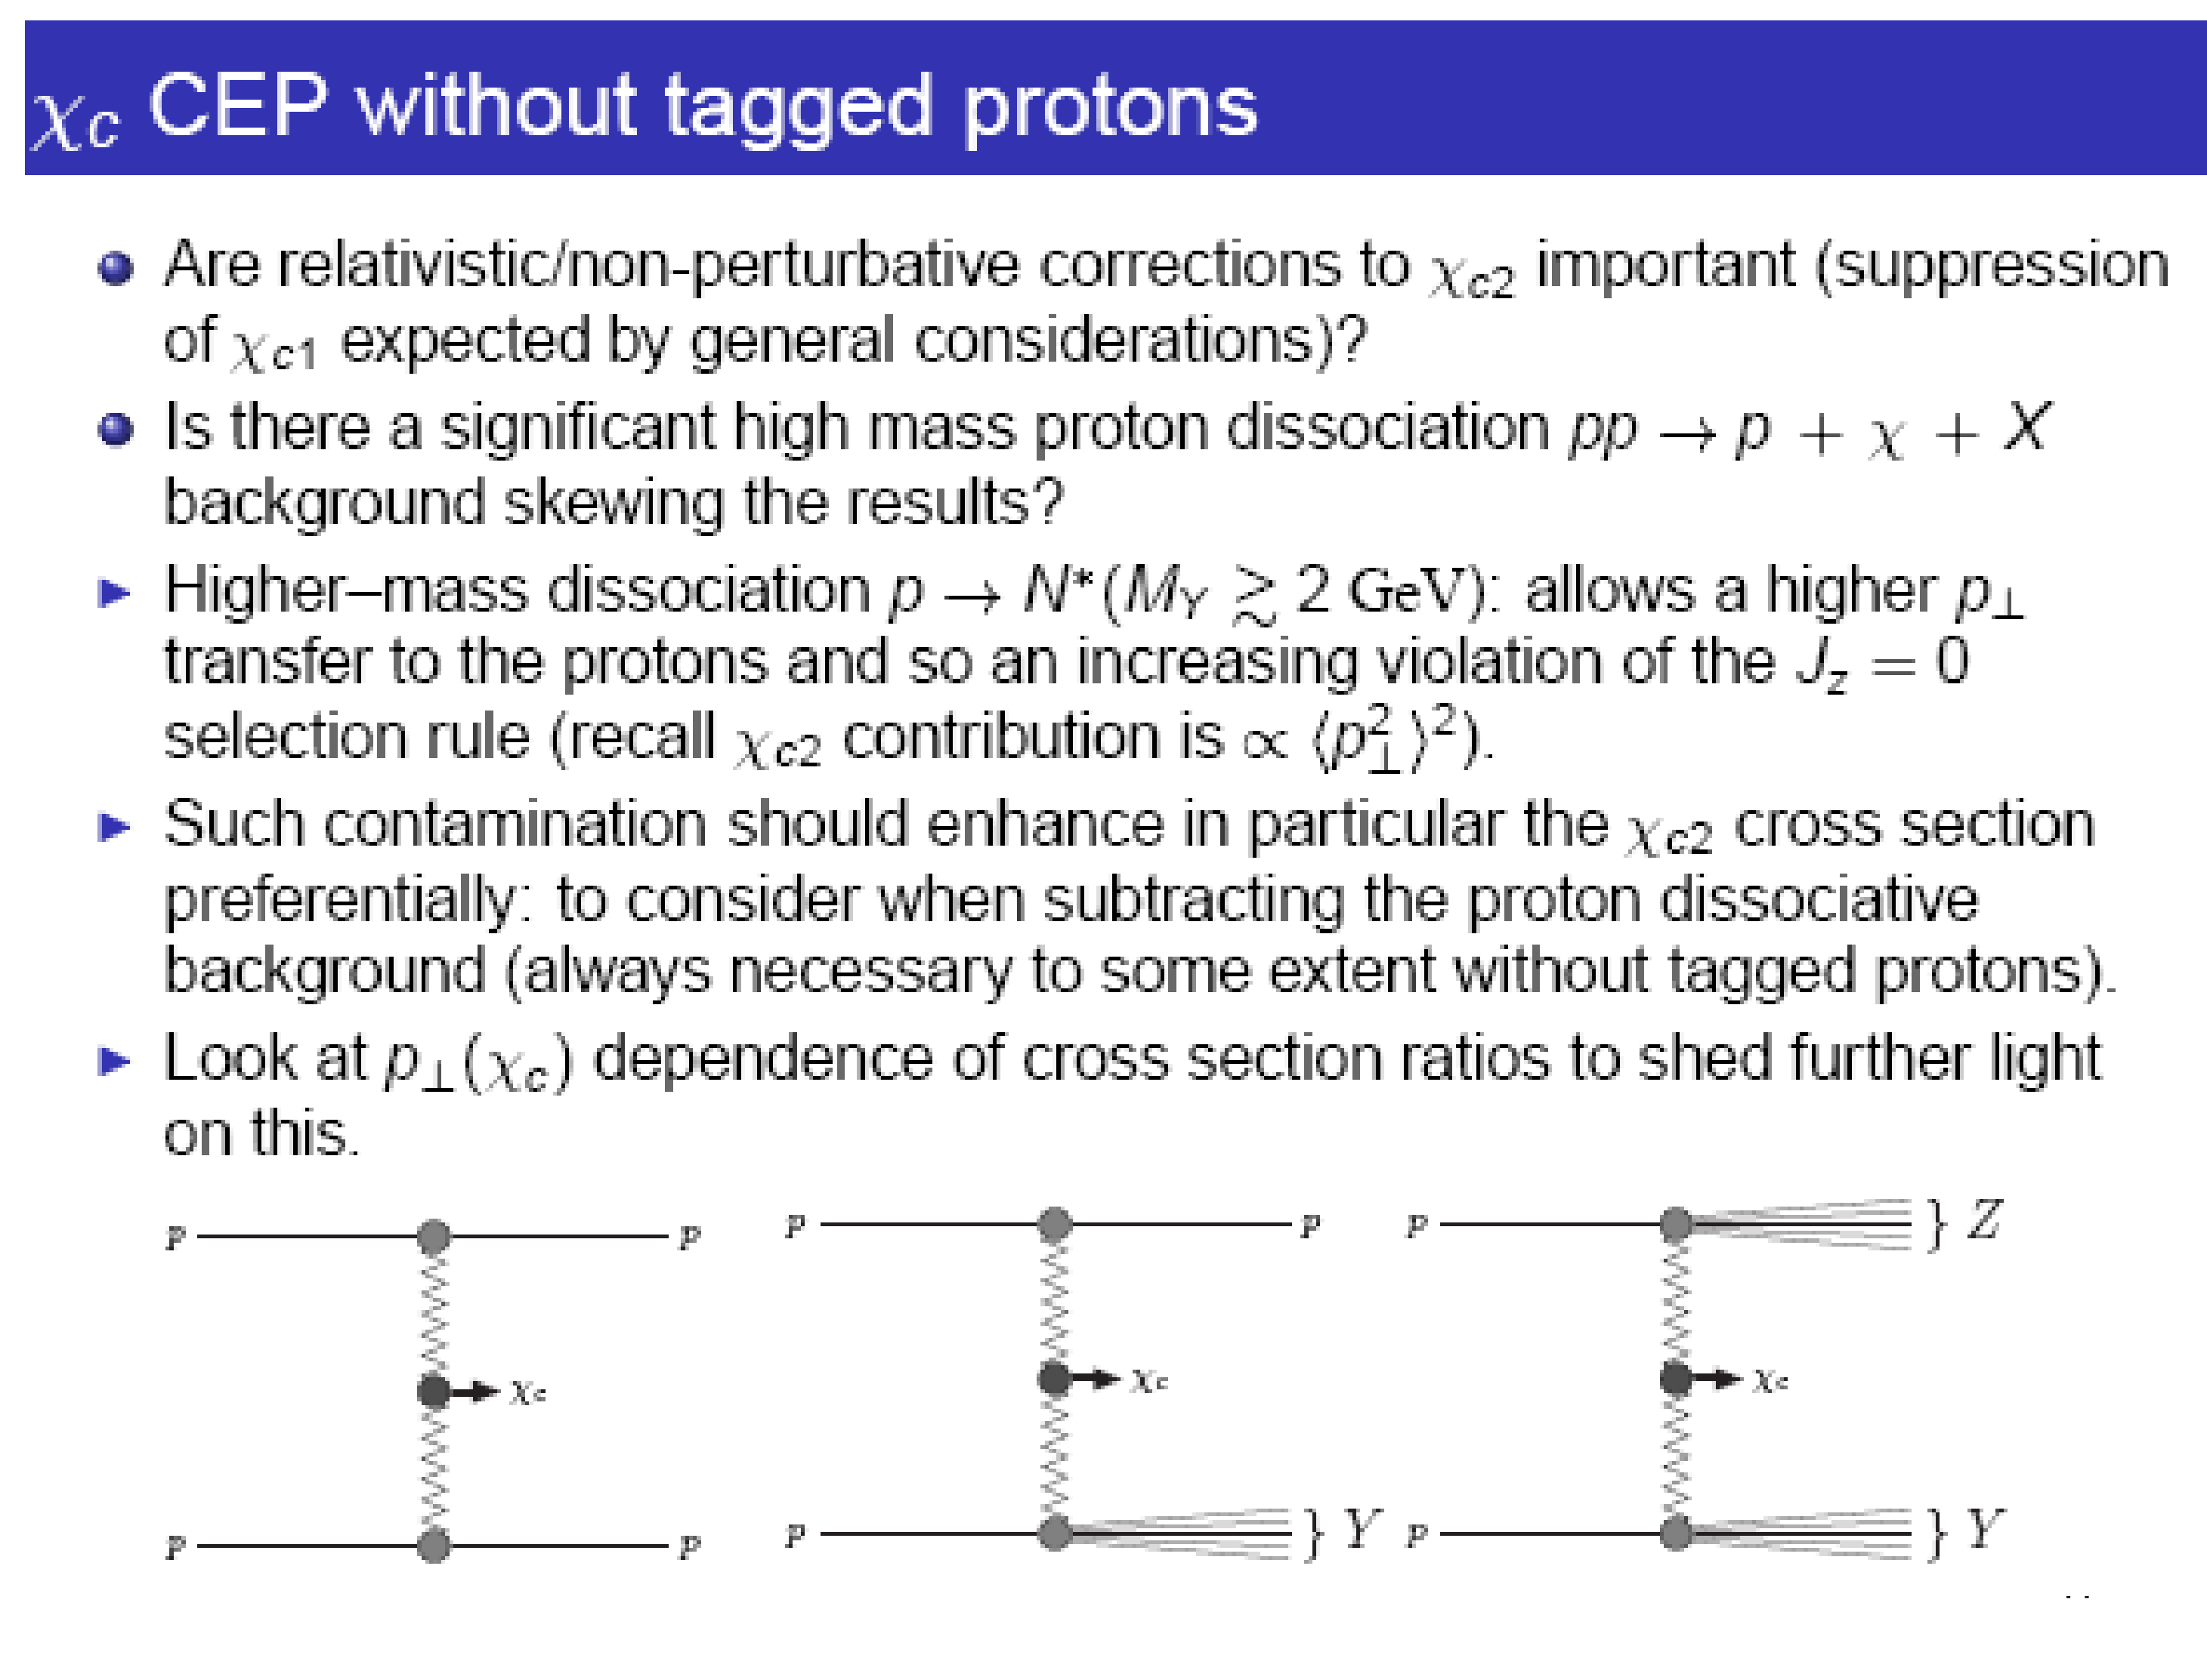

Slide 42
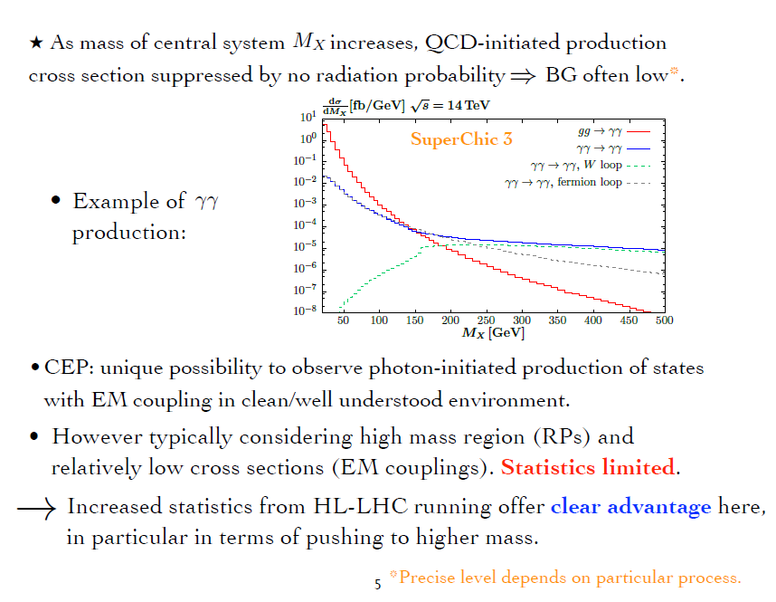
up to 1-2 TeV
Currently, pure CEP studies at the LHC are dominated (also HIC-UPC)

Slide 43


Slide 44


Slide 45


Slide 46


