Slide 1


WISPy Cold Dark Matter
-
From theory to detection
Heidelberg University
J. Jaeckel**
S. Abel†, J. Berges**, M. Goodsell^{xx}, S. Gardiner†, H. Gies⁰
V. Khoze†, A. Lobanov^{y}, J. Redondo^{x}, A. Ringwald*, C.Wallace†
**ITP Heidelberg, †IPPP Durham, *DESY,
^{Y}MPIfR Bonn, ^{x}MPI Munich, ^{xx}Cern, ⁰ITP Jena

Slide 2
We know...
…nothing

Slide 3
Inventory of the Universe
Dark Energy 68%
Neutrinos
0.1-0.5%
Ordinary matter
5%
Dark Matter
27%

Slide 4

Can Dark Matter
be WISPy?
(Weakly Interacting Sub-eV Particley)
Slim
Dark Matter

Slide 5

Properties of Dark Matter
Dark matter is dark, i.e.
it doesn‘t radiate!
(and also doesn‘t absorb)
very, very weak interactions with light
and with ordinary matter
➔ Exactly the property of
WISPs

Slide 6
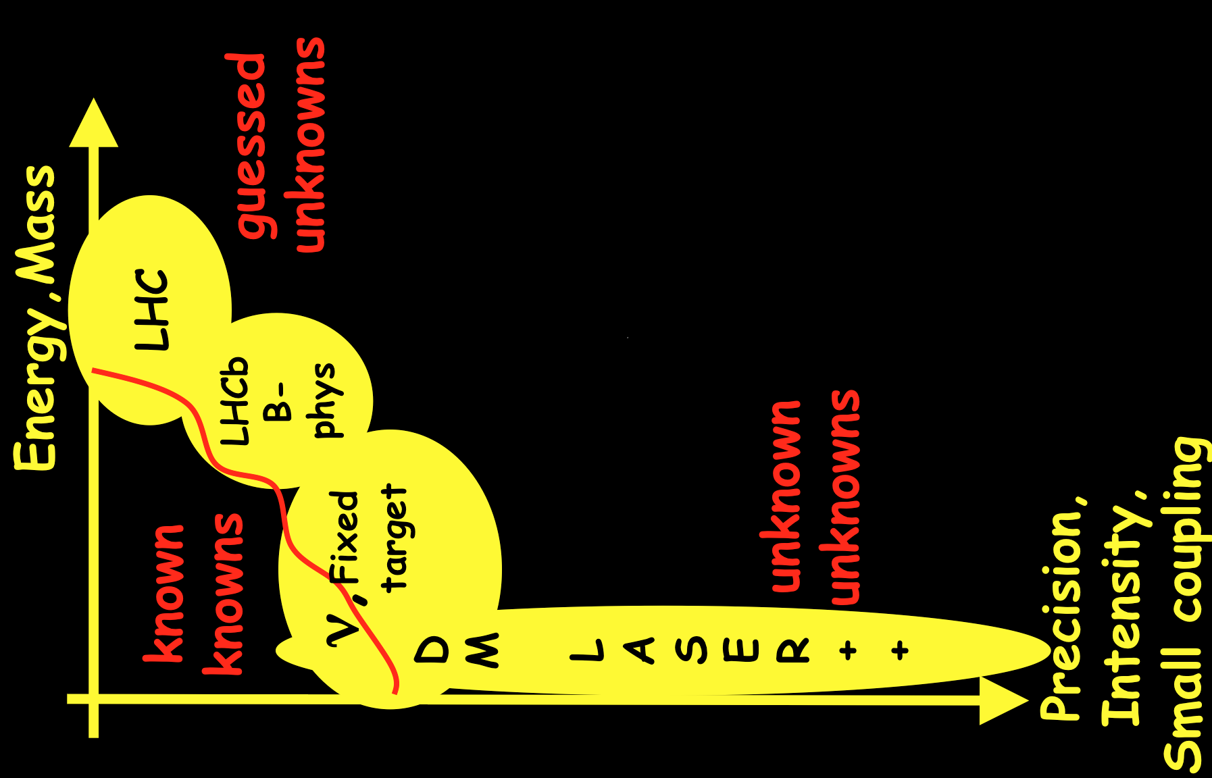
Exploring is (at least) 2 dimensional
“dark”
=
weakly coupled
ν,Fixed
target

Slide 7

A common prejudice
Dark Matter has to be heavy:
Prejudice based on thermal production!
and/or fermionic DM!
Both assumptions give minimal velocity
(thermal/Fermi)
➔ galaxy, i.e. structure, formation inhibited!

Slide 8
Weakly interacting sub-eV DM
Has to be non-thermally (cold!!!) produced
Bosonic!
See misalignment mechanism
Axion(-like particles)
Hidden Photons

Slide 9


Dark matter has to be heavy…
Dark matter has to be heavy

Slide 10
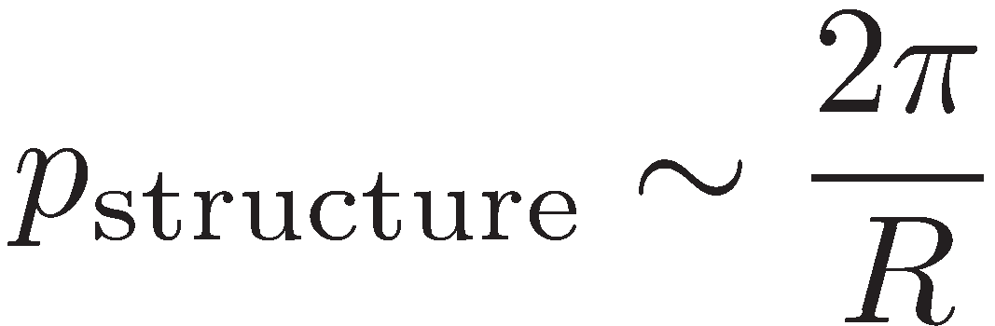
A lower limit for bosons
Nevertheless there is a lower limit also for bosons
Structure of size R
➔ field changes on scale R
➔ Associated momentum
➔ “velocity”
➔ Pretty mild condition!

Slide 11

5+
Questions/challenges
for WISPy DM

Slide 12


The Background, i.e. the Model
We need a good
WISPy DM candidate

Slide 13
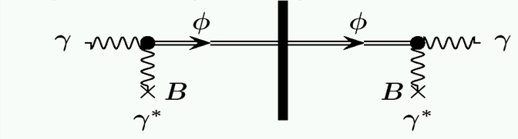
Axion(-like particle)s
a
a

Slide 14
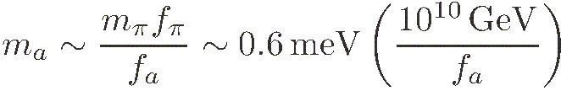

The classic: Axions
Explain absence of CP violation in QCD
by making µ_{QCD} dynamical
New light particle: The Axion
Classical flatness from Peccei-Quinn symmetry
Small mass from quantum anomaly
➔ It’s a Weakly Interacting Sub-eV Particle)
Useful coupling:

Slide 15
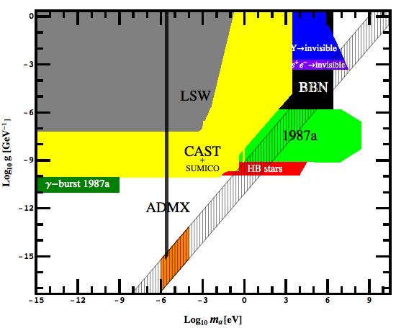
The classic
A simple and compelling field theory candidate!!

Slide 16
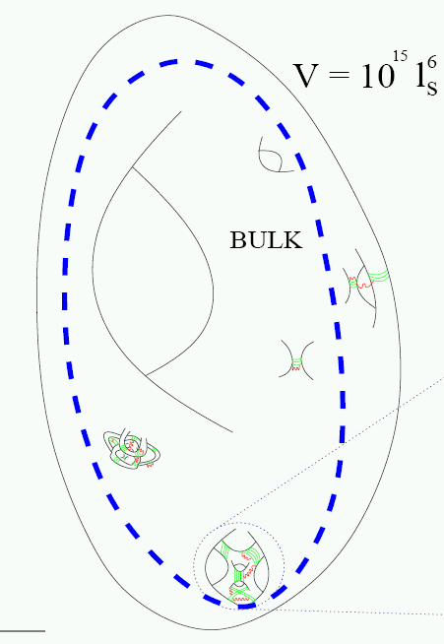
String theory: Moduli and Axions
WISP candidates
String theory needs Extra Dimensions
Must compactify
Shape and size deformations
correspond to fields:
Moduli (WISPs) and Axions
Connected to the fundamental
scale, here string scale

Slide 17
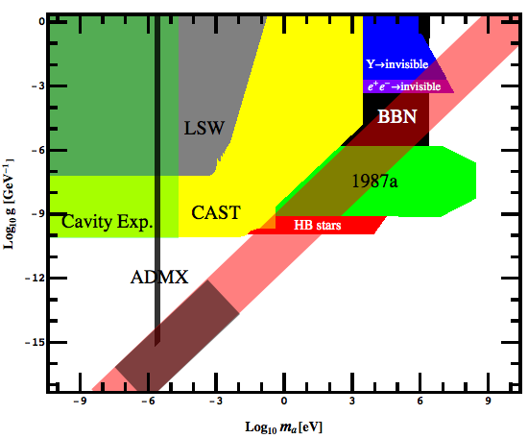
Axion (like particles): Where are we?

Slide 18
Axion (like particles): Where are we?

Slide 19
Axion (like particles): Where are we?
Intermediate strings
Funny Higgs arguments

Slide 20
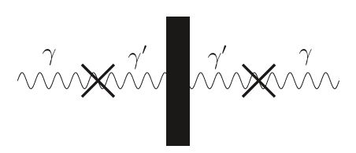
Hidden Photons
The power of kinetic mixing

Slide 21
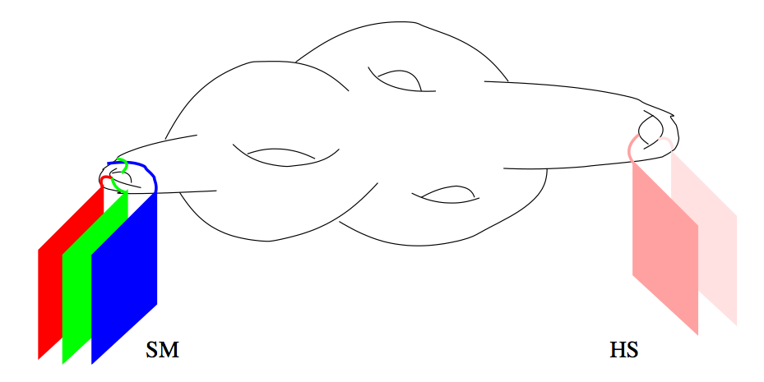


String theory likes extra gauge groups
Many extra U(1)s!
Candidates for WISPs

Slide 22
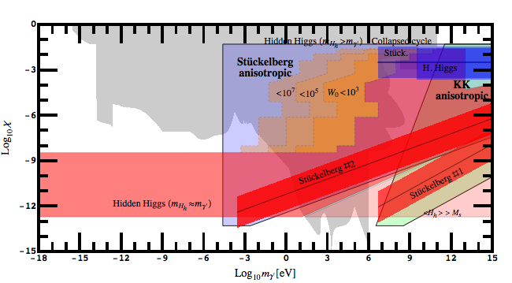
Hidden Photons, all over the place

Slide 23
Challenges
Can we have more concrete predictions?
Preferred parameter regions?
Do these models have other features that can be tested?
(E.g. particles that come along for the
ride; SUSY partners, KK modes etc)

Slide 24
Production
We need to produce
the right abundance
+ it needs to be cold!

Slide 25
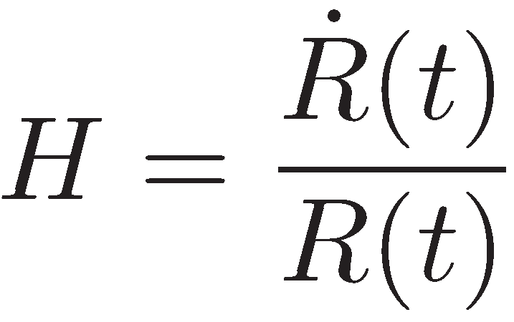

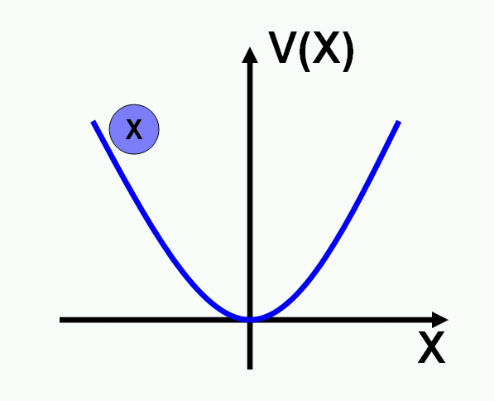


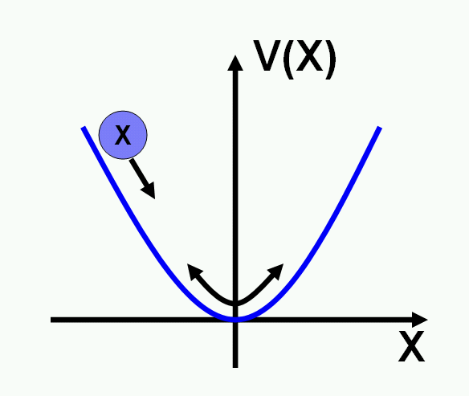


Production of Cold Bosons
➔ Dark Matter
➔ overdamped
oscillator
➔ damped
oscillator

Slide 26



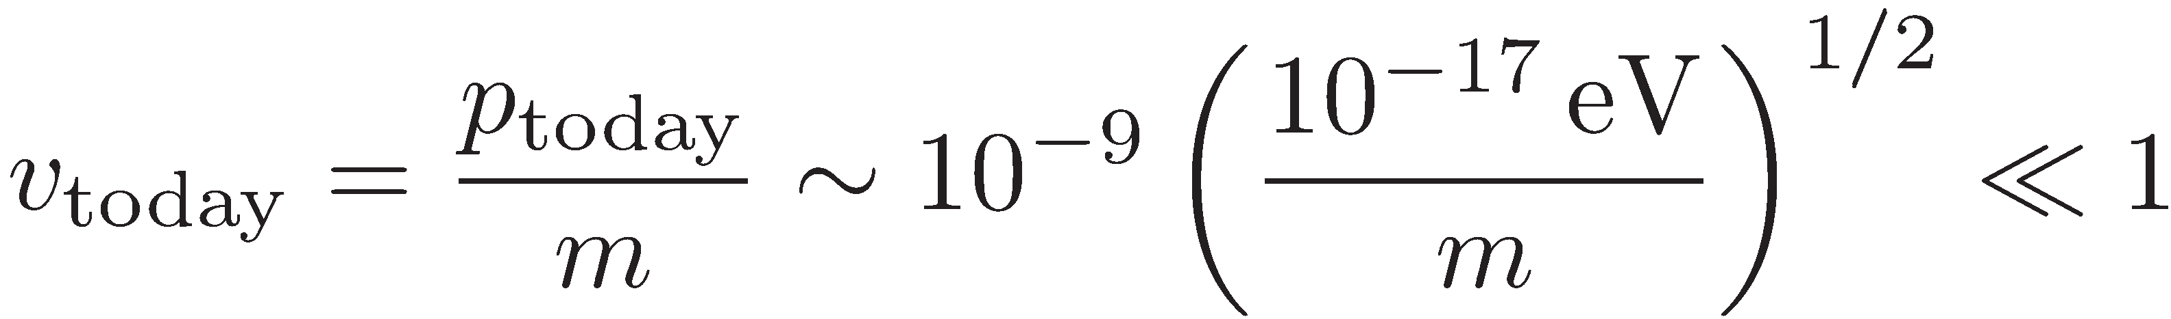
Misaligned production is super-cold!
After Inflation the field is very homogeneous ➔
However, we can never prevent fluctuations of horizon size ➔
From the time of production when till today this has been reduced to
➔ Superslow and supercold!

Slide 27
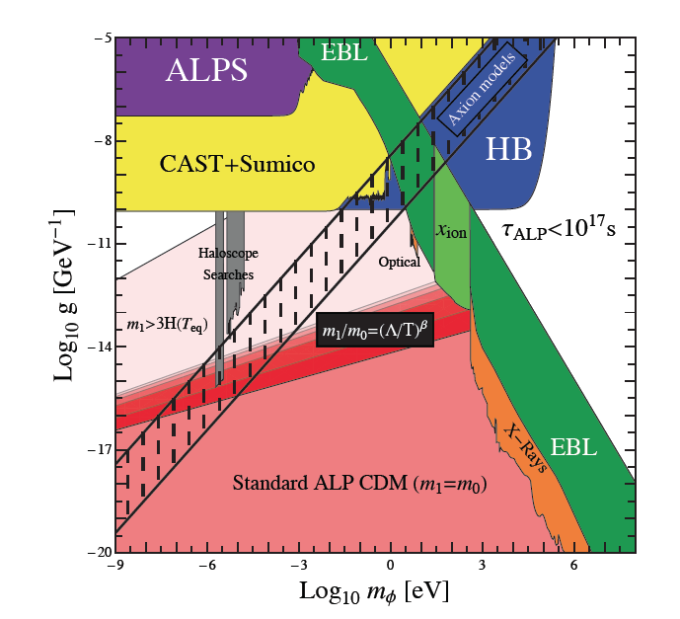
What is missing?
Energy density ~ (ini field)^2; in general arbitrary
For pseudo-Goldstones ~ SSB scale

Slide 28

What is missing?
Energy density ~ (ini field)^2; in general arbitrary
For pseudo-Goldstones (ini field)~ SSB scale
For HPs ????
➔ Can we improve our understanding/models?

Slide 29


A Curiosity
For HPs the simple EOM
Requires gravitational terms of the form
-- Motivation in fundamental theory?
-- Effects of different terms?
-- Effects of such terms for scalars/axions?

Slide 30
Other non-thermal mechanisms
Decays of heavier particles
Decays of Topological defects, such as cosmic strings or domain walls
(May be very relevant for axions!)
More???

Slide 31
Survival + Cosmology
The DM particle
needs to
survive on cosmological
time-scales
+ should not be in conflict
with cosmological
observations

Slide 32
Axion(-like particle) Dark Matter

Slide 33
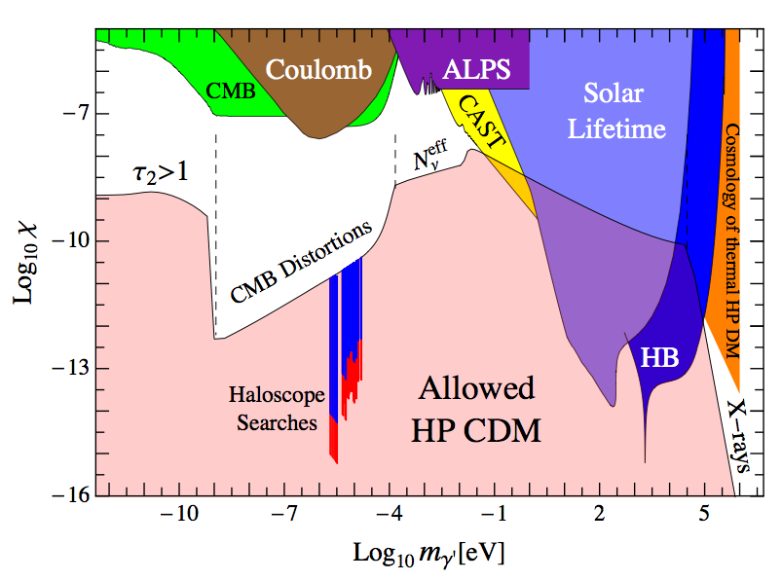
Hidden Photon Dark Matter

Slide 34
Good state…
Standard cosmology is in good shape
Peculiarities could arise from unusual things like BEC formation ➔ see later

Slide 35
Observable features
Do we have astrophysical
or cosmological
signatures?

Slide 36
Decay + evaporation signatures
The same things affecting our viability could be used for detection
For example
Works probably only when “around the corner”

Slide 37
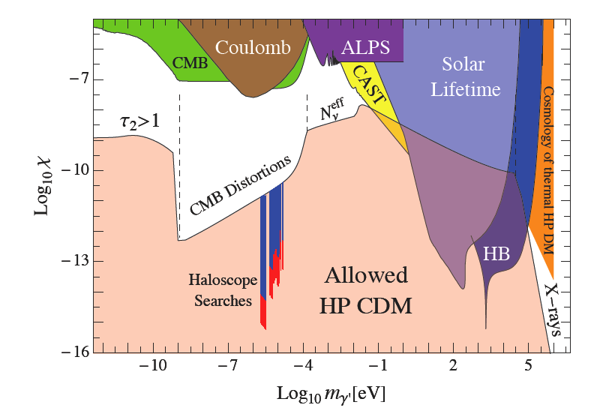
Decay + evaporation signatures
A possible exception:
interesting region for CMB spectral probes

Slide 38
Truly new + WISPy features
m_{WISP}~10⁻²² eV
➔ Changes in structure formation
a la warm dark matter???
➔ Can it help with halo problem?
Novel state of matter BEC
➔ Collective behavior
➔ imprints in structure formation

Slide 39
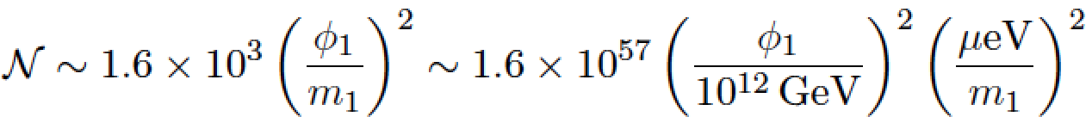
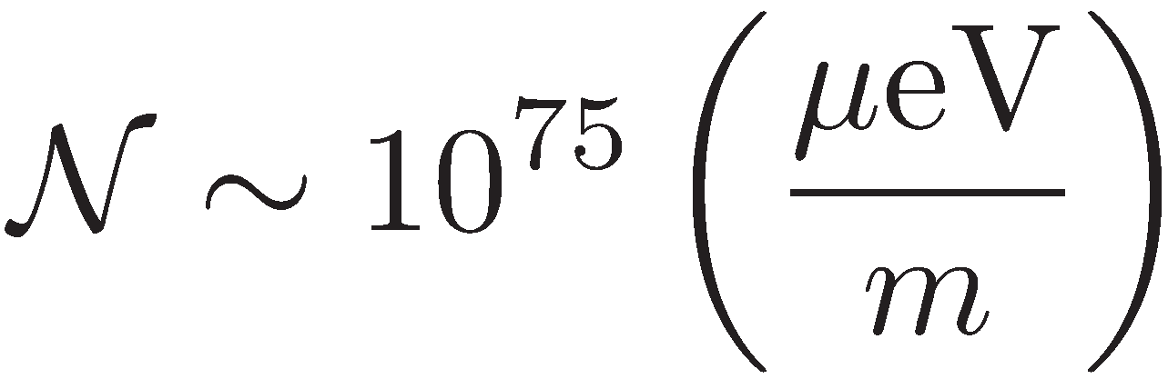
Bose-Einstein Condensation
For WISPs very high occupation numbers are a typical feature
However for BEC we need a significant proportion in a single state!!
To have collective behavior on a
1000 lightyear scale we need
➔ Significant re-shuffling/interactions needed

Slide 40
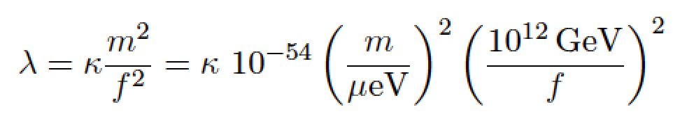

BEC II
  Interactions? very small !!!!!
However, interaction rates could be Bose enhanced by factors
Large contributions from long-range gravitational interactions???
➔ More by Sacha

Slide 41

A personal note on BEC
Very preliminary/work in progress!!!
BEC formation is non-equilibrium
  For equilibrium need to establish exponential tail with ➔ no enhanced rates
  Non-equilibrium calculation suggests condensate formation!
BEC fraction may differ from equilibrium value

Slide 42

Experimental tests
Laboratory tests
Direct Detection
  Discovery
  Dark Astronomy
  (Directional Detection)

Slide 43
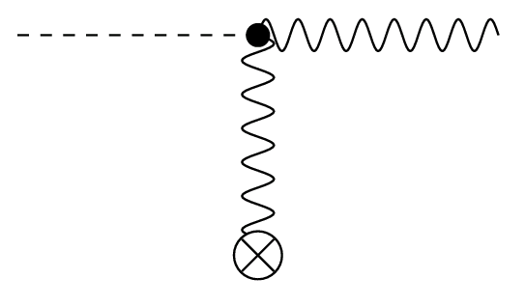
Use a plentiful source of HPs
Photon
(amplified in resonator)
Hidden photon
(dark matter)
Photon Regeneration

Slide 44
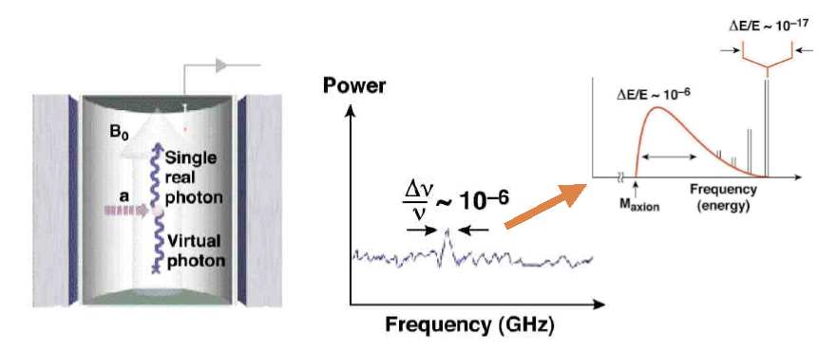
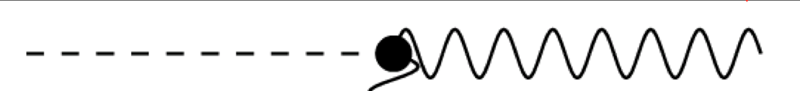
Signal: Total energy of hidden photon
RF Receiver
DM
Hidden
photon
Virial velocity
in galaxy halo!

Slide 45
Signal: Total energy of hidden photon
RF Receiver
DM
Hidden
photon
BEC???

Slide 46
An extremely sensitive probe!!!

Slide 47
Broadband
Search Strategy

Slide 48
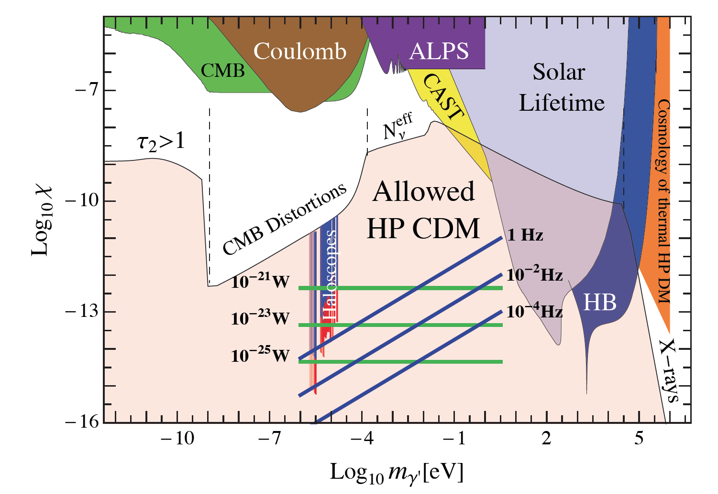
Dark Matter Antenna
Antenna converts HP->photon
Radiation concentrated in center
Detector
Probes here;
very sensitive!!

Slide 49
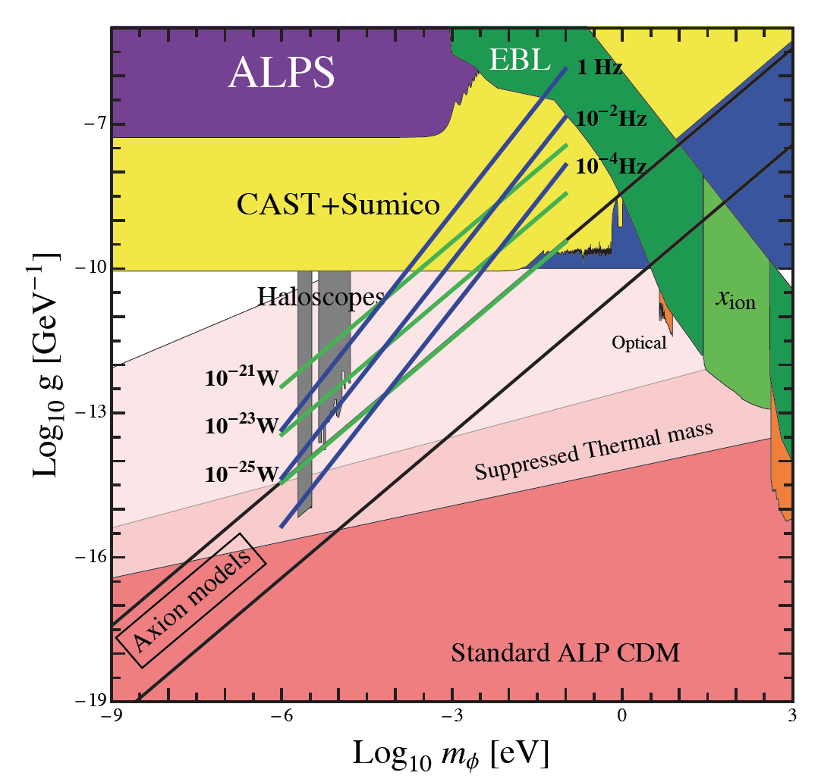
Works also for axion-like particles

Slide 50
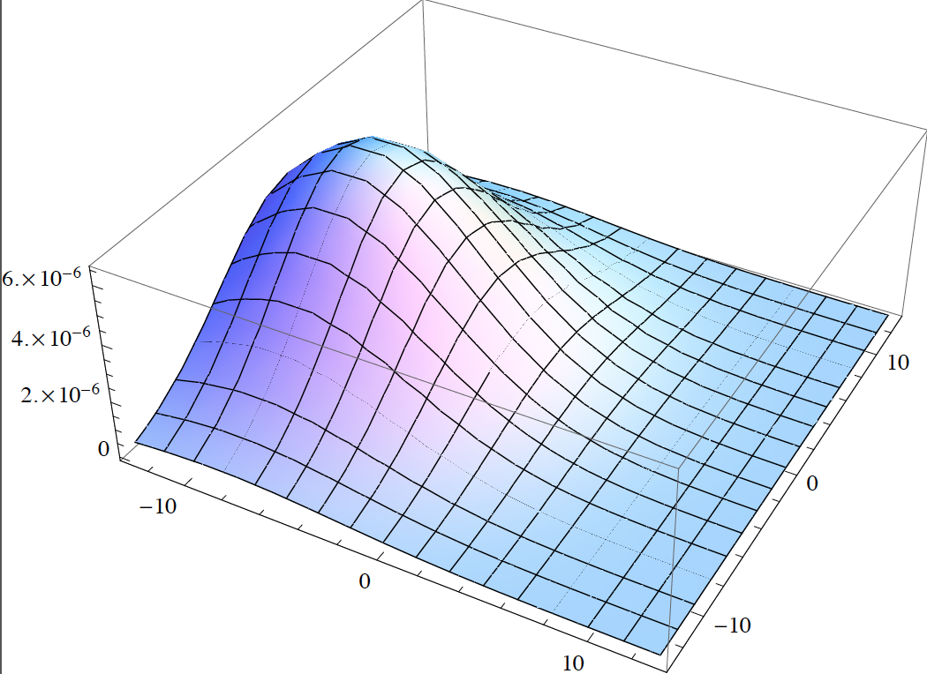
A Dream for Astrology ehhm Astronomy
Emission from moving dark matter
A picture of the DM-velocity distribution
V_{DM} =0
V_{DM}≠0=
Screen

Slide 51
Challenges
Vast areas of parameter space to test!
Need ideas for m<10⁻⁸ eV
➔ Wire antennas???

Slide 52
Challenges
Vast areas of parameter space to test!
More important:
Need to make it happen!!!!

Slide 53

Application
Earn money with WISPs
®-Centauri
From 10⁹⁹€
My God, New-France is
so cheap these days…
WISP Tours Inc.

Slide 54



The CDM-WISP
CDM-WISP
mirror
B
Superconducting
magnets

Slide 55
Conclusions

Slide 56
Conclusions
WISPy dark matter is in good shape
We have ideas from models to detection
Still a few interesting surprises (BEC) possible
Need Discovery (Tools)

