Slide 1
Predicting Complex Models for Industrial Processes
Lumley Castle 28th of June 2018
Stefan Egan – P&G coordinator
Arturo Martinez - P&G co-coordinator
Richard Bower – Durham University Coordinator
Miguel Icaza , Kevin Kwok, Giorgio Manzoni – Durham University

Slide 2
Outline
The nature of the problem
Innovative solution: the LASSO technique
Enhancing the predictive power of LASSO
The importance of normalisation
Applications: from theory to empirical data
Conclusion and future improvements

Slide 3
1. The nature of the problem

Slide 4
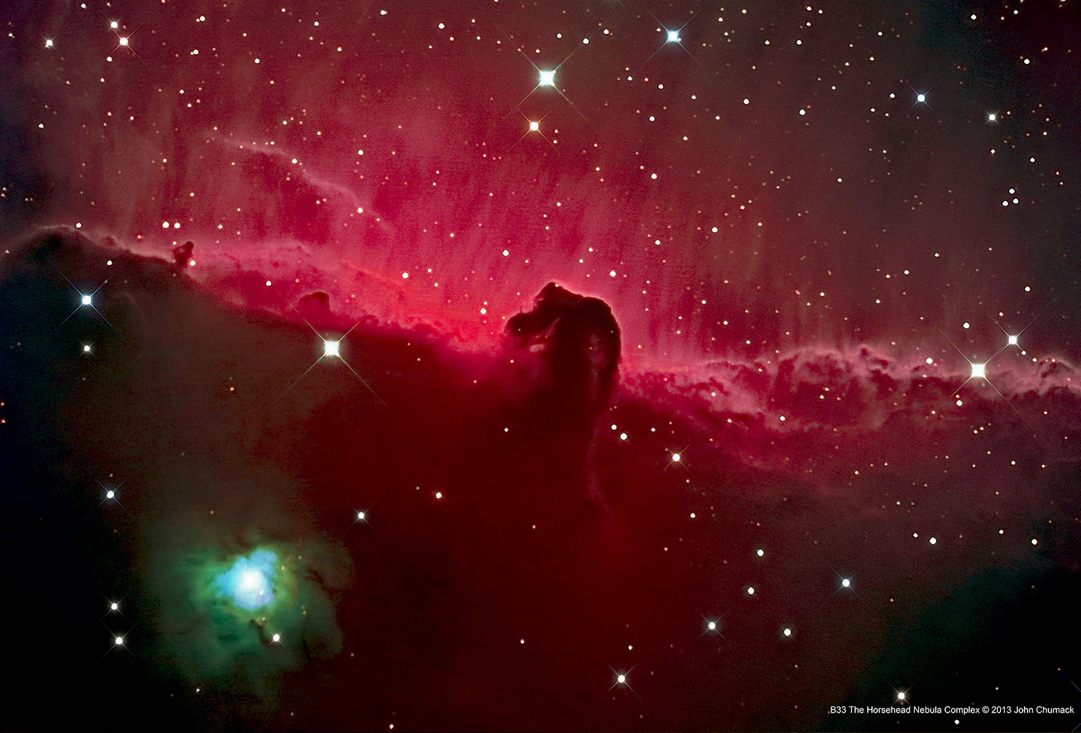
P&G and astronomy
Slurry
Nozzle
Droplets
Gas inflow
Granules
HII regions
Hot air
AGN wind
Fan
Active Galactic Nuclei (AGN)
SPRAY DRYING PROCESS FOR LAUNDRY POWDER
ACCRETION OF GAS INTO A BLACK HOLE
Notes:
An H II region or HII region is a region of interstellar atomic hydrogen that is ionized.

Slide 5
Challenge to P&G
We want to predict:
Powder Density
Solubility
Shelf Impression
Dosing Accuracy
60+ parameters [a-b]
(~15 relevant to Density)
R&D
Physical Testing
Product Launch
1950s
200+ experiments
8,000 data points
2000s
Manually trained Semi-Empirical Model
(TODAY)
Virtual Testing
Costly & slow (so don’t do it often!)
Relies on the ‘art’ of the modeller
Risk of overfitting (so many parameters!)
Use less than 50% of available data to train models
Risk of model bias (e.g. clustered data)
2020
(FUTURE)
Self-trained or “self-learning” model
MISSION: Predict Density with improved efficiency and accuracy using continually self-learning models vs. current manual retraining approaches.

Slide 6
Finding the optimum model
Ingredients and Process Conditions
Parameters from the linear combination of bases functions
N = number of library function
n = number of variables (ingredients)
Usually N >> n
Data
Multivariable
fitting
Optimised function
Start
End
Library of bases functions
Aim: Eliminate redundant functions to recover the physics

Slide 7
2. Innovative solution: the LASSO technique

Slide 8
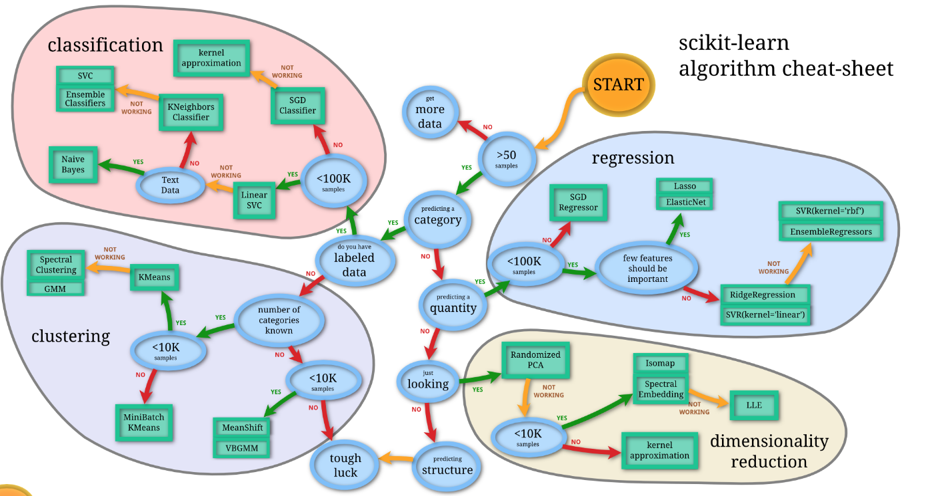
Why LASSO fits our data problem?
http://scikit-learn.org/stable/tutorial/machine_learning_map/index.html

Slide 9
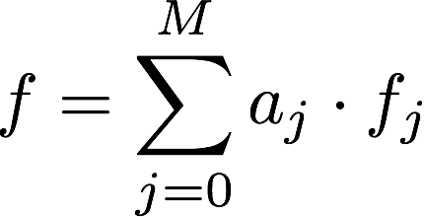
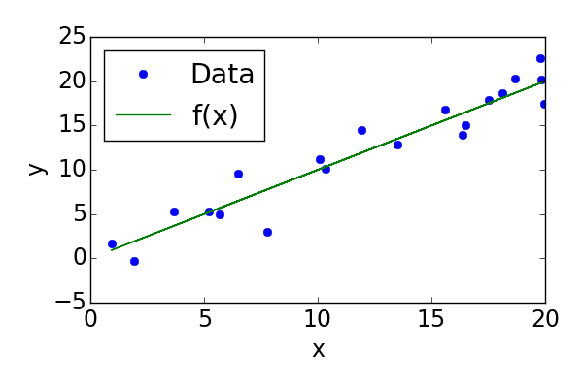
Why LASSO?
Challenge: find the best
PENALTY TO AVOID OVERFITTING
The fit of a function is usually obtained by minimising the chi squared
LASSO = Least Absolute Shrinkage and Selection Operator
Smaller number of parameters
Stronger predictive power
Notes:
Mention penalty help avoid overfitting -> smaller number of parameters -> stronger predictive power

Slide 10
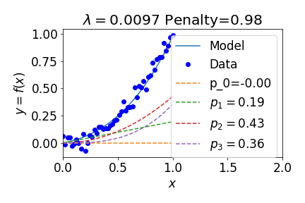
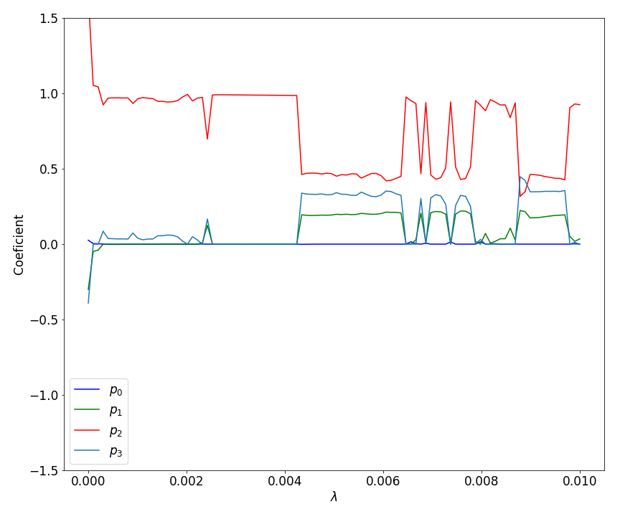
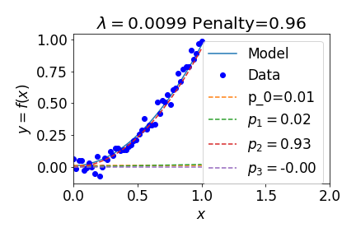
Is the standard LASSO enough?
No efficient penalty for the number of parameters!

Slide 11
3. Enhancing the predictive power of LASSO

Slide 12
Modified LASSO
NEW PENALTY FUNCTION
ERROR ESTIMATION
First and Second term should have the same order of magnitude now!!
(After normalization)

Slide 13
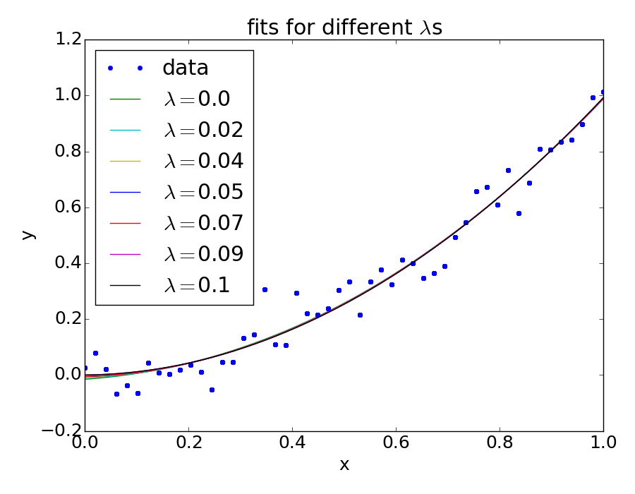
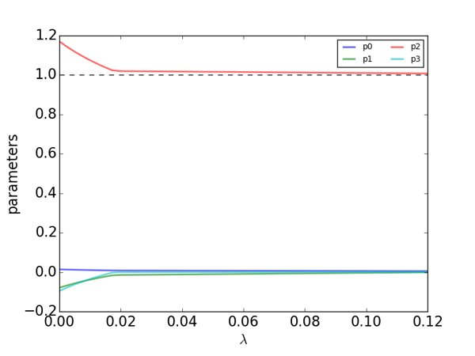
Basic study:

Slide 14
4. The importance of normalisation

Slide 15
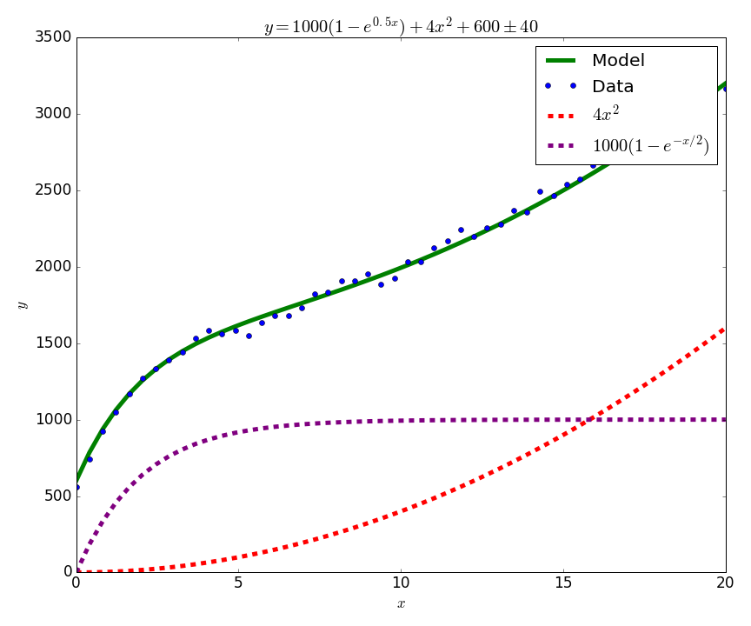
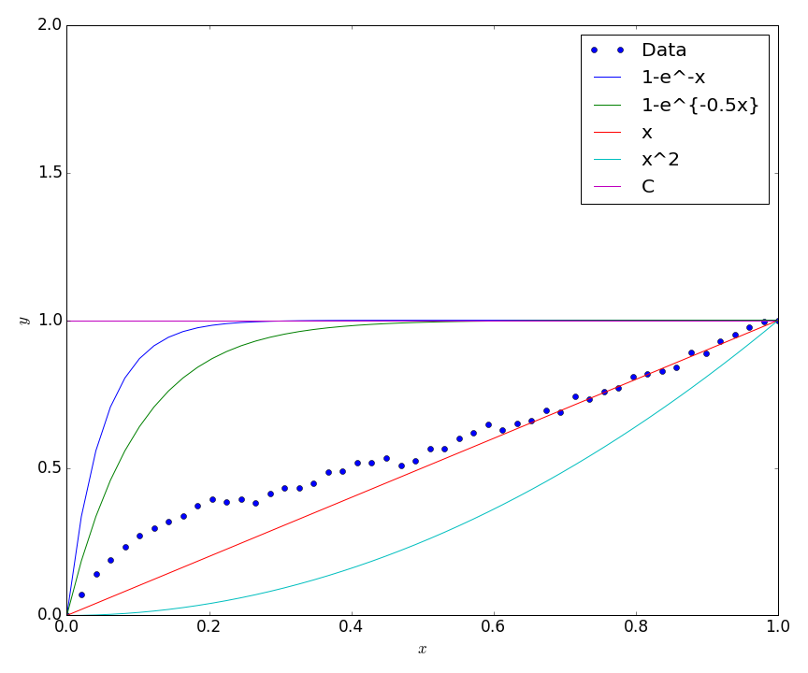
The Idea behind normalization
Let's move to a normalized space!
Exponential decay is as significant as the quadratic term but there is a bigger penalty for properly fitting the exp!

Slide 16
Change of variables
Where:

Slide 17
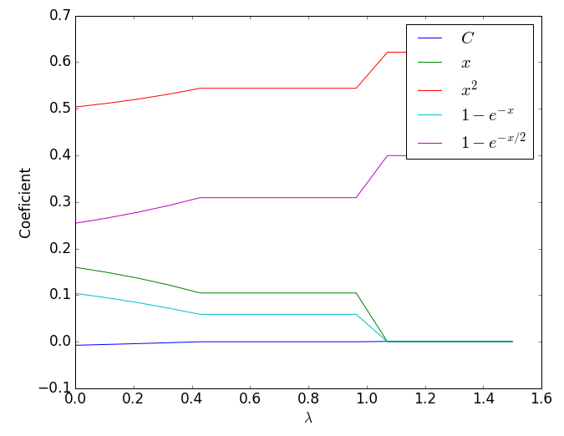
Fitting in normalized space
How do we know if this is the model that we were hoping to recover?

Slide 18
Going back to normalized space
Our equations for returning to real space are:
For example if :

Slide 19
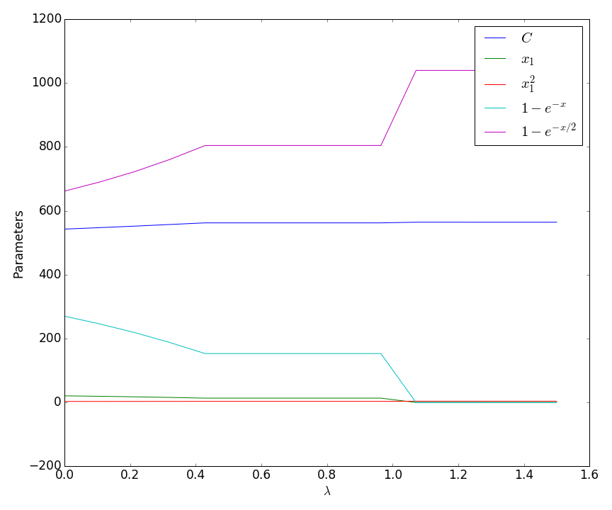
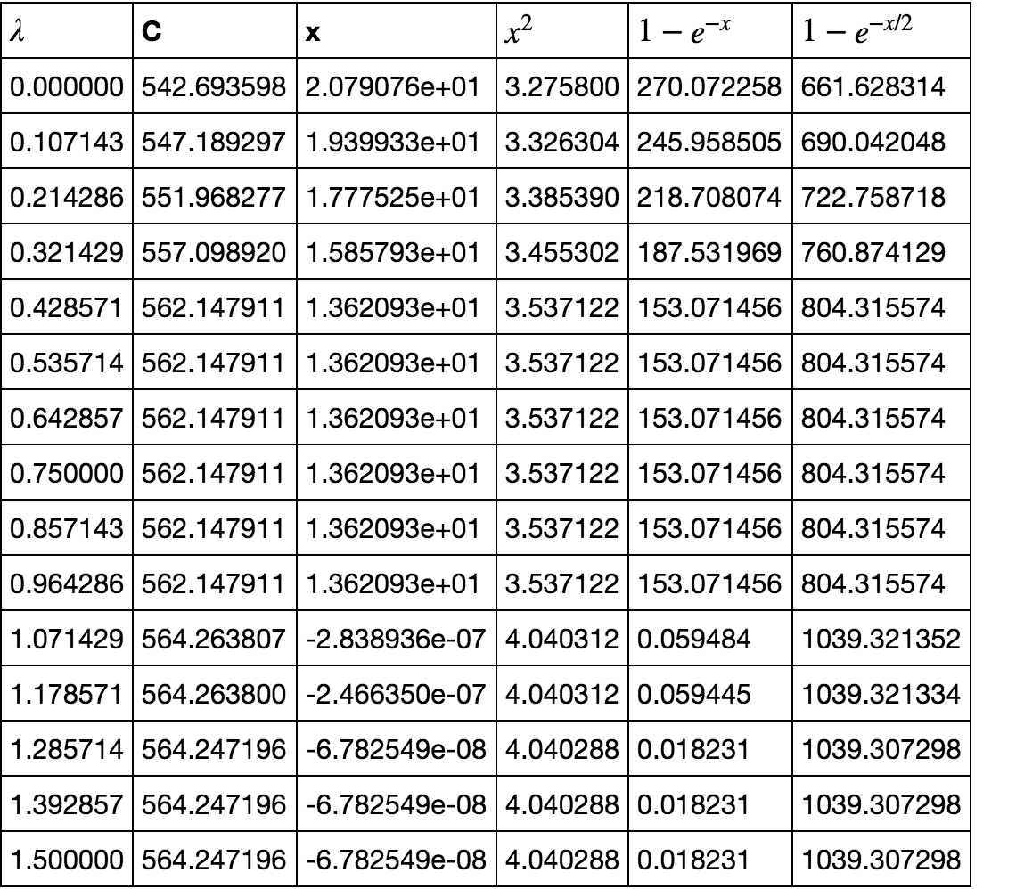
Back in the original space!

Slide 20
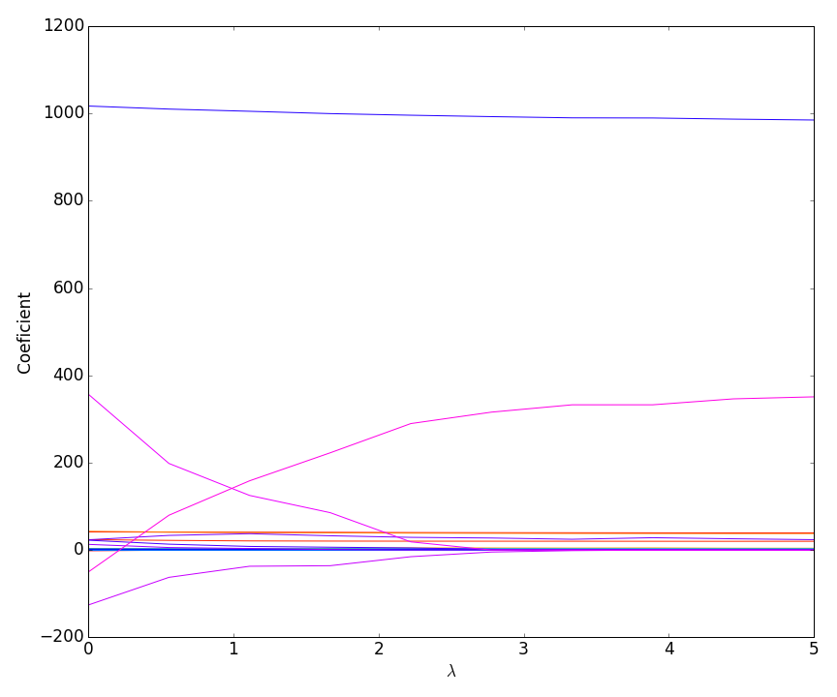
Multidimension test
Number of functions: 34!!

Slide 21
Multidimension test

Slide 22
5. Applications: from theory to empirical data

Slide 23
Applying to P&G data
Cocktail recipe
Challenges:
Independent and dependent variables
Categorical variables
Missing values
Combination of functions from the library:
Linear + squared + cross-multiplied
+exponential decay (as described in previous slides) + constant
13 variables
118 functions in total

Slide 24
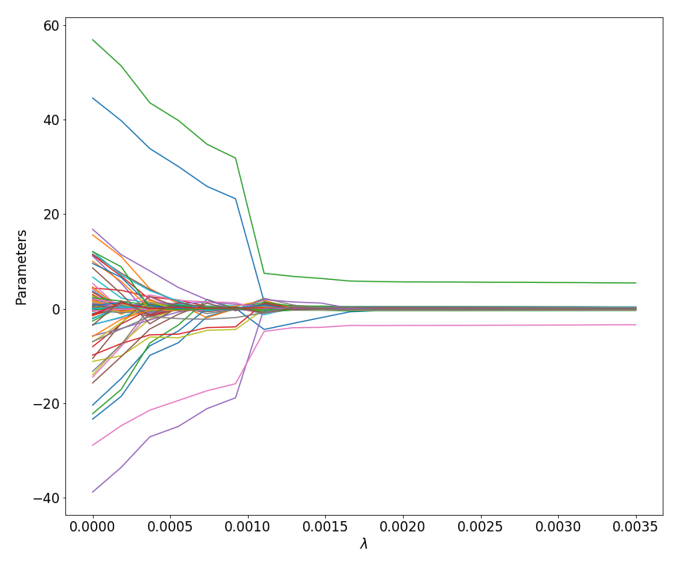
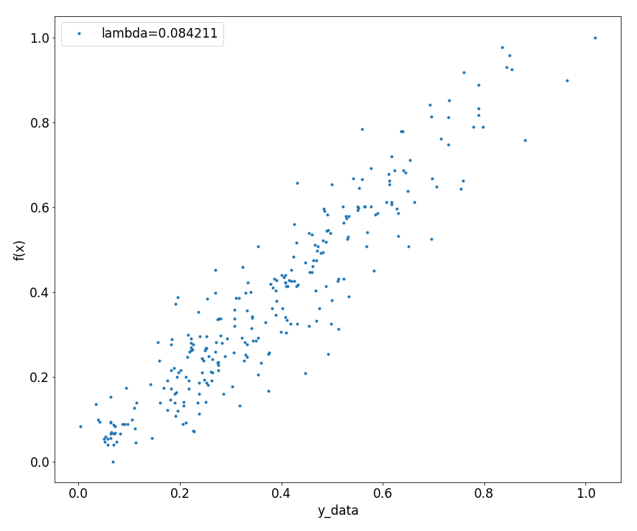
Fitting P&G data with LASSO

Slide 25
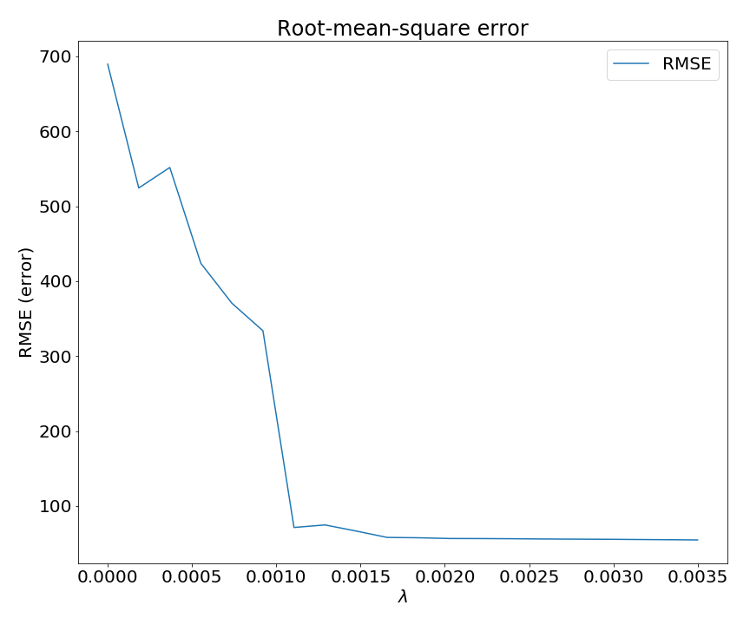
Real data: validating the optimised function
RMSE(lambda =0) = 689
RMSE(lambda = 0.0015) = 56.5

Slide 26
6. Summary and future improvements

Slide 27
Summary
The LASSO technique has stronger predictive capability than a normal chi squared fit
We have improved the LASSO efficiency by introducing a penalty for the number of parameters and not just for their values
A solution with less parameters is often more physical and prevents overfitting
We can find the optimal value of lambda by combining information from the chi squared and the penalty term alongside human input
Current limitation lies with the function minimiser

Slide 28
Future work
Developing a better way of minimising the function (e.g. utilising information about the gradient)
Understand the LASSO in terms of the Bayesian priors
Further explore the training vs validation aspect e.g. where is the true lambda if there is one
Implement an automated way of finding the optimal lambda
Gaussian process (Vernon et al. 2011)
Train our algorithm on known functions to enhance the efficiency
Apply this technique to astronomy and particle physics
Graphical user interface
Notes:
Gaussian process provides a nice bayesian way using the correlation function to further investigate the space where more points might be needed?

Slide 29
Thank you
Notes:
It looks like we are about to fight someone but we are actually fighting data.

