Slide 1
LRGs caused by Pomeron,
photon (W,Z) or Odderon exchanges

Slide 2

ALFA/TOTEM
(Radiation tolerance)
Threshold scan.

Slide 3

X
~200m
AFP/PPS
(LHC runs 1,2)
(ALICE-double Gap trigger, Runs 1 and 2)

Slide 4
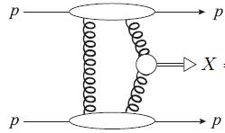
KMR-97-01

Slide 5
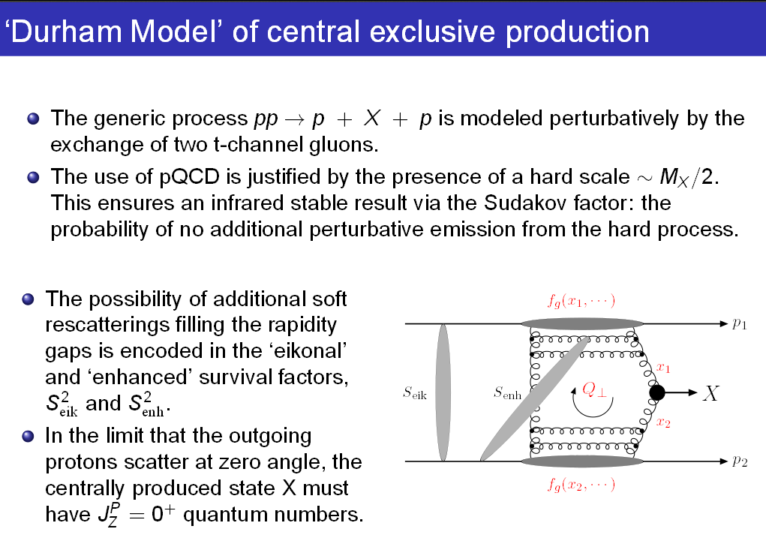
KMR-1997-2001

Slide 7
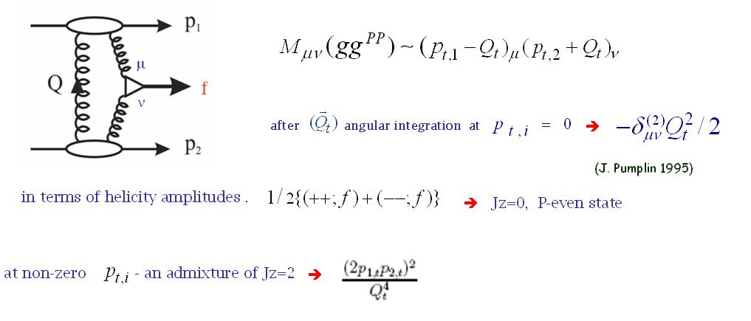
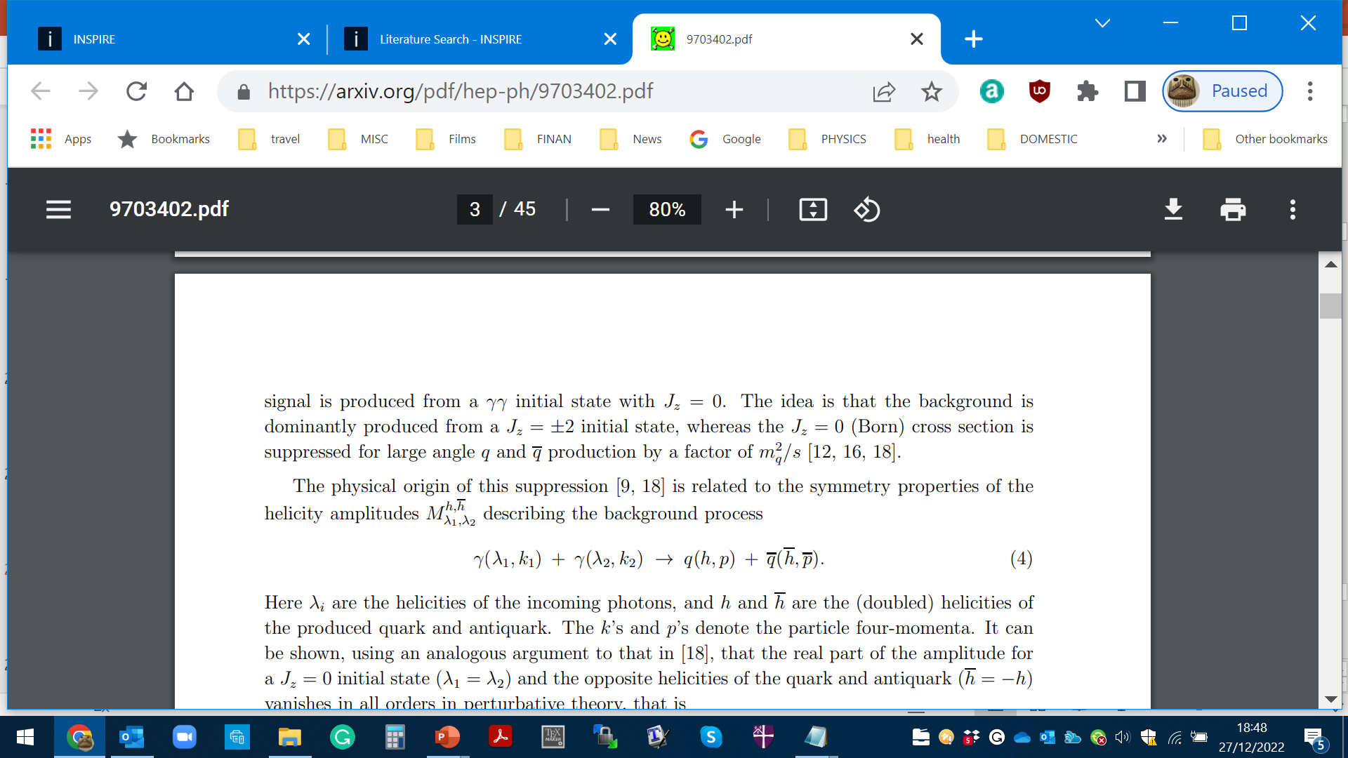
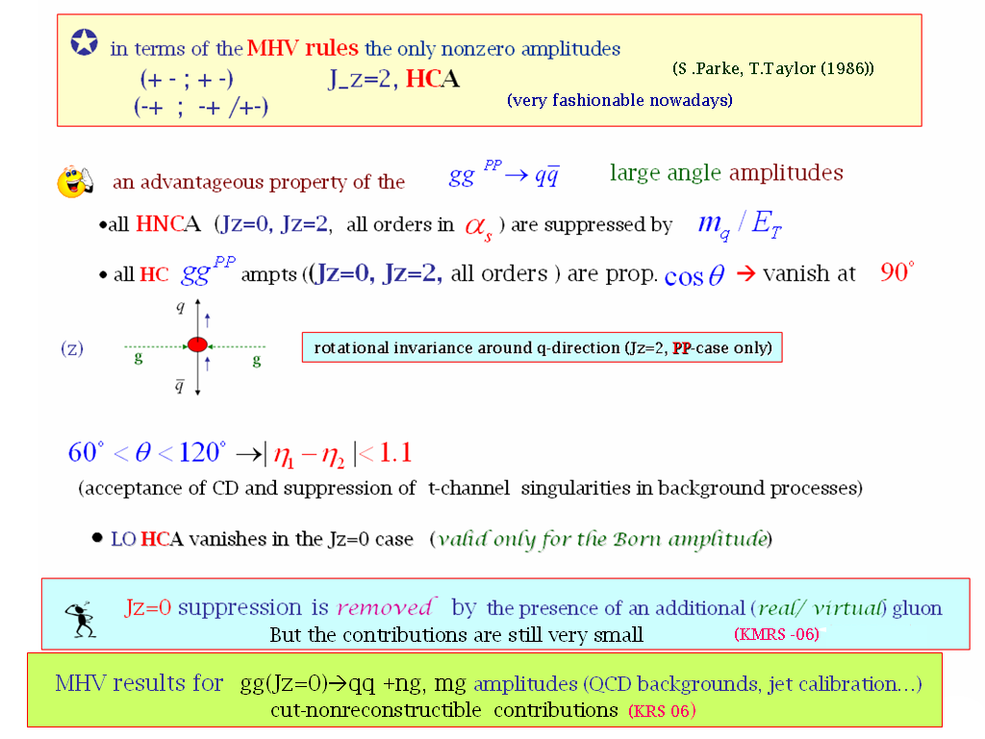


Important consequences for$H→b\overline{b}$
Symmetry properties of the amplitude (FKM-97)
(++,+-) (--,+-)
(++,-+) (--,-+)
$$J_{Z}=0$$
(nullifies in the massless limit)
gg→qq
‘An Amplitude for n Gluon Scattering’

Slide 8
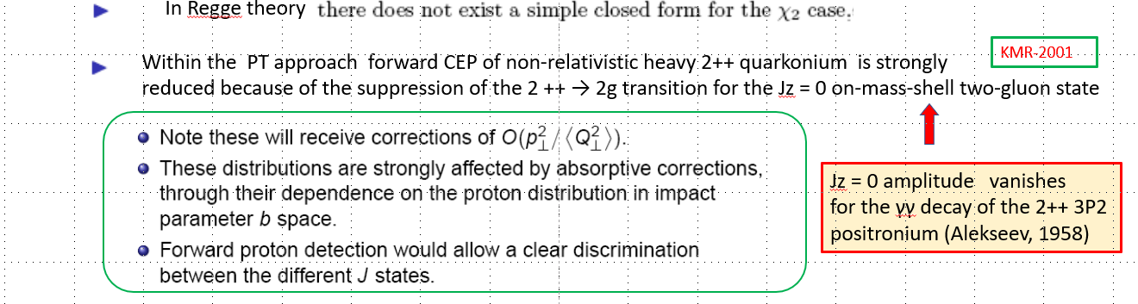
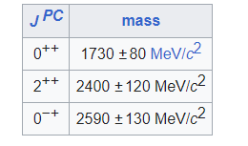
Jz = 0 amplitude vanishes
for the γγ decay of the 2++ 3P2
positronium (Tumanov, 53;Alekseev, 58)
Glueball filter ?
Eur.Phys.J.C 80 (2020) 11, 1077
(could be outdated)

Slide 9

Durham Group
1997-2013
✶

Slide 10
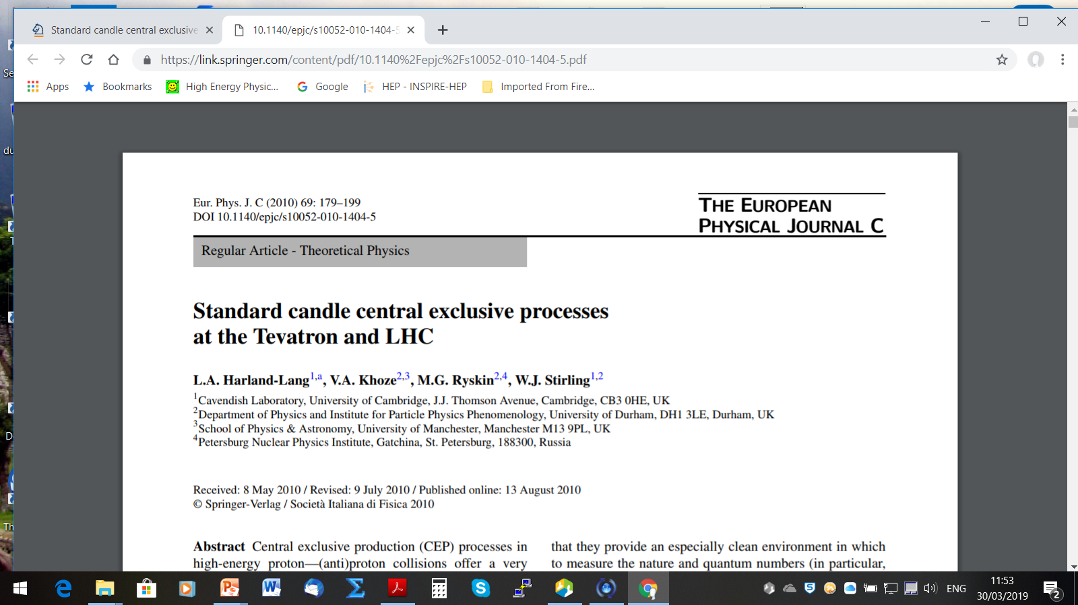



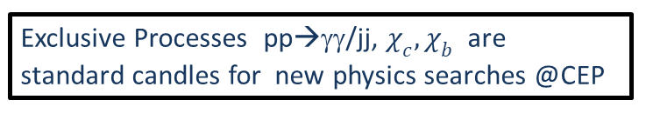
(spread of theory predictions)

Slide 11
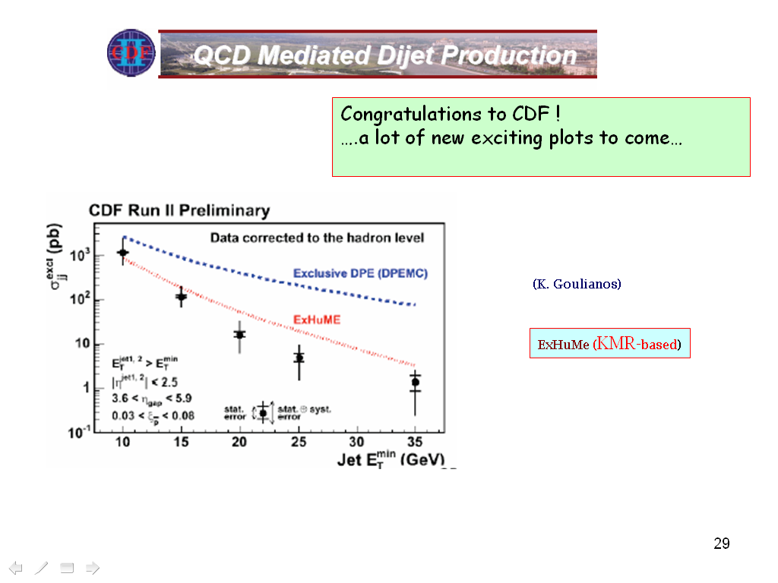
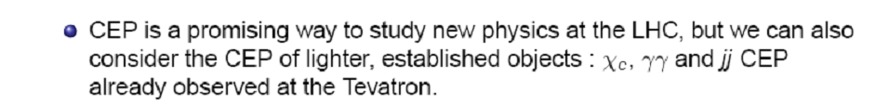
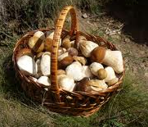
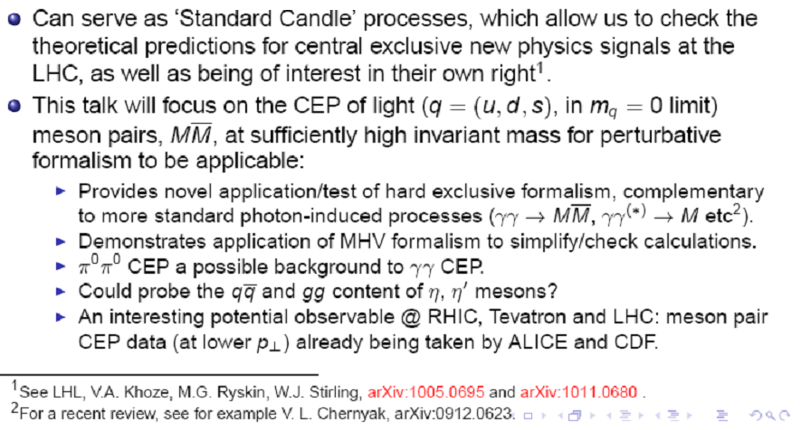
( LHCb RG results)
and light

Slide 12
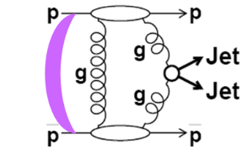
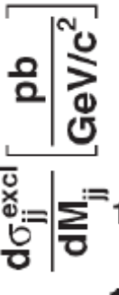
CDF
PRD-2008
D0-2010
Visualization of QCD Sudakov formfactor
Durham

Slide 13
T. Aaltonen et al. (CDF Collaboration), Phys. Rev. Lett. 108, 081801 (2012)
43 events
Et>2.5 GeV
(KMRS-04)
(HKRS-10)
proved to be very small (CDF) ( in agreement with expectations)

Slide 14
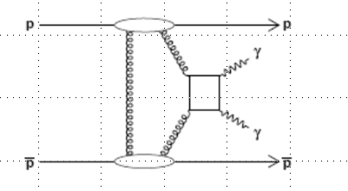
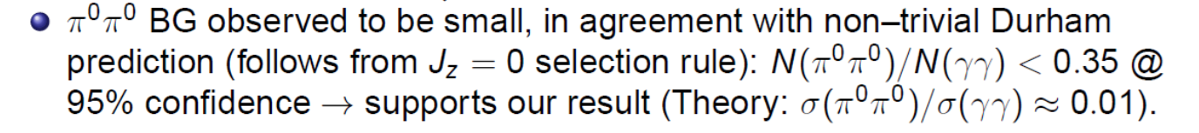
2012
D0-2010-dijets, new
CEP RHIC and
LHCb ( , 22 )
✶

Slide 15
RC-numerically suppressed
KMR-01
(Tumanov-1953,A. Alekseev-1958-positronium)
Glueball Filter ??

Slide 16
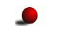
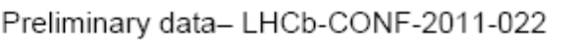


The ratio of high Et dijets in production with one and two rapidity gaps. CDF
CDF results on exclusive charmonium CEP, (CDF, PRL-09)
Hopes to continue with HERSCHEL

Slide 17

Dimeson SAGA

Slide 19
40 diagrams (4 basic)

(M.Benayoun,V.Chernyak,-1990)

Slide 21
is this easy to understand ?
Was popular (among the more formal community) MHV- technique
Nowadays the enthusiasm has a bit faded away- other approaches

Slide 22
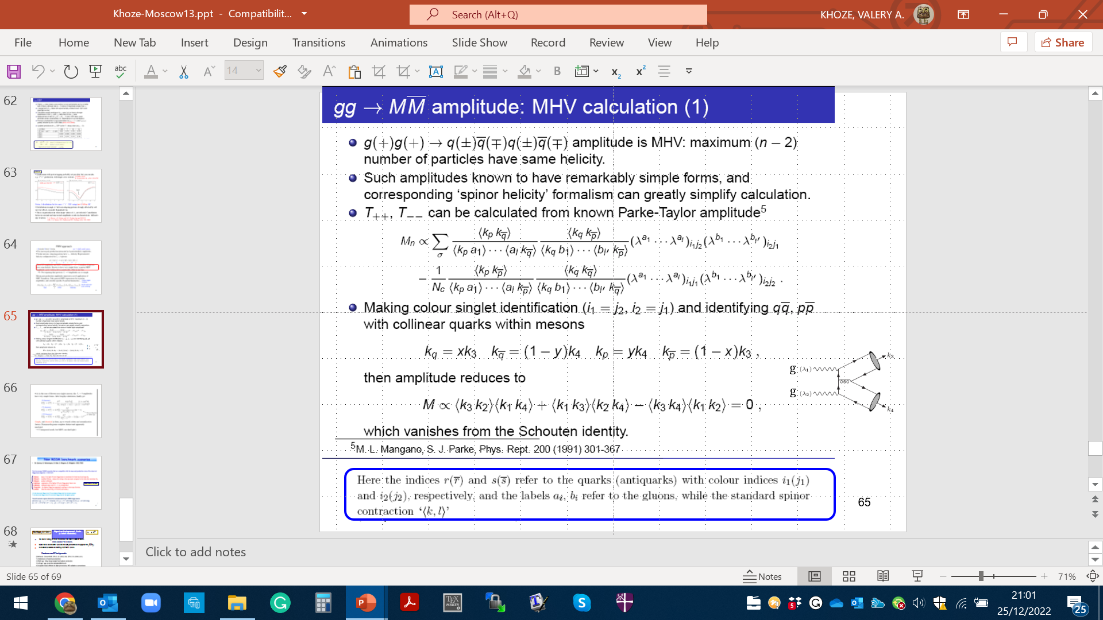

Slide 26
Of special interest: searching for the structures in
J/ψJ/ψ spectrum in the CEP environment.

Slide 27
OTHER SELECTED CEP TOPICS

Slide 29
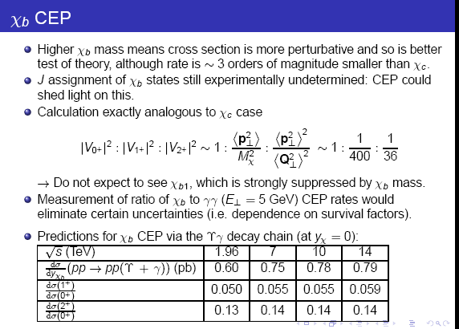

✴
HKRS-10

Slide 30
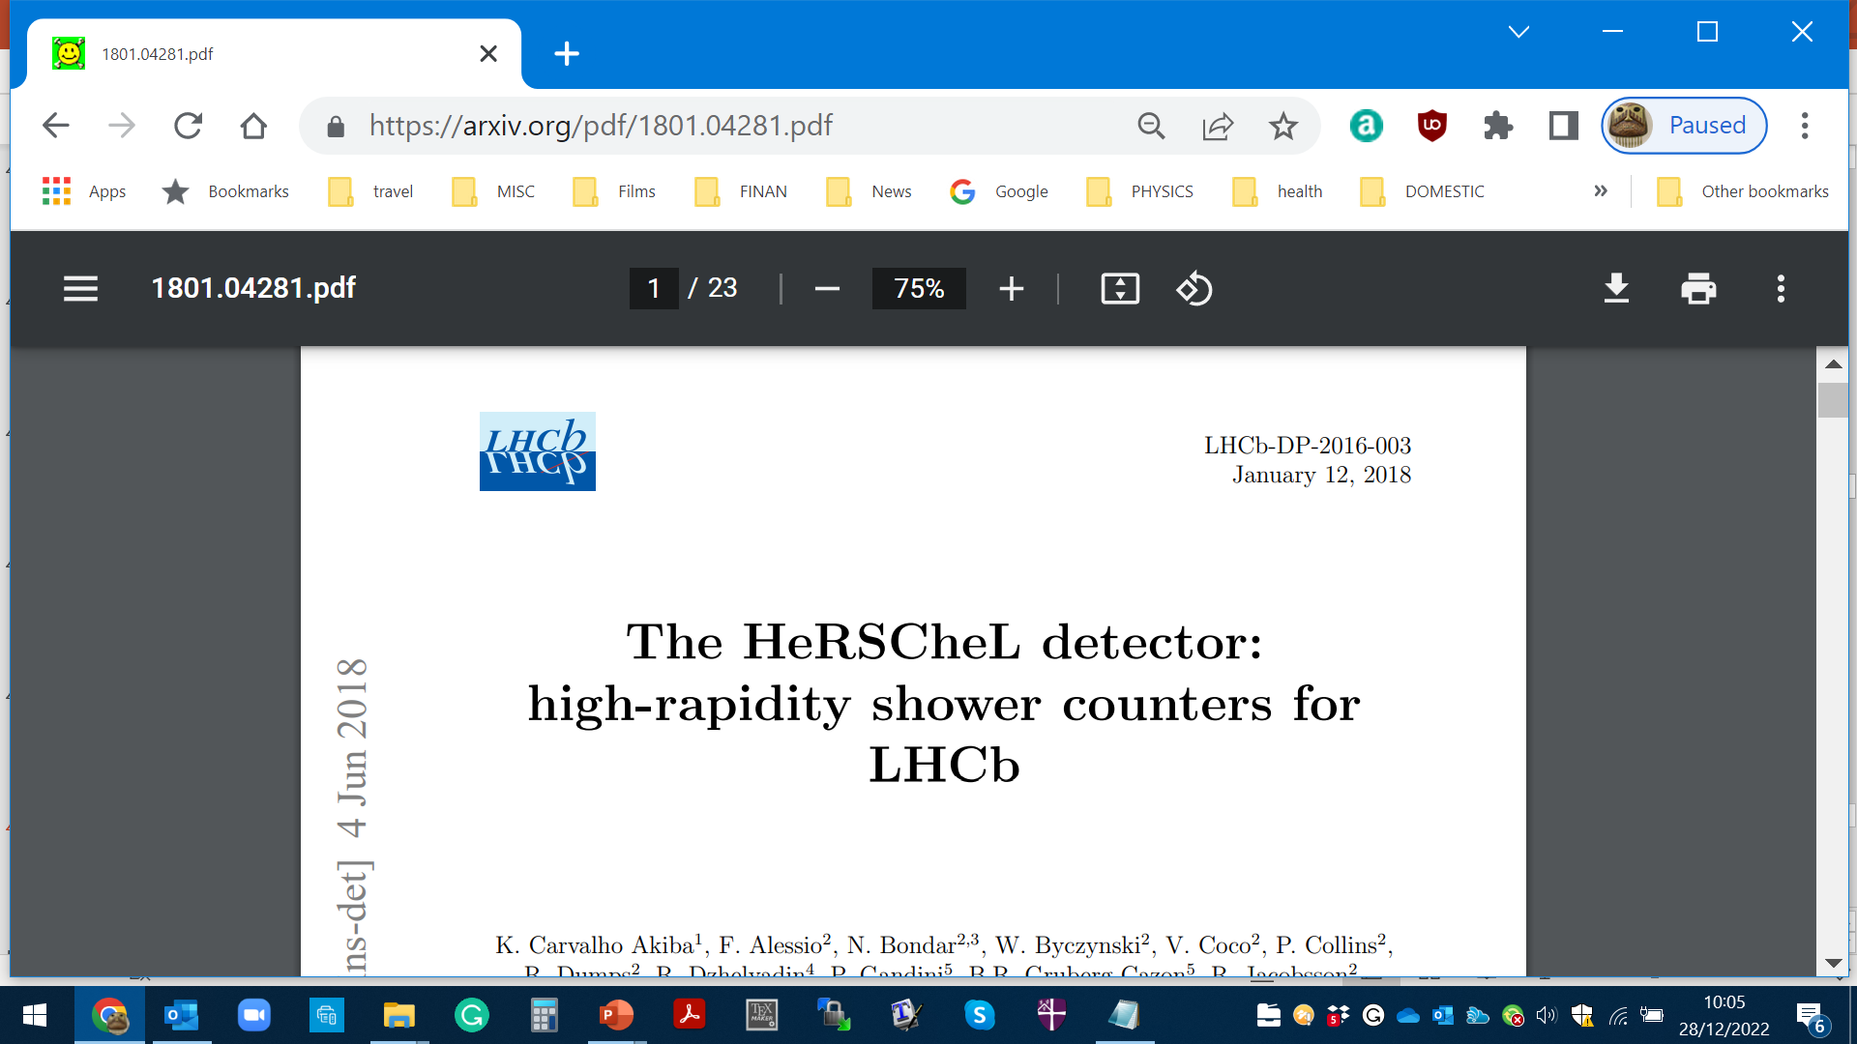
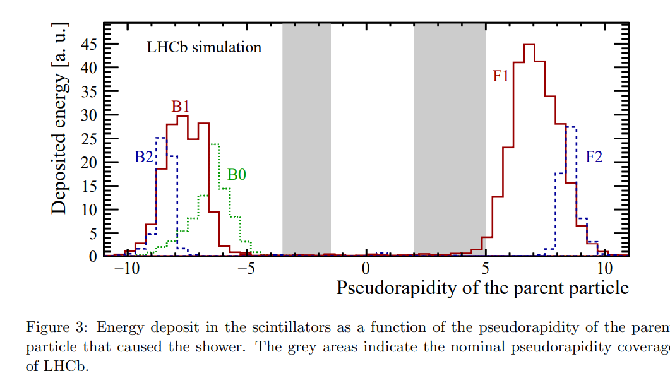

Slide 31
✴

Slide 33
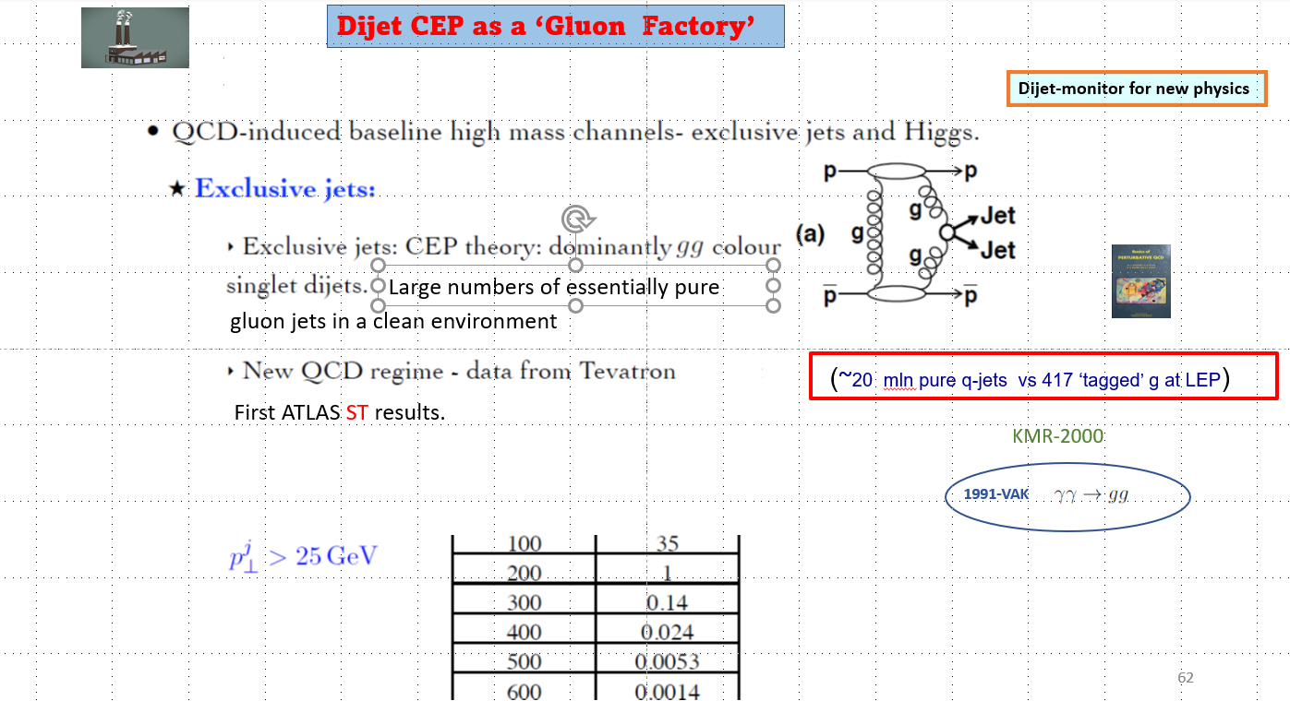

Slide 34
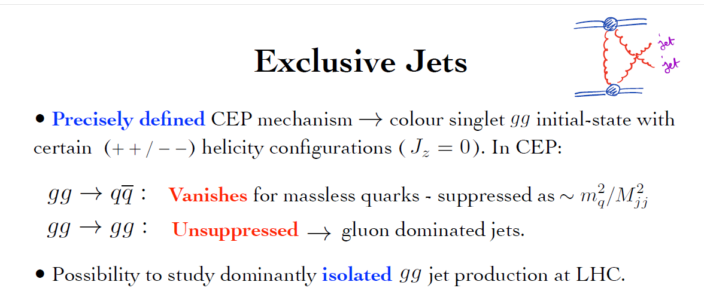
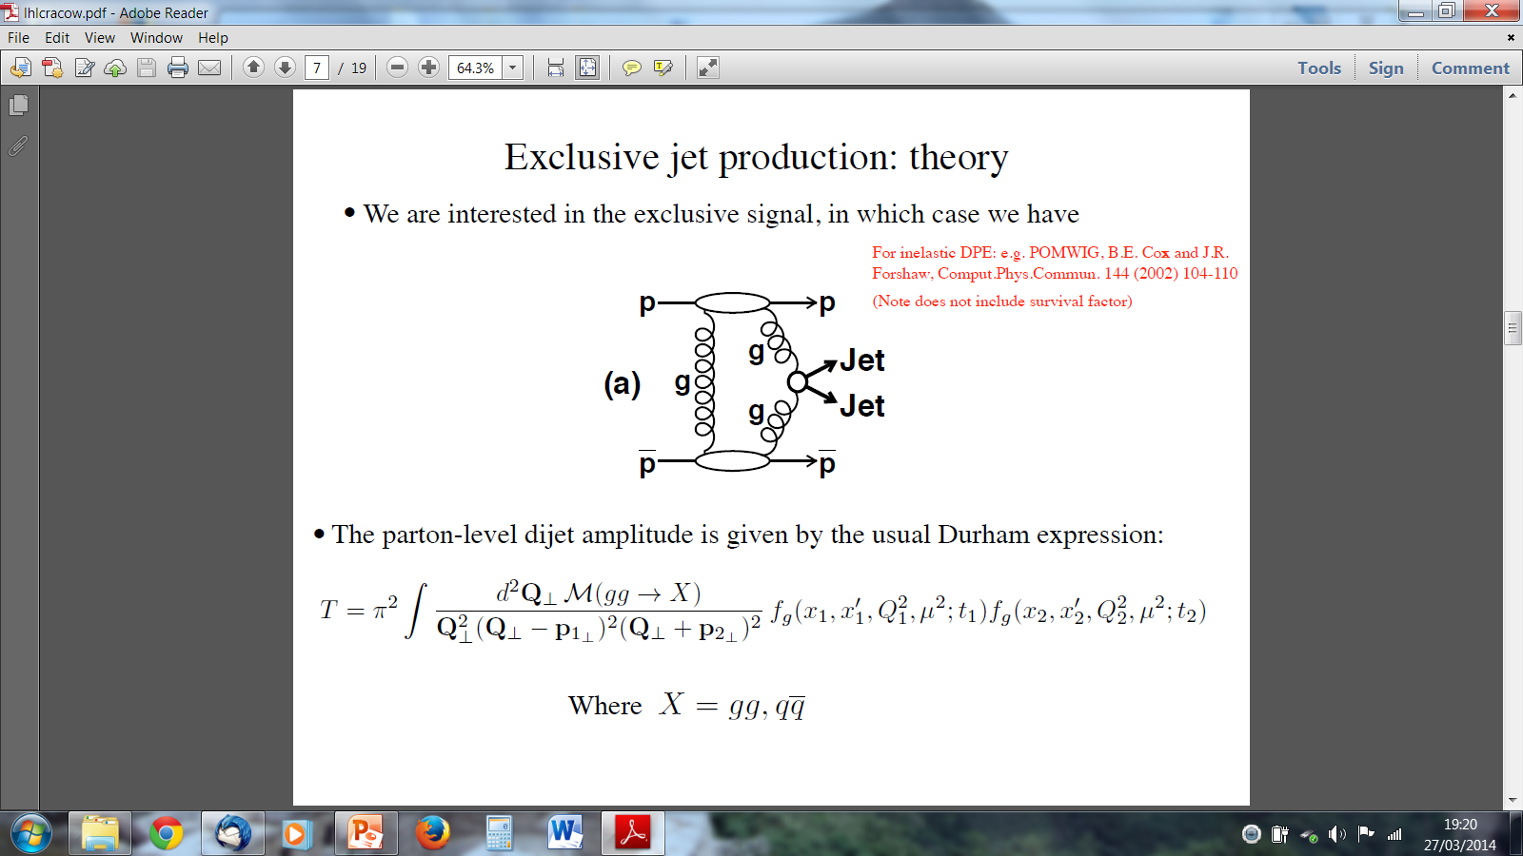
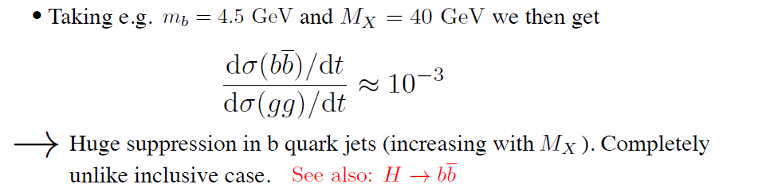
EXCLUSIVE JET PRODUCTION
(CDF-2008)

Slide 35
SuperChic-2

Slide 36
(Phys.Rev.D 68 (2003) 034001)
hep-ex/0205037
It may make sense to repeat this measurement at the LHC/RHIC ?
KKMTR, 2001-2002

Slide 37
(V.Yu.Petrov, M.G.Ryskin)
Sphaleron-transition on top of an energy barrier

Slide 38
Instantons have never been observed experimentally, however, they are
playing a very important role in the theoretical models of confinement and
chiral symmetry breaking
(V.Yu.Petrov, M.G.Ryskin)
one of the biggest challenges for particle physics to date
‘soft bombs’ –high-multiplicity spherically symmetric distributions of relatively soft particles
Extended objects in space-time
Effectively –a family of new multiparton vertices in Feynman diagrams

Slide 39
(M.G. Ryskin)

Slide 40
KKMRT-2021-2022
dominates
KMR-like
✶ Detecting two outgoing protons would allow placing an upper limit on Instanton mass.
✶
(‘hermiticity’)
state

Slide 41
Dominant
Fig.2
~ hundreds of pb
but Z²
Fig.3
UPC-no PU nightmare
HIC
Full set of analytical formulas for the partonic processes, calculated for the first time

Slide 42
CENTRAL PRODUCTION
TMKR arXiv:2208.14089 [hep-ph]
✶
pb
✶
The x-
✶

Slide 45


CONCLUSION
The direct experimental observation of Instanton-induced processes would be a real breakthrough in particle physics.
(lower end of partonic energies 20-80 GeV).
An existing lack of evidence by no means leads to the conclusion that QCD instanton
“does not exist”, but rather that their actual production rate is on the low end of predictions.
Potential for large sources of theoretical uncertainties covering orders of magnitude.
A practical point for future progress is to test theory normalization of predicted instanton rate with data.
Searches for the signal in non-diffractive events are very challenging: modeling the detailed final state, background suppression, and separation from the possible SM and BSM sources of the “hedgehog-like ” events. Events with a large pT signature are too rare.
Diffraction (single tag, CEP) promises some attractive advantages: cleaner signal, suppressed
‘standard’ backgrounds (MPI).
Currently, after accounting for the detector effects the distributions are sufficiently washed out, and it becomes quite challenging to extract the pure instanton signal. On top of this, the PU background turns out to be large, especially for the case with two tagged protons requiring work at lower luminosities.

Slide 46


Strong need for enthusiastic experimental experts to join the efforts, addressing such issues as detector effects, PU at high luminosity, and timing resolution…..
One of the main obstacle currently – PU at high luminosity
Possible directions for further studies
✵
Feasibility of searches for moderate mass Instantons in UPC
✵
Using good timing from Central Detectors for both ST and DT events.
✵
Identification of charm quark jets in the final state

Slide 47

Forward Proton Tagging significantly could extend the physics reach of the ATLAS and CMS detectors by giving access to a wide
range of exciting new physics channels.
FPT has the potential to make measurements that are unique at LHC.
FPT could serve as a spin-parity analyser and offers a sensitive probe of the CP structure of the new states.
There are a number of important measurements to be performed in the RG environment at LHCb and ALICE at low
μ.
The theory of the CEP is in a reasonably healthy shape,
and dedicated MCs (such as SCs) are well developed
The predictions are backed by the series of CDF/D0 CEP-like measurements as well
as the RAP GAP measurements by the LHCb and ALICE +CEP results from ATLAS& CMS

Slide 48
The dedicated AFP and PPS detectors are allowed to use the timing.
The main issue is PU suppression, though some progress is foreseen,
in particular with the addition of timing from the CD.
But ATLAS has already decided not to run AFP at HL-LHC
(at least not in the foreseeable future)
10ps in Run 4
At large M_{Mmis}> 150-200 GeV the photon-photon fusion dominates
over the gg. LHC is the photon-photon collider!
Such important measurements as the searches for the new Higgs-like states
(e.g. resolving the 96 GeV puzzle) , as well as the moderately-heavy instantons, would require
the 420 m stations.
The bulk of important physics (such as glueball,instantons and other new
state searches) would require low luminosity runs.

Slide 49


Slide 50
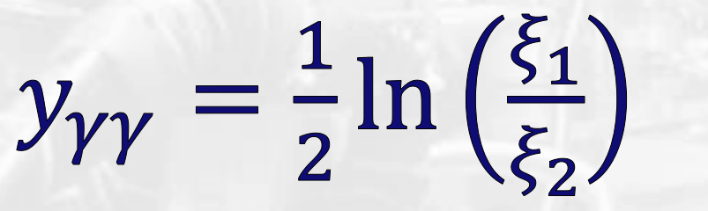


ALFA
TOTEM & ALFA
CMS/PPS & ATLAS/AFP
ALFA
The LHC is an excellent mass spectrometer
$$y_{M}$$
ALFA/TOTEM- radiation tolerance → low PU special runs

Slide 51
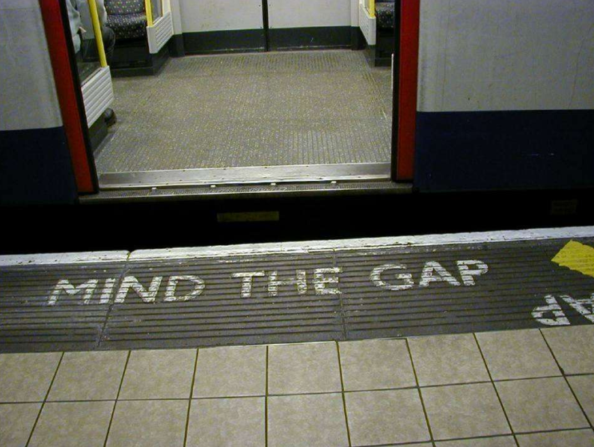


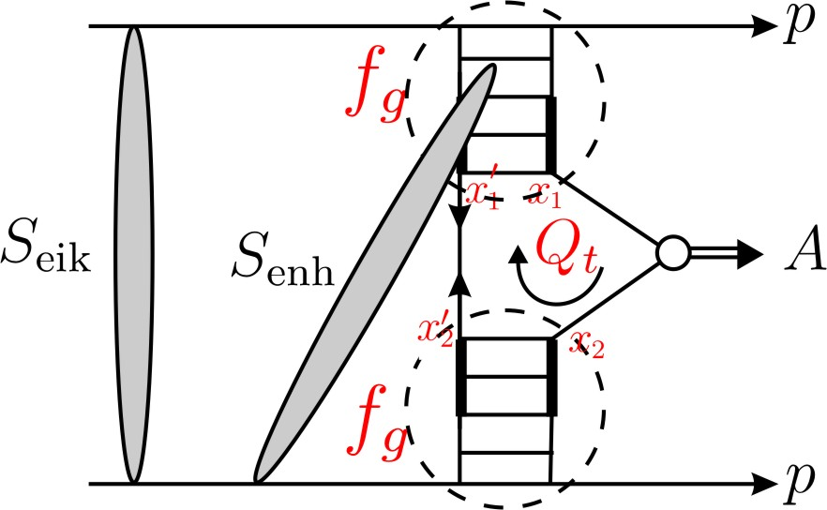
“soft” scattering can easily destroy the gaps
S² ➔ absorption effects -necessitated by unitarity
gap
M
gap
Eikonal rescatt: between protons
Semi-enhanced rescatt: involving intermediate partons
1 >
≫

Slide 52

1 : 0.03 : 0.08

